Slide 1

Offset+
Offset surfaces, or curves, toward the side a reference is on -- surfaces of opposite orientation all move the same way, and curves offset in the frame you choose.
Reference_Side_Features · Onshape custom feature
Draft 2026-09-25

Slide 2

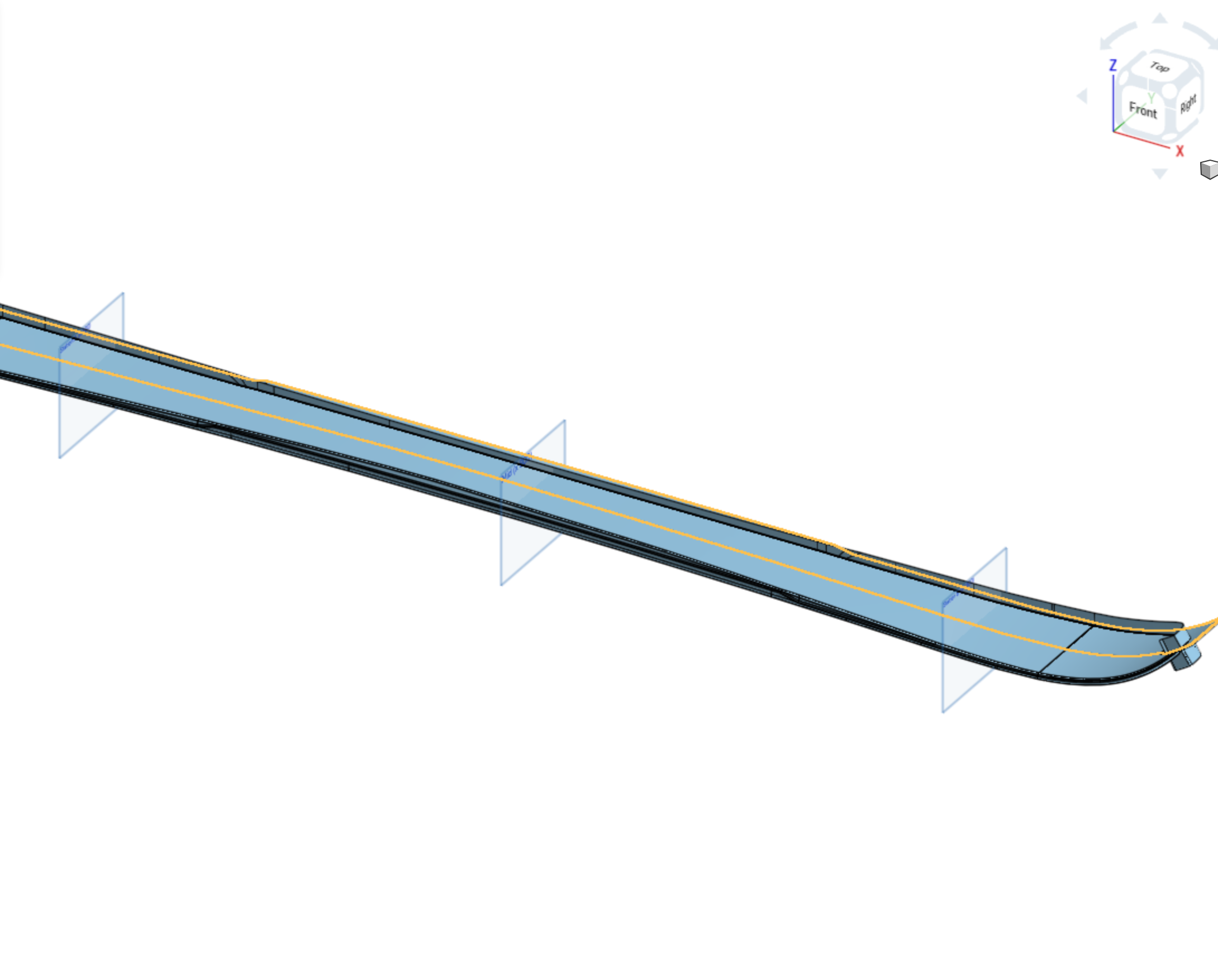
What it does
The built-in offset surface goes along the normal, and the built-in offset curve works in a sketch plane with a flip. Offset+ offsets each surface body toward the reference's side of it, and offsets 3D curves in a transport, surface-normal or plane frame -- toward the reference too.
Use it when
Surfaces from different sources face different ways
A 3D edge chain needs a constant offset (along a surface, lifted off it, or in plan)
Corners of the chain must be rounded or trimmed cleanly
Offset+ open on the ski topsheet: offset 2 mm toward the plane 'Below ski'.
Offset+ · Reference_Side_Features
Draft 2026-09-25

Slide 3
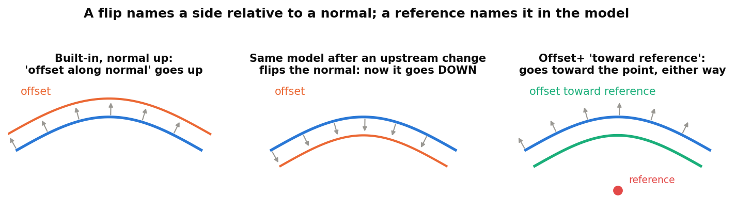
Why a reference instead of a flip
A flip is about a normal
'Front', 'opposite direction', 'Thickness 1' all mean: relative to the normal -- and normals change freely upstream.
A reference is about the model
Pick geometry on the side you mean. The choice survives any change of orientation.
Drop-in
With no reference, the feature behaves exactly like the built-in.
Offset+ · Reference_Side_Features
Draft 2026-09-25

Slide 4
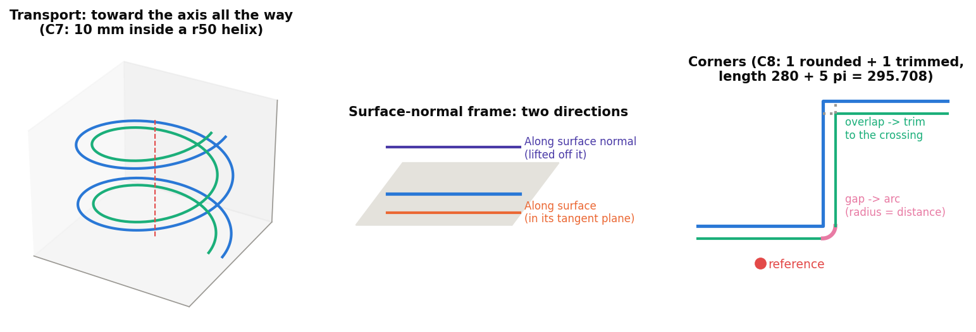
Curve frames and corners
Transport frame
The direction is carried along the chain without twisting -- a helix offset 'toward the axis' stays inside (test C7).
Surface normal / plane
Off a surface, along it, or in the plane perpendicular to a direction (plan view).
Corners
A gap on the outside gets an arc (radius = the distance); an overlap on the inside is trimmed to the crossing (test C8).
Offset+ · Reference_Side_Features
Draft 2026-09-25

Slide 5
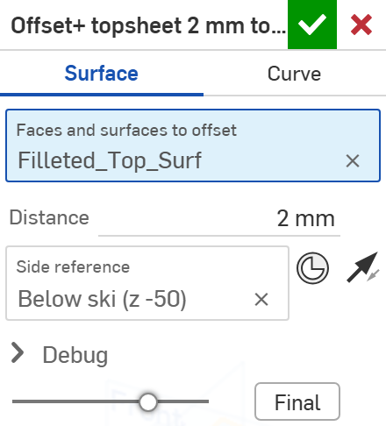
The dialog: surfaces
# | Parameter | What it means
1 | Offset type | SURFACE: offset surface bodies. CURVE: offset edges or wires (next slides).
2 | Faces and surfaces to offset | Each body is offset toward the reference's side of THAT body.
3 | Distance | Offset distance.
4 | Side reference | Geometry on the side to offset toward. Empty = the arrow alone (a plain flip).
5 | Offset toward reference | The arrow. On: toward the reference. Off: away from it.
6 | Debug | Print details: which way each body or chain went, corners and fits.
1
2
3
4
5
6
Offset+ · Reference_Side_Features
Draft 2026-09-25

Slide 6
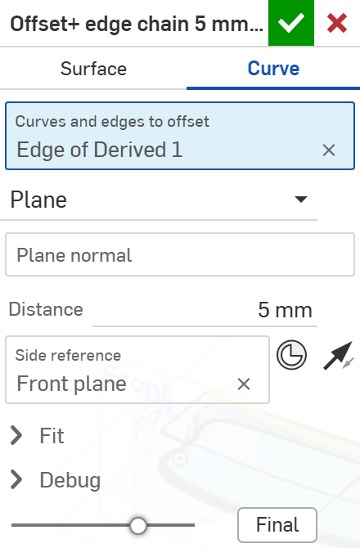
The dialog: curves, plane frame
# | Parameter | What it means
1 | Offset type | CURVE.
2 | Curves and edges to offset | Connected edges form one chain; each chain becomes one wire.
3 | Frame | Transport frame (default) / Surface normal / Plane.
4 | Plane normal | Plane frame: the offset lies in planes perpendicular to this. Empty = world Z (a plan-view offset).
5 | Distance | Offset distance.
6 | Side reference | Here the Front plane: every chain moves toward it.
7 | Offset toward reference | The arrow: toward / away.
8 | Fit | Samples per edge (24), Max station spacing (5 mm), Fit tolerance (0.001 mm).
1
2
3
4
5
6
7
8
Offset+ · Reference_Side_Features
Draft 2026-09-25

Slide 7
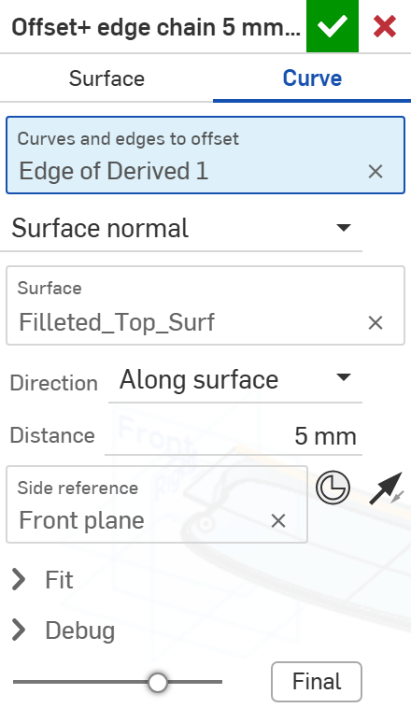
The dialog: curves, surface-normal frame
# | Parameter | What it means
1 | Frame | Surface normal: the direction comes from a surface at each point.
2 | Surface | The surface whose normals define the offset (its orientation does not matter: normals are kept continuous).
3 | Direction | Along surface normal: lift the curve off the surface. Along surface: stay in it, perpendicular to the curve.
1
2
3
On the topsheet edge chain all three frames land at y 70 (5 mm in): the topsheet is flat across its width there. They differ on twisted chains and curved surfaces (tests C5-C7).
Offset+ · Reference_Side_Features
Draft 2026-09-25

Slide 8
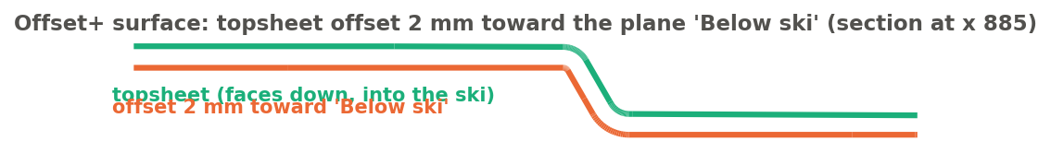
Example: surface offset
Topsheet offset 2 mm toward 'Below ski' (topsheet_surf studio)
The topsheet faces down, into the ski. Offset+ reads which side of the topsheet 'Below ski' is on and offsets that way -- if the topsheet's normal flipped upstream, the offset would still go down. The offset surface keeps the topsheet's orientation (still facing down).
Offset+ · Reference_Side_Features
Draft 2026-09-25

Slide 9
Outputs and messages
Published for Extract variables
Messages
Key | What it holds
output | The offset surfaces or wires.
startVertex / endVertex | Curves: the ends of each wire (start = the end at the source's start).
startEdge / endEdge | Curves: the edge at each end.
cornerArcs | Curves: the arcs that round the outside corners.
boundaryEdges | Surfaces: the open boundary edges of the offset surfaces.
 | Message / what to do
Info | Corners: N rounded, M trimmed. The corner counts are reported here only (not published).
Warning | N corner(s) could not be closed ... The wire has a gap at each. A corner sharper than the offset allows, or skew 3D pieces. Reduce the distance or split the chain there.
Error | The side reference is not to either side of chain k in this frame The reference lies along the curve or on the surface. Move it off to one side.
Error | The curve runs along the plane / surface normal No offset direction exists there in that frame.
Offset+ · Reference_Side_Features
Draft 2026-09-25

Slide 10
Tips and limits
✓
Use a local reference
A mate connector or vertex near the geometry, on the side meant.
!
Outputs keep their input's orientation
The reference picks the side, not the normal. Built-ins downstream that follow the normal (Thicken, Offset surface, Move face) need Orient to reference first -- or use the reference-side feature instead.
✓
Transport for 3D chains
It never flips at an inflection and never twists, so the offset stays on the side it started.
!
Sharp corners and large distances
Where the offsets neither separate nor cross cleanly the corner is left open, with a warning.
Offset+ · Reference_Side_Features
Draft 2026-09-25

Slide 11
Where it lives
Document | Reference_Side_Features (22764764a00a7f607dbc1c4d)
Tab | offset_plus (uses reference_side_utils)
Tests | Reference side tests studio: O1-O2 (surfaces), C1-C8 (curves) - devtools/onshape/check_reference_side_tests.py (34/34)
Examples | topsheet_surf studio (the user's derive of Design_Master topsheet and sidewall bodies)
Explainer | docs/explainers/reference_side/reference_side_explained.md, section 2.3
Related | Split+, Mutual Trim+, Offset+, Thicken+, Orient to reference (same reference rule); Extract variables
Offset+ · Reference_Side_Features
Draft 2026-09-25

