Slide 1
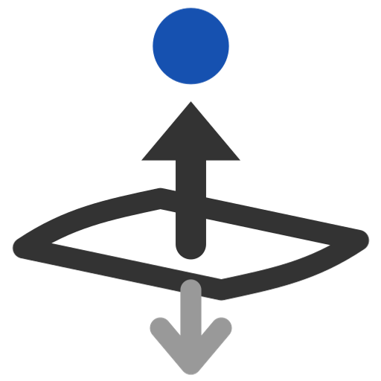
Orient to reference
Flip surfaces so their normals point toward -- or away from -- a reference, so every feature downstream that follows the normal keeps working whatever happens upstream.
Reference_Side_Features · Onshape custom feature
Draft 2026-09-25

Slide 2

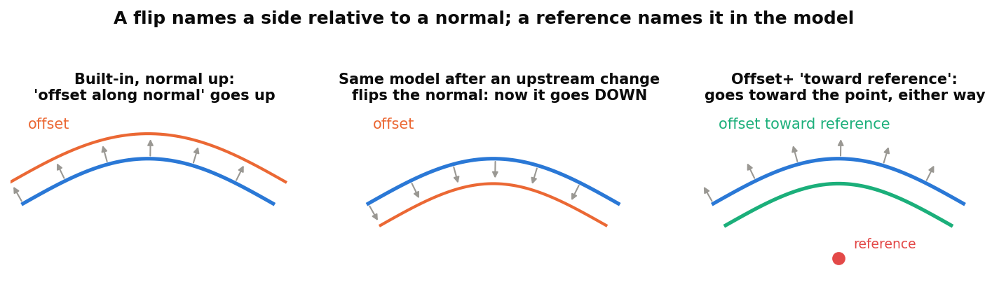
What it does
Many features pick their side by a surface's normal: Thicken's Thickness 1, Offset surface, extrude 'up to', Move face, Split front / back. Normals flip freely when an upstream loft, offset, mirror or sketch changes -- and the reference-side features keep their inputs' orientation. Orient to reference fixes the normal itself: each surface is turned to face the reference (or away).
Use it when
A built-in downstream follows a surface's normal
Surfaces come from different sources and face different ways
You want to SEE which way a set of surfaces faces (normal arrows)
A flip names a side relative to a normal; a reference names it in the model.
Orient to reference · Reference_Side_Features
Draft 2026-09-25

Slide 3
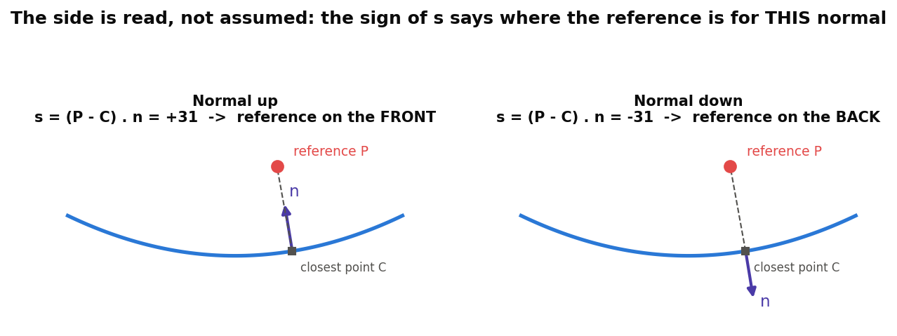
How the side is read
Per surface body
s = (P - C) . n at the body's point nearest the reference. s > 0: the normal already points toward it.
Flip only what is wrong
Bodies facing the wrong way are flipped (opFlipOrientation); the rest are left exactly as they are.
Surfaces only
Solids always face outward and cannot be flipped; selecting one is an error.
Orient to reference · Reference_Side_Features
Draft 2026-09-25

Slide 4
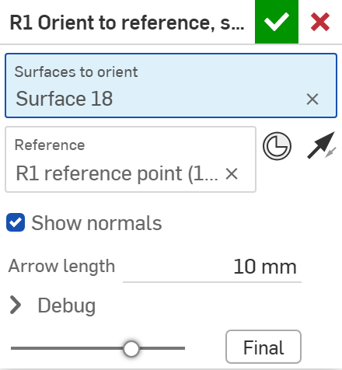
The dialog
# | Parameter | What it means
1 | Surfaces to orient | Surface bodies, or faces of them (a face orients its whole surface body).
2 | Reference | Geometry on the side the normals should face: best a mate connector or vertex near the surfaces.
3 | Normals toward reference | The arrow. On: every normal points toward the reference. Off: away from it.
4 | Show normals | While editing: arrows along each face's normal, after orientation. Green = already right, orange = flipped here.
5 | Arrow length | Length of those arrows (10 mm).
6 | Debug | Print sides: each surface's distance to the reference and whether it was flipped.
1
2
3
4
5
6
Orient to reference · Reference_Side_Features
Draft 2026-09-25

Slide 5
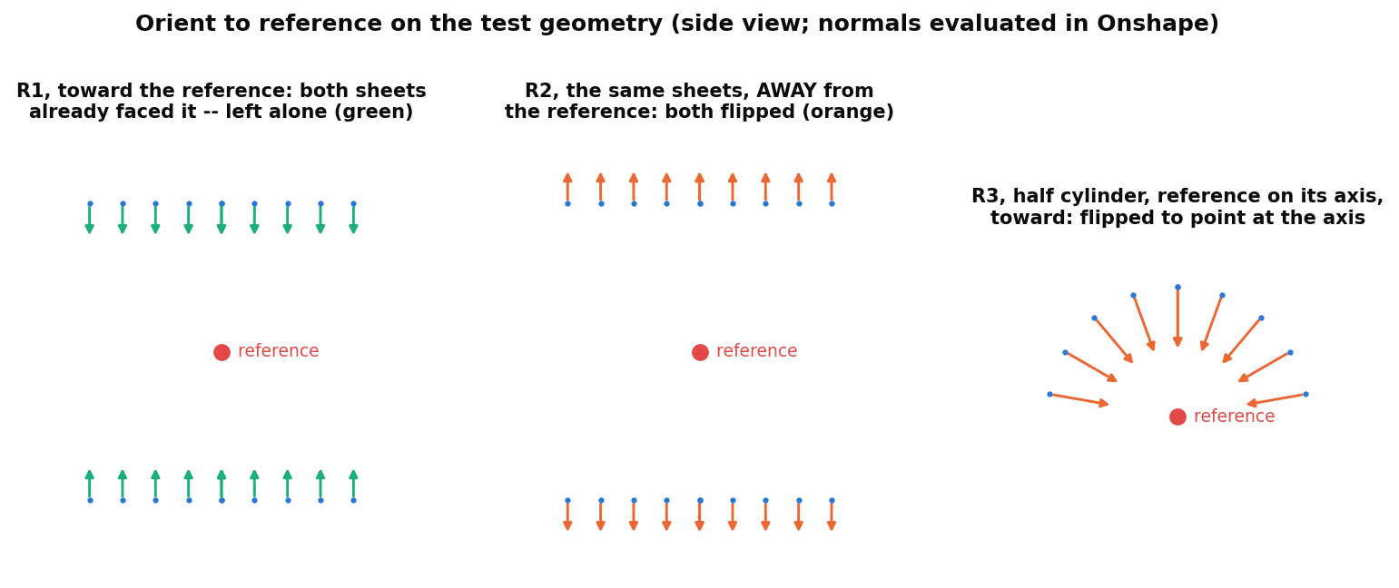
Examples: the normals, evaluated
Test geometry R1-R3, normals read back from Onshape after the feature ran
Two sheets with opposite normals and a reference between them: 'toward' leaves both alone because they already face it (green); 'away' flips both (orange). A half cylinder with the reference on its axis: every normal ends up pointing at the axis.
Orient to reference · Reference_Side_Features
Draft 2026-09-25

Slide 6
Outputs and messages
Published for Extract variables
Messages
Key | What it holds
output | Every selected surface, oriented.
flipped | The surfaces this feature flipped.
unchanged | The surfaces that already faced the right way.
flippedCount | How many were flipped.
 | Message / what to do
Info | Flipped N of M surface(s); K already faced toward / away from the reference.
Error | A solid's faces cannot be flipped Select surfaces; solids always face outward.
Error | The reference lies on surface k Move the reference clearly off that surface.
Orient to reference · Reference_Side_Features
Draft 2026-09-25

Slide 7
Tips and limits
✓
Put it right before the built-in
Orient the surfaces just before the Thicken, Offset surface or extrude that follows their normal.
✓
Or skip the built-in
Thicken+ and Offset+ read the side from a reference directly and do not care which way the normal points.
✓
Use a local reference
A mate connector or vertex near the surfaces, on the side meant. A far plane can read the wrong side where a surface curves.
!
One orientation per body
A merged surface (e.g. a Mutual Trim+ result) is one body and gets one orientation for all its faces.
Orient to reference · Reference_Side_Features
Draft 2026-09-25

Slide 8
Where it lives
Document | Reference_Side_Features (22764764a00a7f607dbc1c4d)
Tab | orient_to_reference (uses reference_side_utils)
Tests | Reference side tests studio: R1-R4 - devtools/onshape/check_reference_side_tests.py (34/34)
Explainer | docs/explainers/reference_side/reference_side_explained.md, sections 1.4 and 2.6
Related | Split+, Mutual Trim+, Offset+, Thicken+ (same reference rule)
Orient to reference · Reference_Side_Features
Draft 2026-09-25

