Slide 1

Thicken+
Onshape's Thicken, with the two thicknesses named 'toward reference' and 'away from reference' instead of by the face normal -- the boolean step unchanged.
Reference_Side_Features · Onshape custom feature
Draft 2026-09-25

Slide 2

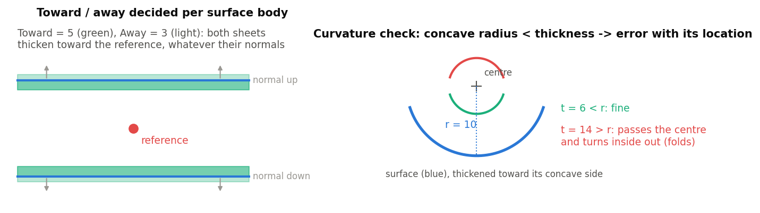
What it does
The built-in Thicken's Thickness 1 goes along the face normal, so the same feature thickens outward on one model and inward on another. Thicken+ decides per surface body which way is 'toward the reference' and puts the Toward thickness there. Everything else -- New / Add / Remove / Intersect, merge scope -- is the built-in.
Use it when
Surfaces of mixed orientation must thicken the same way
A surface's normal may flip upstream
You want a clear error where a thicken would fold, with its location
Left: both sheets thicken toward the reference whatever their normals. Right: the curvature check.
Thicken+ · Reference_Side_Features
Draft 2026-09-25

Slide 3
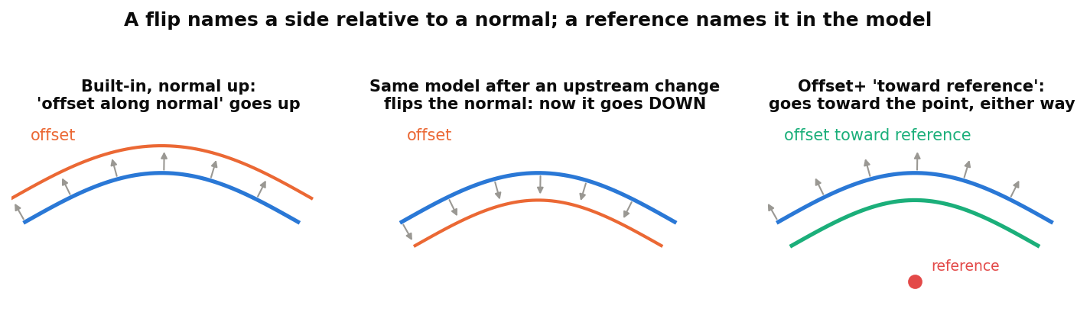
Why a reference instead of a flip
A flip is about a normal
'Front', 'opposite direction', 'Thickness 1' all mean: relative to the normal -- and normals change freely upstream.
A reference is about the model
Pick geometry on the side you mean. The choice survives any change of orientation.
Drop-in
With no reference, the feature behaves exactly like the built-in.
Thicken+ · Reference_Side_Features
Draft 2026-09-25

Slide 4
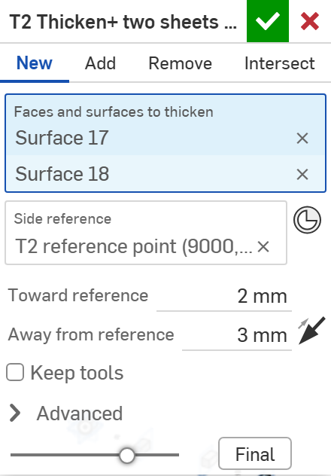
The dialog
# | Parameter | What it means
1 | Creation type | New / Add / Remove / Intersect -- the built-in boolean step, unchanged.
2 | Faces and surfaces to thicken | Surfaces or faces; each owner body is thickened on its own side.
3 | Side reference | Geometry on the side to thicken toward -- best a mate connector or vertex near the surface. Empty = along the normals.
4 | Toward reference | Thickness on the reference's side.
5 | Away from reference | Thickness on the other side.
6 | Swap sides | The arrow: exchange the two thicknesses.
7 | Keep tools | Keep the input surfaces.
8 | Advanced | Check curvature (on): report where a concave radius is smaller than the thickness. Print details.
1
2
3
4
5
6
7
8
Thicken+ · Reference_Side_Features
Draft 2026-09-25

Slide 5
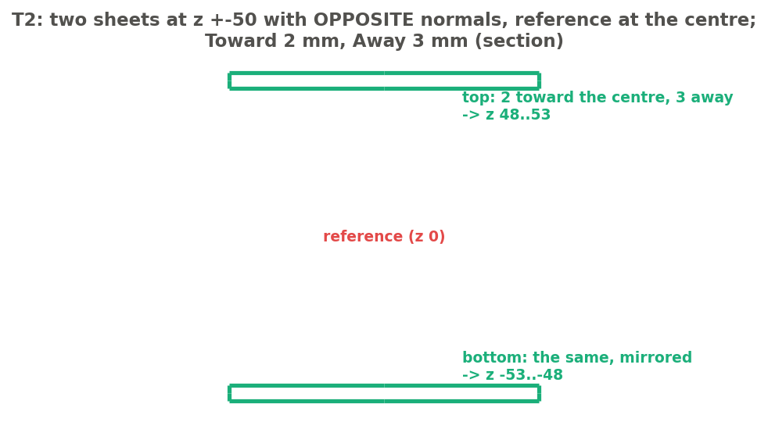
Example: opposite normals, same result
Test T2: sheets at z +50 and -50 with opposite normals, reference at the centre, Toward 2, Away 3
Both sheets put 2 mm toward the centre and 3 mm away: top z 48..53, bottom z -53..-48 -- mirror images, although their normals point opposite ways. T3 (Swap sides) gives 47..52 / -52..-47. T6: Add into a cube, 5 mm up -> one part, volume 1 018 000 mm3.
Thicken+ · Reference_Side_Features
Draft 2026-09-25

Slide 6
The curvature check
Why thickens fail
Thickening toward a concave side by more than its radius turns the offset inside out.
Found before the kernel fails
Each face is sampled on a 9 x 9 grid; the first place that would fold is marked red, with its radius.
Tests T4 / T5
Half cylinder r 10 thickened toward its axis: 15 mm -> the error with location; 5 mm -> a clean shell.
Thicken+ · Reference_Side_Features
Draft 2026-09-25

Slide 7
Outputs and messages
Published for Extract variables
Messages
Key | What it holds
output | The thickened bodies (or the parts they merged into).
towardFaces | The faces on the reference's side (at the Toward thickness).
awayFaces | The faces on the other side (on the input surface when Away is 0).
sideFaces | The faces around the edges of the thickened surfaces.
 | Message / what to do
Error | Both thicknesses are zero.
Error | The side reference lies on surface k Move the reference off the surface.
Error | Surface k is concave with radius r mm at (x, y, z) ... the thicken would fold there. Reduce that side's thickness below r, or swap sides. The red point marks the place.
Thicken+ · Reference_Side_Features
Draft 2026-09-25

Slide 8
Tips and limits
✓
Use it instead of Thicken downstream
Surfaces from Split+, Mutual Trim+ or Offset+ keep their inputs' orientation; Thicken+ does not care which way they face.
✓
Faces stay named through the boolean
towardFaces / awayFaces / sideFaces still resolve after Add merges the result into a part.
!
Orientation does not apply
Its outputs are solids, which always face outward -- Orient to reference is for surfaces.
Thicken+ · Reference_Side_Features
Draft 2026-09-25

Slide 9
Where it lives
Document | Reference_Side_Features (22764764a00a7f607dbc1c4d)
Tab | thicken_plus (uses reference_side_utils)
Tests | Reference side tests studio: T1-T6 (T4 must error) - devtools/onshape/check_reference_side_tests.py (34/34)
Examples | topsheet_surf studio (the user's derive of Design_Master topsheet and sidewall bodies)
Explainer | docs/explainers/reference_side/reference_side_explained.md, section 2.4
Related | Split+, Mutual Trim+, Offset+, Thicken+, Orient to reference (same reference rule); Extract variables
Thicken+ · Reference_Side_Features
Draft 2026-09-25

