Slide 1

Split+
Split parts, surfaces, curves or faces with several tools. Optionally supply reference geometry from which we can establish a more stable definition of which side of the geometry to split we intend to keep or remove
Reference_Side_Features · Onshape custom feature
Draft 2026-09-25 (review 1 applied)

Slide 2

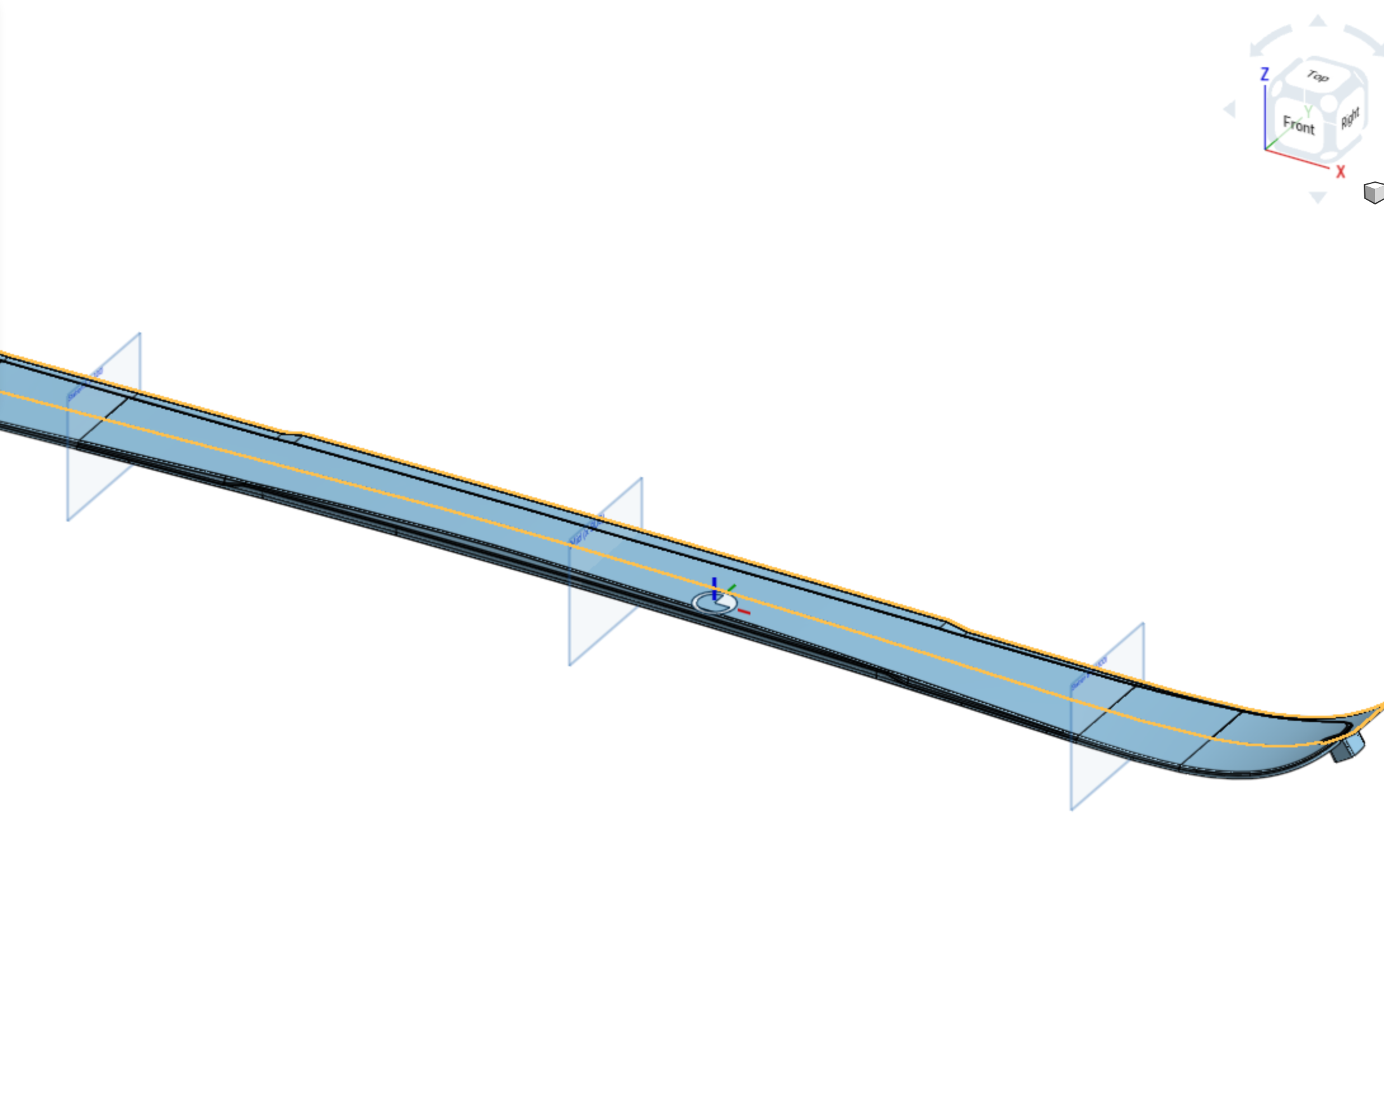
What it does
The built-in Split keeps "front" or "back" of one tool. That choice is tied to the tool's normal, which flips whenever an upstream loft, offset, mirror or sketch changes. Split+ splits by many tools at once and names the side to keep with geometry: a reference that lies on that side.
Use it when
A body must be cut by several planes or surfaces in one step
You keep one side, and the tools' normals may change upstream
Later features need the pieces by position: start, middle, end
Split+ open on a ski topsheet: the target and the two tools (Station A and B) highlight.
Split+ · Reference_Side_Features
Draft 2026-09-25 (review 1 applied)

Slide 3
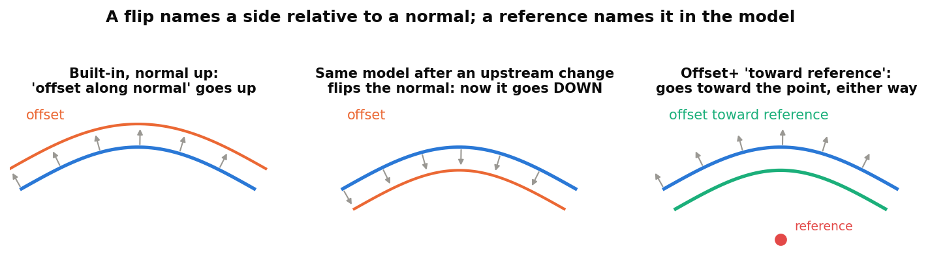
Why a reference instead of a flip
A flip is about a normal
'Keep front' means the side the tool's normal points to -- and normals change freely upstream.
A reference is about the model
Pick geometry on the side you mean. The choice survives any change of orientation.
Drop-in
With no reference, Split+ behaves exactly like the built-in Split.
Split+ · Reference_Side_Features
Draft 2026-09-25 (review 1 applied)

Slide 4
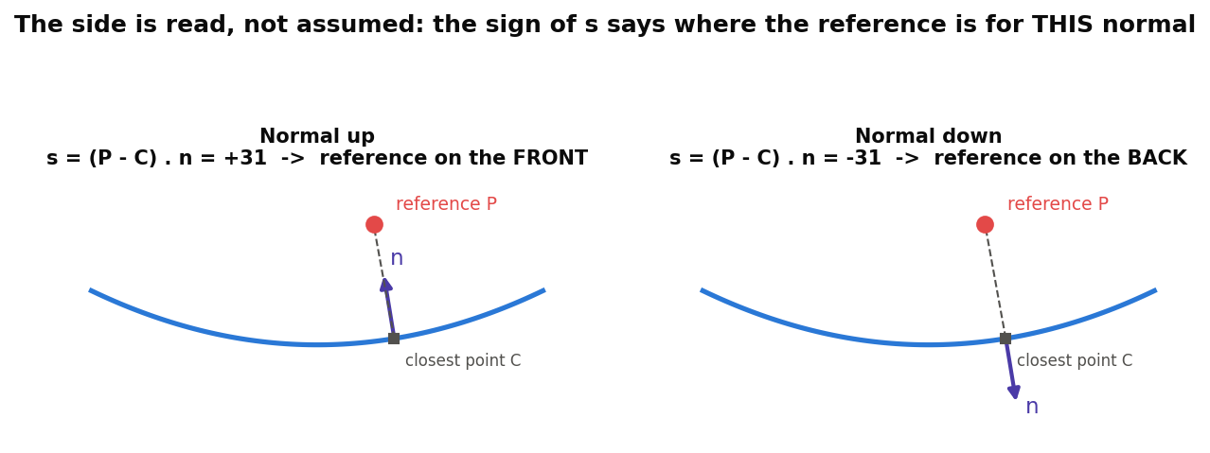
How the side is decided
Signed distance
For each tool: s = (P - C) . n at the closest point. s > 0: the reference is in front of the tool.
Per tool
Each tool keeps the reference's side (box on) or the other side (box off). What survives is on the reference's side of every tool.
No reference
Behaves like the built-in: on = each tool's front, off = its back.
Split+ · Reference_Side_Features
Draft 2026-09-25 (review 1 applied)

Slide 5
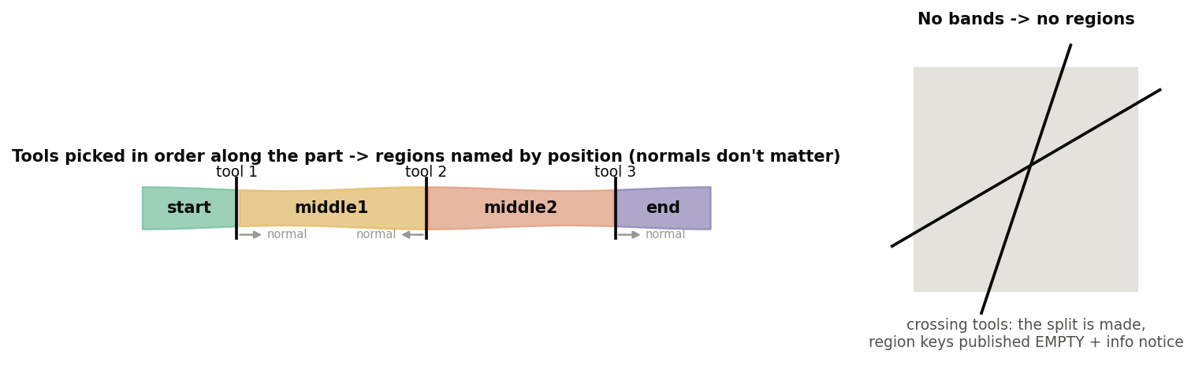
Regions are named by position
Pick tools in order
1 tool: near / far (or front / back). 2 tools: start, middle, end. 3+: start, middle1..N-1, end.
Orientation never matters
'Forward' for each tool is the side the next tool is on.
Crossing tools
The split is made as asked; region keys are published empty, with an info notice.
Split+ · Reference_Side_Features
Draft 2026-09-25 (review 1 applied)

Slide 6
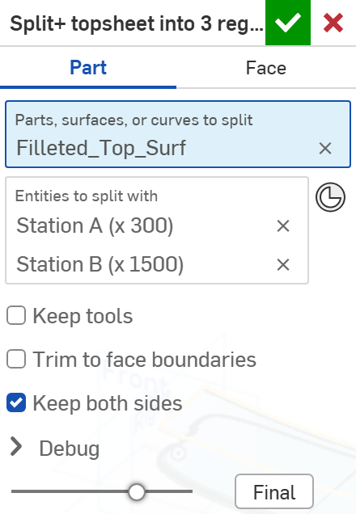
The dialog: split, keep both sides
# | Parameter | What it means
1 | Split type | PART: split whole bodies. FACE: split only the picked faces; nothing is removed.
2 | Parts, surfaces, or curves to split | The targets. Every target is split by every tool.
3 | Entities to split with | Surfaces, faces, planes or mate connectors, in pick order. Pick them in order along the part: region names follow it.
4 | Keep tools | Keep sheet-body tools after the split.
5 | Trim to face boundaries | A single-face tool cuts only within its own boundary, as the built-in.
6 | Keep both sides | On (default): every piece is kept and sorted into regions. Off: keep one side per tool (next slide).
7 | Debug | Print sides: which side of each tool the reference is on, and what was kept.
1
2
3
4
5
6
7
Split+ · Reference_Side_Features
Draft 2026-09-25 (review 1 applied)

Slide 7
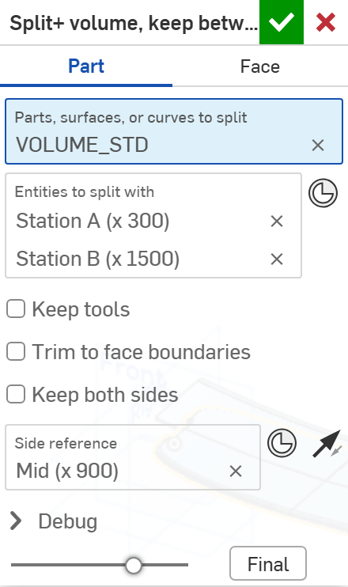
The dialog: keep one side
# | Parameter | What it means
1 | Keep both sides | Off: each tool keeps one side.
2 | Side reference | Geometry on the side to keep -- best a mate connector or vertex inside the region you want. Here: Mid (x 900).
3 | Keep side nearest reference | The arrow. On: keep the side of each tool the reference is on. Off: keep the other side. Without a reference: each tool's front / back.
1
2
3
Result: only the region between Station A and B survives, whatever way the two planes face (example 2).
Split+ · Reference_Side_Features
Draft 2026-09-25 (review 1 applied)

Slide 8
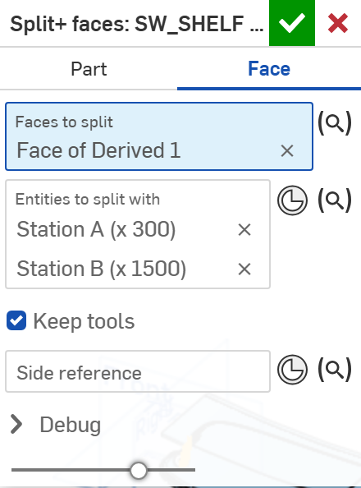
The dialog: face split
# | Parameter | What it means
1 | Split type | FACE: split only the picked faces. Nothing is removed; the pieces stay part of their body.
2 | Faces to split | The faces to split. Planes and mate connectors cut them infinitely; surfaces cut as they are.
3 | Side reference | Optional. With one tool it names the two regions near / far; it never removes anything here.
1
2
3
Regions are published as faces: pick 'middle' in Extract variables to fillet or offset only those faces.
Split+ · Reference_Side_Features
Draft 2026-09-25 (review 1 applied)

Slide 9
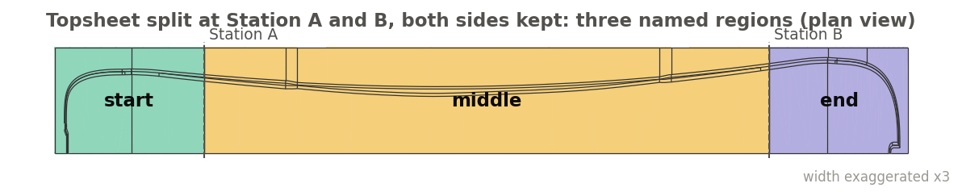
Example 1: three regions
Topsheet split at Station A (x 300) and B (x 1500), Keep both sides on
Nothing is removed. The three pieces are published as start (x -19..300), middle (300..1500) and end (1500..1799), and the cut edges as splitEdges -- one edge per cut: 9 edges, 5 at A and 4 at B.
Split+ · Reference_Side_Features
Draft 2026-09-25 (review 1 applied)

Slide 10
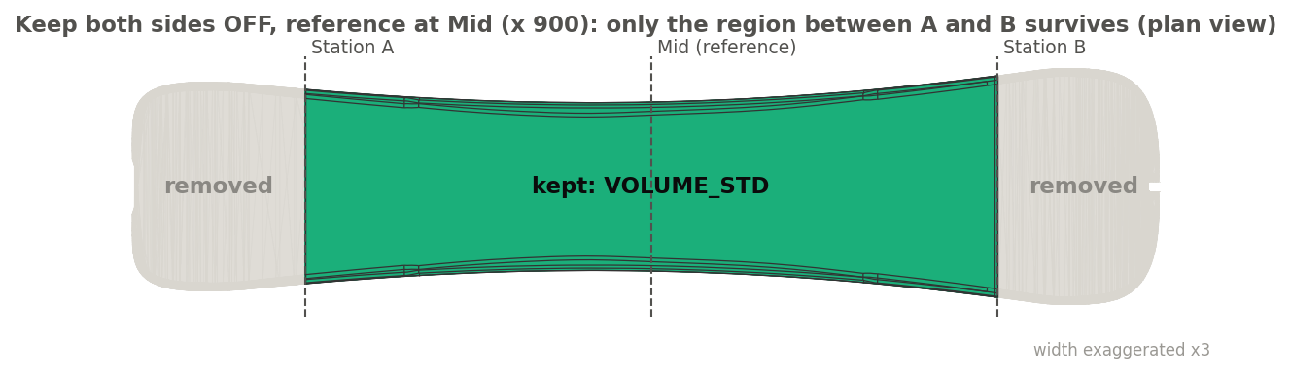
Example 2: keep only the middle
VOLUME_STD split at Station A and B, Keep both sides off, Side reference = Mid (x 900)
Each station plane keeps the side Mid is on, so only the part between A and B survives (green); the tip and tail pieces (grey) are removed. Flipping either plane's normal changes nothing -- which the built-in 'keep front / back' cannot promise.
Split+ · Reference_Side_Features
Draft 2026-09-25 (review 1 applied)

Slide 11
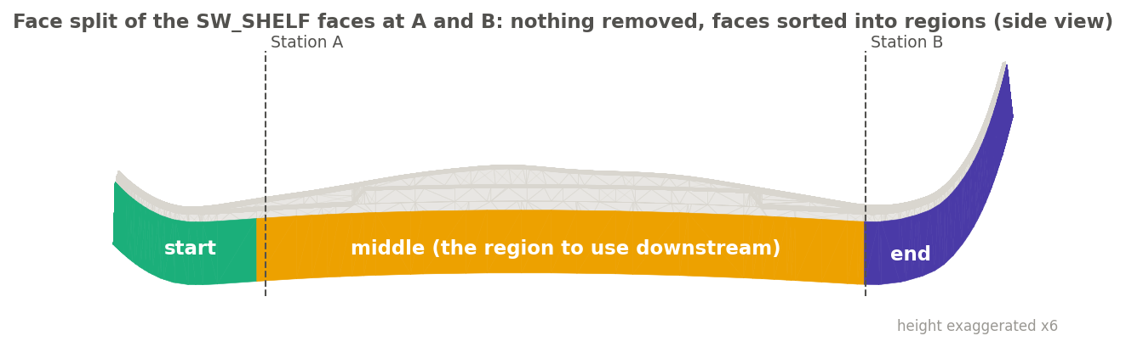
Example 3: split faces, not bodies
Face split: the SW_SHELF faces (the shelf along the sidewall) cut at Station A and B
Nothing is removed and no new body is made: the shelf faces are divided at A and B and published as regions -- start 4 faces, middle 9, end 4. A later feature (a fillet, an offset, a Thicken+) can then work on 'middle' alone, and keeps working when the stations move.
Split+ · Reference_Side_Features
Draft 2026-09-25 (review 1 applied)

Slide 12
Outputs: what Extract variables can publish
Published for Extract variables
Key | What it holds
output | Every resulting piece.
near / far, start / middle* / end | The pieces in each region: bodies (solids, surfaces or curves) in a Part split, faces in a Face split.
<region>Edges | A region's edges except the cuts (for a surface: its open boundary).
outside / inside (+ Edges) | start + end together / every middle region together.
splitEdges | The NEW edges along each cut line -- where a tool crosses a target. Keeping both sides leaves two coincident copies of every cut edge; only one is published. Input edges that were merely cut in two are not included.
cut, startCut / endCut, cut1..N | splitEdges sorted by the tool that made them (each edge goes to its nearest tool): 1 tool: cut; 2 tools: startCut, endCut; 3+: cut1..cutN. Topsheet example: startCut = the 5 edges at x 300.
splitFaces | The cap faces the split created on solids (empty for surfaces and in a Face split).
pieceCount, regionCount | Numbers: pieces left; regions the tools define (N + 1 for N tools).
Split+ · Reference_Side_Features
Draft 2026-09-25 (review 1 applied)

Slide 13
Messages
Messages
 | Message / what to do
Error | A tool is also a target Pick it only once.
Error | The keep side reference lies on tool k Move the reference clearly to one side of that tool.
Error | Nothing is left No part of the targets is on the kept side of every tool.
Info | Split done; regions not published: ... Tools cross, or were picked out of order. The split itself is fine.
Split+ · Reference_Side_Features
Draft 2026-09-25 (review 1 applied)

Slide 14
Tips and limits
✓
Use a local reference
A mate connector or vertex inside the region to keep. A far plane can read the wrong side where the part curves.
!
Edge tools are not offered
The side rule needs a surface. Use the built-in Split for projected edges.
✓
Pick tools along the part
Region names follow pick order.
!
How pieces are sorted into regions
Split+ checks which side of each tool ONE point of each piece lies on (its centre; for a face, the nearest point on the face). A piece that curls back across a tool's extended plane could land in the wrong region -- check regions with Show in Extract variables.
✓
Reference regions, not indices
Extract variables can publish 'middle' or 'startCut'; those names survive changes upstream.
Split+ · Reference_Side_Features
Draft 2026-09-25 (review 1 applied)

Slide 15
Where it lives
Document | Reference_Side_Features (22764764a00a7f607dbc1c4d)
Tab | split_plus (uses reference_side_utils)
Tests | Reference side tests studio: S1-S10 - devtools/onshape/check_reference_side_tests.py
Examples | topsheet_surf studio: Split+ topsheet into 3 regions, Split+ volume keep between A and B, Split+ faces
Explainer | docs/explainers/reference_side/reference_side_explained.md, section 2.2
Related | Mutual Trim+, Offset+, Thicken+ (same reference rule); Extract variables
Split+ · Reference_Side_Features
Draft 2026-09-25 (review 1 applied)

