Slide 1

Split+
Split parts, surfaces, curves or faces with several tools. Optionally supply reference geometry from which we can establish a more stable definition of which side of the geometry to split we intend to keep or remove
Reference_Side_Features · Onshape custom feature
Draft 2026-09-25

Slide 2

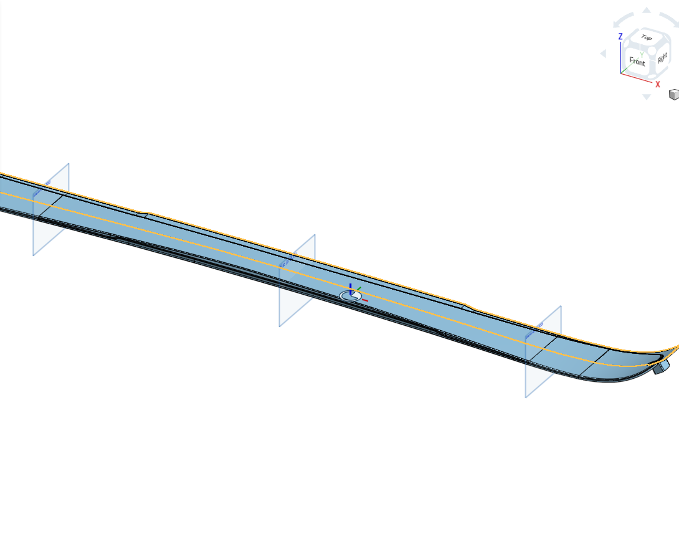
What it does
The built-in Split keeps "front" or "back" of one tool. That choice is tied to the tool's normal, which flips whenever an upstream loft, offset, mirror or sketch changes. Split+ splits by many tools at once and names the side to keep with geometry: a reference that lies on that side.
Use it when
A body must be cut by several planes or surfaces in one step
You keep one side, and the tools' normals may change upstream
Later features need the pieces by position: start, middle, end
Split+ open on a ski topsheet: the targets and tools highlight; Station A and B are the tools.
Split+ · Reference_Side_Features
Draft 2026-09-25

Slide 3
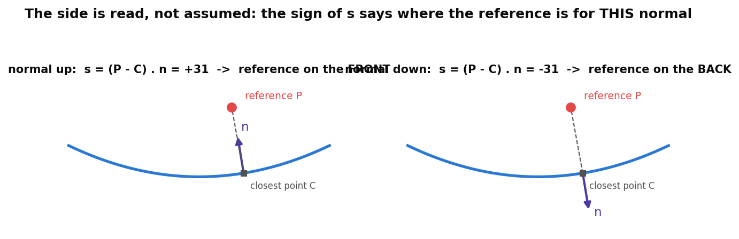
How the side is decided
Signed distance
For each tool: s = (P - C) . n at the closest point. s > 0: the reference is in front of the tool.
Per tool
Each tool keeps the reference's side (box on) or the other side (box off). What survives is on the reference's side of every tool.
No reference
Behaves like the built-in: on = each tool's front, off = its back.
Split+ · Reference_Side_Features
Draft 2026-09-25

Slide 4
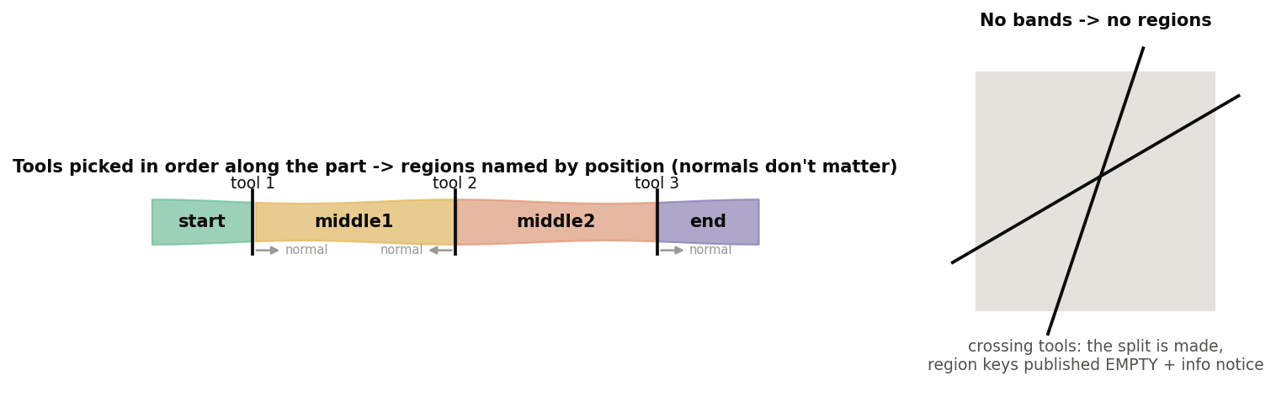
Regions are named by position
Pick tools in order
1 tool: near / far (or front / back). 2 tools: start, middle, end. 3+: start, middle1..N-1, end.
Orientation never matters
'Forward' for each tool is the side the next tool is on.
Crossing tools
The split is made as asked; region keys are published empty, with an info notice.
Split+ · Reference_Side_Features
Draft 2026-09-25

Slide 5
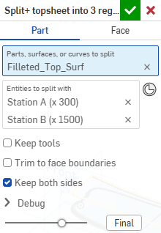
The dialog (1/2)
Parameter | What it means
Split type | PART: split whole bodies. FACE: split only the picked faces; nothing is removed.
Parts, surfaces, or curves to split | (Part) The targets. Every target is split by every tool.
Faces to split | (Face) The faces to split.
Entities to split with | Surfaces, faces, planes or mate connectors, in pick order. Pick them in order along the part.
Keep tools | Keep sheet-body tools after the split.
Trim to face boundaries | (Part) A single-face tool cuts only within its boundary, as the built-in.
Keep both sides | (Part, default on) Off: keep one side per tool.
Side reference | Geometry on one side of the tools. Face split: only names near / far.
Split+ · Reference_Side_Features
Draft 2026-09-25

Slide 6
The dialog (2/2)
Parameter | What it means
Keep side nearest reference | (Part, one side) On: the reference's side of each tool. Off: the other side.
Debug > Print sides | Which side of each tool the reference is on, and what was kept.
Split+ · Reference_Side_Features
Draft 2026-09-25

Slide 7
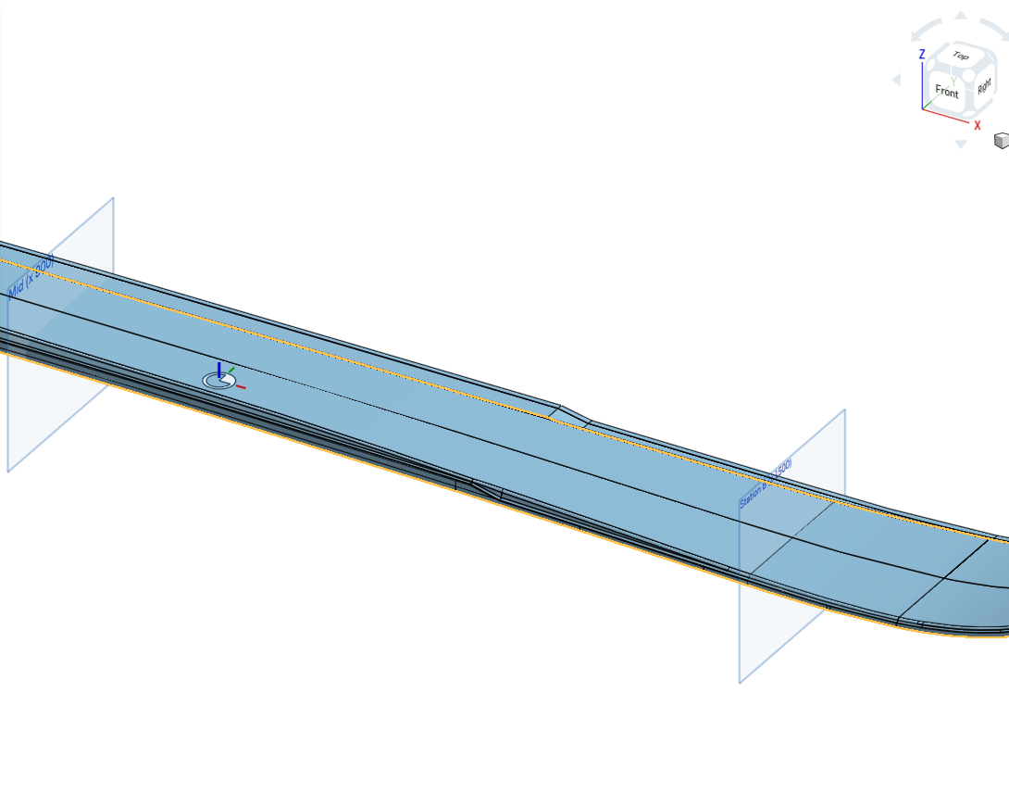
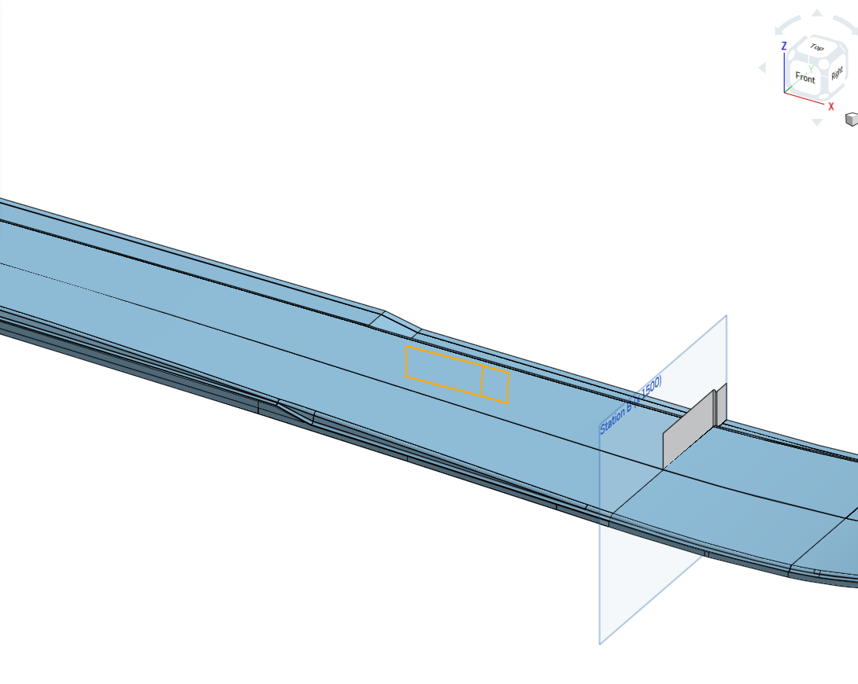
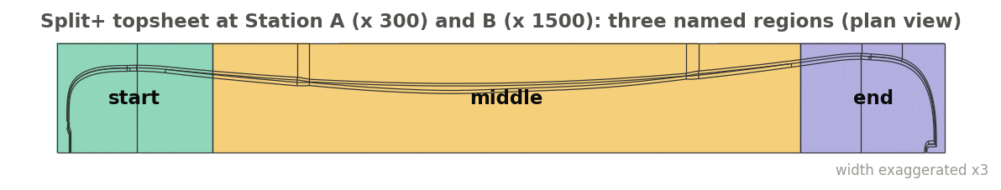
Examples
Topsheet into three regions
Tools Station A (x 300) and B (x 1500), keep both sides. Published: start x -19..300, middle 300..1500, end 1500..1799, and one edge per cut.
Keep between two stations
VOLUME_STD split at A and B with Keep both sides off and the reference at Mid (x 900): only the middle survives, whatever the planes' normals.
Face split
SW_SHELF faces split at A and B (Face type): nothing is removed; the faces come out as start / middle / end regions (4 / 9 / 4 faces).
Split+ · Reference_Side_Features
Draft 2026-09-25

Slide 8
Outputs and messages
Published for Extract variables
Messages
Key | What it holds
output | All resulting pieces
near / far, start / middle* / end | The pieces of each region {FOR ALL ENTITY TYPES??}
<region>Edges | Region edges except the cuts
outside / inside | Start + end / every middle region
splitEdges | Every cut, ONE edge per cut {EDGES THAT GET CUT (one input edge is two split edges), or the intersection edges of our split tool and target?}
cut, startCut / endCut, cut1..N | The cut made by each tool {qSplitBy? What do these actually provide?}
splitFaces | The caps the split created on solids
pieceCount, regionCount | Numbers
 | Message / what to do
Error | A tool is also a target Pick it only once.
Error | The keep side reference lies on tool k Move the reference clearly to one side.
Error | Nothing is left No part of the targets is on the kept side of every tool.
Info | Split done; regions not published: ... Tools cross, or were picked out of order. The split itself is fine.
Split+ · Reference_Side_Features
Draft 2026-09-25

Slide 9
Tips and limits
✓
Use a local reference
A mate connector or vertex inside the region to keep. A far plane can read the wrong side where the part curves.
!
Edge tools are not offered
The side rule needs a surface. Use the built-in Split for projected edges.
✓
Pick tools along the part
Region names follow pick order.
!
Piece placement uses one point per piece
A strongly curved piece is placed by its centroid (faces: nearest point on the face). {I DON’T UNDERSTAND THIS}
✓
Reference regions, not indices
Extract variables can publish 'middle' or 'startCut'; those names survive changes upstream.
Split+ · Reference_Side_Features
Draft 2026-09-25

Slide 10
Where it lives
Document | Reference_Side_Features (22764764a00a7f607dbc1c4d)
Tab | split_plus (uses reference_side_utils)
Tests | Reference side tests studio: S1-S10 - devtools/onshape/check_reference_side_tests.py
Explainer | docs/explainers/reference_side/reference_side_explained.md, section 2.2
Related | Mutual Trim+, Offset+, Thicken+ (same reference rule); Extract variables
Split+ · Reference_Side_Features
Draft 2026-09-25

