Slide 1

Case pattern
Re-run a chain of features for every case of a Case template -- each case with its own selections and values -- and name the new bodies by case.
Case_Pattern · Onshape custom feature
Draft 2026-09-25

Slide 2

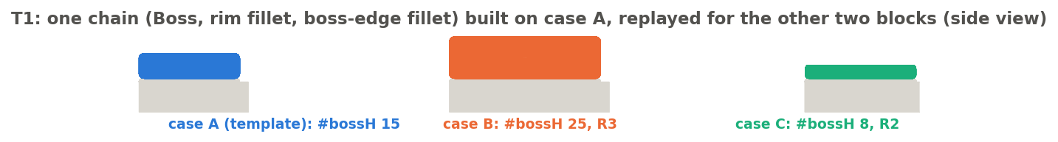
What it does
'Apply to each' for the feature tree. Onshape's Pattern moves copies by a transform; Evan Reese's Query Pattern rebinds one seed. Case pattern rebinds up to 8 query variables and 4 values per case and re-runs the listed features for each case.
Use it when
A detail repeats on places that differ in shape
Each place needs its own dimensions
The chain edits existing geometry (fillets, move face) as well as making new
T1: the boss chain on three blocks, each at its own height and radius.
Case pattern · Case_Pattern
Draft 2026-09-25

Slide 3
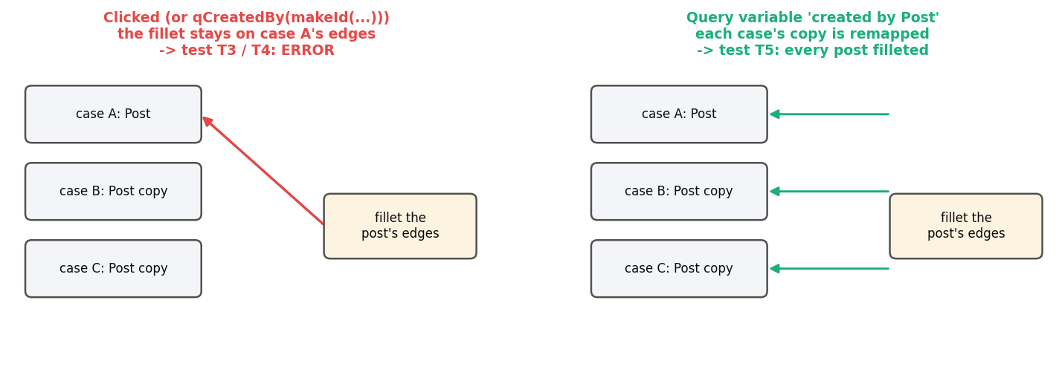
The one rule
Inside the list
Geometry one listed feature made, used by another, must come through a Query variable 'created by' that feature.
Why
Each case runs in a pattern frame that remaps those references onto the case's copies; clicks stay on case 1.
Outside the list
References to existing geometry are fine: they are rebound through the template's names.
Case pattern · Case_Pattern
Draft 2026-09-25

Slide 4
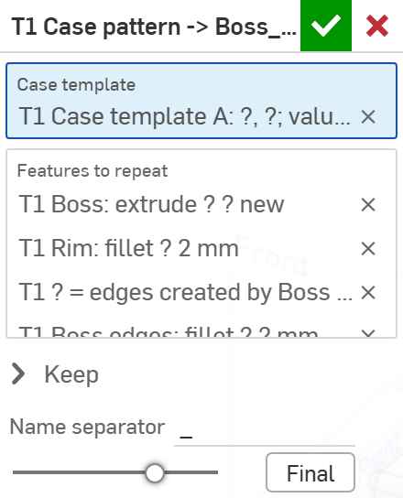
The dialog
# | Parameter | What it means
1 | Case template | Exactly one Case template.
2 | Features to repeat | The chain built on the template's names.
3 | Keep | Which new bodies to keep per case (sketches off by default).
4 | Name separator | Between name and case (default _): Boss_A -> Boss_B.
1
2
3
4
Case pattern · Case_Pattern
Draft 2026-09-25

Slide 5
Example: bosses on three blocks (T1)
Chain: Boss (extrude #top by #bossH), rim fillet 2 mm, #bossEdges = edges created by Boss, fillet #bossEdges at #edgeR
Case A: 15 mm, R3 (the template). Case B: 25 mm, R3. Case C (pentagon): 8 mm, R2. New bodies are named Boss_<case>. (In the studio case B is currently named 'Foobar!'.)
Case pattern · Case_Pattern
Draft 2026-09-25

Slide 6
Outputs and messages
Published for Extract variables
Messages
Key | What it holds
output | The bodies each case created (filtered by Keep), named <name>_<case>.
 | Message / what to do
Warning | Not built: B: input 1 (#top) selects nothing; C: feature 2 failed (...) The other cases are still built.
Error | No case was built.
Info | N bodies kept Onshape's default name Edit the Case pattern once to refresh case 1's names.
Case pattern · Case_Pattern
Draft 2026-09-25

Slide 7
Tips and limits
!
Sketches
Re-solved per case, but references to input geometry stay on case 1. Build sketches on geometry derived from the inputs.
!
Cost
(cases + 1) x the chain on every rebuild.
!
Order matters
Cases run in order and see earlier results; a failed case cannot undo edits to existing geometry.
✓
Verified
Fillet and Move face on existing geometry, new extrudes, native query variables (T1-T5).
Case pattern · Case_Pattern
Draft 2026-09-25

Slide 8
Where it lives
Document | Case_Pattern (2099413dd91f34578b385892)
Tab | case_pattern (both features)
Tests | Case pattern tests studio: T1-T5 (T3, T4 must error) - devtools/onshape/build_case_pattern_tests.py
Explainer | docs/explainers/case_pattern/case_pattern_explained.md
Related | Case template; Query variable
Case pattern · Case_Pattern
Draft 2026-09-25

