Slide 1

Extract variables
One feature per block of the tree that turns what its features produced into named variables and query variables -- regions, cuts, chain ends, the largest faces -- instead of a query variable per name.
Variable_tools · Onshape custom feature
Draft 2026-09-25

Slide 2

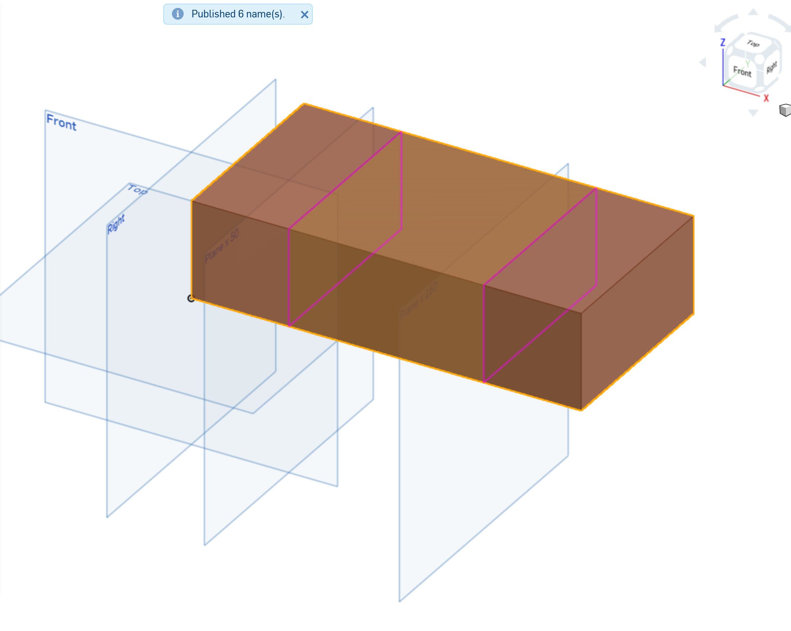
What it does
A variable-driven model needs dozens of named selections so later features keep working when the model changes. Native query variables give one node per name, picked by hand, and cannot express a region, a chain end or 'the two largest faces'. Extract variables publishes them all from one node, from what the source features published.
Use it when
A block of features feeds many later selections
A selection must be computed (region, chain end, largest N)
Names must survive changes upstream
Examples studio: Show highlights what the entries publish; 'Published 6 name(s).'
Extract variables · Variable_tools
Draft 2026-09-25

Slide 3
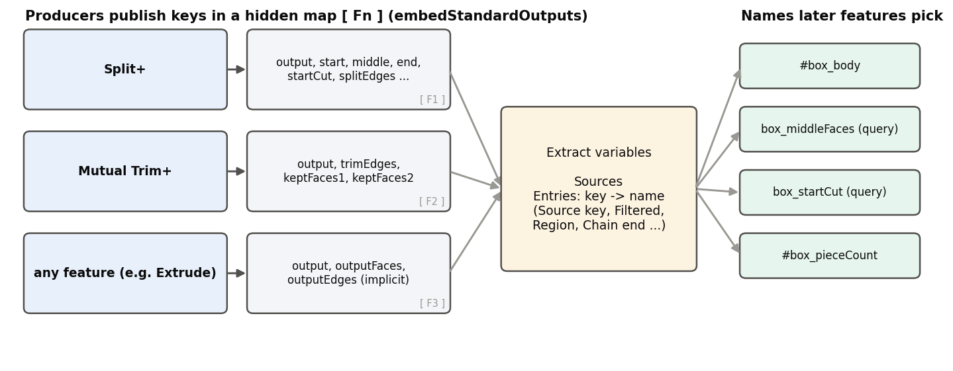
Producers and the consumer
Producers
Our features publish keys (output, regions, cuts, ends ...) in a hidden map; built-ins still offer output and modified* keys.
Addresses
A key offered by one source is its bare name; by several, key@1, key@2 ... (Print keys lists them).
Always present
A producer's keys exist even when empty, so an entry never breaks after an edit.
Extract variables · Variable_tools
Draft 2026-09-25

Slide 4
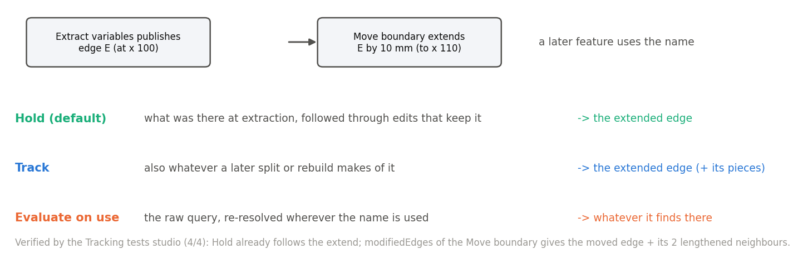
Hold, Track, Evaluate on use
Hold (default)
What was there, followed through edits that keep it -- verified: follows a 10 mm Move boundary extend.
Track
Also what later splits and rebuilds make of it.
Evaluate on use
Re-resolved wherever used: the most live, and the easiest to get wrong.
Extract variables · Variable_tools
Draft 2026-09-25

Slide 5
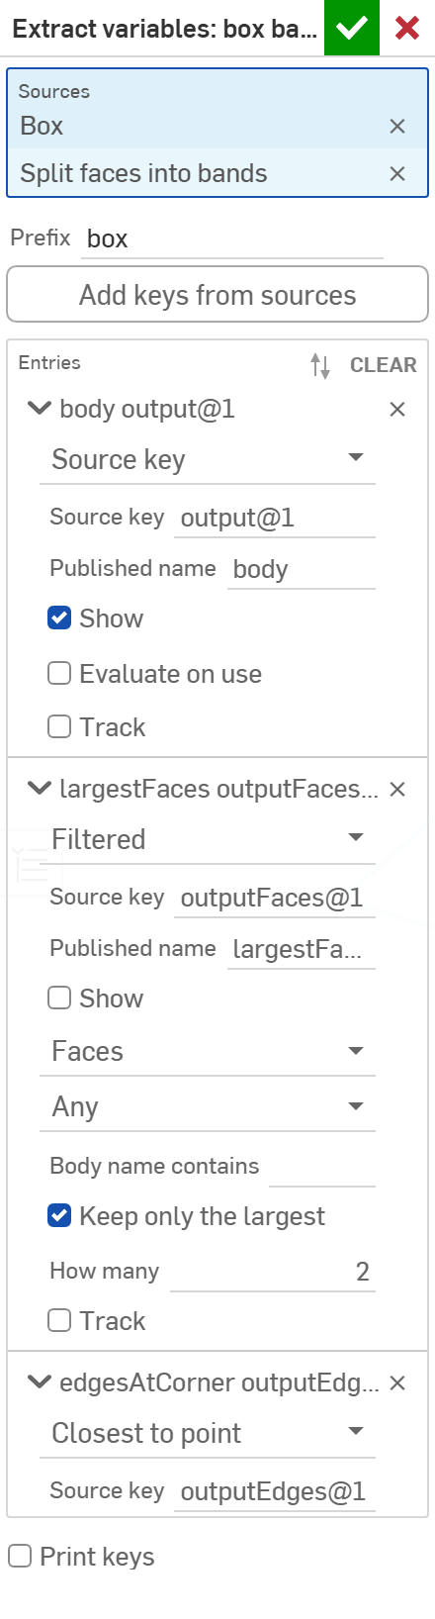
The dialog
1
# | Parameter | What it means
1 | Sources | The features to read (sorted by tree order).
2 | Prefix | Joined to every name with _ (box -> #box_body).
3 | Add keys from sources | Button: one entry per address not yet listed.
4 | Entries | Per name: Type, Source key, Published name, Show, Track / Evaluate on use; Filtered adds entity type, body type, name, largest N.
5 | Print keys | List every address with its description.
6 | Manifest | Optional: one map variable listing everything published.
2
3
4
Entry types: Source key, Filtered, Closest to point, Shared edges, Chain end, Edges between points, Bridging curve input, Region.
5
6
Extract variables · Variable_tools
Draft 2026-09-25

Slide 6
Example: box bands
Sources: a Box and a split of its faces into bands; prefix 'box'
Entries publish the body (output@1), the two largest faces (Filtered, keep 2), the edges at a corner (Closest to point), shared edges and two regions -- 6 names, plus a manifest. With Show on, the published body and cuts are highlighted.
Extract variables · Variable_tools
Draft 2026-09-25

Slide 7
Outputs and messages
Published for Extract variables
Messages
Key | What it holds
#<prefix>_<name> | A value entry: an ordinary variable.
<prefix>_<name> (query) | A query entry: a native query variable, in the dropdowns of later features.
manifest (optional) | One map variable listing everything published.
 | Message / what to do
Info | Published N name(s). Empty names are published too, and listed.
Info | Nothing published yet: press Add keys...
Warning | Entry k (key): reason. Not published: unknown or ambiguous key (choices listed), a value where geometry was expected, a missing point ...
Error | a name used twice Two entries publish the same name.
Extract variables · Variable_tools
Draft 2026-09-25

Slide 8
Tips and limits
✓
Press Add keys, then prune
It lists everything the sources offer; delete what you do not need and rename the rest.
✓
Prefer Hold
Use Track for things later split; Evaluate on use only when you know why.
!
Adding a source
Every source offers output: a second source makes the bare 'output' ambiguous -- use output@1.
Extract variables · Variable_tools
Draft 2026-09-25

Slide 9
Where it lives
Document | Variable_tools (a47f90bfa6b17a59e20cebd0), V2
Tabs | extract_variables, extract_variables_utils, extract_outputs (the producer library, pinned by every producer)
Tests | Tracking tests studio (4/4), variable_tools_tests (Region, 6/6)
Examples | Examples studio: Extract variables: box bands
Explainer | docs/explainers/variable_tools/variable_tools_explained.md
Related | Every producer: Split+, Mutual Trim+, Offset+, Thicken+, Orient to reference, Clean wire, Map / Merge curve, ...
Extract variables · Variable_tools
Draft 2026-09-25

