Slide 1

Analyze baseline
Measure an existing side profile -- camber height, rocker contact points and lengths, tip heights -- to compare a ski with its design targets.
xSection · Onshape custom feature
Draft 2026-09-25

Slide 2

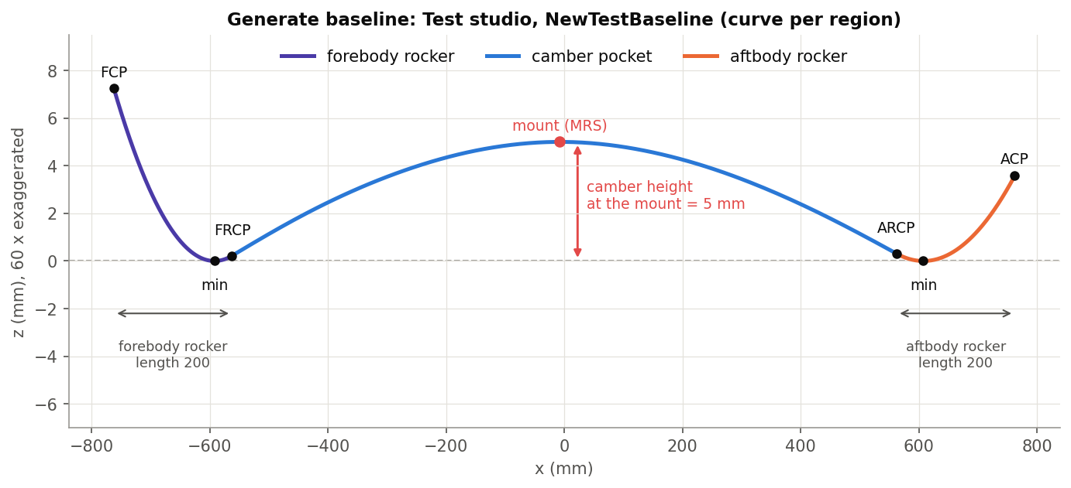
What it does
Generate baseline builds a profile from targets; Analyze baseline goes the other way. Give it any baseline -- scanned, drawn, or generated -- and it reports the same quantities, and can draw them as a sketch.
Use it when
Check a scanned or supplied ski against targets
Verify a hand-drawn baseline
Document a profile's numbers
The quantities it reports: minima, camber, FRCP / ARCP, rocker lengths, tip heights.
Analyze baseline · xSection
Draft 2026-09-25

Slide 3
The dialog
Parameter | What it means
Baseline edges | The side profile (a tangent chain).
FCP / ACP | Contact points (X only).
Calculated data | Read-only: FB / AB minimum, max camber point, camber height, FRCP, FRCPL, FRCP tangent, FCPH, ARCP, ARCPL, ARCP tangent, ACPH.
Output measurement sketch | Chords, tangent lines and normals on the XZ plane.
Recalculate | Button (the values are also refreshed on every dialog change).
Analyze baseline · xSection
Draft 2026-09-25

Slide 4
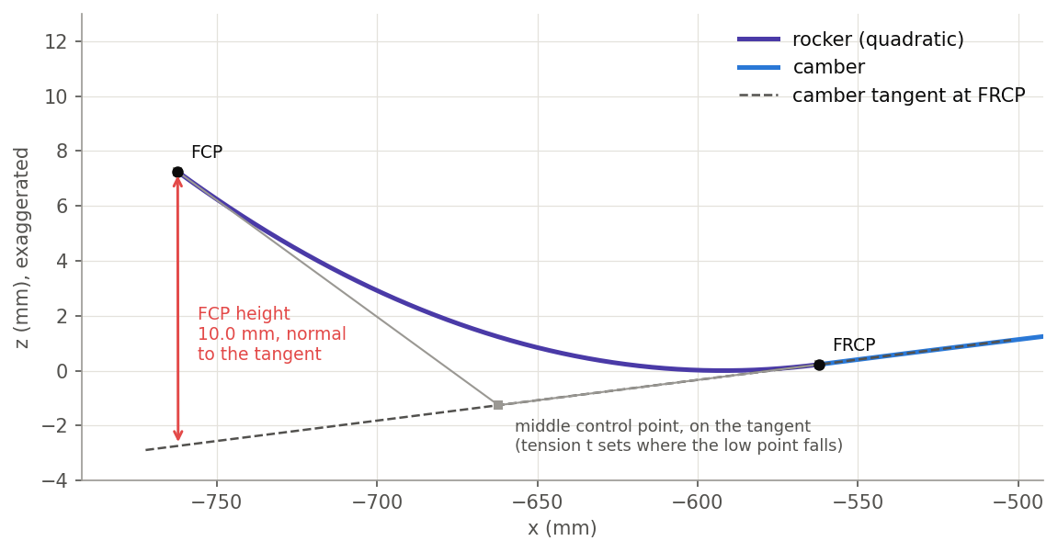
How it measures
Camber
Largest perpendicular distance from the line between the two low points.
FRCP / ARCP
The lowest inflection in each half; FRCPL = its distance from FCP.
FCPH / ACPH
The tip's perpendicular distance to the tangent at FRCP / ARCP.
Analyze baseline · xSection
Draft 2026-09-25

Slide 5
Tips and limits
!
Dialog only
Values are computed while editing and do not follow later geometry changes.
!
No inflection
A half with no inflection leaves its fields empty.
!
Name
The feature is spelled 'Analze baseline' in Onshape.
Analyze baseline · xSection
Draft 2026-09-25

Slide 6
Where it lives
Document | xSection (f8deedeb1fbd819a8fa20113), 'Stiffness Tools'
Tab | analyzeBaseline (beam/analyzeBaseline.fs)
Tests | none
Examples | Test2 studio: Analze baseline 1
Explainer | docs/explainers/xsection/xsection_explained.md, section 2.6
Related | EI and Cross Section, Estimate Stiffness, Estimate Deflection, Generate / Analyze baseline, Update profile
Analyze baseline · xSection
Draft 2026-09-25

