Slide 1

EI and Cross Section
Cut the ski's layup at stations and compute, at each, the bending stiffness EI, torsional stiffness GJ, neutral axis and mass -- then the ski's flex numbers and weight.
xSection · Onshape custom feature
Draft 2026-09-25

Slide 2

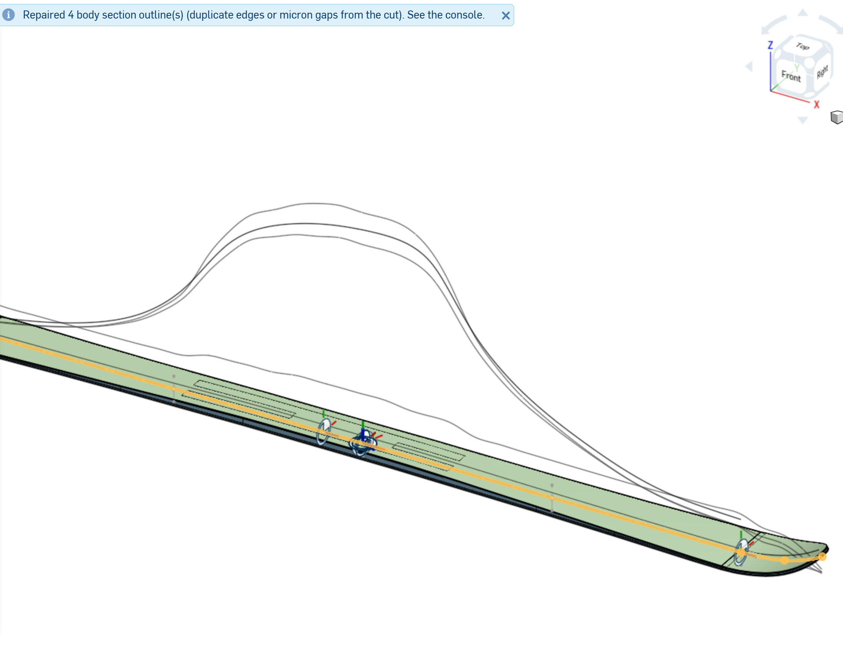
What it does
A ski's flex comes from its layup: every ply's shape and material. EI and Cross Section reads the layup straight from CAD (one solid per ply, each with an Onshape material), looks up the moduli in a CSV table, and gives EI(x), GJ(x), the neutral axis and the flex numbers -- so a design change shows its stiffness effect at once.
Use it when
You change a layup, core profile or sidecut
You need the EI curve for deflection, baseline or profile work
You compare a design with measured stiffness
ROY_Test: the output curves (EI, GJ ...) above the ski; the info reports repaired outlines.
EI and Cross Section · xSection
Draft 2026-09-25

Slide 3
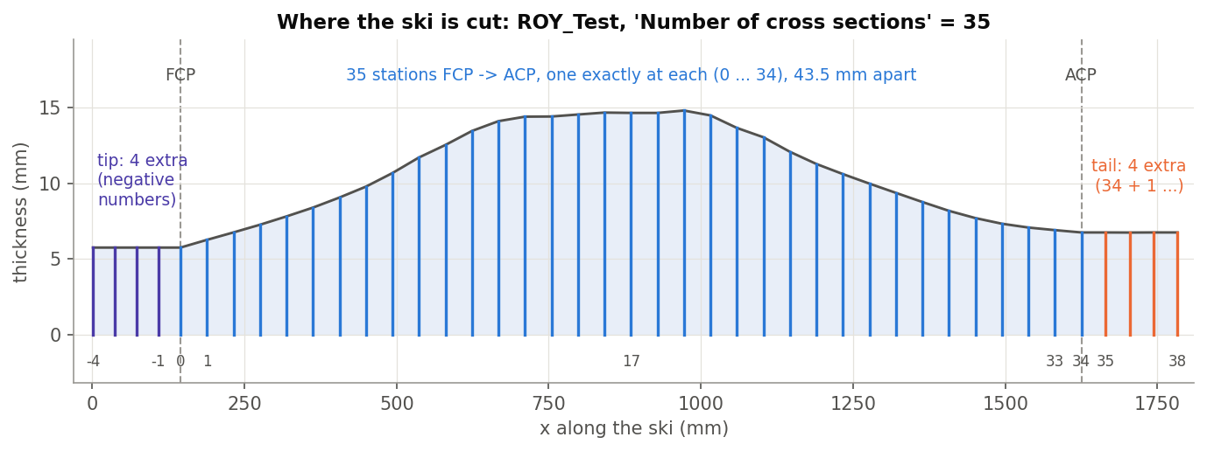
Stations
FCP to ACP
N stations evenly spaced, one exactly at each contact point (numbered 0 ... N-1).
Tip and tail
Up to 4 extra each at about the same spacing; the tip's are numbered negative.
One cut per body
Outlines are cleaned (duplicates, micron gaps), triangulated and integrated.
EI and Cross Section · xSection
Draft 2026-09-25

Slide 4
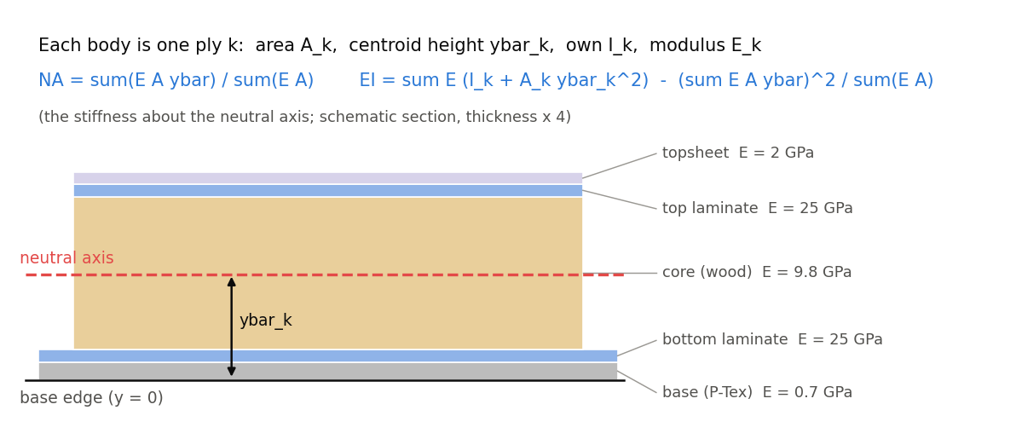
EI of a laminate
Each body is a ply
Area, centroid height above the base, its own I, and its modulus E along the ski.
Neutral axis
The E-weighted centroid; EI is the stiffness about it.
E, not Q11
A narrow ski bends like a beam: Q11 would overstate by ~12 % (wood, Titanal), more for +-45 fabric.
EI and Cross Section · xSection
Draft 2026-09-25

Slide 5
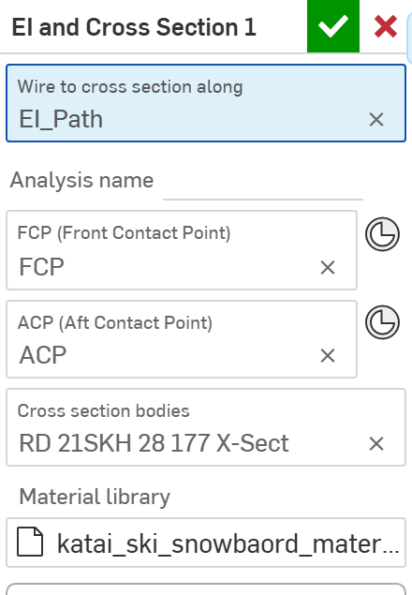
The dialog (1/2)
# | Parameter | What it means
1 | Wire to cross section along | One wire along the ski (X increasing).
2 | Analysis name | Prefix for the output curves.
3 | FCP | Front contact point (vertex, planar face or mate connector; X only).
4 | ACP | Aft contact point. FCP and ACP are optional, but flex numbers need both.
5 | Cross section bodies | The layer solids (composites are unpacked).
6 | Material library | materialData.csv: name, density, E, nu, Q11 ... Q66.
1
2
3
4
5
6
EI and Cross Section · xSection
Draft 2026-09-25

Slide 6
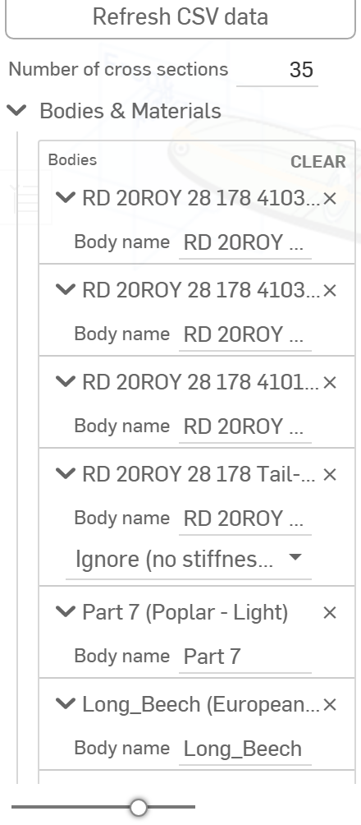
The dialog (2/2)
7
# | Parameter | What it means
7 | Refresh CSV data | Button: re-read the table.
8 | Number of cross sections | 3-200 (50); with FCP / ACP, this many from FCP to ACP.
9 | Bodies & Materials | Per body: its material must match a CSV name exactly, or choose Ignore / Provide material data.
10 | Output Options | Create composites (slow), language, material and body-detail tables.
11 | Debug | Draw edges / points / mesh of chosen stations and bodies.
8
9
EI and Cross Section · xSection
Draft 2026-09-25

Slide 7
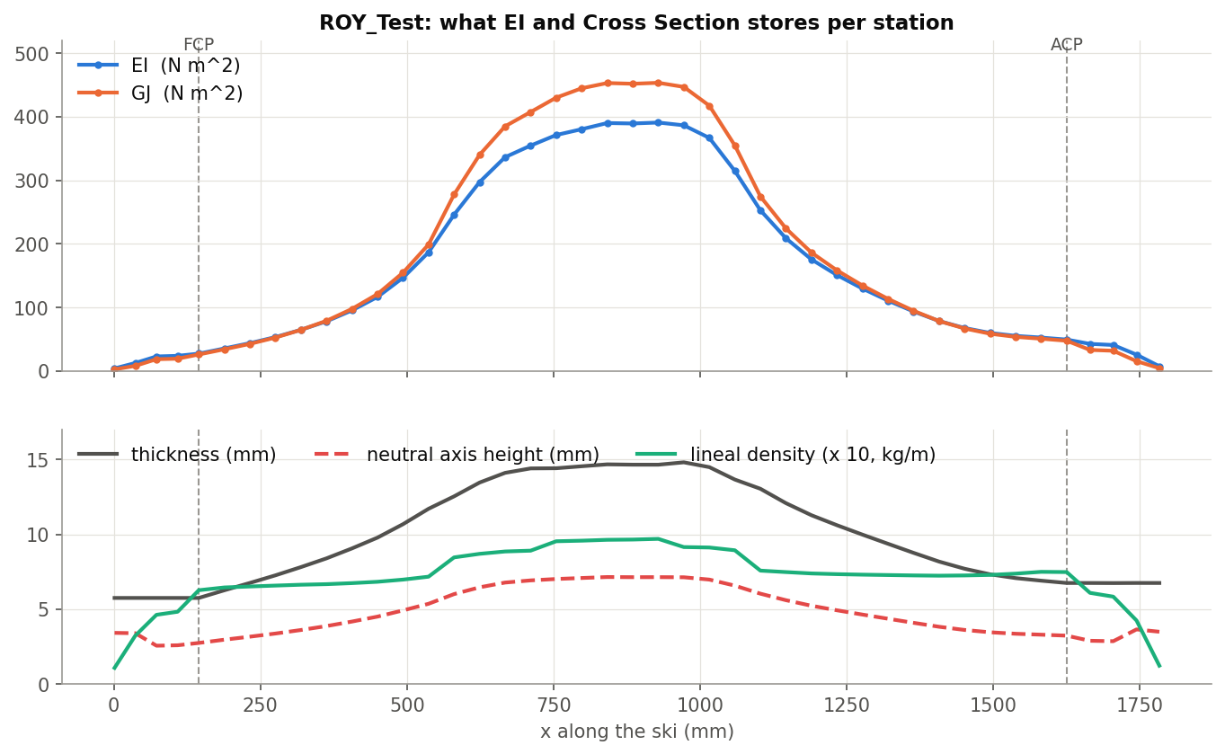
Example: ROY_Test, 35 stations
EI peaks at 390 N m^2 under the foot; GJ follows (453); the neutral axis sits near mid-thickness
Summary: 20.7 lb/in and 81.3 mm under 30 kg (variable EI); 16.2 lb/in prismatic. The stations cut 4 bodies with micron gaps, repaired (info).
EI and Cross Section · xSection
Draft 2026-09-25

Slide 8
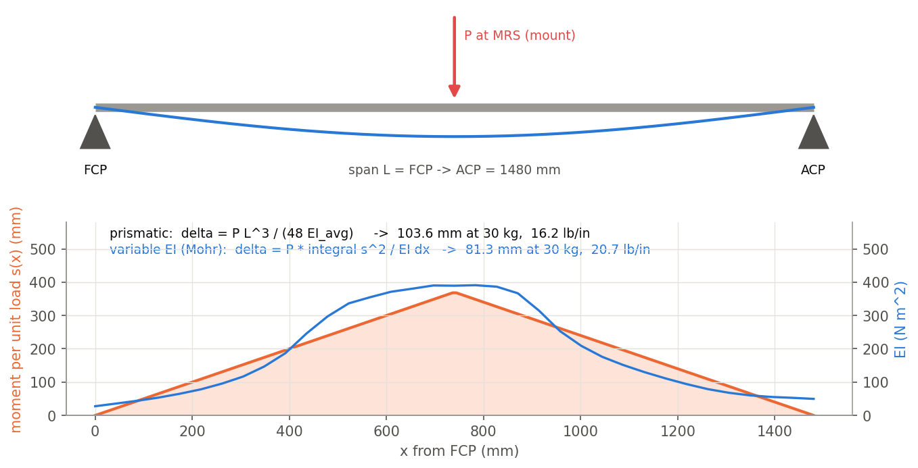
Flex numbers
The test
Simply supported at FCP and ACP, a point load at the mount (MRS).
Prismatic
P L^3 / (48 EI_avg): the average EI over the span.
Variable EI (Mohr)
P x integral s^2 / EI: the stiff middle counts more -- 20.7 vs 16.2 lb/in on ROY_Test.
EI and Cross Section · xSection
Draft 2026-09-25

Slide 9
Outputs and messages
Outputs
Messages
Key | What it holds
<name>_EI | EI curve: Z mm = EI N m^2. The input of every other xSection feature.
_GJ, _neutralAxis, _linealDensity, _profileHeight | GJ (mm = N m^2), NA height, mass per length (1 kg/m = 100 mm), thickness (true scale).
CrossSectionAnalysis (attribute) | Everything per station, read by the Cross-Section Analysis table and Update profile.
 | Message / what to do
Info | Repaired N body section outline(s)... Duplicate edges or micron gaps closed; details on the console.
Warning | N body section(s) between FCP and ACP could not be closed or came out with no area EI is low there.
EI and Cross Section · xSection
Draft 2026-09-25

Slide 10
Tips and limits
✓
Name materials exactly
The Onshape material name must match the CSV Name, case and spaces included; otherwise the body is ignored or needs data.
!
Wood cores
Some CSV rows (Aspen, Poplar) are isotropic placeholders: EI is fine, their GJ is overstated.
✓
Turn off Create composites
It is the slowest step and only draws the section wires.
!
Ends
Planes grazing the tip or tail can lose a thin outline (console only).
EI and Cross Section · xSection
Draft 2026-09-25

Slide 11
Where it lives
Document | xSection (f8deedeb1fbd819a8fa20113), 'Stiffness Tools'
Tab | xSect (features/xSect.fs + core/, section/, materials/, beam/)
Tests | xSection tests studio: analytic EI / NA / GJ (check_xsection_tests.py)
Examples | ROY_Test
Explainer | docs/explainers/xsection/xsection_explained.md, section 1.1-1.6, 2.1
Related | EI and Cross Section, Estimate Stiffness, Estimate Deflection, Generate / Analyze baseline, Update profile
EI and Cross Section · xSection
Draft 2026-09-25

