Slide 1

Estimate Deflection
Bend the ski under a load case: an EI curve, up to three supports and two applied loads, each spread over a width -- out comes the deflected shape.
xSection · Onshape custom feature
Draft 2026-09-25

Slide 2

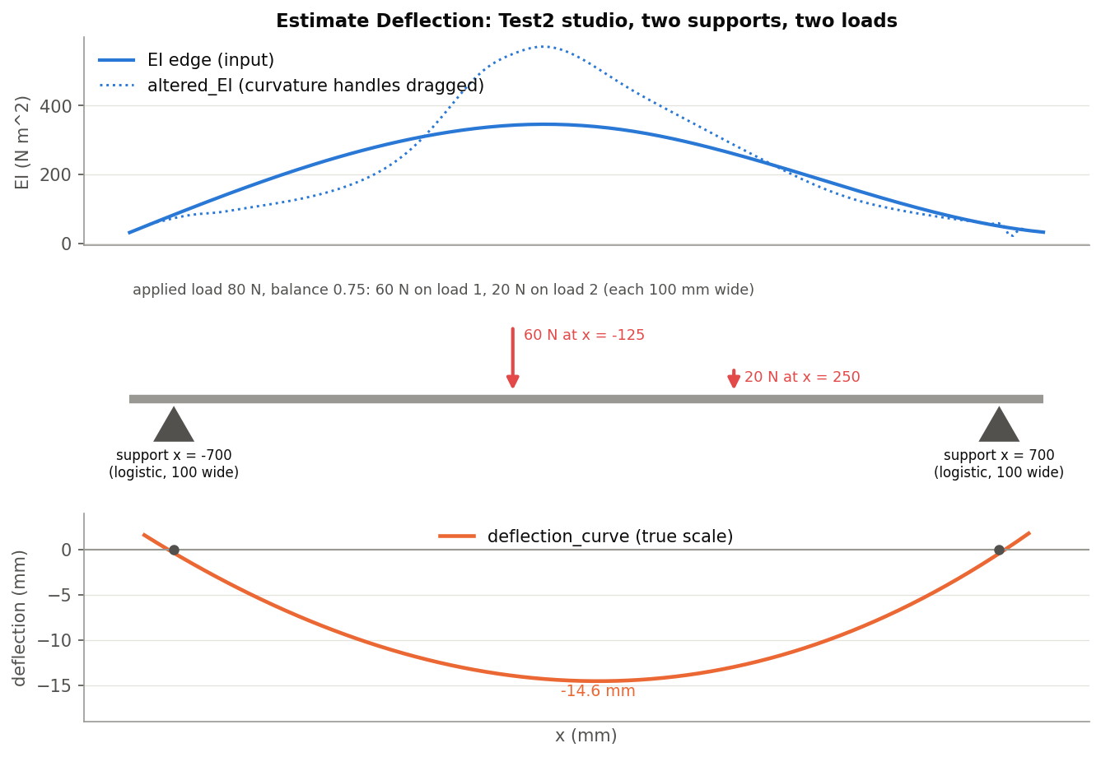
What it does
Flex numbers are one load case. Estimate Deflection solves any: a bench test, a skier's weight fore and aft, a binding plate. Curvature = M / EI integrated twice gives the shape, zero at supports 1 and 2.
Use it when
Predict a bench or on-snow deflection
See the effect of a binding plate or mounting moment
Find the EI that would give a shape (drag the curvature)
Test2: supports at +-700 mm, 60 N and 20 N loads -> 14.6 mm.
Estimate Deflection · xSection
Draft 2026-09-25

Slide 3
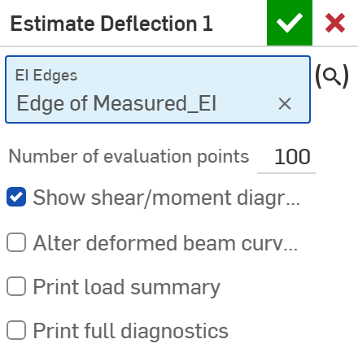
The dialog (1/2)
# | Parameter | What it means
1 | EI Edges | The EI curve: an edge in the XZ plane, world Z in mm = EI in N m^2 (EI and Cross Section's <name>_EI, a measured or a target curve).
2 | Number of evaluation points | 20-500 (100); also EI samples per edge.
3 | Show shear/moment diagrams | Draw V and M.
4 | Alter deformed beam curvature | Drag curvature handles; outputs the matching EI (altered_EI).
1
2
3
4
Estimate Deflection · xSection
Draft 2026-09-25

Slide 4
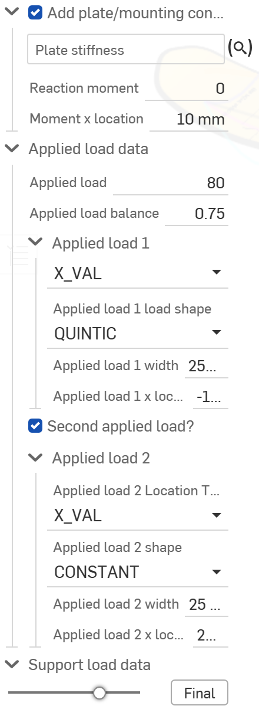
The dialog (2/2)
5
# | Parameter | What it means
5 | Add plate/mounting conditions? | Plate stiffness edge, reaction moment (N m, positive) and its x.
6 | Applied load data | Load 3-600 N, balance between two loads; each: location, shape, width.
7 | Support load data | Supports 1, 2 (optional 3 with its share); each: location, shape, width.
8 | Output Options | Span (full EI / supports); Fit or Approximate.
6
7
Estimate Deflection · xSection
Draft 2026-09-25

Slide 5
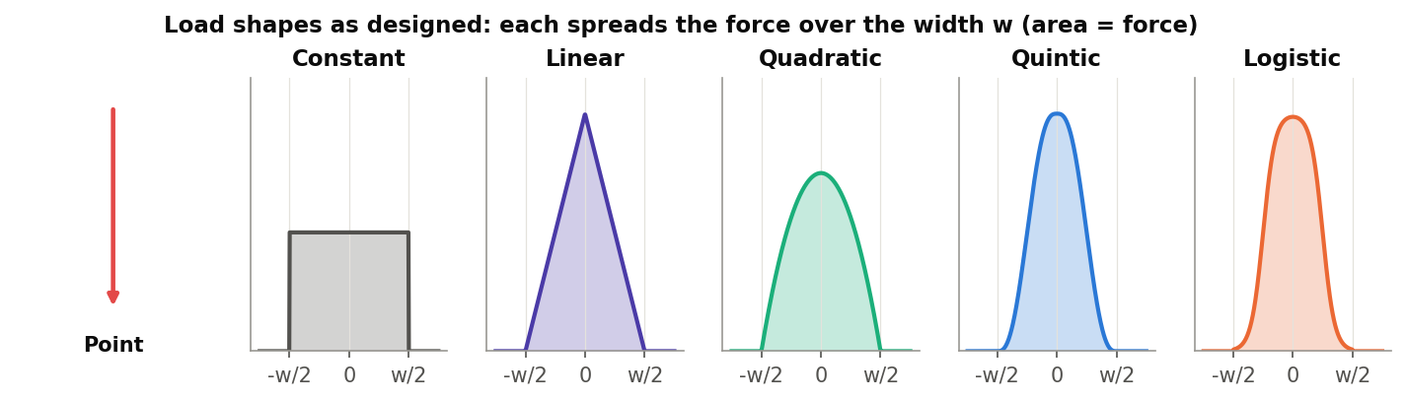
Load shapes
Spread over a width
Each shape integrates to the load's force.
Supports too
Reactions can be spread (Logistic suits a support pad).
Known bug
Every distributed shape is computed as Logistic today (enum compared with strings). Point is correct.
Estimate Deflection · xSection
Draft 2026-09-25

Slide 6
Example: Test2
EI eiTarget; supports x = -700 / 700; 80 N split 0.75: 60 N at -125, 20 N at 250 (100 mm wide)
The deflection_curve sags 14.6 mm near the middle. With 'Alter deformed beam curvature' on, the dragged shape gives altered_EI (dotted).
Estimate Deflection · xSection
Draft 2026-09-25

Slide 7
Outputs and messages
Outputs
Messages
Key | What it holds
deflection_curve | The deflected shape, Z = deflection, true scale.
altered_EI | Optional: the EI curve that gives the dragged curvature (EI format).
 | Message / what to do
Error | fewer than 2 EI samples / all EI zero
Error | supports 1 and 2 at the same x / zero span
Estimate Deflection · xSection
Draft 2026-09-25

Slide 8
Tips and limits
!
Load shapes
Until fixed, Constant / Linear / Quadratic / Quintic all behave as Logistic.
!
Support 3
Takes a fixed share of the load; the deflection is zero only at supports 1 and 2.
!
Moment
The reaction moment cannot be negative.
Estimate Deflection · xSection
Draft 2026-09-25

Slide 9
Where it lives
Document | xSection (f8deedeb1fbd819a8fa20113), 'Stiffness Tools'
Tab | estimateDeflection (+ beam/estimateDeflectionSolver.fs)
Tests | none
Examples | Test2 studio: Estimate Deflection 1
Explainer | docs/explainers/xsection/xsection_explained.md, section 2.4
Related | EI and Cross Section, Estimate Stiffness, Estimate Deflection, Generate / Analyze baseline, Update profile
Estimate Deflection · xSection
Draft 2026-09-25

