Slide 1

Estimate Stiffness
The four flex numbers of any EI curve -- yours, a target, a competitor's -- between two contact points.
xSection · Onshape custom feature
Draft 2026-09-25

Slide 2

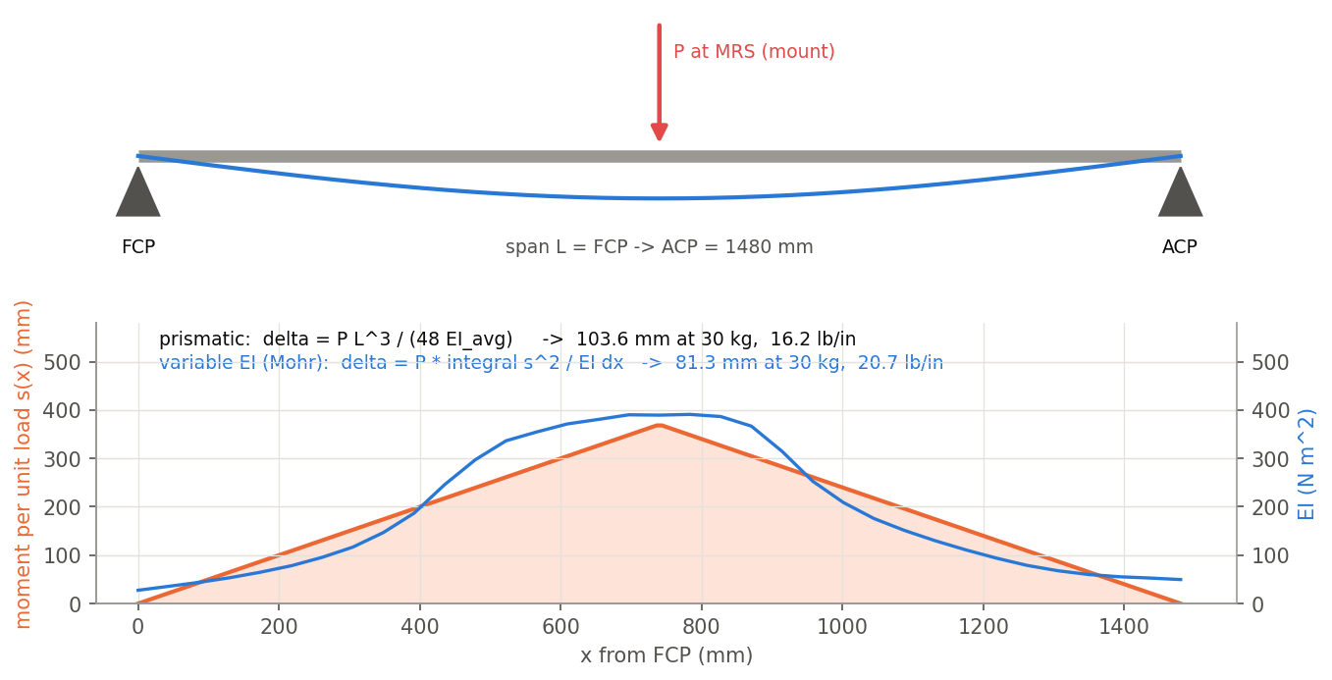
What it does
EI and Cross Section gives flex numbers for a modelled layup. Estimate Stiffness gives the same four numbers for any EI curve, so a measured or target curve can be compared on the same scale.
Use it when
Rate a target or measured EI curve
Compare two EI curves by the numbers
Check a hand-edited EI profile
The test behind the numbers: FCP-ACP simply supported, load at the mount.
Estimate Stiffness · xSection
Draft 2026-09-25

Slide 3
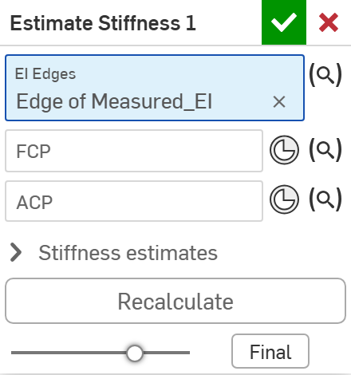
The dialog
# | Parameter | What it means
1 | EI Edges | The EI curve: an edge in the XZ plane, world Z in mm = EI in N m^2 (EI and Cross Section's <name>_EI, a measured or a target curve).
2 | FCP | Front contact point (X only).
3 | ACP | Aft contact point (X only).
4 | Stiffness estimates | Read-only: prismatic lb/in and mm/30 kg; estimated (variable EI) lb/in and mm/30 kg.
5 | Recalculate | Button: compute the numbers.
1
2
3
4
5
Estimate Stiffness · xSection
Draft 2026-09-25

Slide 4
Tips and limits
!
Dialog only
Numbers are computed when you press Recalculate and do not follow later geometry changes.
!
FCP before ACP
If FCP is not before ACP in X nothing is computed, silently.
✓
Short curves
An EI curve shorter than FCP-ACP is extended to reach them.
Estimate Stiffness · xSection
Draft 2026-09-25

Slide 5
Where it lives
Document | xSection (f8deedeb1fbd819a8fa20113), 'Stiffness Tools'
Tab | estimateStiffness (+ beam/xSectBeamAnalysis.fs)
Tests | none
Examples | Test studio: Estimate Stiffness 1
Explainer | docs/explainers/xsection/xsection_explained.md, section 1.6, 2.3
Related | EI and Cross Section, Estimate Stiffness, Estimate Deflection, Generate / Analyze baseline, Update profile
Estimate Stiffness · xSection
Draft 2026-09-25

