Slide 1
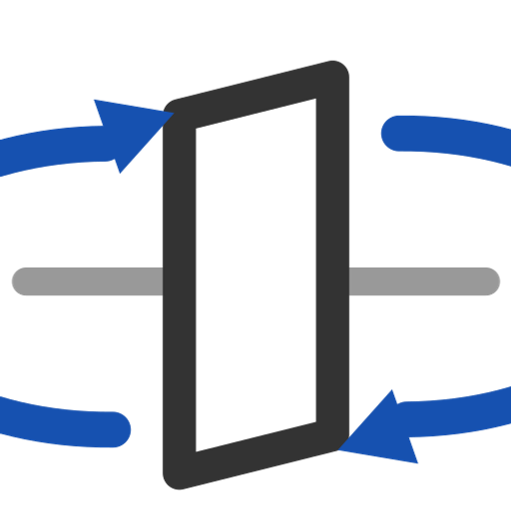
Solve GJ
Legacy: recompute the torsional stiffness GJ of an existing EI and Cross Section feature and write it back to its stored data and table.
xSection · Onshape custom feature
Draft 2026-09-25

Slide 2

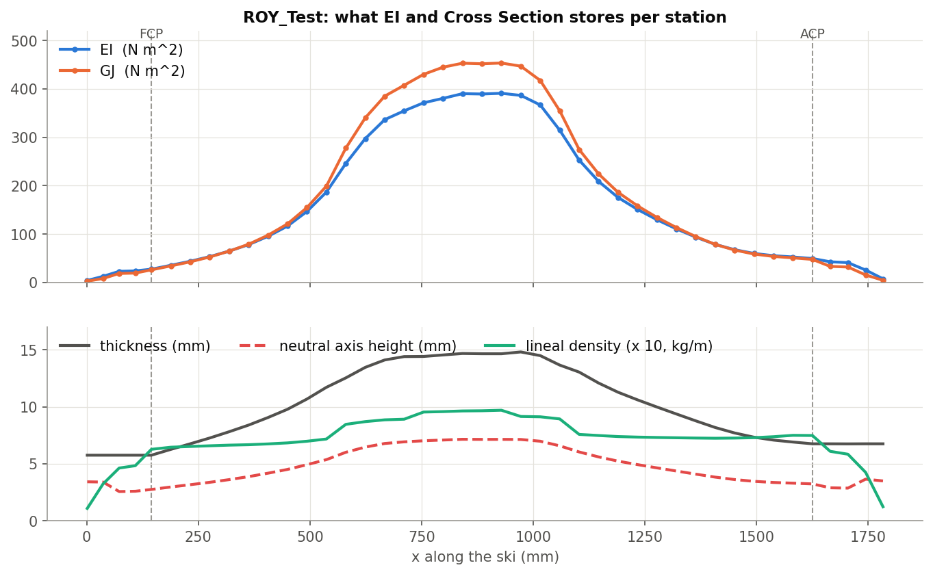
What it does
GJ used to be a separate step. EI and Cross Section now computes GJ itself with the same solver, so Solve GJ changes nothing on a current model. It is kept so older documents still regenerate.
Use it when
An older document still has it in the tree
Not needed for new work
GJ (orange) is already in every EI and Cross Section result.
Solve GJ · xSection
Draft 2026-09-25

Slide 3
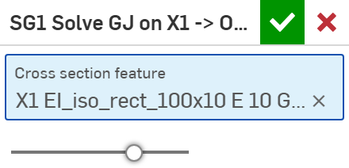
The dialog
# | Parameter | What it means
1 | Cross section feature | One EI and Cross Section feature.
1
GJ = 4 x sum(G x Iz) over the section's triangles, G = each body's Q66 (thin-plate Saint-Venant).
Solve GJ · xSection
Draft 2026-09-25

Slide 4
Outputs and messages
Outputs
Messages
Key | What it holds
(stored data) | GJ of every station in the feature's CrossSectionAnalysis data and table.
 | Message / what to do
Error | Select the cross section feature. Nothing selected.
Error | (missing data / station count mismatch) The selected feature has no stored sections.
Solve GJ · xSection
Draft 2026-09-25

Slide 5
Tips and limits
✓
Fixed 2026-09-25
The recomputed GJ was written to a copy and lost; errors were swallowed. Both fixed.
!
Redundant
Safe to delete from new models.
Solve GJ · xSection
Draft 2026-09-25

Slide 6
Where it lives
Document | xSection (f8deedeb1fbd819a8fa20113), 'Stiffness Tools'
Tab | GJ_Feature (+ section/gjAnalysis.fs, gjDataAccess.fs)
Tests | SG1 in the xSection tests studio (stored GJ 125.31)
Examples | xSection tests: SG1
Explainer | docs/explainers/xsection/xsection_explained.md, section 1.5, 2.2
Related | EI and Cross Section, Estimate Stiffness, Estimate Deflection, Generate / Analyze baseline, Update profile
Solve GJ · xSection
Draft 2026-09-25

