Slide 1

Update profile
Inverse design: from an EI and Cross Section model and a target EI curve, propose the thickness profile that hits the target.
xSection · Onshape custom feature
Draft 2026-09-25

Slide 2

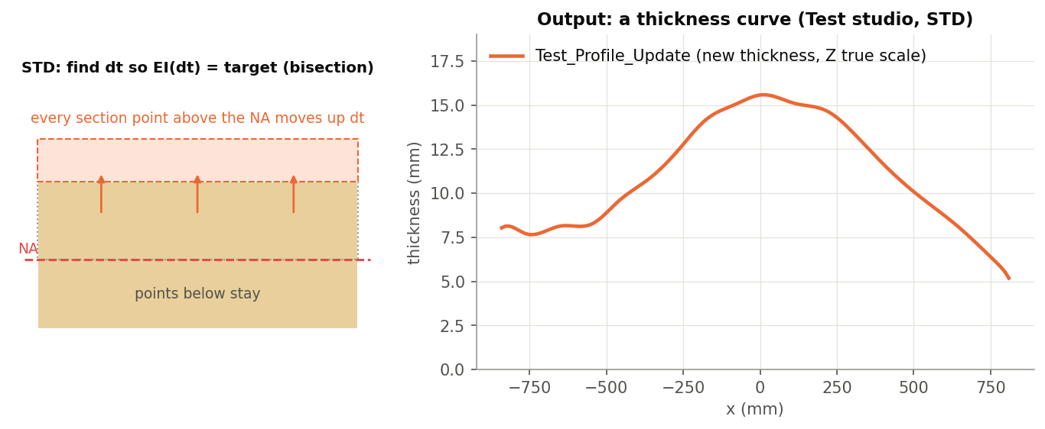
What it does
Knowing the EI you want is easy; knowing the core thickness that gives it is not. Update profile uses the modelled sections to solve, station by station, for the thickness that meets a target EI curve.
Use it when
Hit a target flex from an existing layup
Scale a design part-way toward a target
Estimate thickness changes quickly (DELTA / PERCENT)
STD: section points above the neutral axis move up; output is a thickness curve.
Update profile · xSection
Draft 2026-09-25

Slide 3
Three solvers
STD
Full section model: move every point above the NA up by dt; bisection on dt until EI = target.
DELTA
Fit EI / width = alpha t^beta over all stations; solve t for the new EI.
PERCENT
Scale thickness by the EI ratio, using the fitted beta.
Update profile · xSection
Draft 2026-09-25

Slide 4
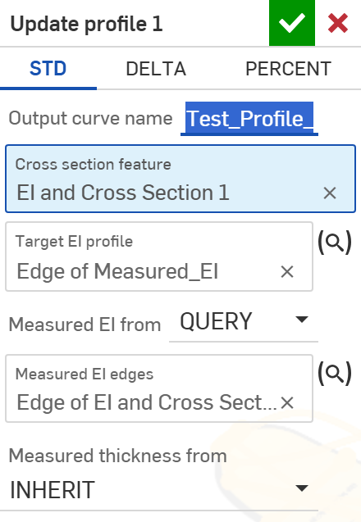
The dialog (STD) (1/2)
# | Parameter | What it means
1 | Solver type | STD / DELTA / PERCENT.
2 | Output curve name | Default 'Updated thickness'.
3 | Cross section feature | The EI and Cross Section feature.
4 | Target EI profile | The EI curve: an edge in the XZ plane, world Z in mm = EI in N m^2 (EI and Cross Section's <name>_EI, a measured or a target curve).
5 | Measured EI from | Inherit (the model) or Query (edges).
6 | Measured thickness from | Inherit or Query (the Query edges are not used).
1
2
3
4
5
6
Update profile · xSection
Draft 2026-09-25

Slide 5
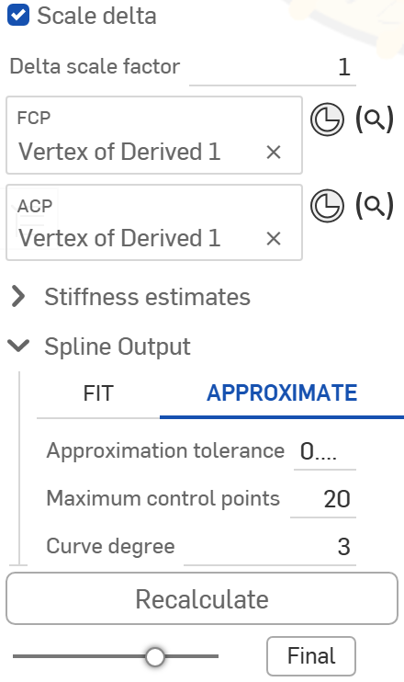
The dialog (STD) (2/2)
7
# | Parameter | What it means
7 | Scale delta | Apply only part of the change: measured + factor x (target - measured).
8 | FCP | With ACP: read-only flex numbers of the target.
9 | ACP | Aft contact point.
10 | Spline Output | Fit / Approximate.
11 | Recalculate | No effect today.
8
9
10
11
Update profile · xSection
Draft 2026-09-25

Slide 6
Outputs and messages
Outputs
Messages
Key | What it holds
<Output curve name> | Thickness wire, Z = thickness, true scale.
profileUpdates (attribute) | Per station: x, measured and updated thickness and EI; shown by the Profile Updates table (+ dt, dEI).
 | Message / what to do
(none) | A spline fit that fails draws red / magenta debug points; no error.
Update profile · xSection
Draft 2026-09-25

Slide 7
Tips and limits
!
Growth above the NA
STD assumes added thickness goes on top (core / topsheet); a base-side change is not modelled.
!
Coarse target read
The target EI is sampled 11 times per edge; stations outside it are skipped.
!
Guard
A new thickness outside 0.1-200 mm is reset to the old one.
Update profile · xSection
Draft 2026-09-25

Slide 8
Where it lives
Document | xSection (f8deedeb1fbd819a8fa20113), 'Stiffness Tools'
Tab | updateProfile (+ tables/profileUpdatesTable.fs)
Tests | none
Examples | Test studio: Update profile 1
Explainer | docs/explainers/xsection/xsection_explained.md, section 2.7
Related | EI and Cross Section, Estimate Stiffness, Estimate Deflection, Generate / Analyze baseline, Update profile
Update profile · xSection
Draft 2026-09-25

