Slide 1
Analysis of Algorithms: Introduction, What to Count and Consider, Rates of Growth, Sequential Search Analysis.

Slide 2
Algorithm
An algorithm is a finite set of instructions that if followed accomplishes a particular task
All algorithms must satisfy the following criteria:
Input- There are zero or more quantities that are externally supplied
Output- At least one quantity is produced
Definiteness- Each instruction is clear and unambiguous
Finiteness- If we trace out the instructions of an algorithm then for all cases the algorithm terminates after a finite number of steps
Effectiveness- Every instruction must be basic enough to be carried out, in principle, by a person using only pencil and paper; it also must be feasible

Slide 3
What to count and consider?
An algorithm may consist of several operations
May not be possible to count every one of them as a function of N(number of inputs)

Slide 4
Example- algo to count the number of characters in a file
Count=0
While there are more characters in the file do
Increment count by 1
Get the next character
End while
Print count
If there are 500 characters then Total number of operations is
Intializations | 1
Increments | 500
Conditional checks | 500+1
Printing | 1

Slide 5
The number of initialization and printing operations remain same for a file of any size
Identify which is the significant operation/s in the algorithm
Once that is decided we should determine which of these operations are integral to the algorithm and which merely contribute to the overheads

Slide 6
Major significant operations
Comparison
arithmetic

Slide 7
Cases to consider during analysis
Best case input
Input set that allows an algorithm to perform most quickly
The algorithm takes the shortest time to execute
Ex- search- if the value is found in the first location
Best case will result in a constant time of 1

Slide 8
Worst case input
Input set that allows an algorithm to perform most slowly
Is an important analysis because it gives us an idea of the most time an algorithm will ever take
Ex- search- value is in the last or not in the list
N comparisons

Slide 9
Average case input
Input set that allows an algorithm to give an average performance
Four steps
Determine the number of different groups into which all possible input sets can be divided
Determine the probability that the input will come from each of these groups
Determine how long the algorithm will run for each of these groups. All of the input in each group should take the same amount of time and if they do not the group must be split into two separate groups
Calculate average case time using the formula:
m
A(n)=∑P_{i} *t_{i}
_{i=1}
n | Size of input
m | Number of groups
P_{i} | Probability that the input will be from group i
t_{i} | Time that algorithm takes for input from group i

Slide 10
Rates of growth
While doing the analysis of algorithms more than the exact number of operations performed by the algorithm it is the rate of increase in operations as the size of the problem increases is of more importance

Slide 11
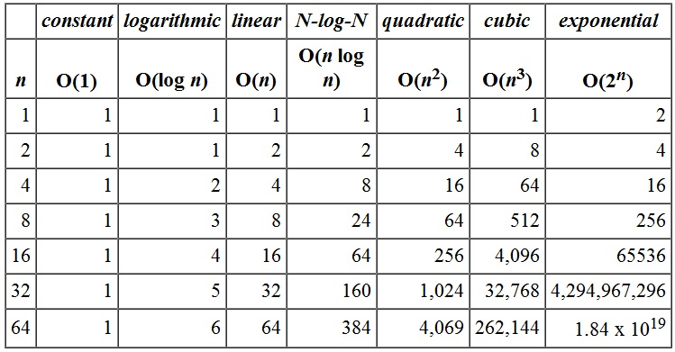
Rate of increase in algorithms

Slide 12
Analysis of sequential search algorithm
Sequentialsearch(list,value,N)
List the elements to be searched
Value – the value being searched for
N-the number of elements in the list
For i= 1 to N
if(Value=list[i])
return i
End if
End for
Return 0

Slide 13
Worst case analysis
Two worst cases
The value being searched matches the last element in the list
The value being searched is not present in the list
Since the elements are unique(assumption) in both cases N comparisons would be made

Slide 14
Average Case analysis
Two cases
The first assumes that the search is always successful
The second assumes that the value being searched will sometimes not be found

Slide 15
If the value being searched is present in the list ,it can be present at any one of the N places
There is a probability of 1/N for each potential location
A(N)= (N+1)/2

Slide 16
Second case
There will be N comparisons

Slide 17
Algorithm | Efficiency
Linear Search | O(n)
Binary Search | O(log₂ n)
Bubble Sort | O(n²) –[wc] O(n²) [AC] O(n²) [BC]
Selection Sort | O(n²) –[wc] O(n²) [AC] O(n²) [BC]
Insertion Sort | O(n²) –[wc] O(n²) [AC] O(n-1)[BC]

