Slide 1
Unit – 3
DATA LINK LAYER
19/12/2019

Slide 2
OUTLINE
Introduction to Data-Link Layer
Error Detection and Correction
Introduction
checksum Multiple Access:
Random access – Aloha

Slide 3
Introduction to Data-Link Layer
Data can be corrupted
during transmission.
Some applications require that
errors be detected and corrected.

Slide 4
Types of Errors –single bit/multiple/burst
Redundancy
The central concept in detecting or correcting errors is redundancy. To be able to detect or correct errors, we need to send some extra bits with our data. These redundant bits are added by the sender and removed by the receiver. Their presence allows the receiver to detect or correct corrupted bits.
Detection Versus Correction
In error correction, we need to know the exact number of bits that are corrupted and, more importantly, their location in the message. The number of errors and the size of the message are important factors.

Slide 5
In a single-bit error, only 1 bit in the data unit has changed.

Slide 6
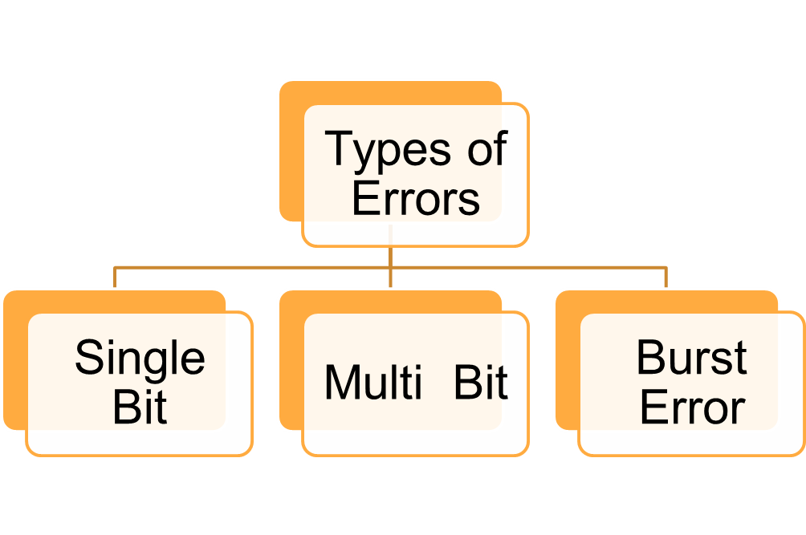

Slide 7

Single bit error

Slide 8

Burst error of length 8

Slide 9
Redundancy is achieved through various coding schemes.
a relationship between the redundant bits and the actual data bits.
Ratio between redundant bits to data bits
Coding schemes:
  Block coding (Imp)
  Convolution coding(not required)

Slide 10
BLOCK CODING
In block coding, we divide our message into blocks, each of k bits, called datawords.
We add r redundant bits to each block to make the length
n = k + r.
The resulting n-bit blocks are called codewords.

Slide 11

Block Coding :Error Detection
Process of error detection in block coding
To detect or correct errors, we need to send redundant bits

Slide 12
In block coding, we divide our message into blocks, each of k bits, called datawords. We add r redundant bits to each block to make the length n = k + r. The resulting n-bit blocks are called codewords.

Slide 13

A code for error detection
An error-detecting code can detect only the types of errors
for which it is designed; other types of errors may remain undetected

Slide 14
Hamming Distance
One of the central concepts in coding for error control is the idea of the Hamming distance.
The Hamming distance between two words (of the same size) is the number of differences between the corresponding bits.
The Hamming distance between two words x and y is given as as d(x, y).

Slide 15
For example, if the codeword 00000 is sent and 01101 is received, 3 bits are in error and the Hamming distance between the two is d(00000, 01101) = 3. In other words, if the Hamming distance between the sent and the received codeword is not zero, the codeword has been corrupted during transmission.
The Hamming distance can easily be found if we apply the XOR operation (⊕) on the two words and count the number of 1s in the result. Note that the Hamming distance is a value greater than or equal to zero.

Slide 16
Minimum Hamming Distance for Error Detection
In a set of codewords, the minimum Hamming distance is the smallest Hamming distance between all possible pairs of codewords.
To guarantee the detection of up to s errors in all cases, the minimum Hamming distance in a block code must be d_{min} = s+ 1

Slide 17
checksum
The last error detection method we discuss here is called the checksum, or arithmetic checksum.
The checksum is used in the Internet by several protocols although not at the data link layer.
Checksum is an error-detecting technique that can be applied to a message of any length.
In the Internet, the checksum technique is mostly used at the network and transport layer rather than the data-link layer.

Slide 18
At the source, the message is first divided into m-bit units.
The generator then creates an extra m-bit unit called the checksum, which is sent with the message.
At the destination, the checker creates a new checksum from the combination of the message and sent checksum.
If the new checksum is all 0s, the message is accepted; otherwise, the message is discarded.

Slide 19
Note that in the real implementation, the checksum unit is not necessarily added at the end of the message; it can be inserted in the middle of the message.

Slide 20
Concept
Suppose the message is a list of five 4-bit numbers that we want to send to a destination. In addition to sending these numbers, we send the sum of the numbers.
For example, if the set of numbers is (7, 11, 12, 0, 6), we send (7, 11, 12, 0, 6, 36), where 36 is the sum of the original numbers.
The receiver adds the five numbers and compares the result with the sum. If the two are the same, the receiver assumes no error, accepts the five numbers, and discards the sum.
Otherwise, there is an error somewhere and the message is not accepted.

Slide 21
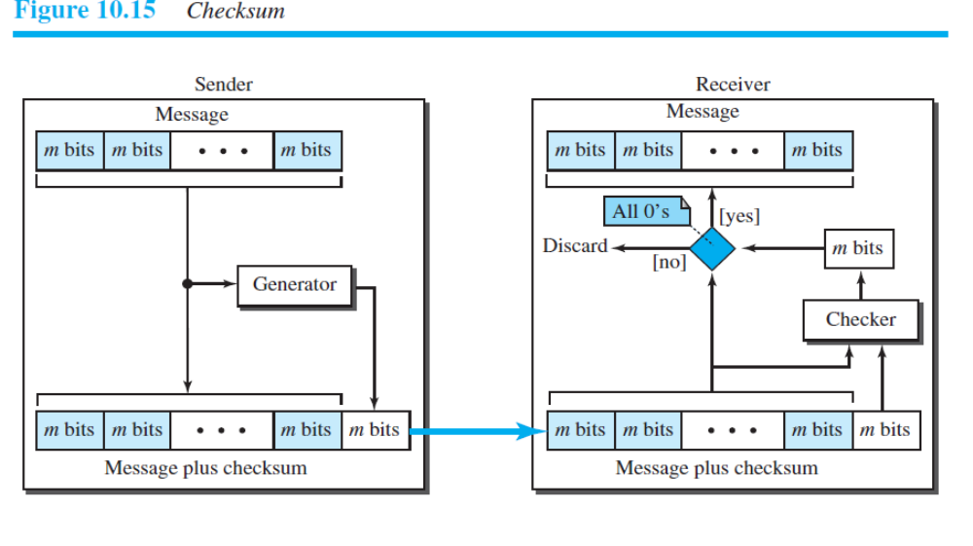

Slide 22
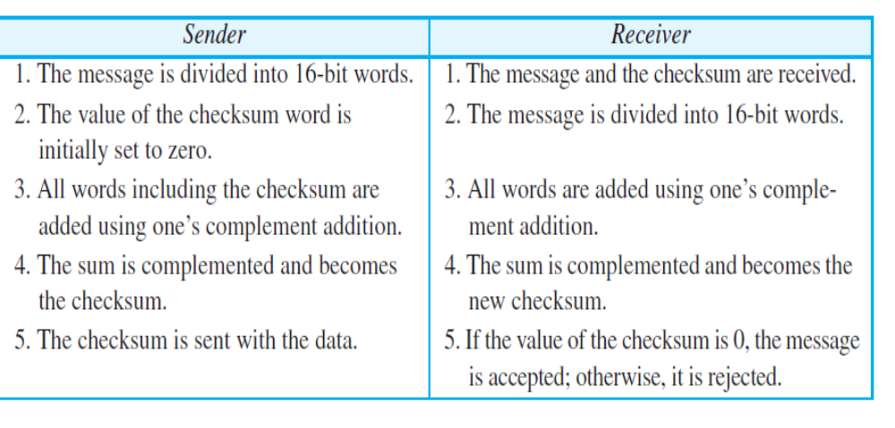
Internet checksum

Slide 23
Idea
One’s Complement
Internet Checksum

Slide 24
Data link layer divided into two functionality-oriented sublayers

Slide 25

Taxonomy of multiple-access protocols
*

Slide 26
RANDOM ACCESS
In random access or contention methods:
no station is superior to another station and none is assigned the control over another.
No station permits, or does not permit, another station to send.
At each instance, a station that has data to send uses a procedure defined by the protocol to make a decision on whether or not to send.
This decision depends on the state of the medium (idle or busy).

Slide 27
Two features
First, there is no scheduled time for a station to transmit. Transmission is random among the stations. That is why these
methods are called random access.
Second, no rules specify which station should send next. Stations compete with one another to access the medium.
That is why these methods are also called contention methods.
In a random-access method, each station has the right to the medium without being controlled by any other station.
However, if more than one station tries to send, there is
an access conflict—collision—and the frames will be either destroyed or modified.

Slide 28
How to avoid access conflict or to resolve it when it happens ?
Does station follows a procedure?
What?

Slide 29
When can the station access the medium?
What can the station do if the medium is busy?
How can the station determine the success or failure of the transmission?
What can the station do if there is an access conflict?

Slide 30
*
ALOHA
Carrier Sense Multiple Access
Carrier Sense Multiple Access with Collision Detection
Carrier Sense Multiple Access with Collision Avoidance

Slide 31
ALOHA
ALOHA, the earliest random access method, was developed at the University of Hawaii in early 1970.
It was designed for a radio (wireless) LAN, but it can be used on any shared medium.
It is obvious that there are potential collisions in this arrangement. The medium is shared between the stations.
When a station sends data, an other station may attempt to do so at the same time. The data from the two stations collide and become garbled
  Pure ALOHA
  Slotted ALOHA.

Slide 32
Pure ALOHA Network
The original ALOHA protocol is called pure ALOHA.
This is a simple but elegant protocol.
The idea is that each station sends a frame whenever it has a frame to send (multiple access).
However, since there is only one channel to share, there is the possibility of collision between frames from different stations.

Slide 33

Frames in a Pure ALOHA network

Slide 34
The pure ALOHA protocol relies on acknowledgments from the receiver.
When a station sends a frame, it expects the receiver to send an acknowledgment.
If the acknowledgment does not arrive after a time-out period, the station assumes that the frame (or the acknowledgment) has been destroyed and resends the frame.
A collision involves two or more stations. If all these stations try to resend their frames after the time-out, the frames will collide again.

Slide 35
Pure ALOHA dictates that when the time-out period passes, each station waits a random amount of time before resending its frame- backoff time TB.
Pure ALOHA has a second method to prevent congesting the channel with retransmitted frames. After a maximum number of retransmission attempts Kmax, a station must give up and try later.

Slide 36
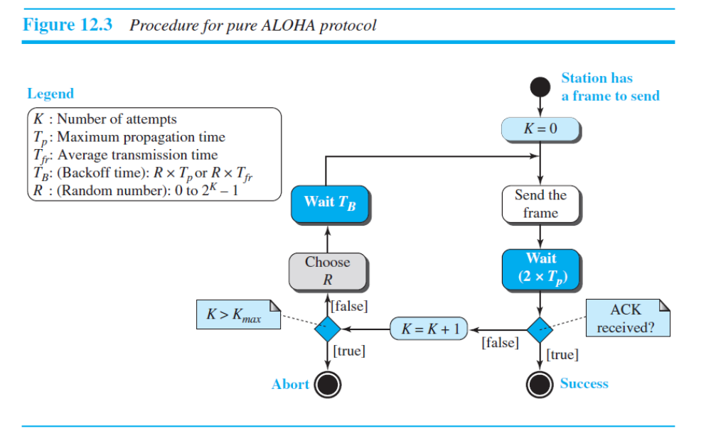

Slide 37
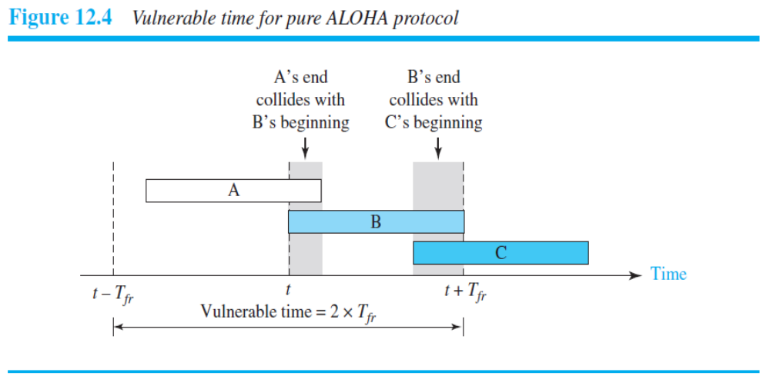
Vulnerable Time

Slide 38
Slotted ALOHA was invented to improve the efficiency of pure ALOHA.
In slotted ALOHA we divide the time into slots of T_{fr} seconds and force the station to send only at the beginning of the time slot
Because a station is allowed to send only at the beginning of the synchronized time slot, if a station misses this moment, it must wait until the beginning of the next time slot.
SLOTTED ALOHA

Slide 39
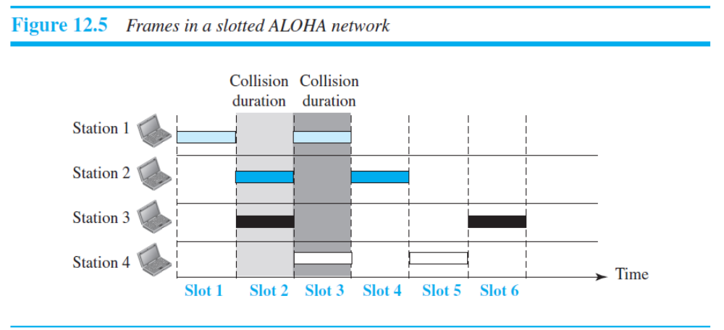

Slide 40
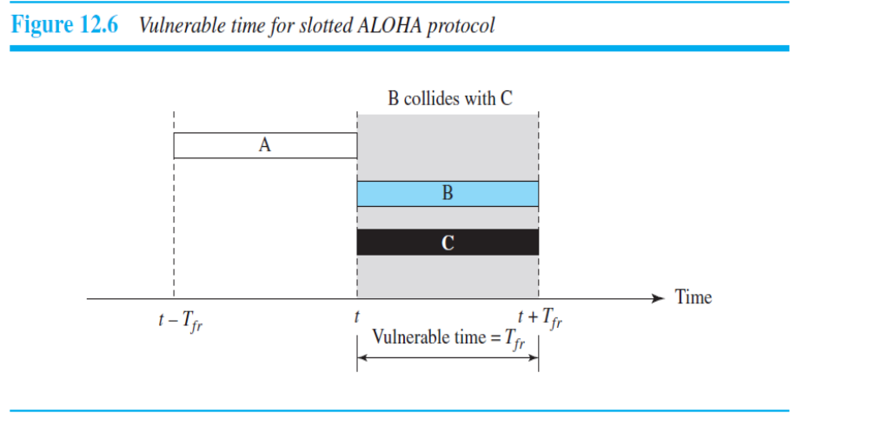
VULNERABLE TIME

Slide 41
CSMA
To minimize the chance of collision and, therefore, increase the performance, the CSMA method was developed.
The chance of collision can be reduced if a station senses the medium before trying to use it.
Carrier sense multiple access (CSMA) requires that each station first listen to the medium (or check the state of the medium) before sending.
In other words, CSMA is based on the principle “sense before transmit” or “listen before talk.

Slide 42
CSMA
CSMA can reduce the possibility of collision, but it cannot eliminate it.
The possibility of collision still exists because of propagation delay
when a station sends a frame, it still takes time (although very short) for the first bit to reach every station and for every station to sense it. In other words, a station may sense the medium and find it idle, only because the first bit sent by another station has not yet been received

Slide 43
What should a station do if the channel is busy?
What should a station do if the channel is idle?

Slide 44
Persistence Methods
the 1-persistent method,
the nonpersistent method, and
the p-persistent method.
The p-persistent method is used if the channel has time slots with a slot duration equal to or greater than the maximum propagation time.
The p-persistent approach combines the advantages of the other two strategies.
It reduces the chance of collision and improves efficiency.

Slide 45
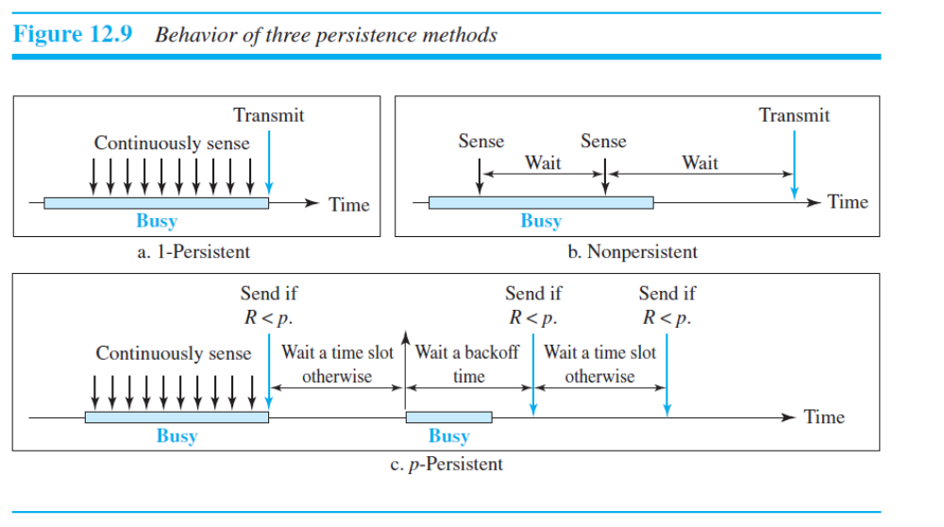

Slide 46


Slide 47

CSMA/CD

Slide 48
CSMA/CD
In this method, a station monitors the medium after it sends a frame to see if the transmission was successful. If so, the station is finished.
If, however, there is a collision, the frame is sent again.

Slide 49

Collision and abortion in CSMA/CD

Slide 50

Flow diagram for the CSMA/CD

Slide 51
OBSERVATIONS
The first difference is the addition of the persistence process
We need to sense the channel before we start sending the frame by using one of the persistence processes we discussed previously (nonpersistent, 1-persistent, or p-persistent).
The second difference is the frame transmission. In ALOHA, we first transmit the entire frame and then wait for an acknowledgment. In CSMA/CD, transmission and collision detection are continuous processes.

Slide 52
We do not send the entire frame and then look for a collision. The station transmits and receives continuously and simultaneously.
The third difference is the sending of a short jamming signal to make sure that all other stations become aware of the collision.

Slide 53
In CSMA/CA, the IFS can also be used to define the priority of a station or a frame.
Carrier sense multiple access with collision avoidance (CSMA/CA) was invented for wireless networks.
Collisions are avoided through the use of CSMA/CA’s three
strategies:
the interframe space,
the contention window, and
acknowledgments,
The contention window is an amount of time divided into slots. A station that is ready to send chooses a random number of slots as its wait time.

Slide 54


Slide 55
Flow diagram for CSMA/CA
Channel idle? Don’t transmit yet!
Wait Inter Frame Space (IFS) time.
Still idle after IFS? Don’t transmit yet!
Now in Contention Window. Choose random number and wait that
_{many slots.}
Did you wait R slots and all slots were
available? Go ahead, transmit.
Now, wait time-out for a response.

Slide 56
Controlled Access

Slide 57
In controlled access, the stations consult one another to find which station has the right to send. A station cannot send unless it has been authorized by other stations.
Reservation
Polling
Token Passing

Slide 58
Reservation
A station needs to make a reservation before sending data. Time is divided into intervals.
In each interval, a reservation frame precedes the data frames sent in that interval
If there are N stations in the system, there are exactly N reservation mini slots in the reservation frame.
Each mini slot belongs to a station. When a station needs to send a data frame, it makes a reservation in its own mini slot. The stations that have made reservations can send their data frames after the reservation frame.

Slide 59

Reservation access method

Slide 60
Polling
Polling works with topologies in which one device is designated as a primary station and the other devices are secondary stations .
All data exchanges must be made through the primary device even when the ultimate destination is a secondary device.
The primary device controls the link; the secondary devices follow its instructions.
It is up to the primary device to determine which device is allowed to use the channel at a given time. The primary device, therefore, is always the initiator of a session
This method uses poll and select functions to prevent collisions.
However, the drawback is if the primary station fails, the system goes down.

Slide 61
Select
The select function is used whenever the primary device has something to send. If it has something to send, the primary device sends it.
What it does not know, however, is whether the target device is prepared to receive. So the primary must alert the secondary to the upcoming transmission and wait for an acknowledgment of the secondary’s ready status.
Before sending data, the primary creates and transmits a select (SEL) frame, one field of which includes the address of the intended secondary.

Slide 62


Slide 63
TOKEN PASSING
In this method, a special packet called a token circulates through the ring. The possession of the token gives the station the right to access the channel and send its data.

Slide 64
In the token-passing method, the stations in a network are organized in a logical ring.
In other words, for each station, there is a predecessor and a successor . The predecessor is the station which is logically before the station in the ring; the successor is the station which is after the station in the ring.
The current station is the one that is accessing the channel now. The right to this access has been passed from the predecessor to the current station.
The right will be passed to the successor when the current station has no more data to send.

Slide 65
CHANNELIZATION

Slide 66
Channelization is a multiple-access method in which the available bandwidth of a link is shared in time, frequency, or through code, between different stations.
Frequency-Division Multiple Access (FDMA)
Time-Division Multiple Access (TDMA)
Code-Division Multiple Access (CDMA)

Slide 67
In frequency-division multiple access (FDMA), the available bandwidth is divided into frequency bands. Each station is allocated a band to send its data.
In other words, each band is reserved for a specific station, and it belongs to the station all the time.
Each station also uses a bandpass filter to confine the transmitter frequencies. To prevent station interferences, the allocated bands are separated from one another by small guard bands.

Slide 68

Frequency-division multiple access (FDMA)

Slide 69
In FDMA, the available bandwidth of the common channel is divided into bands that are separated by guard bands.

Slide 70
TDMA
In time-division multiple access (TDMA), the stations share the bandwidth of the channel in time.
Each station is allocated a time slot during which it can send data. Each station transmits its data in its assigned time slot.
The main problem with TDMA lies in achieving synchronization between the different stations.
Each station needs to know the beginning of its slot and the location of its slot. This may be difficult because of propagation delays introduced in the system if the stations are spread over a large area.
To compensate for the delays, we can insert guard times. Synchronization is normally accomplished by having some synchronization bits (normally referred to as preamble bits) at the beginning of each slot.

Slide 71

TDMA

Slide 72
In TDMA, the bandwidth is just one channel that is timeshared between different stations.
The main problem with TDMA lies in achieving synchronization between the different stations.

Slide 73
CDMA
Code-division multiple access (CDMA) was conceived several decades ago. Recent advances in electronic technology have finally made its implementation possible.
CDMA differs from FDMA in that only one channel occupies the entire bandwidth of the link.
It differs from TDMA in that all stations can send data simultaneously; there is no timesharing.
In CDMA, one channel carries all transmissions simultaneously.

Slide 74

Simple idea of communication with code
Analogy -Example

Slide 75
If we multiply each code by another, we get 0.
If we multiply each code by itself, we get 4 (the number of stations).
CDMA is based on coding theory. Each station is assigned a code, which is a sequence of numbers called chips.
Rules/Walsh Tables-Walsh table, which is a two-dimensional table with an equal number of rows and columns,
orthogonal sequences

Slide 76
Wireless LANs

Slide 77
IEEE 802.11 PROJECT -Introduction
Wireless communication is one of the fastest-growing technologies. The demand for connecting devices without the use of cables is increasing everywhere.
Wireless LANs can be found on college campuses, in office buildings, and in many public areas.

Slide 78
Architectural Comparison
Let us first compare the architecture of wired and wireless LANs to give some idea of what we need to look for when we study wireless LANs.
Medium
The first difference we can see between a wired and a wireless LAN is the medium. In a wired LAN, we use wires to connect hosts.
In a wireless LAN, the medium is air, the signal is generally broadcast.

Slide 79
Hosts
In a wired LAN, a host is always connected to its network at a point with a fixed link-layer address related to its network interface card (NIC).
In a wireless LAN, a host is not physically connected to the network; it can move freely and can use the services provided by the network.
Isolated LANs
A wired isolated LAN is a set of hosts connected via a link-layer switch.
A wireless isolated LAN, called an ad hoc network in wireless LAN terminology, is a set of hosts that communicate freely with each other.

Slide 80
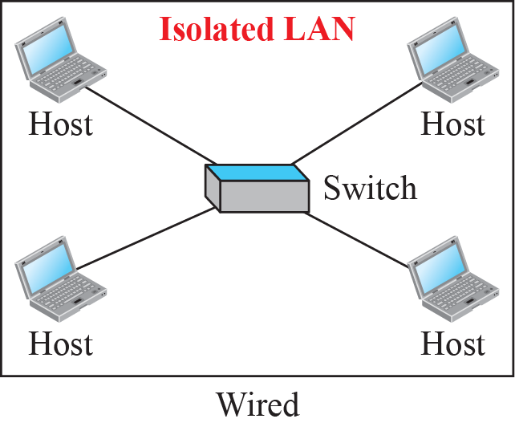
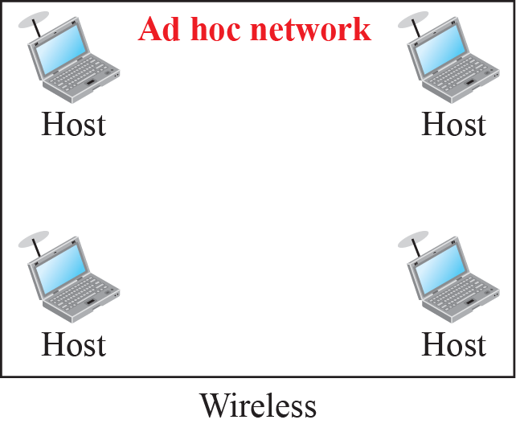
Isolated LANs: wired versus wireless

Slide 81
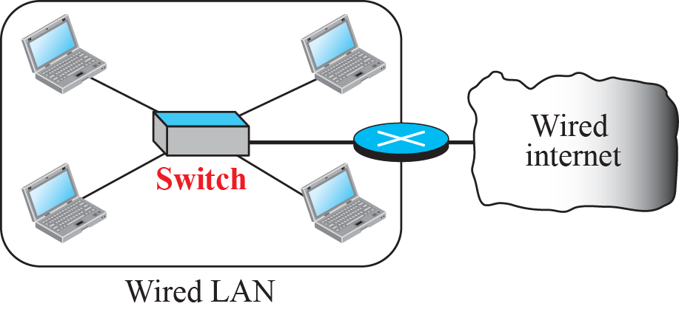
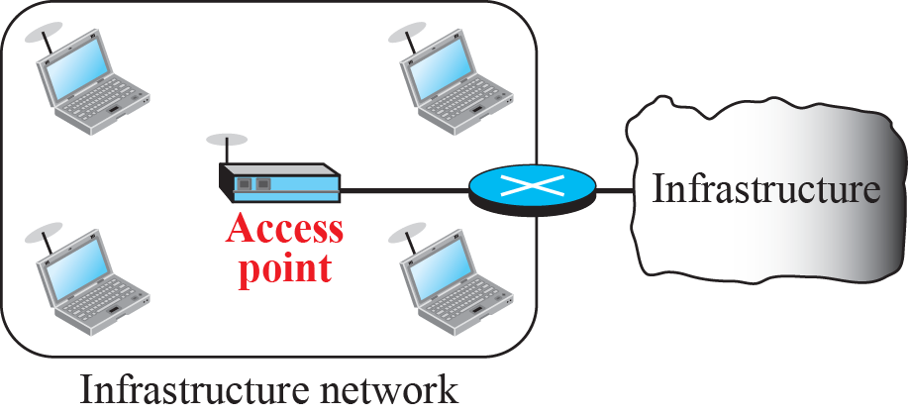
Connection of a wired LAN and a wireless LAN to other
networks

Slide 82
Characteristics
There are several characteristics of wireless LANs that either do not apply to wired LANs or the existence of which is negligible and can be ignored.
Attenuation
The strength of electromagnetic signals decreases rapidly because the signal disperses in all directions; only a small portion of it reaches the receiver.
Interference
Another issue is that a receiver may receive signals not only from the intended sender, but also from other senders if they are using the same frequency band.

Slide 83
Multipath Propagation
A receiver may receive more than one signal from the same sender because electromagnetic waves can be reflected back from obstacles such as walls, the ground, or objects.
The result is that the receiver receives some signals at different phases (because they travel different paths). This makes the signal less recognizable.
Error
If SNR is high, it means that the signal is stronger than the noise (unwanted signal), so we may be able to convert the signal to actual data.
On the other hand, when SNR is low, it means that the signal is corrupted by the noise and the data cannot be recovered.

Slide 84
Maybe the most important issue we need to discuss in a wireless LAN is access control—how a wireless host can get access to the shared medium (air). The CSMA/CD algorithm does not work in wireless LANs for three reasons:
Wireless hosts do not have enough power to send and receive at the same time.
The hidden station problem prevents collision detection
The distance between stations can be great.

Slide 85
IEEE 802.11 PROJECT
IEEE has defined the specifications for a wireless LAN, called IEEE 802.11, which covers the physical and data-link layers.
It is sometimes called wireless Ethernet. In some countries, including the United States, the public uses the term WiFi (short for wireless fidelity) as a synonym for wireless LAN.
WiFi, however, is a wireless LAN that is certified by the WiFi Alliance.

Slide 86
A BSS without an AP is called an ad hoc network;
a BSS with an AP is called an infrastructure network.

Slide 87
IEEE has defined the specifications for a wireless LAN, called IEEE 802.11, which covers the physical and data link layers.
Architecture
MAC Sublayer
Physical Layer

Slide 88
Architecture
The standard defines two kinds of services:
the basic service set (BSS) and
the extended service set (ESS)
IEEE 802.11 defines the basic service set (BSS) as the building blocks of a wireless LAN.
A basic service set is made of stationary or mobile wireless stations and an optional central base station, known as the access point (AP).

Slide 89
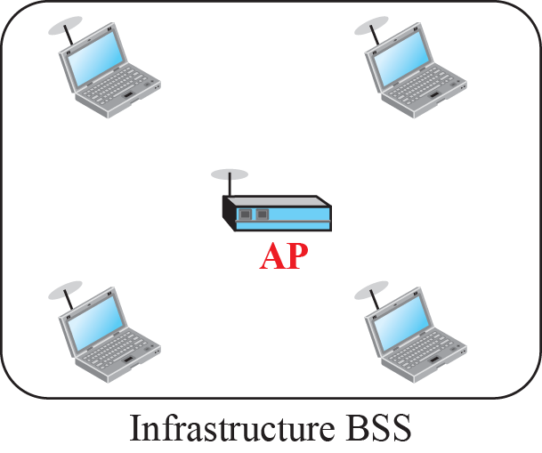
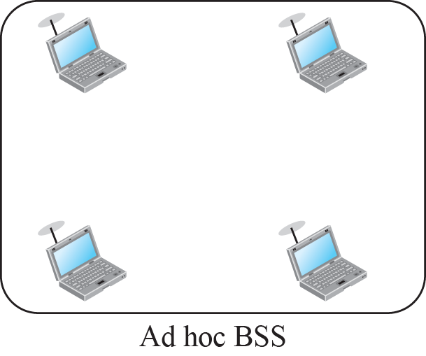
Basic service sets (BSSs)

Slide 90
Extended service set (ESS)
An extended service set (ESS) is made up of two or more BSSs with APs.
When BSSs are connected, the stations within reach of one another can communicate without the use of an AP.
However, communication between a station in a BSS and the
outside BSS occurs via the AP.
The distribution system connects the APs in the BSSs.

Slide 91
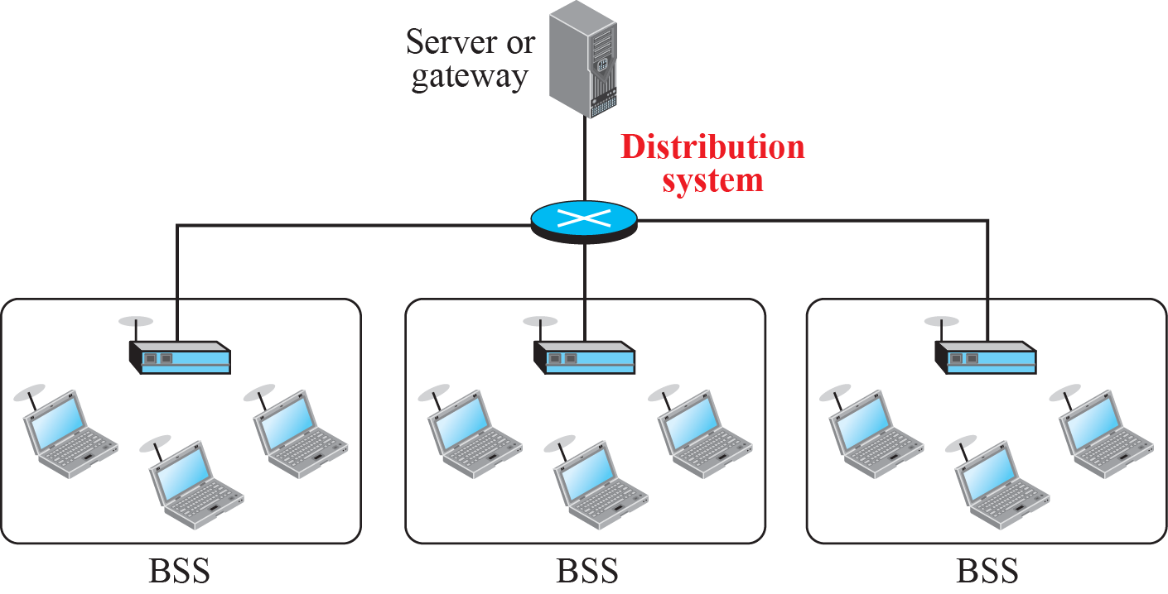
Extended service set (ESS)

Slide 92
Extended service set uses two types of stations:
mobile and
stationary.
The mobile stations are normal stations inside a BSS
The stationary stations are AP stations that are part of a wired LAN
Case Study
The idea is similar to communication in a cellular network

Slide 93
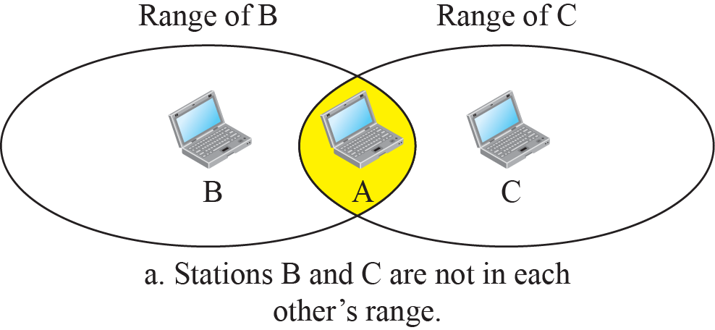
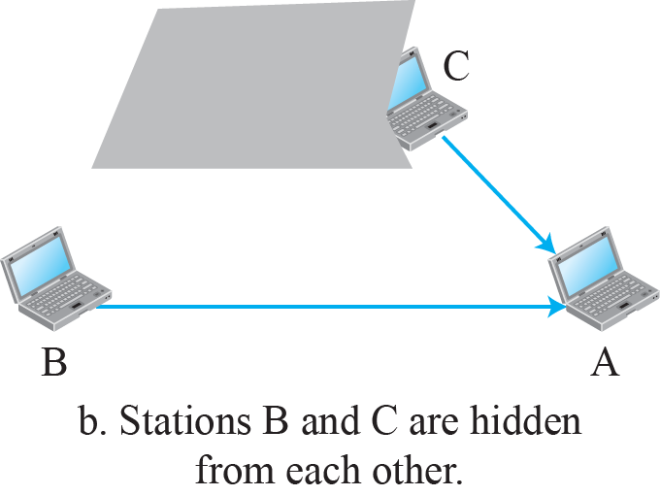
15.<number>

Slide 94
In wireless networking, the hidden node problem or hidden terminal problem occurs when a node can communicate with a wireless access point (AP), but cannot directly communicate with other nodes that are communicating with that AP. This leads to difficulties in medium access control sublayer since multiple nodes can send data packets to the AP simultaneously, which creates interference at the AP resulting in neither packet getting through.

Slide 95
MAC Sublayer
IEEE 802.11 defines two MAC sublayers:
the distributed coordination function (DCF) and
point coordination function (PCF).
DCF uses CSMA/CA as the access method
Point Coordination Function (PCF) is an optional access method that can be implemented in an infrastructure network (not in an ad hoc network).

Slide 96
MAC Sublayer -PCF
It is implemented on top of the DCF and is used mostly for time-sensitive transmission.
PCF has a centralized, contention-free polling access method.
The AP performs polling for stations that are capable of being polled. The stations are polled one after another, sending any data they have to the AP.
To give priority to PCF over DCF, another interframe space, PIFS, has been defined. PIFS (PCF IFS) is shorter than DIFS. This means that if, at the same time, a station wants to use only DCF and an AP wants to use PCF, the AP has priority.

Slide 97
Contention-Free Service with the PCF To support applications that require near real-time service, the 802.11 standard includes a second coordination function to provide a different way of accessing the wireless medium.
A contended service is a service which offers the users of the network a minimum statistically guaranteed contention ratio, while typically offering peaks of usage of up to the maximum bandwidth supplied to the user.

Slide 98
MAC Sublayer -PCF
Due to the priority of PCF over DCF, stations that only use DCF may not gain access to the medium. To prevent this, a repetition interval has been designed to cover both contention-free PCF and contention-based DCF traffic. The repetition interval, which is repeated continuously, starts with a special control frame, called a beacon frame.
When the stations hear the beacon frame, they start their NAV for the duration of the contention-free period of the repetition interval.
When the stations hear the beacon frame, they start their NAV for the duration of the contention-free period of the repetition interval.

Slide 99
At the end of the contention-free period, the PC sends a CF end
(contention-free end) frame to allow the contention-based stations to use the medium.

Slide 100
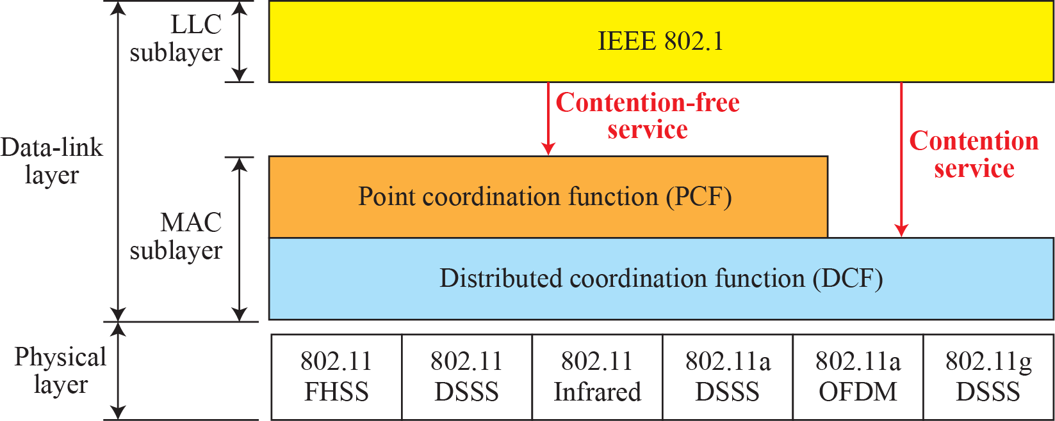
MAC layers in IEEE 802.11 standard
FHSS - frequency hopping spread spectrum
DSSS - direct sequence spread spectrum
OFDM - orthogonal frequency division multiplexing

Slide 101
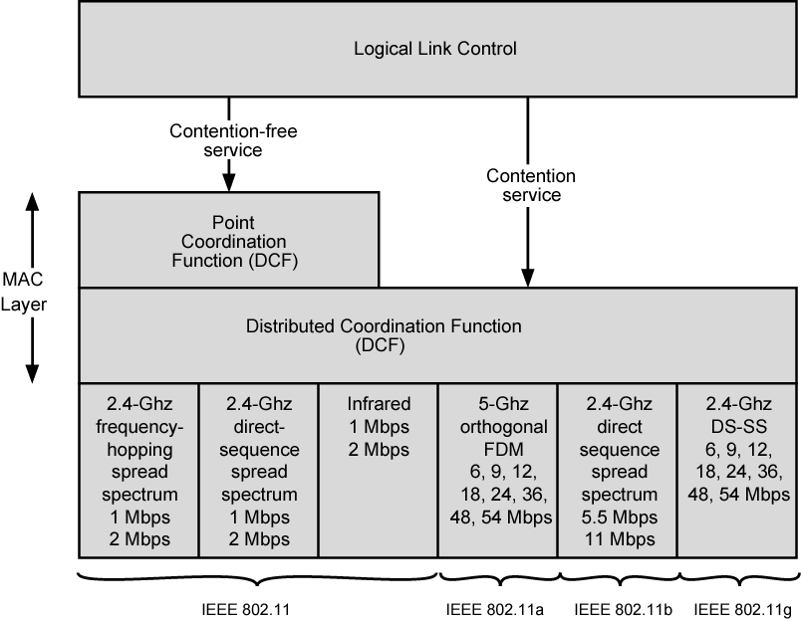
IEEE 802.11 Protocol Architecture [FOR REFERENCE ] FROM WILLIAM STALLINGS

Slide 102
Fragmentation
A corrupt frame has to be retransmitted.
It is more efficient.
Frame types
Management Frames – for initial communication between stations and AP
Control frames are used for accessing the channel and acknowledging frames.
Data frames are used for carrying data and control information.

Slide 103
Acknowledgment is needed in this protocol because the station does not have any means to check for the successful arrival of its data at the destination.
On the other hand, the lack of collision in CSMA/CD is a kind of indication to the source that data have arrived. (Collision During Handshaking)
Hidden-Station Problem solution: Handshaking(RTS AND CTS)
How do other stations defer sending their data if one station acquires access?
A) Network allocation vector (NAV)

Slide 104
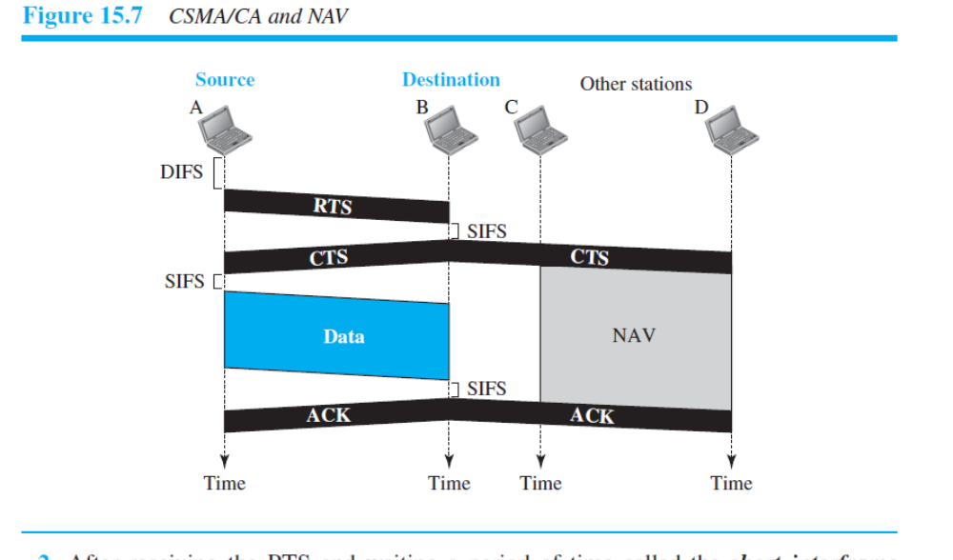

Slide 105
Addressing Mechanism
The IEEE 802.11 addressing mechanism specifies four cases, defined by the value of the two flags in the Frame Control(FC) field, To DS and From DS.
Each flag can be either 0 or 1, resulting in four different situations.
The interpretation of the four addresses (address 1 to address 4) in the MAC frame depends on the value of these flags, as shown in Table 15.3.

Slide 106
Address 1 is always the address of the next device that the frame will visit.
Address 2 is always the address of the previous device that the frame has left.
Address 3 is the address of the final destination station if it is not defined by address 1 or the original source station if it is not defined by address 2.
Address 4 is the original source when the distribution system is also wireless.

Slide 107
Bluetooth is a wireless LAN technology designed to connect devices of different functions such as telephones, notebooks, computers, cameras, printers, coffee makers, and so on. A Bluetooth LAN is an ad hoc network, which means that the network is formed spontaneously.
Architecture
Bluetooth Layers
Baseband Layer
L2CAP

Slide 108
Bluetooth defines two types of networks: piconet and scatternet
Piconets
A Bluetooth network is called a piconet, or a small net. A piconet can have up to eight stations, one of which is called the primary; the rest are called secondaries.
All the secondary stations synchronize their clocks and hopping sequence with the primary.
Note that a piconet can have only one primary station. The communication between the primary and secondary stations can be one- to-one or one-to-many.

Slide 109
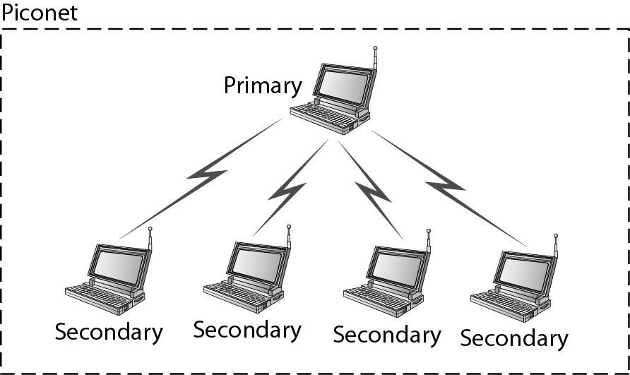
Bluetooth :Two types of networks

Slide 110
Piconets can be combined to form what is called a scatternet. A secondary station in one piconet can be the primary in another piconet.
This station can receive messages from the primary in the first piconet (as a secondary) and, acting as a primary, deliver them to secondaries in the second piconet.
A station can be a member of two piconets.

Slide 111
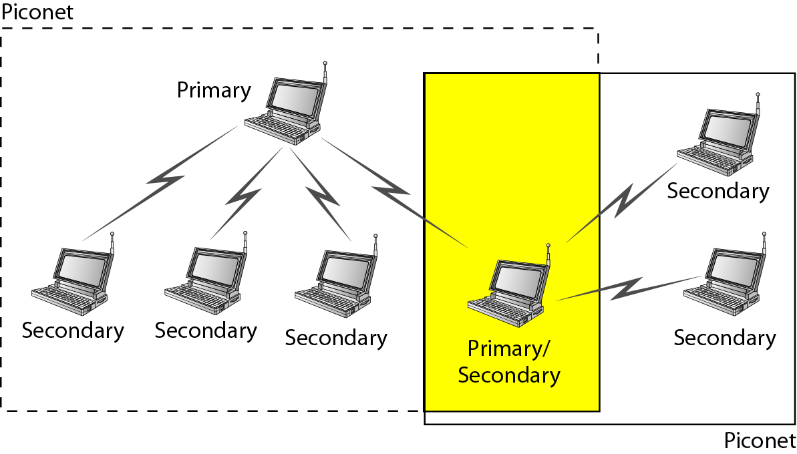
SCATTERNET

Slide 112
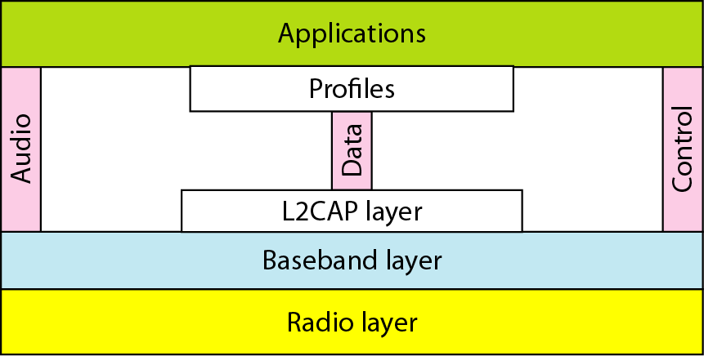
Bluetooth layers

