Slide 1
Unit – 4
NETWORK LAYER
02/02/2020

Slide 2
What is internet model match with Bluetooth layers
20.<number>

Slide 3
INTERNETWORKING
Connecting networks together to make an internetwork or an internet.
Topics discussed in this section:
Need for Network Layer
Internet as a Datagram Network
Internet as a Connectionless Network

Slide 4
Packetizing
-The first duty of the network layer is definitely packetizing: encapsulating the payload (data received from upper layer) in a network-layer packet at the source and decapsulating the payload from the network-layer packet at the destination. In other words, one duty of the network layer is to carry a payload from the source to the destination without changing it or using it.
Routing and Forwarding
-is responsible for finding the best one among these possible routes(How ? routing protocols)
-The decision-making table a router normally uses for applying this action is sometimes called the forwarding table and sometimes the routing table.
20.<number>

Slide 5
When a router receives a packet from one of its attached networks, it needs to forward the packet to another attached network (in
unicast routing) or to some attached networks (in multicast routing).
To make this decision, the router uses a piece of information in the packet header-destination address or a label.
Other Services
Error Control
Flow Control
Congestion Control
Quality of Service
20.<number>

Slide 6
Although error control also can be implemented in the network layer, the designers of the network layer in the Internet ignored this issue for the data being carried by the network layer. One reason
for this decision is the fact that the packet in the network layer may be fragmented at each router, which makes error checking at this layer inefficient.
We need to mention that although the network layer in the Internet does not directly provide error control, the Internet uses an auxiliary protocol, ICMP, that provides some kind of error control if the datagram is discarded or has some unknown information in the header.
20.<number>
Notes:
Internet Control Message Protocol

Slide 7
Flow control regulates the amount of data a source can send without overwhelming the receiver.
Congestion Control
Congestion in the network layer is a situation in which too many datagrams are present in an area of the Internet.
Datagrams sent by source computers is beyond the capacity of the network or routers.
(For Reference) Datagrams are the IP packets that provide a quick and unreliable service like UDP, and all IP packets are datagrams; however, at the TCP layer, what is termed a TCP segment is the sometimes necessary IP fragmentation of a datagram, but those are referred to as packets.
20.<number>

Slide 8

Figure 20.1 Links between two hosts
20.<number>

Slide 9

Figure 20.2 Network layer in an internetwork
20.<number>

Slide 10

Figure 20.3 Network layer at the source, router, and destination
20.<number>

Slide 11

Figure 20.3 Network layer at the source, router, and destination (continued)

Slide 12
Switching at the network layer in the Internet uses the datagram approach to packet switching.
Datagram packet-switching is a packet switching technology by which each packet, now called a datagram,
Notes:
Datagram approach - A datagram is a basic transfer unit associated with a packet-switched network.

Slide 13

Note
Communication at the network layer in the Internet is connectionless.

Slide 14
Datagram Approach: Connectionless Service
Virtual-Circuit Approach: Connection-Oriented Service
In a connection-oriented service (also called virtual-circuit approach), there is a relationship
20.<number>

Slide 15
Class Activity :MAC Address and IP Address. Why do we need both?
20.<number>

Slide 16
MAC Address is used to ensure the physical address of computer
It uniquely identifies the devices on a network.
IP address are used to uniquely identifies the connection of network with that device take part in a network.
The header of each IP packet contains the IP address of the sending host, and that of the destination host
20.<number>

Slide 17
IPv4 ADDRESSES
An IPv4 address is a 32-bit address that uniquely and universally defines the connection of a device (for example, a computer or a router) to the Internet.
Topics discussed in this section:
Address Space
Notations
Classful Addressing
Classless Addressing
Network Address Translation (NAT)
19.<number>

Slide 18
IPV4 ADDRESSES
The identifier used in the IP layer of the TCP/IP protocol suite to identify the connection of each device to the Internet is called the Internet address or IP address.
An IPv4 address is a 32-bit address that uniquely and universally defines the connection of a host or a router to the Internet.
The IP address is the address of the connection, not the
host or the router, because if the device is moved to another network, the IP address may be changed.
20.<number>

Slide 19
'IP' stands for 'Internet Protocol'. There are two versions of IP that currently coexist in the global Internet: IP version 4 (IPv4) and IP version 6 (IPv6). IP addresses are made up of binary values and drive the routing of all data over the Internet.
IPv4 addresses are unique and universal in the sense that each address defines one, and only one, connection to the Internet.
IPv4 addresses are 32 bits long, and IPv6 addresses 128 bits long.
A protocol like IPv4 that defines addresses has an address space.
20.<number>

Slide 20
Address Space
An address space is the total number of addresses used by the protocol.
If a protocol uses b bits to define an address, the address space is 2^{b} because each bit can have two different values (0 or 1).
IPv4 uses 32-bit addresses, which means that the address space is 2³² or 4,294,967,296 (more than four billion).
20.<number>

Slide 21
Imagine ?
If there were no restrictions, more than 4 billion devices could be connected to the Internet.
20.<number>

Slide 22
Notation
There are three common notations to show an IPv4 address:
binary notation (base 2),
dotted-decimal notation (base 256), and
hexadecimal notation (base 16).
To make the address more readable, one or more spaces are usually inserted between each octet (8 bits). Each octet is often referred to as a byte.
To make the IPv4 address more compact and easier to read, it is usually written in decimal form with a decimal point (dot) separating the bytes.
20.<number>

Slide 23
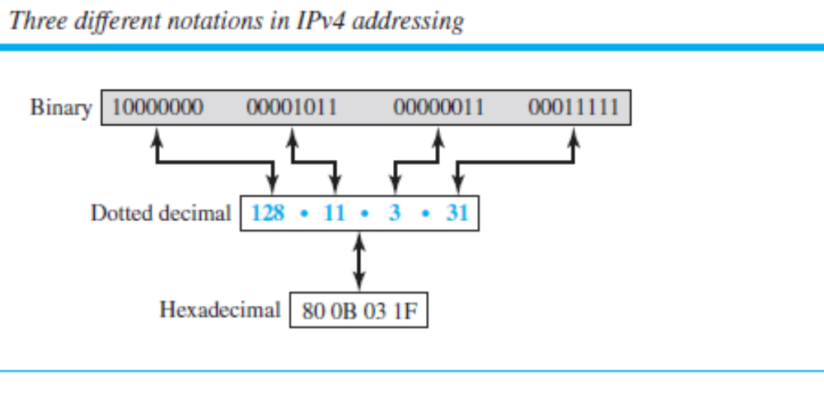
This format is referred to as dotted-decimal notation. Note that because each byte (octet) is only 8 bits, each number in the dotted-decimal notation is between 0 and 255.
20.<number>

Slide 24

Identify the formats
20.<number>
Notes:
Dotted-decimal notation and binary notation for an IPv4 address

Slide 25

Practice Problems
Change the following IPv4 addresses from binary notation to dotted-decimal notation.
20.<number>

Slide 26

Solution
We replace each group of 8 bits with its equivalent decimal number (see Appendix B) and add dots for separation.
20.<number>

Slide 27
Hierarchy in Addressing
A 32-bit IPv4 address is also hierarchical, but divided only into two parts.
The first part of the address, called the prefix , defines the network; the second part of the address, called the suffix, defines the node (connection of a device to the Internet)
Ex: Postal address ( reference)
20.<number>

Slide 28
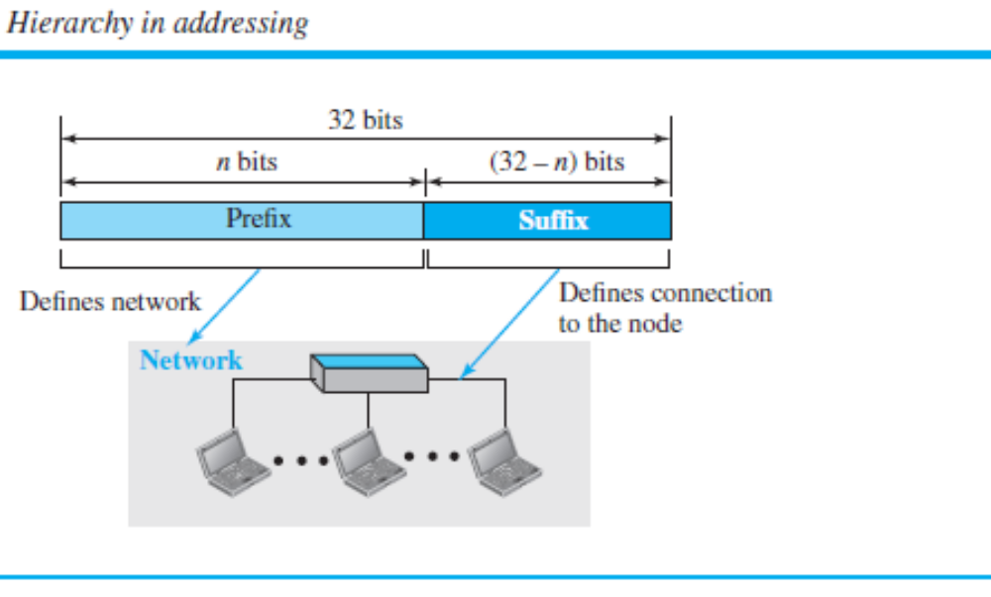
20.<number>

Slide 29
Classful addressing and classless addressing
A prefix can be fixed length or variable length. The network identifier in the IPv4 was first designed as a fixed-length prefix. This scheme, which is now obsolete, is referred to as classful addressing.
The new scheme, which is referred to as classless addressing, uses a variable-length network prefix.
20.<number>

Slide 30
In classful addressing, the address space is divided into five classes:
A, B, C, D, and E.
In class A, the network length is 8 bits, but since the first bit, which is 0, defines the class, we can have only seven bits as the network identifier. This means there are only 2⁷ = 128 networks in the world that can have a class A address.
In class B, the network length is 16 bits, but since the first two bits, which are (10)₂, define the class, we can have only 14 bits as the network identifier. This means there are only 2¹⁴ = 16,384 networks in the world that can have a class B address.
20.<number>

Slide 31
All addresses that start with (110)₂ belong to class C. In class C, the network length is 24 bits, but since three bits define the class, we can have only 21 bits as the network identifier. This means there are 2²¹ = 2,097,152 networks in the world that can have a class C address.
Class D is not divided into prefix and suffix. It is used for multicast addresses.
All addresses that start with 1111 in binary belong to class E. As in Class D, Class E is not divided into prefix and suffix and is used as reserve.
20.<number>

Slide 32

Finding the classes in binary and dotted-decimal notation
20.<number>

Slide 33



Number of blocks and block size and Applications of classful IPv4 addressing
MULTICAST
UNICAST
20.<number>

Slide 34
In classful addressing, a large part of the available addresses were wasted
Classful addressing, which is almost obsolete (Why?), is replaced with Classless addressing.
Address Depletion
20.<number>

Slide 35
Address Depletion(Example)
class can be assigned to only 128 organizations in the world, but each organization needs to have a single network (seen by the rest of the
world) with 16,777,216 nodes (computers in this single network). Since there may be only a few organizations that are this large, most of the addresses in this class were wasted (unused).
Class B addresses were designed for midsize organizations, but many
of the addresses in this class also remained unused.
Class C addresses have a completely different flaw in design. The number of addresses that can be used in each network (256)
was so small that most companies were not comfortable using a block in this address class.
Class E addresses were almost never used, wasting the whole class
20.<number>

Slide 36

A block of 16 addresses granted to a small organization
20.<number>

Slide 37

Figure 20.4 Position of IPv4 in TCP/IP protocol suite
20.<number>

Slide 38

Figure 20.5 IPv4 datagram format
Notes:
Ver- version IPV4/

Slide 39
The first address in a block is
normally not assigned to any device;
it is used as the network address that represents the organization
to the rest of the world.
20.<number>

Slide 40
Subnetting and Supernetting
To alleviate address depletion, two strategies were proposed and, to some extent, implemented: subnetting and supernetting.
In subnetting, a class A or class B block is divided into several subnets. Each subnet has a larger prefix length than the original
network. For example, if a network in class A is divided into four subnets, each subnet has a prefix of nsub = 10.
subnetting was devised to divide a large block into smaller ones, supernetting was devised to combine several class C blocks into a larger block to be attractive to organizations
20.<number>

Slide 41

Two levels of hierarchy in an IPv4 address
20.<number>
Notes:
EX:Telephone

Slide 42

Configuration and addresses in a subnetted network
20.<number>

Slide 43

Three-level hierarchy in an IPv4 address
20.<number>

Slide 44
Classless Addressing
In classless addressing, the whole address space is divided into variable length blocks. The prefix in an address defines the block (network); the suffix defines the node (device). Theoretically, we can have a block of 20, 21, 22, . . . , 232 addresses.
One of the restrictions, as we discuss later, is that the number of addresses in a block needs to be a power of 2.
An organization can be granted one block of addresses.
20.<number>

Slide 45
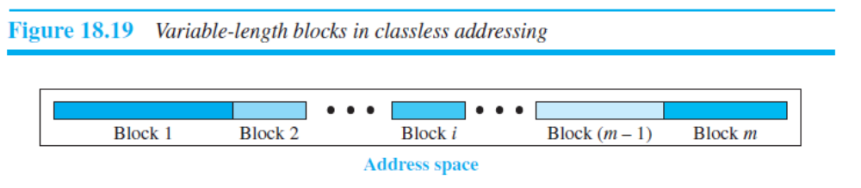
The division of the whole address space into nonoverlapping blocks
Unlike classful addressing, the prefix length in classless addressing is variable.
In other words, classful addressing is a special case of classless addressing.
20.<number>

Slide 46
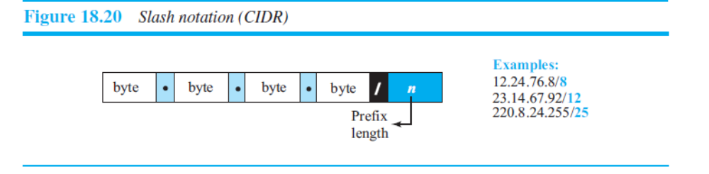
Prefix Length: Slash Notation
The notation is informally referred to as slash notation and formally as classless interdomain routing or CIDR (pronounced cider) strategy.
20.<number>

Slide 47

NAT-Network Address Translation (NAT)
A technology that can provide the mapping between the private and universal addresses, and at the same time support virtual private networks.
20.<number>

Slide 48
IPv6 ADDRESSES
Despite all short-term solutions, address depletion is still a long-term problem for the Internet. This and other problems in the IP protocol itself have been the motivation for IPv6.
Topics discussed in this section:
Structure
Address Space
20.<number>

Slide 49
IPv6 ADDRESSING
Address depletion of IPv4 and other shortcomings of this protocol prompted a new version of IP in the early 1990s.
The new version, which is called Internet Protocol version 6 (IPv6) or IP new generation (IPng) was a proposal to augment the address space of IPv4 and at the same time redesign the format of the IP packet and revise some auxiliary protocols such as ICMP.
20.<number>

Slide 50

IPv6 uses hierarchical addressing. For this reason, IPv6 allows slash or CIDR notation.
Address Space :
The address space of IPv6 contains 2128 addresses. This address space is 296 times the IPv4 address—definitely no address depletion
Three Address Types In IPv6, a destination address can belong to one of three categories:
unicast,
anycast,
and multicast.
20.<number>

Slide 51
IPv4 | IPv6
IPv4 addresses are 32 bit length. | IPv6 addresses are 128 bit length.
IPv4 addresses are binary numbers represented in decimals. | IPv6 addresses are binary numbers represented in hexadecimals.
IPSec support is only optional. | Inbuilt IPSec support.
Fragmentation is done by sender and forwarding routers. | Fragmentation is done only by sender.
No packet flow identification. | Packet flow identification is available within the IPv6 header using the Flow Label field.
Checksum field is available in IPv4 header | No checksum field in IPv6 header.
Options fields are available in IPv4 header. | No option fields, but IPv6 Extension headers are available.
Address Resolution Protocol (ARP) is available to map IPv4 addresses to MAC addresses. | Address Resolution Protocol (ARP) is replaced with a function of Neighbor Discovery Protocol (NDP).
Internet Group Management Protocol (IGMP) is used to manage multicast group membership. | IGMP is replaced with Multicast Listener Discovery (MLD) messages.
Broadcast messages are available. | Broadcast messages are not available. Instead a link-local scope "All nodes" multicast IPv6 address (FF02::1) is used for broadcast similar functionality.
Manual configuration (Static) of IPv4 addresses or DHCP (Dynamic configuration) is required to configure IPv4 addresses. | Auto-configuration of addresses is available.
19.<number>

Slide 52
Why IPv6? | IPv4 | IPv6
IPv6 has more addresses | 4.3 billion addresses | 340 trillion trillion trillion addresses
IPv6 networks are easier and cheaper to manage | Networks must be configured manually or with DHCP. IPv4 has had many overlays to handle Internet growth, which demand increasing maintenance efforts. | IPv6 networks provide autoconfiguration capabilities. They are simpler, flatter and more manageable for large installations.
IPv6 restores end-to-end transparency | Widespread use of NAT devices means that a single NAT address can mask thousands of non-routable addresses, making end-to-end integrity unachievable. | Direct addressing is possible due to vast address space – the need for network address translation devices is effectively eliminated.
IPv6 has improved security features | Security is dependent on applications – IPv4 was not designed with security in mind. | IPSEC is built into the IPv6 protocol, usable with a suitable key infrastructure.
IPv6 has improved mobility capabilities | Relatively constrained network topologies restrict mobility and interoperability capabilities in the IPv4 Internet. | IPv6 provides interoperability and mobility capabilities which are already widely embedded in network devices.
IPv6 encourages innovation | IPv4 was designed as a transport and communications medium, and increasingly any work on IPv4 is to find ways around the constraints. | Given the numbers of addresses, scalability and flexibility of IPv6, its potential for triggering innovation and assisting collaboration is unbounded.
19.<number>

Slide 53

*Comparison between IPv4 and IPv6 packet headers
20.<number>

Slide 54

Figure 20.17 Extension header types
20.<number>

Slide 55
Table 20.10 Comparison between IPv4 options and IPv6 extension headers
20.<number>

Slide 56

Table 20.1 Types of service
20.<number>

Slide 57

Table 20.2 Default types of service
20.<number>

Slide 58

Table 20.3 Values for codepoints
20.<number>

Slide 59
Note
The total length field defines the total length of the datagram including the header.
20.<number>

Slide 60

Figure 20.7 Encapsulation of a small datagram in an Ethernet frame
20.<number>

Slide 61

Figure 20.8 Protocol field and encapsulated data
20.<number>

Slide 62

Table 20.4 Protocol values
20.<number>

Slide 63

Figure 20.9 Maximum transfer unit (MTU)
20.<number>

Slide 64

Table 20.5 MTUs for some networks
20.<number>

Slide 65

Figure 20.10 Flags used in fragmentation
20.<number>

Slide 66

Figure 20.13 Example of checksum calculation in IPv4
20.<number>

Slide 67
IPv6
The network layer protocol in the TCP/IP protocol suite is currently IPv4. Although IPv4 is well designed, data communication has evolved since the inception of IPv4 in the 1970s. IPv4 has some deficiencies that make it unsuitable for the fast-growing Internet.
Topics discussed in this section:
Advantages
Packet Format
Extension Headers
20.<number>

Slide 68

Figure 20.15 IPv6 datagram header and payload
20.<number>

Slide 69

Figure 20.16 Format of an IPv6 datagram
20.<number>

Slide 70

Table 20.6 Next header codes for IPv6
20.<number>

Slide 71

Table 20.7 Priorities for congestion-controlled traffic
20.<number>

Slide 72

Table 20.8 Priorities for noncongestion-controlled traffic
20.<number>

Slide 73
Table 20.9 Comparison between IPv4 and IPv6 packet headers
20.<number>

Slide 74
Figure 20.17 Extension header types
20.<number>

Slide 75
Table 20.10 Comparison between IPv4 options and IPv6 extension headers
20.<number>

Slide 76
Network Layer: Delivery, Forwarding, and Routing
Delivery- refers to the way a packet is handled by underlying network under the control of the network layer.
Forwarding- refers to the way a packet is delivered to the next station.
Routing- refers to the way routing tables are created to help in forwarding.
Routing protocols are used to continuously update the routing tables that are consulted for Forwarding and Routing.
20.<number>

Slide 77
Network Layer: Delivery, Forwarding, and Routing
A routing table can be either static or dynamic.
-A static table is one with manual entries.
-A dynamic table is one that is updated automatically when there is a change somewhere in the Internet.
A routing protocol is a combination of rules and procedures that lets routers in the Internet inform each other of changes
20.<number>

Slide 78
Desirable properties of Routing Algorithms:
  Correctness (applicable to all)
  Simplicity (applicable to all)
  Robustness: able to cope up with
    changes in topology, load.
    hardware and software failures
  Stability (hard to achieve)
    Converge to equilibrium
  Fairness (conflicting)
  Optimality (conflicting) see next fig.
Types of Routing Algorithms:
  Non-Adaptive: Static. Routing decisions computed in advance, off-line and downloaded.
  Adaptive: Dynamic. Adaptive to the changes in topology and load. Issue here is how to get the information? Locally, From adjacent routers, from all routers?
20.<number>

Slide 79

Figure 22.12 Autonomous systems
22.<number>

Slide 80
Unicast Routing Protocol
In unicast routing, a packet is routed, hop by hop, from its source to its destination by the help of forwarding tables.
An Internet as a Graph
Optimization
Intra- and Interdomain Routing
Distance Vector Routing and RIP
Link State Routing and OSPF
Path Vector Routing and BGP
20.<number>

Slide 81
An Internet as a Graph
To find the best route, an internet can be modeled as a graph. A graph in computer science is a set of nodes and edges (lines) that connect the nodes.
To model an internet as a graph, we can think of each router as a node and each network between a pair of routers as an edge.
An internet is, in fact, modeled as a weighted graph, in which each edge is associated with a cost.
Least-Cost Routing
Least-Cost Trees
20.<number>

Slide 82

Routing Algorithms
Routing Information Protocol
Open Shortest Path First
Border Gateway Protocol
20.<number>
Notes:
An autonomous system is a collection of connected Internet Protocol routing prefixes under the control of one or more network operators on behalf of a single administrative entity or domain that presents a common, clearly defined routing policy to the internet. Wikipedia

Slide 83
Following two are Dynamic Routing Algorithms:
  1. Distance Vector Routing Algorithm.
  2. Link State Routing Algorithm.
Distance Vector Routing Algorithm- two important topics:
the Bellman-Ford equation and the
concept of distance vectors.
20.<number>
Notes:
Intra domain is any protocol in which Routing algorithm works only within domains on the other hand Inter domain is any protocol in which Routing algorithm works within and between domains. ... It need to know only about other routers within their domain.

Slide 84
Bellman-Ford Equation
The heart of distance-vector routing is the famous Bellman-Ford equation.
This equation is used to find the least cost (shortest distance) between a source node, x, and a destination node, y, through some intermediary nodes (a, b, c, . . .) when the costs between the source and the intermediary nodes and the least costs between the intermediary nodes and the destination are given.
The following shows the general case in which Dij is the shortest distance and cij is the cost between nodes i and j.
Dxy = min{(cxa + Day), (cxb + Dby), (cxc + Dcy), …}
20.<number>

Slide 85
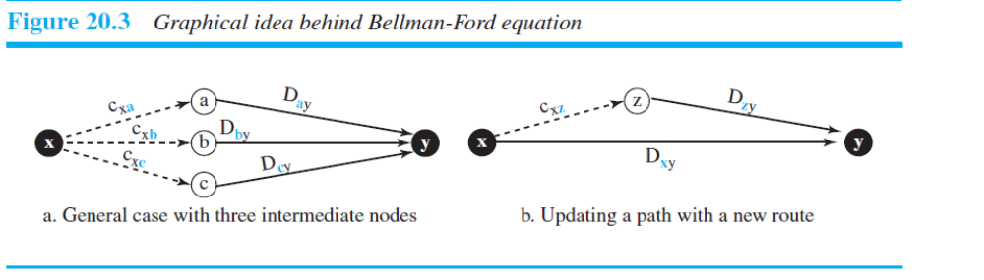
20.<number>

Slide 86
Distance Vector
The concept of a distance vector is the rationale for the name distance-vector routing.
A least-cost tree is a combination of least-cost paths from the root of the tree to all destinations.
These paths are graphically glued together to form the tree.
Distance-vector routing unglues these paths and creates a distance vector, a one-dimensional array to represent the tree.
20.<number>

Slide 87
Distance Vector Routing Algorithm:
At each step within a router:
  Get routing tables from neighbours
  Compute distance to neighbours
  Compute new routing table
Router transmits its distance vector to each of its neighbors.
Each router receives and saves the most recently received distance vector from each of its neighbors.
A router recalculates its distance vector when:
  It receives a distance vector from a neighbor containing different information than before.
  It discovers that a link to a neighbor has gone down (i.e., a topology change).
The DV calculation is based on minimizing the cost to each destination.
The distance vector routing algorithm is sometimes called by other names, the distributed Bellman-Ford routing algorithm and the Ford-Fulkerson algorithm.
20.<number>

Slide 88

Figure 22.14 Distance vector routing tables
22.<number>

Slide 89

Figure 22.15 Initialization of tables in distance vector routing
22.<number>

Slide 90
Note
In distance vector routing, each node shares its routing table with its
immediate neighbors periodically and when there is a change.
22.<number>

Slide 91

Figure 22.16 Updating in distance vector routing
22.<number>

Slide 92
Drawback of Distance Vector Routing:
  Count to Infinity Problem:
    It reacts rapidly to good news,
    But, leisurely to bad news.
A problem with distance-vector routing is that any decrease in cost (good news) propagates quickly, but any increase in cost (bad news) will propagate slowly. For a routing protocol to work properly, if a link is broken (cost becomes infinity), every other router should be aware of it immediately, but in distance-vector routing, this takes some time.The problem is referred to as count to infinity.
It sometimes takes several updates before the cost for a broken link is recorded as infinity by all routers
  Take too long to converge changes in one node to all other nodes.
Solution?
Link State Routing.
20.<number>

Slide 93

Figure 22.19 Example of a domain using RIP
22.<number>

Slide 94
Link State | Distance Vector
link states algorithm is an algorithm using global information | the distance vector algorithm is iterative, asynchronous, and distributed
each node talks with all other nodes, but tell them only the cost of it's directly comparison of some of their attribute | each node talks to only its directly connected neighbors, but provides its neighbor with least cost estimates from itself to all the nodes.
Message complexity: With link state, every node has to keep the information about the cost of each link within the network. | Message complexity: with distance vector algorithm, message is exchanged between two hosts which are directly connected to each other.
very times, if any of the link cost is changed, all the nodes are updated. | change of cost in the link which is belong to the least cost path for one of the nodes, the DV algorithm will update the new value. But if the change doesn't belong to the least cost part between 2 hosts, there will no updating.
Speed of convergence: can converge faster in comparison of later. | Speed of convergence: can converge slowly and have routing loops while the algorithm is converging.
Such probability is less. | DV algorithm also suffers from the count to infinity problem.
Robustness: For LS, when a router is down, it can broadcast a wrong cost for the closest one. LS node is computing for its own forwarding table and other node do the calculation for themselves. Better than DV. | Robustness: DV, the wrong least cost path can be passed to more than one or all of the node so the wrong calculation will be process in the entire net work. This problem of DV is much worse than LS algorithm.

Slide 95
Link-State Routing
This method uses the term link-state to define the characteristic of a link (an edge) that represents a network in the internet.
Link-State Database (LSDB)
The collection of states for all links is called the link-state database (LSDB).
The LSDB can be represented as a two-dimensional array (matrix) in which the value of each cell defines the cost of the corresponding link.
20.<number>

Slide 96
Now the question is how each node can create this LSDB that contains information about the whole internet.
This can be done by a process called flooding. Each node can
send some greeting messages to all its immediate neighbors (those nodes to which it isconnected directly) to collect two pieces of information for each neighboring node:
1) the identity of the node and 2) the cost of the link. The combination of these two pieces of information is called the LS packet (LSP).
20.<number>

Slide 97
Each router must do the following:
Discover its neighbors, learn their network address.
Measure the delay or cost to each of its neighbors.
Construct a packet telling all it has just learned.
Send this packet to all other routers.
Compute the shortest path to every other router.
A complete topology is developed. Then Dijkstra’s Algorithm can be used to compute the shortest path.
Following 5 steps are followed to implement it.
Learning about the Neighbors
Measuring Line Cost.
Building Link State Packets.
Distributing the Link State Packets.
Computing the New Routes.
20.<number>

Slide 98
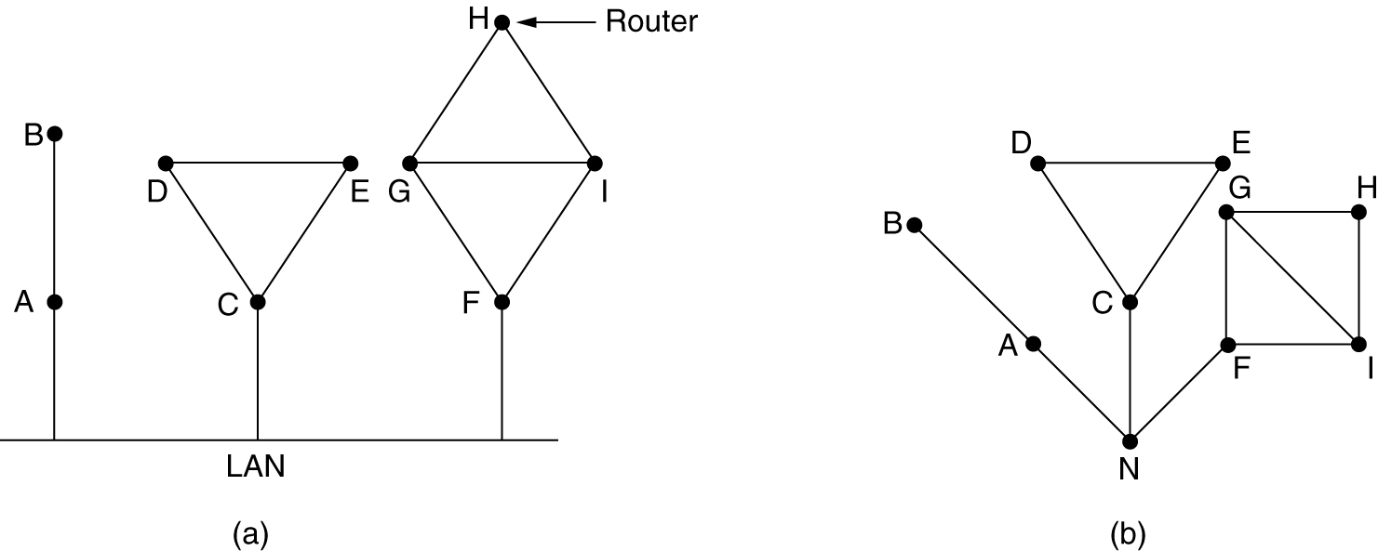
(a) Nine routers and a LAN. (b) A graph model of (a).
20.<number>

Slide 99
Step 1: Learning about the Neighbours:
  Upon boot of router,
    Send HELLO packet on each point-to-point line
    Routers are supposed to send reply with a globally unique name
Step 2: Measuring the Line Cost:
  Measure round-trip delay using ECHO Packet and wait for its reply
  Take load into account? Yes. Arguments both ways: when choice is given to router having same number of hops from S to D.
    Yes! preference for unloaded line as shortest path.
    No! where oscillations are possible.
  Better Solution? Distribute Load over multiple lines.
20.<number>

Slide 100
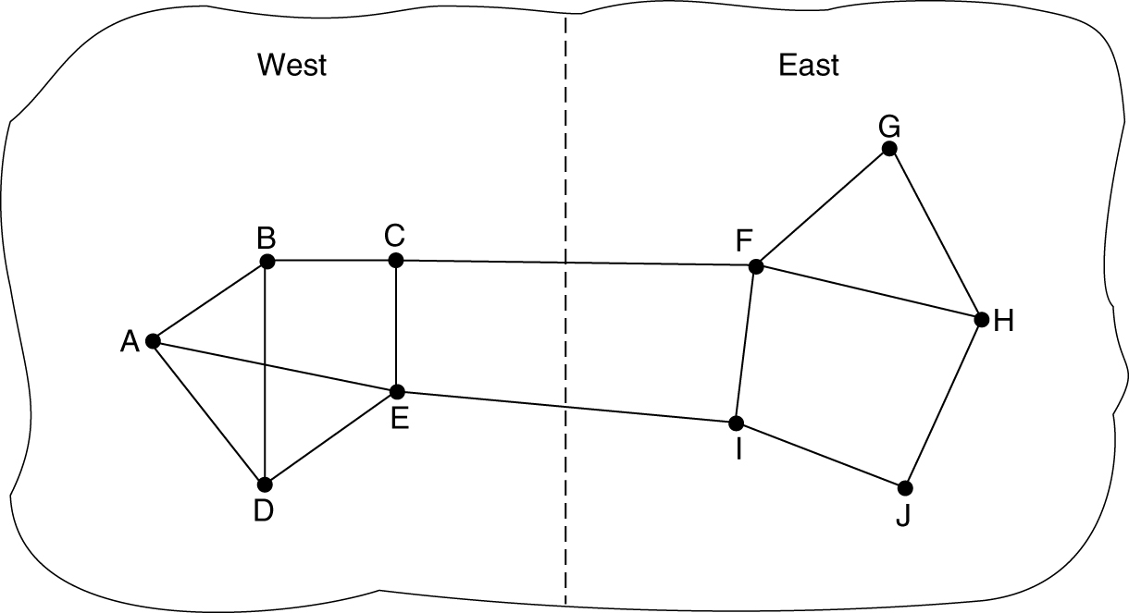
Measuring Line Cost
A subnet in which the East and West parts are connected by two lines.
20.<number>

Slide 101
Step 3: Building Link State Packets:
  Packet containing:
    Identity of sender
    Sequence number + age
    For each neighbour:
    name + distance
  When to build the link state packets?
    Periodically
    when significant events occur
See next figure.
20.<number>

Slide 102
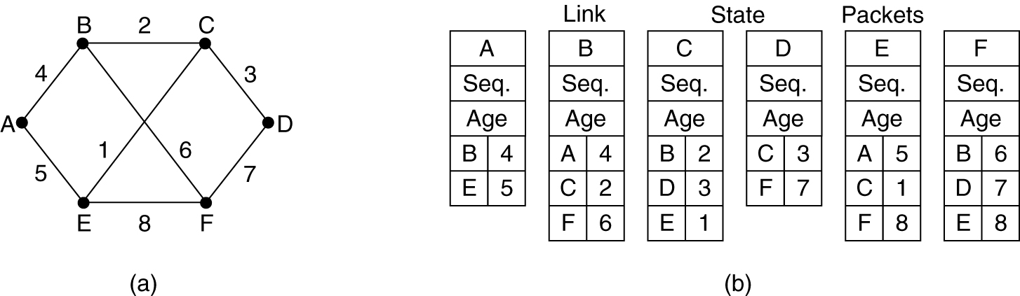
Building Link State Packets
(a) A subnet. (b) The link state packets for this subnet.
20.<number>

Slide 103
Step 4: Distributing Link State Packets:
Distributing link state packets
  Trickiest part of algorithm
    Arrival time for packets different
    How to keep consistent routing tables?
  Basic algorithm
    Flooding +
    Sequence number (in each packet) to limit duplicates.
20.<number>

Slide 104
  Manageable problems
    Wrap around of sequence numbers results to wrong data. Solution? Use 32 bit sequence number.
    Wrong sequence number used in case of :
      lost in case of crash
      Corrupted data transmitted.
  Solution? include the age of each packet after the sequence number and decrement it once per second. When the age hits zero, the information from that router is discarded.
      duplicates are discarded
      Old packets are thrown out
20.<number>

Slide 105
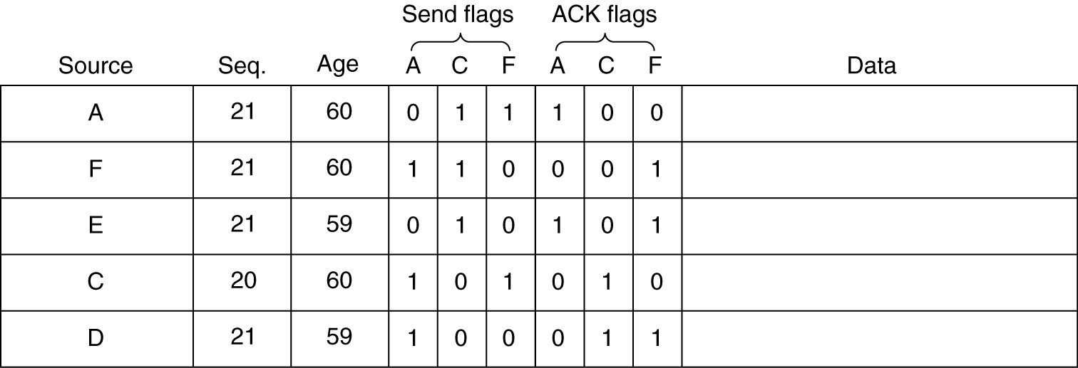
Distributing the Link State Packets
The packet buffer for router B in the previous slide.

Slide 106
Step 5: Computing new routes:
  With a full set of link state packets, a router can:
    Construct the entire subnet graph
    Run Dijkstra’s algorithm to compute the shortest path to each destination
  Problems for large subnets
    Memory to store data
    Compute time for developing these tables.
Usage:
  IS-IS protocol (Intermediate System, Intermediate System)
    Designed for DECnet(digital equipment corporation network protocol suite), adopted by ISO(international standardization organization), used still in internet.
    Supports multiple network layer protocols
  OSPF(Open Shortest Path First) protocol used in Internet
  Common features:
    Self-stabilizing method of flooding link state updates
    Concept of a designated router on a LAN
    Method of computing and supporting path splitting and multiple metrics.
    Useful in Multi Protocol Environment.
20.<number>

Slide 107

Figure 22.20 Concept of link state routing
22.<number>

Slide 108

Figure 22.21 Link state knowledge
22.<number>

Slide 109
What does it mean to be the shortest (or optimal) route?
Minimize mean packet delay
Maximize the network throughput
Minimize the number of hops along the path
Dijkstra algorithm:
Each node is labeled (in parentheses) with its distance from the source node along the best known path.
Initially, no paths are known, so all nodes are labeled with infinity.
As the algorithm proceeds and paths are found, the labels may change, reflecting better paths.
A label may be either tentative or permanent.
Initially, all labels are tentative.
When it is discovered that a label represents the shortest possible path from the source to that node, it is made permanent and never changed thereafter.
Now lets see the algorithm which describes this procedure to develop shortest path from source to destination.
20.<number>

Slide 110

Figure 22.22 Dijkstra algorithm
22.<number>

Slide 111

Figure 22.23 Example of formation of shortest path tree
22.<number>

Slide 112

Table 22.2 Routing table for node A
22.<number>

Slide 113
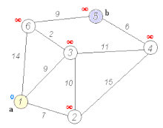
20.<number>

Slide 114

Figure 22.24 Areas in an autonomous system
22.<number>

