Slide 1
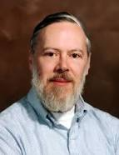

Slide 2
Dennis MacAlistair Ritchie (September 9, 1941 – c. October 12, 2011) was an American computer scientist. He created the C programming language and, with long-time colleague Ken Thompson, the Unix operating system

Slide 3
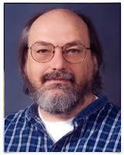

Slide 4
Kenneth Lane "Ken" Thompson (born February 4, 1943), commonly referred to as ken in hacker circles, is an American pioneer of computer science. Having worked at Bell Labs for most of his career, Thompson designed and implemented the original Unix operating system. He also invented the B programming language, the direct predecessor to the C programming language,

Slide 5
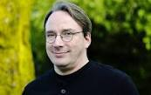

Slide 6
Linus Benedict Torvalds born December 28, 1969) is a Finnish-American software engineer who is the creator and, for a long time, principal developer of the Linux kernel, which became the kernel for operating systems such as the Linux operating system, Android, and Chrome OS

Slide 7
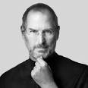

Slide 8
Steven Paul Jobs ( February 24, 1955 – October 5, 2011) was an American entrepreneur, businessman, inventor, and industrial designer. He was the co-founder, chairman, and chief executive officer (CEO) of Apple Inc.

Slide 9
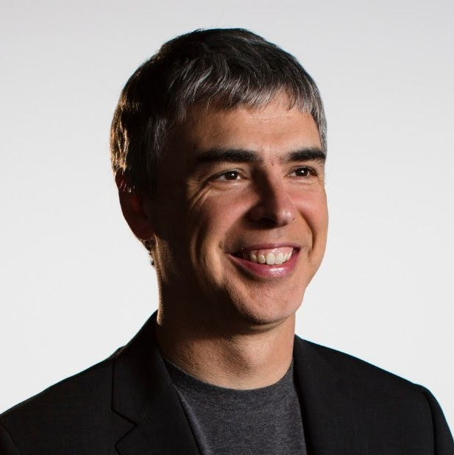

Slide 10
Lawrence Edward Page (born March 26, 1973) is an American computer scientist and Internet entrepreneur who co-founded Google with Sergey Brin.
Page is the chief executive officer (CEO) of Google's parent company, Alphabet Inc. After stepping aside as Google CEO in August 2001 in favour of Eric Schmidt, he re-assumed the role in April 2011. He announced his intention to step aside a second time in July 2015 to become CEO of Alphabet, under which Google's assets would be reorganized.

Slide 11
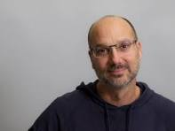

Slide 12
Andrew E. "Andy" Rubin (born 1963) is an American computer programmer, engineer, entrepreneur, and venture capitalist. He is the founder and CEO of tech startup incubator Playground Global and a partner at venture capital firm Redpoint Ventures. He is the co-founder and former CEO of both Danger Inc. and Android Inc.

Slide 13
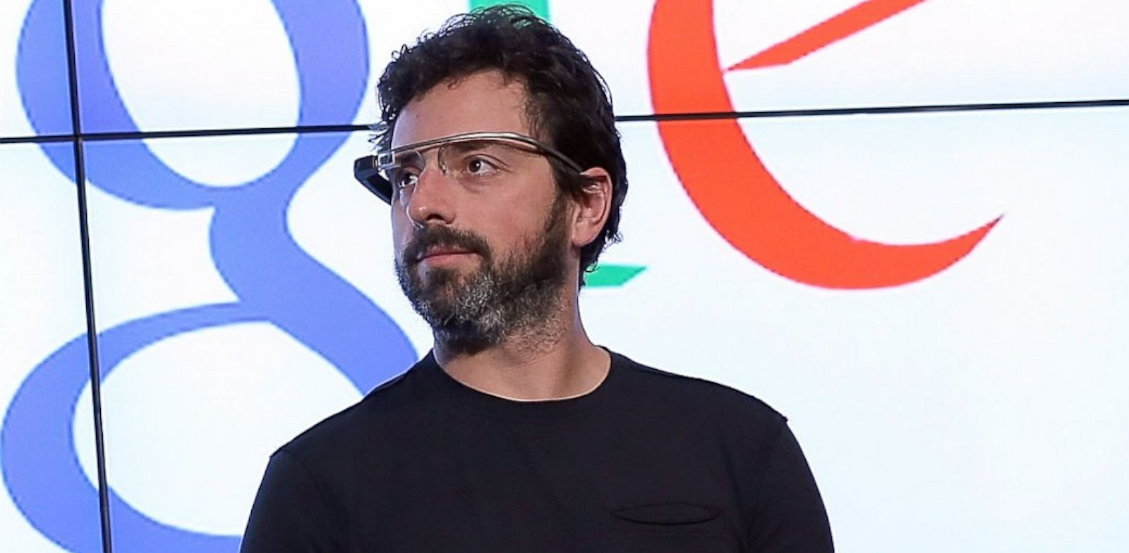

Slide 14
Sergey Mikhaylovich Brin (Russianborn August 21, 1973) is a Russian American computer scientist, internet entrepreneur, and philanthropist.Together with Larry Page, he co-founded Google. Brin is the President of Google's parent company Alphabet Inc.

Slide 15


Slide 16
Dan Bornstein
Dalvik virtual machine (DVM) in Google's Android operating system that executes applications written for Android. Dalvik is an integral part of the Android software stack in Android versions 4.4 "KitKat" and earlier, which is typically used on mobile devices such as mobile phones and tablet computers, and more recently on devices such as smart TVs and wearables.
Dalvik is open-source software, originally written by Dan Bornstein, who named it after the fishing village of Dalvík in Iceland.

Slide 17
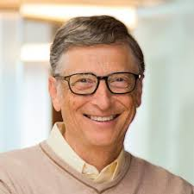

Slide 18
William Henry Gates III (born October 28, 1955) is an American business magnate, investor, author and philanthropist.^{[1][2]}
In 1975, Gates and Paul Allen co-founded Microsoft, which became the world's largest PC software company.
During his career at Microsoft, Gates held the positions of chairman, CEO and chief software architect, while also being the largest individual shareholder until May 2014.

Slide 19


Slide 20
The Open Source Initiative (OSI) is an organization dedicated to promoting open-source software.
The organization was founded in late February 1998 by Bruce Perens and Eric S. Raymond, part of a group inspired by the Netscape Communications Corporation publishing the source code for its flagship Netscape Communicator product.

