Slide 1
Jenkins 部署及配置
Author:tpeng
Date:2018.02.26
Mail: 398222836@qq.com

Slide 2
wget http://mirrors.jenkins.io/war-stable/latest/jenkins.war
java –jar jenkins.war
访问：
http://172.20.10.200:8080/

Slide 3
管理账号：
server1/123456
问题：
http://blog.csdn.net/txyzqc/article/details/77885367

Slide 4
安装插件
高级代理设置>升级站点：http://updates.jenkins.io/update-center.json
去掉https
安装插件
Deploy to container Plugin
Maven Integration plugin
Publish Over SSH
Github
Gitlab
Role-based Authorization Strategy
JaCoCo plugin
SonarQube Scanner for Jenkins

Slide 5
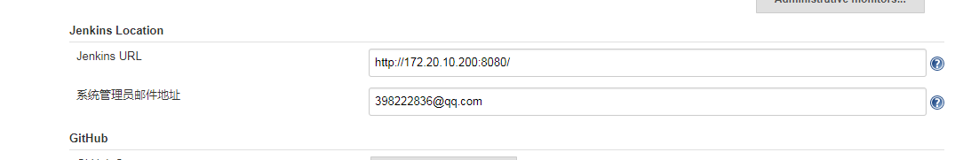
系统设置

Slide 6
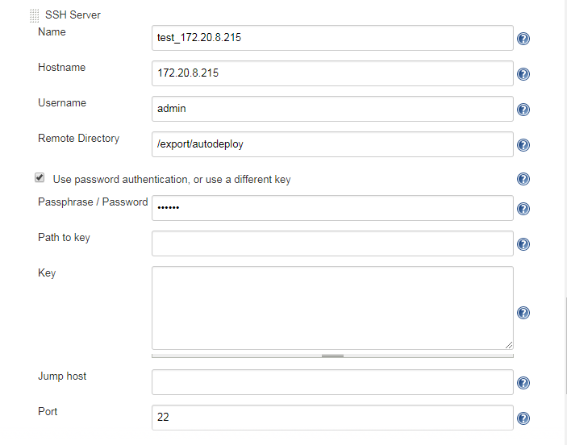

Slide 7
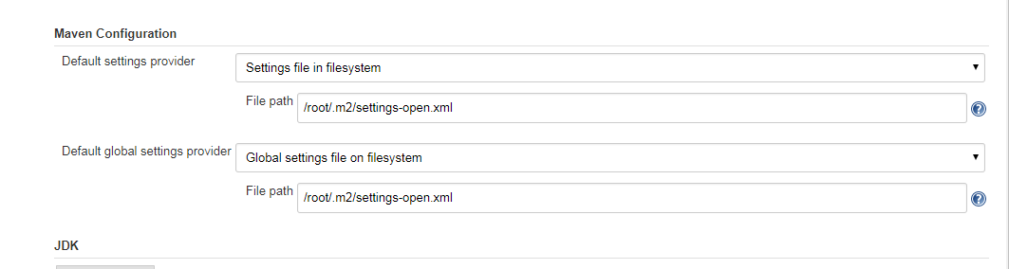
全局工具配置

Slide 8
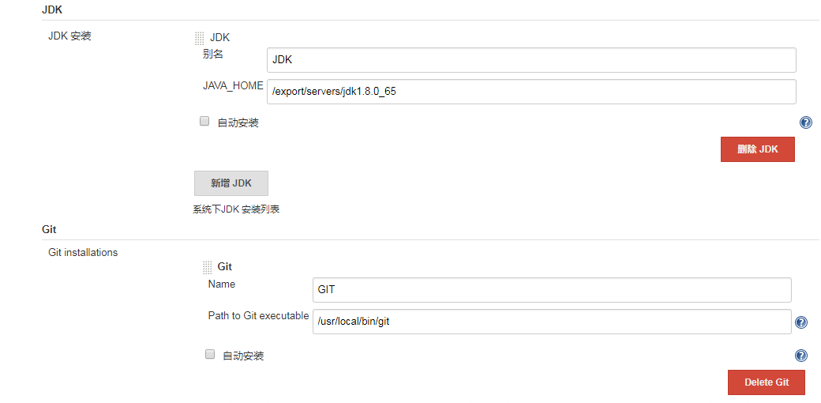

Slide 9
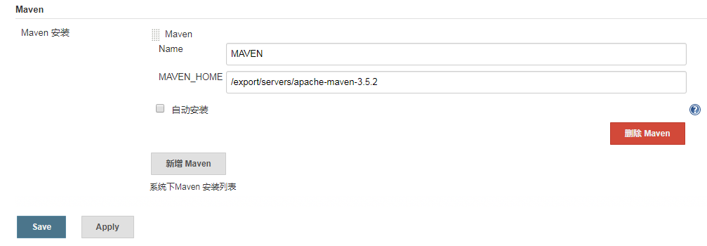

Slide 10
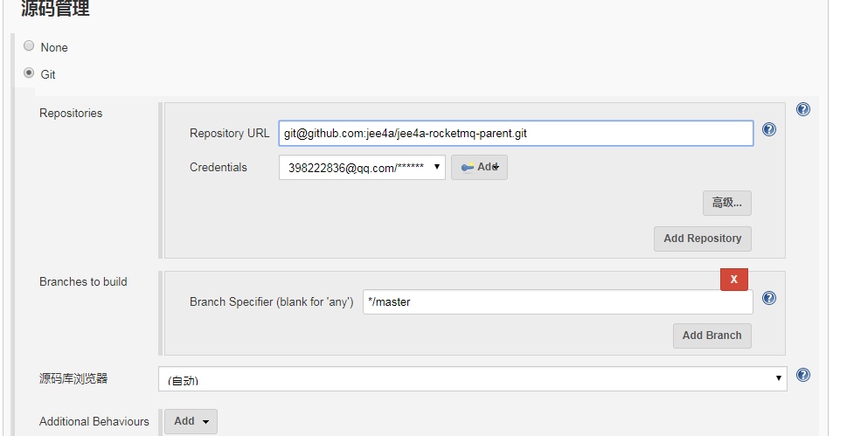
新建项目

Slide 11
Git 配置
https://www.jianshu.com/p/a7d7df97fe4b

Slide 12
git@git.hexindai.com:micro_credit/hexin-crm.git
*/dev_hexin_crm_20180312
hexin-crm-service/target/*.jar
hexin-crm-service/target
crm.hxjr.com
export LANG=zh_CN.UTF-8
rm -rf /export/data/springbootRoot/crm.hxjr.com/* && cp /export/autodeploy/target/hexin-crm-service-0.0.1-SNAPSHOT.jar /export/data/springbootRoot/crm.hxjr.com/crm.hxjr.com.jar && /export/home/springboot/crm.hxjr.com/bin/run.sh

Slide 13
运行脚本
jar
start.sh
#!/bin/bash
BOOT_BASE=/export/home/springboot
JAR_BASE=/export/data/springbootRoot
export JAVA_HOME=/export/servers/jdk1.8.0_65
export CLASSPATH=.:$JAVA_HOME/lib:$CLASSPATH
export PATH=$JAVA_HOME/bin:$PATH
java -jar $JAR_BASE/producer.jee4a.com/producer.jee4a.com.jar --server.port=8082 >/dev/null 2>&1 &

Slide 14
stop.sh
#!/bin/bash
BOOT_BASE=/export/home/springboot
JAR_BASE=/export/data/springbootRoot
export JAVA_HOME=/export/servers/jdk1.8.0_65
export CLASSPATH=.:$JAVA_HOME/lib:$CLASSPATH
export PATH=$JAVA_HOME/bin:$PATH
java -jar $JAR_BASE/producer.jee4a.com/producer.jee4a.com.jar --server.port=8082 >/dev/null 2>&1 &
-bash-4.2$ cat stop.sh
#!/bin/bash
JAR_BASE=/export/data/springbootRoot
PID=$(ps -ef | grep $JAR_BASE/producer.jee4a.com/producer.jee4a.com.jar | grep -v grep | awk '{ print $2 }')
if [ -z "$PID" ]
then
echo Application is already stopped
else
echo kill $PID
kill -9 $PID
fi

Slide 15
run.sh
#!/bin/bash
BOOT_BASE=/export/home/springboot
JAR_BASE=/export/data/springbootRoot
WHO=`whoami`
LOG=`date --date='1 months ago' +%Y-%m`\
#########################starting#############
start() {
echo "*****************************************"
echo "*** application starting action ***"
echo "*****************************************"
if [[ $WHO == root ]];then
su - admin -c $BOOT_BASE/producer.jee4a.com/bin/start.sh|awk '{printf "..."}END{print "Finished"}'
elif [[ $WHO == admin ]];then
$BOOT_BASE/producer.jee4a.com/bin/start.sh|awk '{printf "..."}END{print "Finished"}'
fi
if [[ $? == 0 ]];then
echo "#################################"
echo "# application started succeed!! #"
echo "#################################"
fi
tail -f $BOOT_BASE/producer.jee4a.com/logs/producer.jee4a.com.log
}
#########################stoping####################
stop() {
echo "*****************************************"
echo "*** application stoping action ***"
echo "*****************************************"
if [[ $WHO == root ]];then
su - admin -c $BOOT_BASE/producer.jee4a.com/bin/stop.sh|awk '{printf "..."}END{print "Finished"}'
elif [[ $WHO == admin ]];then
$BOOT_BASE/producer.jee4a.com/bin/stop.sh|awk '{printf "..."}END{print "Finished"}'
fi
if [[ $? == 0 ]];then
echo "################################"
echo "# application stoped succeed!! #"
echo "################################"
fi
}
restart(){
stop
start
}
case "$1" in
start)
start
;;
stop)
stop
;;
restart)
restart
;;
?|help)
echo $"Usage: $0 {start|stop|restart|help|?}"
;;
*)
restart
esac

