Slide 1

CUDA PathTracer
(Prototype)
Raimond Tunnel

Slide 2

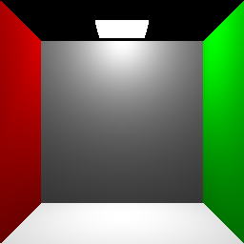
Standard Graphics Pipeline
Transform vertices (vertex shader, GPU)
Rasterize the geometry (GPU)
Color the pixels (fragment shader, GPU)

Slide 3
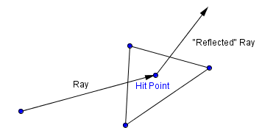
Ray Tracing
Cast a ray (point & direction)
Find what it hits in our scene
  Möller-Trumbore intersection algorithm
  http://en.wikipedia.org/wiki/M%C3%B6ller%E2%80%93Trumbore_intersection_algorithm
Cast another ray from the hitpoint
(in some direction)

Slide 4
Path Tracing
Shoot rays from the viewer, through the pixels.
Have them bounce around in the scene.
Bounce with a random new direction.
Accumulate the reflected light (BRDF).
Upon hitting a light source, you know the color.
Do this 800+ times per pixel, average results.

Slide 5
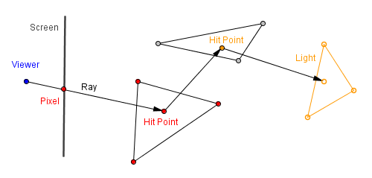
Path Tracing

Slide 6
Path Tracing
Computationally more expensive than SGP.
Random direction, in hopes of finding good enough approximation of light paths.
Monte-Carlo like integration
Can be easily parallelized, no dependancies between computations!

Slide 7
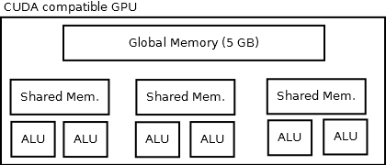
CUDA
Language for programming Nvidia GPU-s to do general purpose computing.
(you can always program any modern GPU with shaders, but then you are restricted to SGP)
CUDA-compatible GPU-s have a grid of blocks. Blocks have many arithmetic-logic units (ALU-s) in them and its own shared memory.
Max 1024 threads in a block.
Can queue huge number of blocks.

Slide 8
My Implementation
https://github.com/jee7/cuda-pathtracer
Parallelization by rays
Global queue of rays that need a resolution
Generate all initial rays, put them to queue
Call a large number of worker threads to resolve the queue (dynamic parallelization)
Save results to array and collect from CPU
Write stuff to file, use JavaScript to see the pic.
Because of the EENet cluster. No OpenGL or any other display. Maybe VirtualGL?

Slide 9
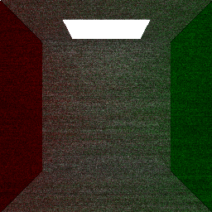
Results (256×256, 20 iter.)

Slide 10
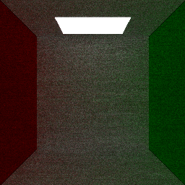
Results (256×256, 40 iter.)

Slide 11
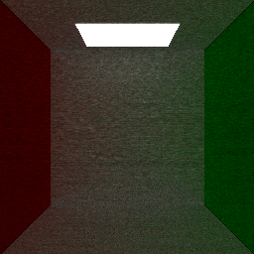
Results (256×256, 80 iter.)

Slide 12
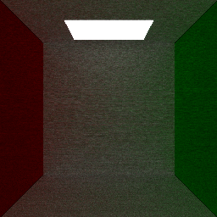
Results (256×256, 100 iter.)

Slide 13
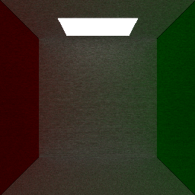
Results (256×256, 200 iter.)

Slide 14
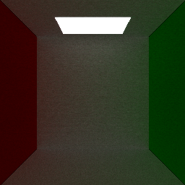
Results (256×256, 400 iter.)

Slide 15
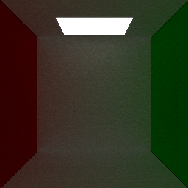
Results (256×256, 600 iter.)

Slide 16
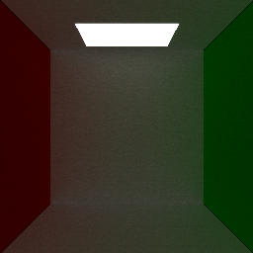
Results (256×256, 800 iter.)
Notice the global illumination...

Slide 17
Future Ideas
Total global queue takes a lot or memory, resolve rays via batches.
Utilize shared memory, can probably handle 1000 rays in there.
Try out different other approaches besides the random ray bounce.
That is all... thanks!

