Slide 1
Study and Analysis of Hybrid CPU-FPGA computing
EE 669: R n D presentation
Name: Yatish Turakhia
Roll No: 09D07015

Slide 2
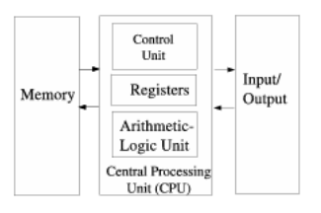
Von Neumann Paradigm
Backbone of modern general purpose computing.
Consists of the following:
Separate memory for storing data and instructions
A control unit (PC, Decoder etc)
An arithmetic and logic unit (datapath)
I/O to communicate with outside world
Major advantage: flexibility. Can program almost any existing algorithms!
Figure 1. Von Neumann Architecture

Slide 3
Von Neumann Paradigm: Limitations
Data moves between memory requires instruction streams.
Execution of operations requires fetching and decoding of instructions.
Instruction streams memory-cycle-hungry.
Sequential execution: not most efficient!!
Excessive power consumption!

Slide 4
Trends in modern day processors
Transistor density continues to rise exponentially.
Power density rising exponentially too [2][16]. Future processors to be power-limited. More transistors than can be simultaneously switched on.
Performance scaling harder to achieve. Need to reinvent computing!!
Increasing focus on heterogeneous computing: application-specific acceleration using dedicated hardware accelerators [16] or heterogeneous CMPs with different processors [1] [11].
Strong trend towards hybrid architectures that combine FPGAs and general purpose processors [6][7][8][15]

Slide 5
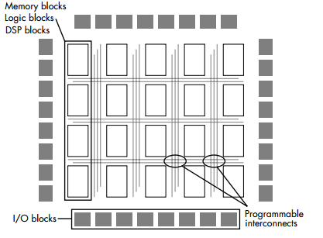
Reconfigurable computing: the hardware paradigm
Field Programmable Gate Arrays (FPGAs) are programmable semiconductor devices that are based around a matrix of configurable logic blocks connected via programmable interconnects .
Figure 2. Typical FPGA architecture

Slide 6
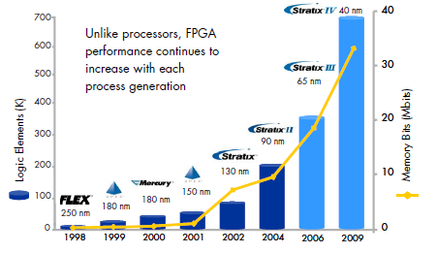
FPGA Advantages
Highly customizable. Custom pipelining.
Highly parallelizable: Can replicate a hardware function block multiple times.
Primarily driven by data streams: no instructions!
Much more power efficient in comparison to CPU. Per area power consumed 10-100 times better for FPGA compared to a standard Intel Core[6].
Scalable roadmap! [14]
Orders of magnitude of speedup over standard processors [8], [23] with 10-40X lower clock rate. The “Reconfigurable Computing Paradox ”[22]
Figure 3. FPGA density. Source: [14]

Slide 7
Major Contributions
Study and analysis on CPU-FPGA computing and tools.
Study and implementation of algorithms using high level synthesis tools like C-to-Verilog[3].
Study and implementation of algorithms using hardware-software co-design using SIRC Application Programming Interface (API).
Developing a complete framework to easily implement algorithms on CPU-FPGA interface using SIRC.
Preparing a roadmap and groundwork for further study in this direction.

Slide 8
CPU-FPGA Co-processing
Divide the applications computations into a set of software instructions executing on the processor and a portion which runs on an FPGA [7]
The timing-critical portions of the design should execute on the faster FPGA while non-critical portions should run on the processor [6][7].
Communication necessary between processor and hardware (FPGA). Need for an interface between CPU and FPGA.

Slide 9
High Level Synthesis
High programming cost associated with FPGA. Requires low level RTL specification for synthesis.
HLS: Automated generation of RTL design from a high level behavioral specification while satisfying design constraints and optimizing on the given cost function [9].
Several open source HLS tools available: LegUp [18], C-to-Verilog [3] etc. Commercial ones include Xpilot [19], Pico [20] etc

Slide 10
High Level Synthesis
A typical HLS tools uses dataflow analysis to extract parallelism, perform loop unrolling, implement clocking strategy and data path and control path allocation.
We used C-to-Verilog to implement following two algorithms on Xilinx Virtex XUPV5 board:
Addition of 2 input arrays.
Discrete Wavelet Transform

Slide 11
Simple Interface for Reconfigurable Computing (SIRC)
Simple, open-source communication API between CPU and FPGA [12][13].
A simple and easy to use high-level communication and synchronization protocol.
Abstracts way implementation details. No need to worry about drivers, OS or communication protocol.
Need only basic knowledge of C++ and Verilog for usage.
Communication over Gigabit Ethernet. Ethernet is unreliable, but SIRC uses TCP-like ACK/retry mechanism to provide reliable communication

Slide 12
SIRC: Overview
Uses two APIs: one on software side and one on hardware side. Master Slave arrangement. Host PC is master and FPGA slave.
Software code:
Sends data from host to FPGA using an input buffer which is connected to FPGA
Signals the FPGA to begin its execution on the input data
Waits till the FPGA completes its computation on the input data
Receives the output data from the FPGA using an output buffer which is also connected to the FPGA

Slide 13
SIRC: Overview
Hardware Execution:
Waits till it receives a signal from the host to begin execution.
Receives the input data from the input buffer connected to host and starts processing. On completion, it puts the result data on the output buffer.
Signals to host that it has completed its execution and goes back to idle state.

Slide 14
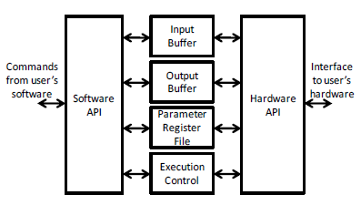
SIRC: Overview
Figure 4. SIRC software and hardware API. Source [12]
SIRC also allows creation of multiple API interfaces to overlapped I/O and hide latencies
Provides bandwidth ~450 Mbps for small transfers and upto 950 Mbps (98% theoretical
maximum) for transfers above 512KB.

Slide 15
Matrix Multiplication GF(2)
GF(2): Finite field containing 2 elements. Smallest possible finite field.
Applications in coding theory, cryptographic algorithms, matrix inversion [4] etc.
GF algorithms better suited on FPGA. No instructions on GF operations in CPU.

Slide 16
Matrix Multiplication GF(2): Implementation Details
Used Verilog based synthesizable code for performing multiplication of two 32 bit x 32 bit matrix blocks. Multiplier has 2 components: transpose and rank 1 update.
Multiplication of larger matrices by block multiplication algorithm [5].
Block reuse to minimize communication. Send one block of matrix A and row of blocks for matrix B.
Output blocks sent to PC via output buffers where accumulate operation takes place.
Used input and output FIFOs to interact with hardware API of SIRC. Simplifies hardware programming significantly.
Software C++ code running on 64-bit 2.66 GHz Intel i7 processor. Hardware on Xilinx Virtex XUPV5 FPGA.

Slide 17
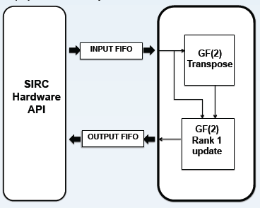
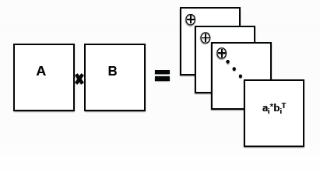
Matrix Multiplication GF(2): Implementation Details
(a)
(b)
Figure 5. (a) Multiplication of 2 matrix blocks (b) GF(2) multiplication using SIRC H/W API on FPGA

Slide 18
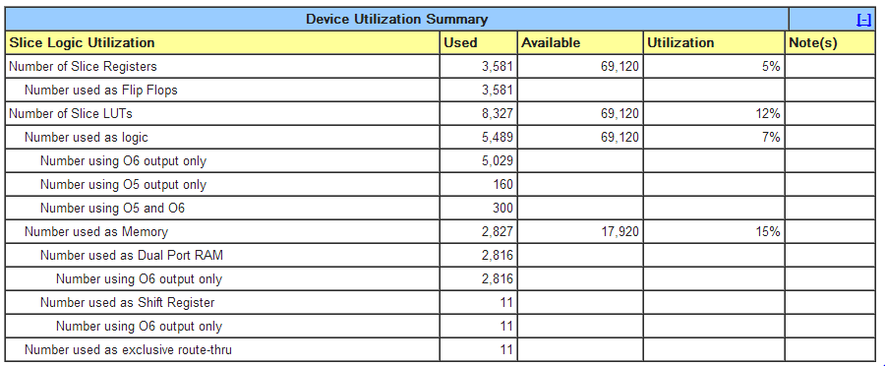
Matrix Multiplication GF(2): Implementation Details

Slide 19
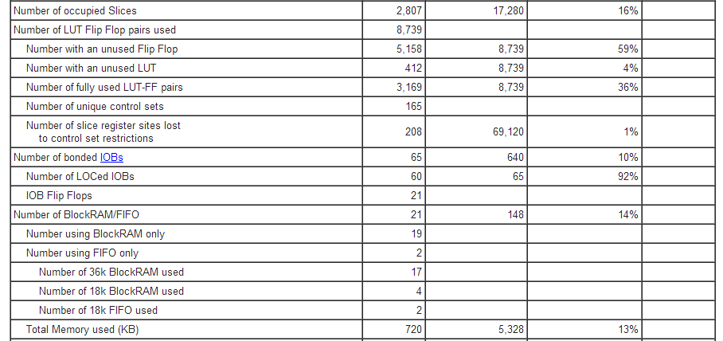
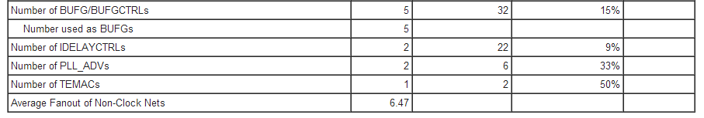
Matrix Multiplication GF(2): Implementation Details

Slide 20
Matrix Multiplication GF(2): Results
For multiplication of two 1024 bit x 1024 bit matrices, total execution time= 0.33 sec when we blocks are re-used and about 3.30 sec when no reuse.
203 clock cycles at 167MHz .
Block multiplication implemented in naïve way. Can be optimized further but Ethernet communication is major bottleneck

Slide 21
Matrix Multiplication GF(2): Comparison
M4RI [17] probably the fastest library for arithmetic over GF(2).
Uses “Method of four Russians” and look-up-table based tricks to efficiently compute GF2 matrix product.
Compute time for 10,000x10,000 matrix product on i7 processor = 1.504 seconds. O(n^{log_2(7)} ) algorithm.
However, its much slower for GF(2^e) e>1 computations. CPU-FPGA likely to be faster in this case

Slide 22
Other Applications using SIRC
Used SPIRAL [21] core generator for 32-bit fixed-point 8-point DFT.
8-point input available in BRAM of FPGA. FPGA computes the DFT and sends the result to CPU when asked.
Takes ~0.56 sec for execution. Again communication is the major bottleneck.

Slide 23
Discussion
Communication is the major bottleneck.
At 450 Mbps, ~75 usec required for transfer of 33 blocks of 32 bit x 32 bit size. => for 2*32*32 such transfers, we would require ~153 msec.
In addition to ethernet transmission delay, ~65usec additional overhead incurred by SIRC protocol for each transfer. ~133 msec for 2*32*32 transfers.
~286msec out of ~330 msec spent in communication. Major bottleneck!

Slide 24
Future Work
C++ application
Use SIRC to generate multiple API interfaces to exploit parallelism and streaming-style execution with overlapped I/O.
Study and exploration of open-source profiling and partitioning tools.
Work towards a completely automated C++-to-CPU-FPGA tool flow by integrating SIRC with open-source profiling and HLS tools.
Profile and Partition
Debug and Verify
Compile and Optimize
RTL for FPGA and synthesis to bitmap
Compiled C++ code with hardware API
FPGA
Host PC
Figure 5. Automated CPU-FPGA tool flow

Slide 25
Future Work
Explore of benefits of hardware acceleration for other applications and domains:
Sparse Matrix-Vector Product. Gaussian elimination
LU decomposition/ Cholesky decomposition
Coding theory: RS/ LDPC/ Expander decoding
Cryptography: DES, Rijndael etc
Signal and Image Processing: Wavelet transform, filtering etc
Algorithms: Monte Carlo, BlackScholes, PageRank etc
More detailed study and comparison of performance with benchmarks.
Build on a strong library foundation for FPGA-based accelerated computing of applications for programmability and reusability.

Slide 26
Limitations
Communication over Gigabit Ethernet: too slow for data-intensive applications. Communication latency is the major bottleneck.
SIRC cannot simultaneously read and write to FPGA with single interface.
High programming costs for low level HDLs. Open source high level synthesis tools [3] [18] not most optimum.
Separate tool flows and programming for hardware and software. Need for a single programming model.

Slide 27
Limitations
Cost of reconfiguration too high! Need to minimize reconfiguration time to as small as possible to enable reconfiguration at run-time as well.
SIRC does not support multi-context reconfiguration.
Need better tools for programming and analysis of hybrid computing. Need to know where cycles are being spent!

Slide 28
Conclusion
Literature survey on recent trends in HPC and hybrid CPU-FPGA computing.
Study and implementation of algorithms on FPGA using high-level synthesis tools such as C-to-Verilog [3] and SPIRAL [21].
Study and implementation of GF2 32x32 bit matrix multiplication using SIRC for hybrid CPU-FPGA application. The codes can serve as templates for a variety of application we plan to implement in future.
FPGA has limited resources and memory. Unable to implement highly complicated hardware blocks.

Slide 29
Conclusion
Extending GF2 multiplication for larger matrices using block multiplication.
Preparing a roadmap and laying a strong foundation for further research and exploration in this direction.

Slide 30
References
[1] “Variable SMP – A Multi-Core CPU Architecture for Low Power and High Performance,” pp. 1–16.
[2] H. Esmaeilzadeh, E. Blem, R. St. Amant, K. Sankaralingam, and D. Burger, “Dark silicon and the end of multicore scaling,” Proceeding of the 38th annual international symposium on Computer architecture - ISCA ’11, p. 365, 2011.
[3] “Rotem, Nadav, et al. ‘C-to-Verilog.’ Automating circuit design.[HTML](http://c-toverilog. com) (2010).”
[4] Wiki, “GF(2).” [Online]. Available: http://en.wikipedia.org/wiki/GF(2).
[5] Wiki, “Block Multiplication.” [Online]. Available: https://en.wikipedia.org/wiki/Block_matrix.
[6] Peter Richards and Stephen Weston, “Technology in Banking: a problem in scale and complexity,” 2011.
[7] T. Trend and T. Reconfigurable, “Dynamically Reconfigurable Processors,” 1998.
[8] T. J. Todman, G. A. Constantinides, S. J. E. Wilton, O. Mencer, W. Luk, and P. Y. K. Cheung, “Reconfigurable computing : architectures and design methods,” vol. 152, no. 2, pp. 193–207, 2005.

Slide 31
References
[9] Z. Peng, “High-Level Synthesis,” pp. 1–24. [ONLINE]: http://www.ida.liu.se/~petel/SysSyn/lect3.frm.pdf
[10] S. Nematbakhsh, G. Stitt, F. Vahid, S. Nematbakhsh, G. Stitt, and F. Vahid, “The Effect of FPGA Size on Software Speedup from Hardware / Software Partitioning The Effect of FPGA Size on Software Speedup from Hardware / Software Partitioning.”
[11] P. Greenhalgh, “Big . LITTLE Processing with ARM Cortex TM -A15 & Cortex-A7,” no. September, pp. 1–8, 2011.
[12] K. Eguro, “SIRC : An Extensible Reconfigurable Computing Communication API,” pp. 1–4.
[13] K. Eguro, “Simple Interface for Reconfigurable Computing ( SIRC ): PC ⬄ Xilinx V5 / V6 Communication,” vol. 2007, pp. 1–33, 2007.
[14] A. Corporation, “White Paper FPGA Coprocessing Evolution : Sustained Performance Approaches Peak Performance,” no. June, pp. 1–8, 2009.
[15] G. Chatziparaskevas, A. Brokalakis, and I. Papaefstathiou, “An FPGA-based Parallel Processor for Black-Scholes Option Pricing Using Finite Differences Schemes,” 2012.
[16] M. Taylor, “Is Dark Silicon Useful ? Harnessing the Four Horsemen of the Coming Dark Silicon Apocalypse,” 2012.
[17] “M4RI- Open-source Linear Algebra Library.” [Online]. Available: http://m4ri.sagemath.org/.
[18] Andrew Canis et. al. 2011. LegUp: high-level synthesis for FPGA-based processor/accelerator systems. In Proceedings of the 19th ACM/SIGDA international symposium on Field programmable gate arrays (FPGA '11). ACM, New York, NY, USA, 33-36.

Slide 32
References
[19] D. Chen, J. Cong, Y. Fan, G. Han, W. Jiang, and Z. Zhang, “xPilot : A Platform-Based Behavioral Synthesis System.”
[20] “Pico Computing.” [Online]. Available: http://picocomputing.com/.
[21] “SPIRAL code generator.” [Online]. Available: http://www.spiral.net/codegenerator.html.
[22] A. Schopenhauer, G. M. Curve, and M. Age, “THE VON NEUMANN SYNDROME TU Kaiserslautern , http://hartenstein.de Energy Wall , Memory Wall and Education Wall fuel the von Neu- von Neumann syndrome :,” 2010.
[23] S. Che, J. Li, J. W. Sheaffer, K. Skadron, and J. Lach, “Accelerating Compute-Intensive Applications with GPUs and FPGAs.”

Slide 33
VN paradigm
Limitations of VN paradigm
Reconfigurable computing defining a new paradigm
Comparison: CPU vs FPGA vs GPU
Advantage of reconfigurable computing
Further motivation and ongoing work
High Level Synthesis
SIRC
Protocol and programming
Contributions of this work
Implementation Details
Experimental Study
Observations and Results
Discussion
Future Work
Limitations
Conclusion
References

