Slide 1

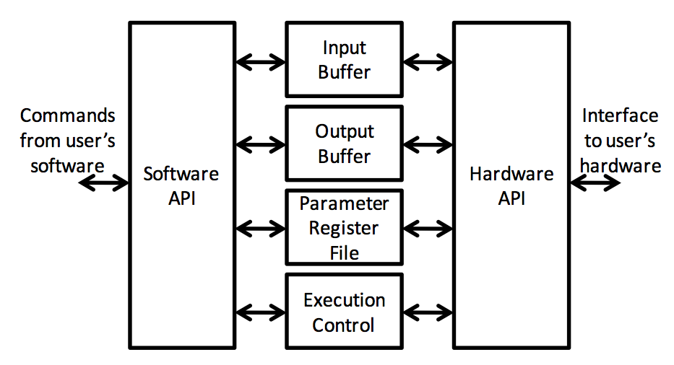
Explorations in FPGA-CPU Co-Processing
Abhishek Bhowmick, Udit Jalan Guide: Prof. Sachin Patkar
High Performance Computing Lab,
Department of Electrical Engineering, IIT Bombay
Introduction
SIRC Interface for Host – FPGA
Communication
Hardware Design
FPGA based accelerators speed up several applications in the domains of HPC, DSP, encryption/decryption etc
Cost of hardware design is prohibitive and has limited its applications
A software-hardware co-design to get the best of both worlds
Aim is to provide a complete framework using commodity hardware like CPU and FPGA to accelerate an application written in high level language like C
A 32*32 multiplier consists of 2 basic blocks – GF(2) Transpose and GF(2) rank 1 update
SIRC [1](Simple Interface for Reconfigurable Computing) provides an API that allows communication and synchronization of a host CPU with an FPGA (over Ethernet)
Consistent across all platforms
INPUT FIFO
GF(2) Transpose
SIRC Hardware API
Program Code
C Compiler
Profiler
OUTPUT FIFO
GF(2)
Rank 1 update
CPU
HLS/ IP core Library
Input and output FIFOs are created to feed in the multiplier blocks with a new input each clock cycle
The entire design has been synthesized, implemented and verified on a Virtex 5 FPGA on the Xilinx XUPV5 board
203 clock cycles (@167 Mhz) for one 32*32 matrix-matrix product
Roughly 3.2 sec for an unoptimized 1024*1024 matrix matrix multiplication
FPGA
Fig 2 : SIRC software and hardware APIs [1]
Multiple API interfaces can be implemented to allow overlapped I/O and hide latencies
Effective transfer rates of 450 Mbps for small transfers increasing upto 950 Mbps for transfers exceeding 512 KB
Hardware / software partitioners divide an application's computations into sequential code for execution on general processor and parallelizable portion to be run on accelerator (FPGA, ASIC, DSP, GPU etc)
Several tools automate the process of hw/sw partitioning, based on methods like profiling to satisfy constraints on performance, power, area
Matrix Multiplication over GF(2)
Conclusion and Future Work
Matrix-matrix multiplication is an important primitive in computational linear algebra
Galois field operations are well suited for FPGA implementation
A GF(2) matrix multiplier application using block multiplication algorithm has been implemented
The input matrices are divided into 32x32 blocks
Each block multiplication is implemented as shown below:
An entire system to read matrices from a PC and compute their product has been implemented
Currently FPGA-SIRC ethernet communication is the bottleneck
Block re-use on FPGA to minimize communications
Further exploit parallelism to implement several 32*32 matrix-matrix multiplication blocks
Extend for sparse matrix multiplication
High Level Synthesis
C to RTL compilers synthesize applications written in C to synthesizable Verilog
Examples are C-to-Verilog, LegUp, PandA (all open-source), Spiral (soft cores for DSP and numerical kernels)
We have synthesized and tested the following in our implementation:
  Discrete Wavelet Transform (c-to-verilog [2])
  Discrete Fourier Transform (SPIRAL Core generator [3])
♦ References
[1] Eguro, Ken. "SIRC: An extensible reconfigurable computing communication API." Field-Programmable Custom Computing Machines (FCCM), 2010
[2] Rotem, Nadav, et al. "C-to-Verilog." Automating circuit design.[HTML](http://c-to-verilog. com) (2010).
[3] Milder, Peter, et al. "Computer generation of hardware for linear digital signal processing transforms.” (2012)
A
B
a_{i}*b_{i}^{T}

