Slide 1


Slide 2
JSF Overview
JSF Architecture
JSF First Application
JSF Functions

Slide 3
JSF Overview
What is JSF (Java Server Faces)?
Issues?

Slide 4
What is JSF
A set of Web-based GUI controls and handlers?
– JSF provides many prebuilt HTML-oriented GUI controls, along with code to handle their events.
A device-independent GUI control framework?
–JSF can be used to generate graphics in formats other than HTML, using protocols other than HTTP.
An MVC-based Web app framework?
–Like Apache Struts, JSF can be viewed as an MVC framework for building HTML forms, validating their values, invoking business logic, and displaying results.
An Ajax library?
–JSF 2 provides very easy-to-use Ajax support. So, JSF 2 can be viewed as an alternative to jQuery or GWT.
But which is the proper way to view JSF?
–The answer depends on what you are going to use it for, but 1 & 3 are the most common ways of looking at JSF.

Slide 5
Issues
Alternatives: traditional Web apps
–Servlets/JSP (with MVC)
–Struts 2
–JSF 2
Alternatives: Ajax-based Web apps
–Add jQuery (or Ext/JS, etc) to existing app
–Use the Google Web Toolkit and write everything in Java, following a Swing-like style
–Use JSF 2 and add Ajax tags to page

Slide 6
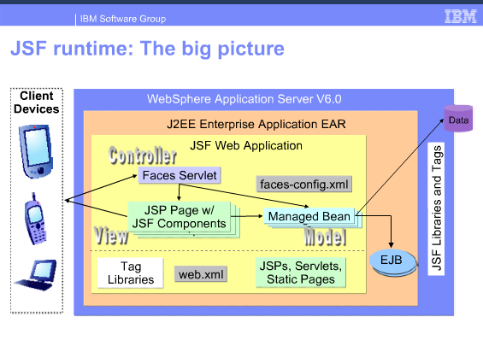
JSF Architecture

Slide 7
JSF First Application
Create Maven Webapp project
Update file pom.xml
Update web.xml
Create new Hello.java file
Create hello.xhtml file

Slide 8
JSF Functions
JSF - Managed Beans
JSF - Page Navigation
JSF – Tags
JSF - DataTable
JSF - Ajax
JSF - Event Handling
JSF - JDBC Integration
JSF - Expression Language
JSF and PrimeFaces

Slide 9
JSF - Managed Beans
Managed Bean is a regular Java Bean class registered with JSF. In other words, Managed Beans is a java bean managed by JSF framework.
The managed bean contains the getter and setter methods, business logic or even a backing bean (a bean contains all the HTML form value).
Managed beans works as Model for UI component.
Managed Bean can be accessed from JSF page.

Slide 10
JSF - Managed Beans
Configure Managed Bean with XML
Define the managed bean in a normal faces-config.xml file.
Example

Slide 11
JSF - Managed Beans
Configure Managed Bean with Annotation
Annotated a Managed Bean with @ManagedBean annotation
Example
Scope Annotations
@RequestScoped
@NoneScoped
@ViewScoped
@SessionScoped
@ApplicationScoped
@CustomScoped

Slide 12
JSF - Managed Beans
Injecting Managed beans in JSF 2.0
@ManagedProperty annotation is used to dependency injection (DI) a managed bean into the property of another managed bean
Example

Slide 13
JSF- Page Navigation
What is navigation?
Navigation rules are those rules provided by JSF Framework which describe which view is to be shown when a button or link is clicked.
Where navigation is configured?
Navigation rules can be defined in JSF configuration file named faces-config.xml.
Navigation rules can be defined in managed beans.
Navigation rules can contain conditions based on which resulted view can be shown.
JSF 2.0 provides implicit navigation as well in which there is no need to define navigation rules as such.

Slide 14
JSF- Page Navigation
Implicit Navigation in JSF 2.0
Conditional Navigation Rule in JSF 2.0
JSF “form-action” navigation rule
JSF : Page Forward vs Page Redirect

Slide 15
Implicit Navigation
Auto navigation in JSF page
Example: page1.xhtml – A JSF page with a command button to move from current page to “page2.xhtml”.
Auto navigation in Managed Bean
Example

Slide 16
Conditional Navigation
Use conditional navigation to solve the complex page navigation flow.
Example

Slide 17
JSF “form-action” navigation
There is circumstance: In managed bean, different methods returns same view name.
E.g:
public String processPage1(){
return "success";
}
public String processPage2(){
return "success";
}

Slide 18
JSF “form-action” navigation
Use “from-action” element to differentiate the two navigation cases in faces-config.xml
Example

Slide 19
JSF : Page Forward vs Page Redirect
Compare between Page Forward and Page Redirect.
How to do Page Forward and Page Redirect in JSF
Using “faces-redirect=true” in JSF file.
Using “<redirect>” tag in faces-config.xml
Examples

Slide 20
JSF - Tags
Basic Tags
Facelets Tags
Converter Tags
Validation Tags

Slide 21
JSF – Basic Tags
Basic Tags are tags help to render HTML standard tags
List of basic tags: h:inputText, h:inputSecret, h:inputTextarea, h:inputHidden, f:param, f:attribute,…
Example

Slide 22
JSF - Facelets Tags
JSF provides special tags to create common layout for a web application called facelets tags. These tags gives flexibility to manage common parts of a multiple pages at one place.
Example

Slide 23
JSF – Data Tables
JSF provides a rich control named DataTable to render and format html tables.
DataTable can iterate over collection or array of values to display data.
DataTable provides attributes to modify its data in easy way.
Example

Slide 24
JSF - Ajax
Brief Ajax technology
AJAX stands for Asynchronous JavaScript And Xml.
Ajax is a technique to use HTTPXMLObject of JavaScript to send data to server and receive data from server asynchronously.
So using Ajax technique, javascript code exchanges data with server, updates parts of web page without reloading the whole page.

Slide 25
JSF - Ajax
JSF Tag
<f:ajax execute="input-component-name" render="output-component-name" />
Example

Slide 27
JSF - Event Handling
When user click on button or link or they make change content of input component, such as h:inputText or h:selectOneMenu,.. one event will be fired by JSF.
This event will be handled by Listener.
Types of Event Handler:
valueChangeListener
actionListener
application Event

Slide 28
JSF - Event Handling
valueChangeListener: the event be fired when user change content of input component, such as h:inputText or h:selectOneMenu.
Example

Slide 29
JSF - Event Handling
actionListener: “Action Events” are fired by clicking on a button or link component, e.g h:commandButton or h:commandLink
Example

Slide 30
JSF and PrimeFaces
PrimeFaces is a component suite open source User Interface (UI) component library for JavaServer Faces (JSF) based applications (wikipedia).
Link: http://www.primefaces.org/showcase/
Example

Slide 31
THANK YOU

