Slide 1

BIPOWER TRACKER
Prepared by :
Manhal Mohamed 21905046
Ahmed salah abdalhi 21904793
Mowafug mohammed abdalla adam 22703734
Mohamed abubaker m. abusoba 19700148
Project supervisor : Prof . DR Runyi Yu

Slide 2
Outlines :
Project Statement
Project Overview
Project Design
Blynk
Cost Analysis
Engineering Standards
Conclusion
Questions And Answers

Slide 3
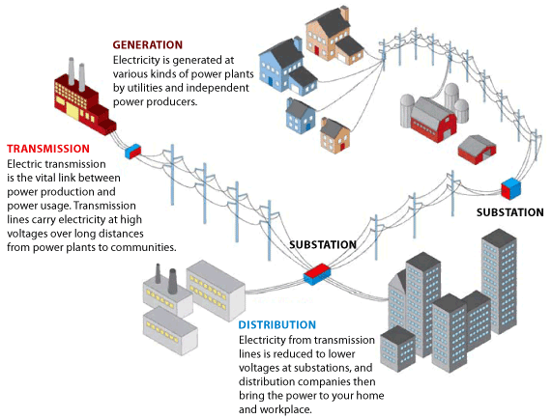
Growing Electricity Demand:
The demand for electricity has significantly increased, resulting in a rise in power generation. However, the high expenses and environmental issues associated with fossil fuels have generated a strong interest in renewable energy, particularly solar power.

Slide 4
PROJECT statement

Slide 5
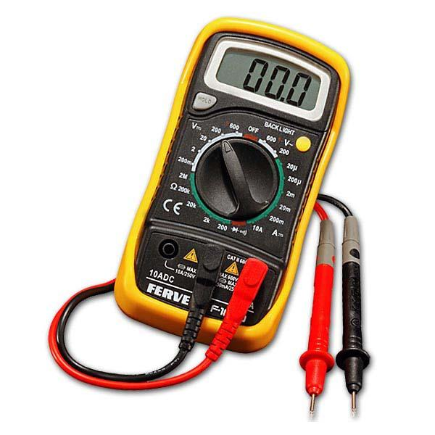
One-way tracker (meter)
Energy Meter is a handy device that measures and keeps track of important electrical parameters.
Most common DC or AC Energy Meters can only measure values in one direction, which is okay for regular household use and simple power generation.
Uni-directional Energy Meters work well for basic setups but become problematic for systems with both forward and backward current flow, like in Solar PV Applications.

Slide 6
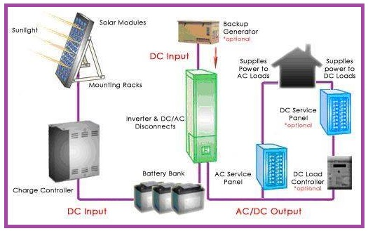
Issues in Solar pv systems
For off-grid PV systems, where batteries involve charging and discharging, and on-grid PV systems, where there's import and export of AC current, using a typical one-way Energy Meter may lead to errors or miss readings.

Slide 7
Importance of Bi-directional trackers ( Meters):
Systems involving two-way current flow, like solar applications, require a special Bi-directional Energy Meter to accurately measure both directions without errors

Slide 8
PROJECT OVERVIEW

Slide 9
Today's project involves creating a Bi-directional AC & DC Energy tracker that can monitor both types of power flow and we'll keep track of it using the Blynk app for remote monitoring.
Flexible Solution for Solar PV:
This energy tracker is designed to be a comprehensive solution for measuring Solar PV Applications, providing flexibility for both DC and AC power flow.
Online Remote Monitoring:
Through the Blynk app, we can monitor these parameters in real-time from anywhere, making it convenient for online remote monitoring.

Slide 10
Recorded Parameters:
DC Parameters:
DC Voltage (Vdc)
DC Export/Import Current (Idc)
DC Power with direction (Wdc)
DC Accumulated Net Energy (Wh-dc)
DC Accumulated Import Energy (Wh-dc
DC Accumulated Export Energy (Wh-dc)
AC Parameters:
RMS AC Voltage (Vac)
RMS AC Export/Import Current (Iac)
AC Real Power with direction (Wac)
Apparent Power (VAac)
AC Accumulated Net Energy (Wh-ac)
AC Accumulated Import Energy (Wh-ac)
AC Accumulated Export Energy (Wh-ac)
Power Factor (Pf)

Slide 11
PROJECT DESIGN

Slide 12
Control Circuit
Power Circuit

Slide 13
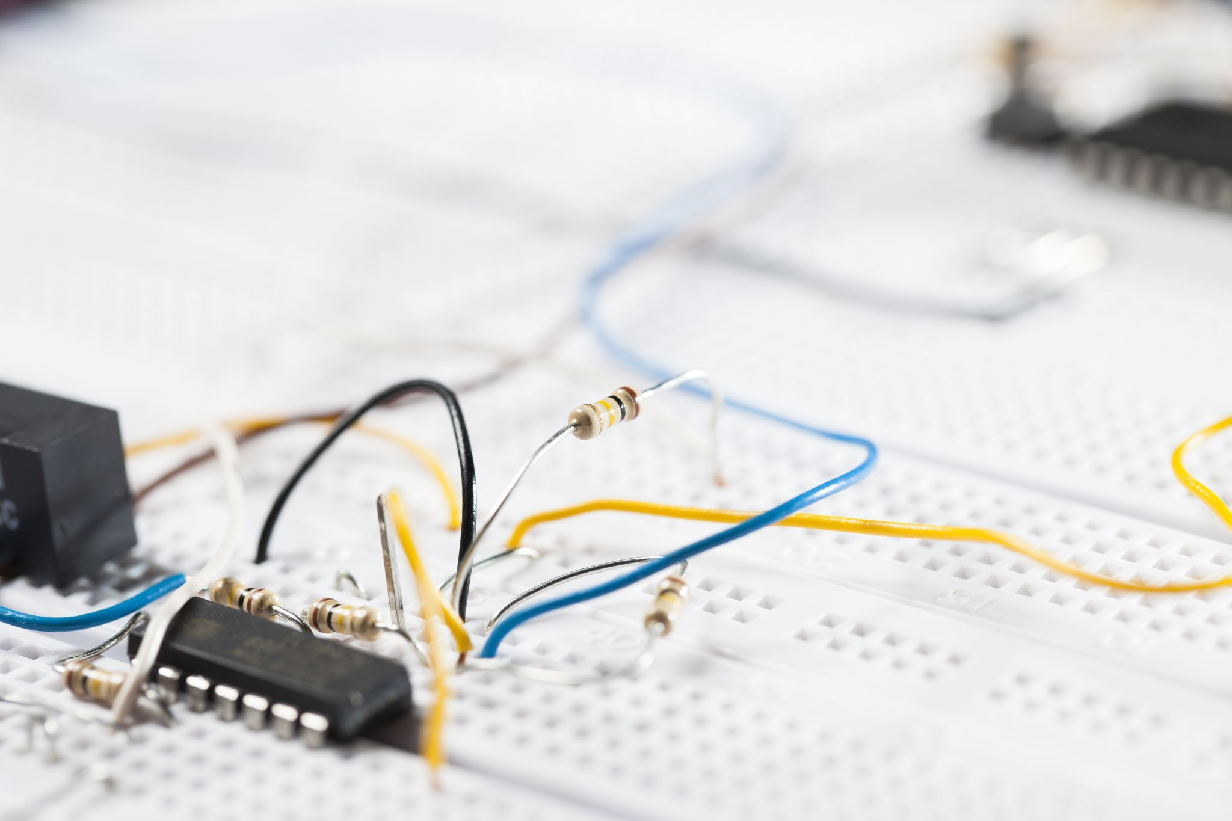
Control circuit :

Slide 14
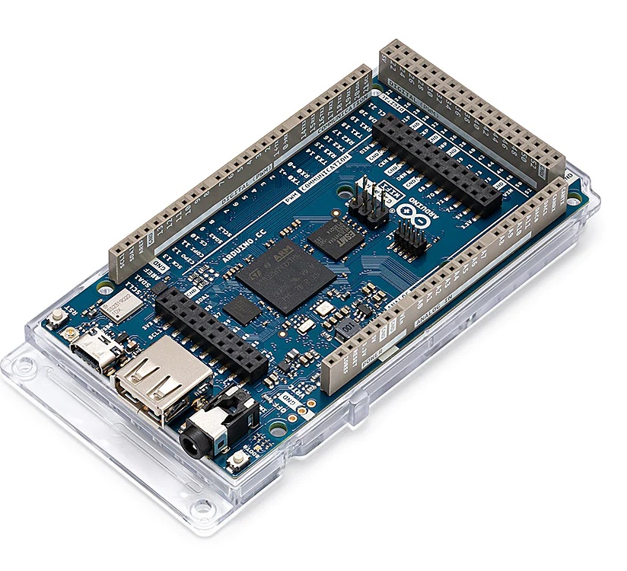
Arduino mega 2560
The Arduino Mega 2560 serves as the central processing unit (CPU) in our system.
It establishes connections with all other electrical components through its versatile I/O (input/output) pins.

Slide 15
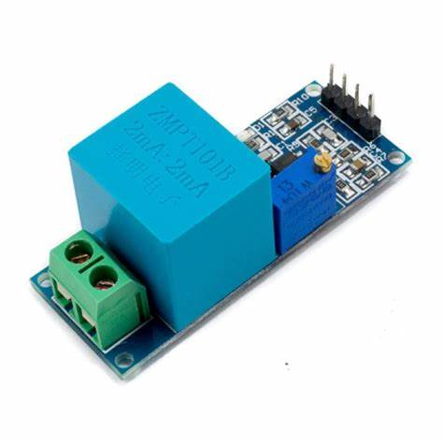
ZMPT101B Voltage Module
The ZMPT101B Voltage Module is a small and flexible sensor created to check AC voltages from 0 to 250V. It produces a voltage signal that matches the measured voltage, making it simple to link with and use alongside microcontrollers.

Slide 16
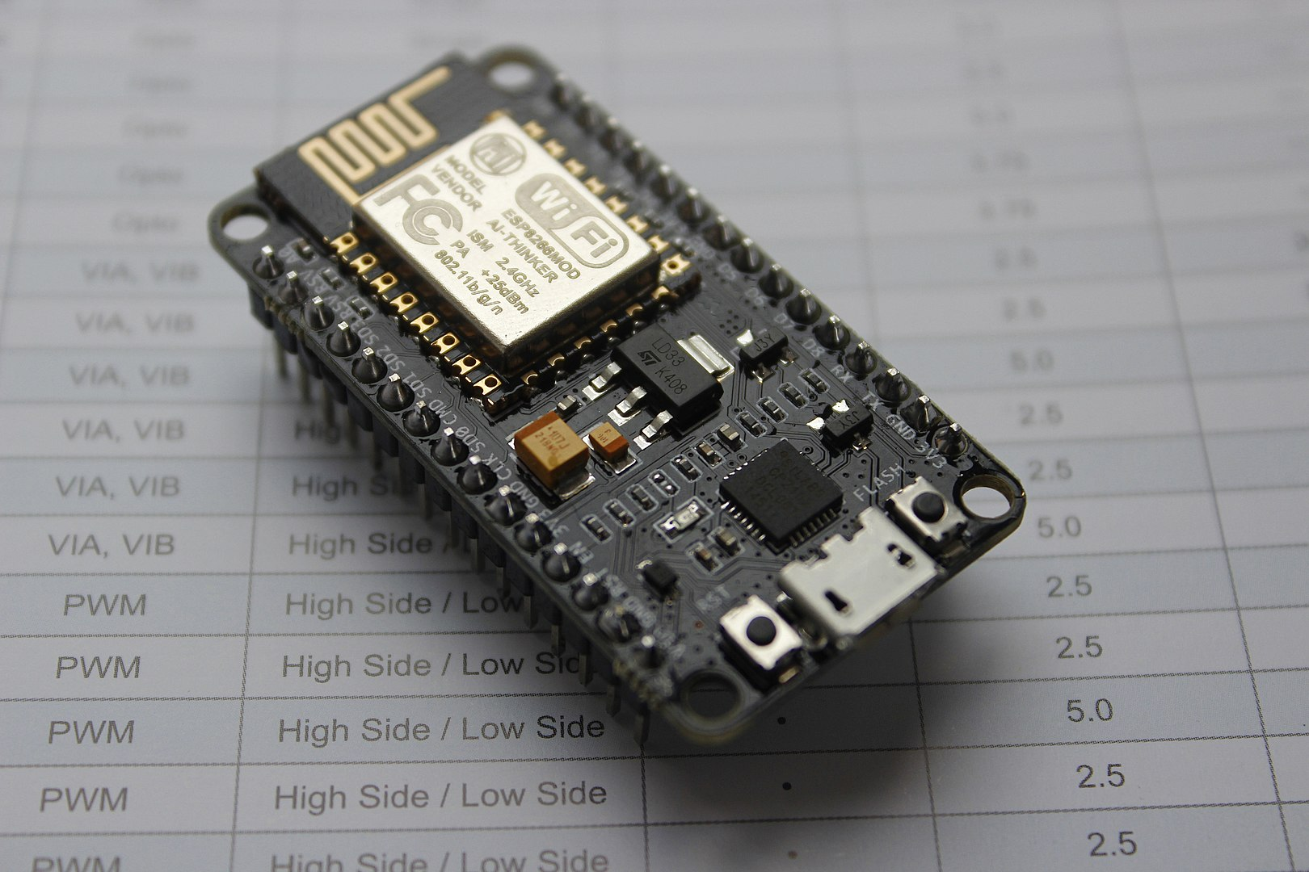
The FireBeetle ESP8266
The FireBeetle ESP8266 is like a central hub for talking wirelessly, made especially for low-power Internet of Things (IoT) projects. It has a 32-bit brain (MCU), a 10-bit sensor (ADC), and can connect to the Internet of Things through Wi-Fi and other interfaces like HSPI, UART, PWM, I2C, and I2S.

Slide 17
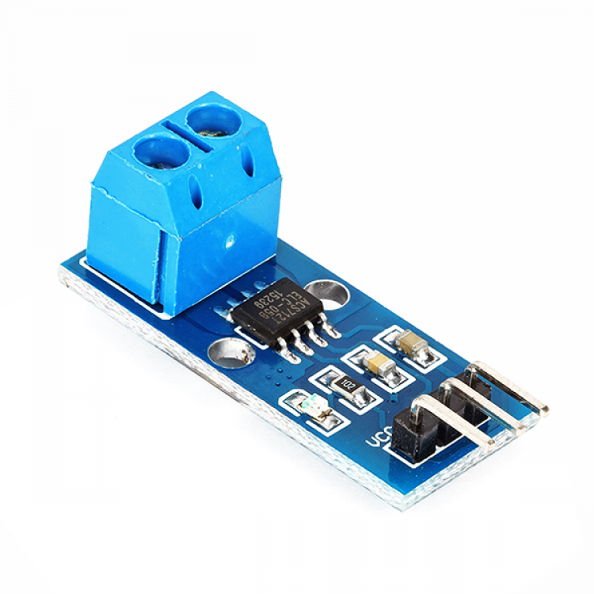
The ACS712 Hall-Effect-Based Linear Current Sensor
The ACS712 Hall-Effect-Based Linear Current Sensor works by using a special circuit and a copper path on the surface. When electric current passes through this copper path, it creates a magnetic field. The sensor then turns this magnetic field into a voltage signal.

Slide 18
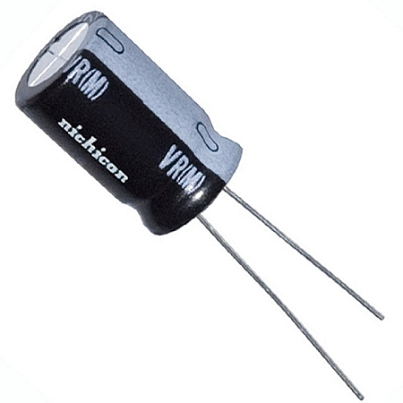
Electrolytic capacitor:
An electrolytic capacitor, measured in farads (F), is a particular kind of capacitor that employs electrolytes to increase its capacitance.

Slide 19
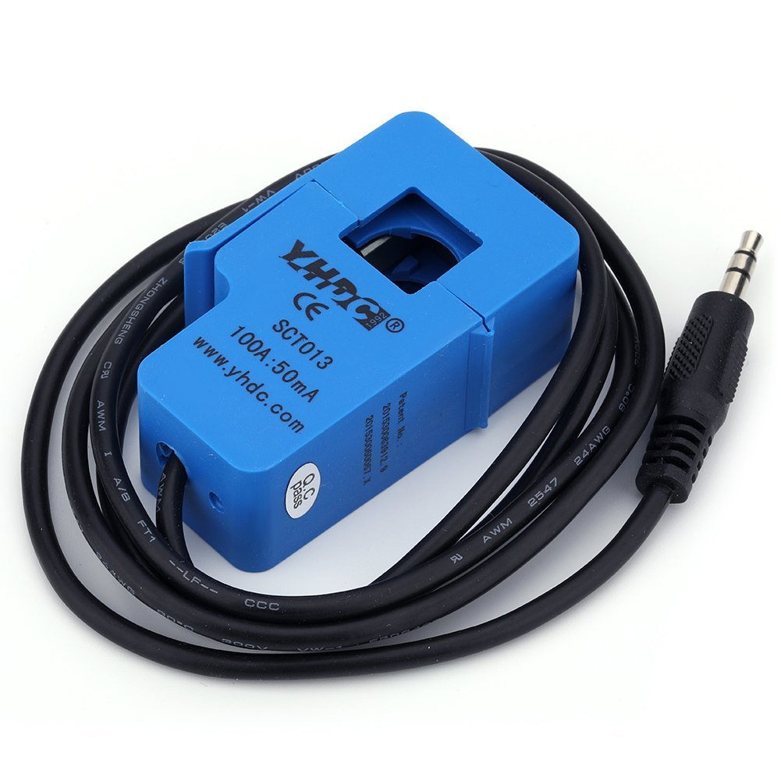
SCT013 Hall-Effect Current Transformer:
The SCT013 measures electric current in a conductor using the Hall Effect.
this transformer provides a way to measure alternating current (AC) without needing to physically touch or disturb the electrical system.

Slide 20
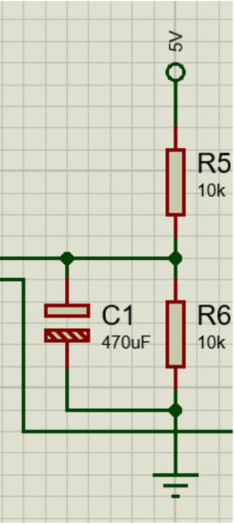
The SCT013 Hall-Effect Current Transformer collaborates with a capacitor and two 10K ohms resistors to measure AC. This circuit serves the purpose of powering up the sensor as a sourcing module.

Slide 21
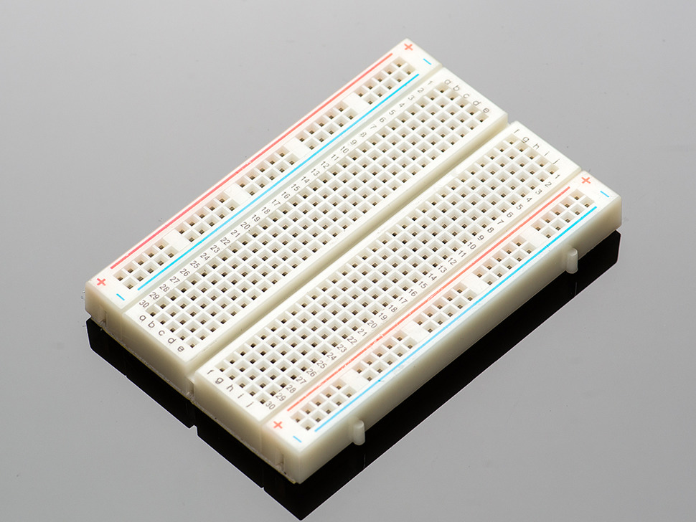
Breadboard
Breadboards are flexible platforms for temporarily assembling electronic circuits without soldering. They use metal clips for easy component insertion, allowing quick modifications and troubleshooting during prototyping.

Slide 22
Power circuit

Slide 23
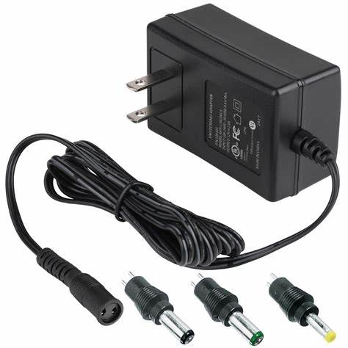
Power Supply:
The power supply is set at 12 volts and 2 amperes, ensuring a steady and controlled electrical output.
provide 12 volts of power
a maximum of 2 amperes

Slide 24
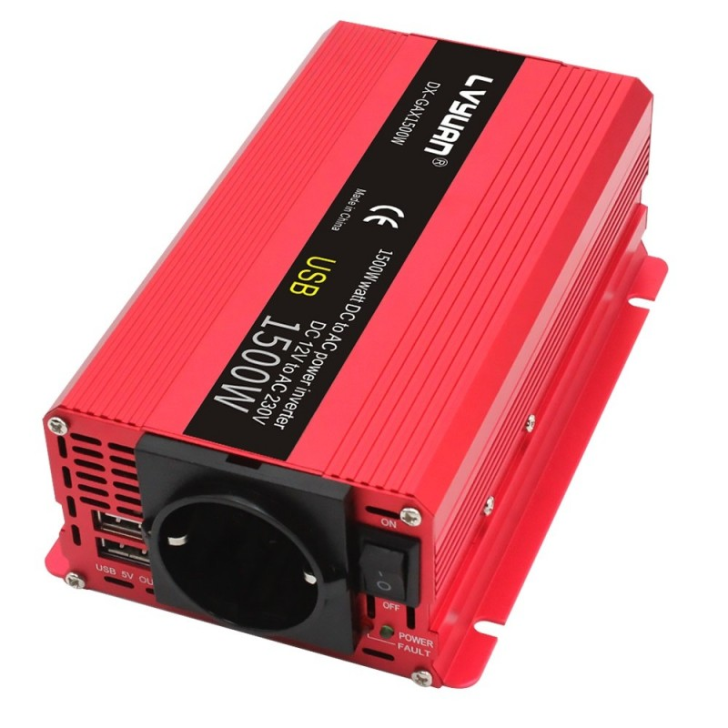
DC-to-AC inverter
A DC-to-AC inverter is an electronic tool that transforms direct current (DC) power, commonly from a battery or solar panel, into alternating current (AC).
This is necessary for running devices that need AC electricity when the power source is DC.

Slide 25
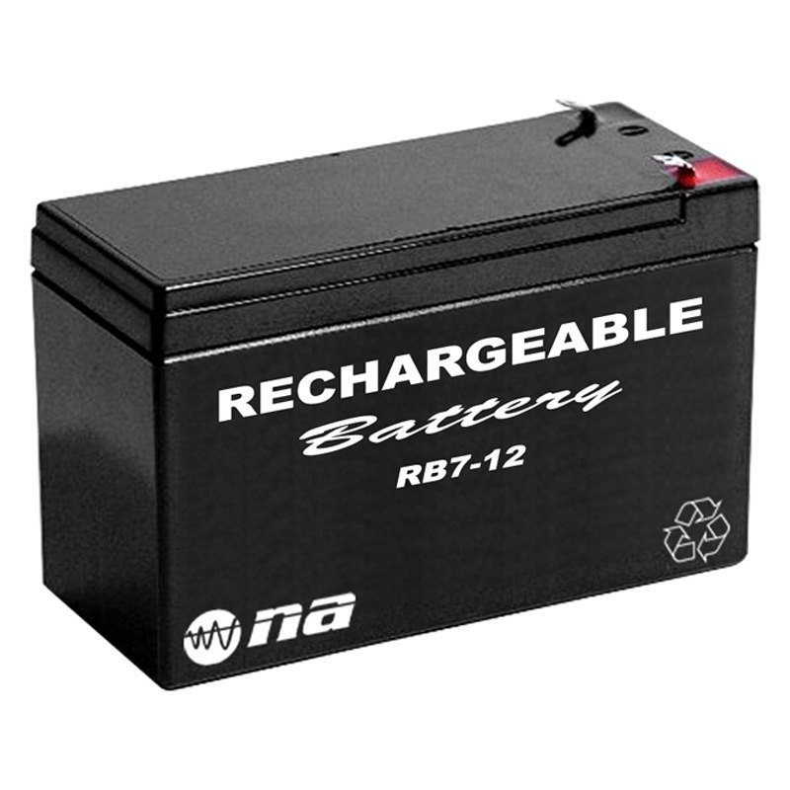
Rechargeable Battery:
The 12V, 7AH Rechargeable Battery is a small and adaptable energy storage option.
It operates at 12 volts and has a capacity of 7 ampere-hours, offering a compact solution for power needs.

Slide 26
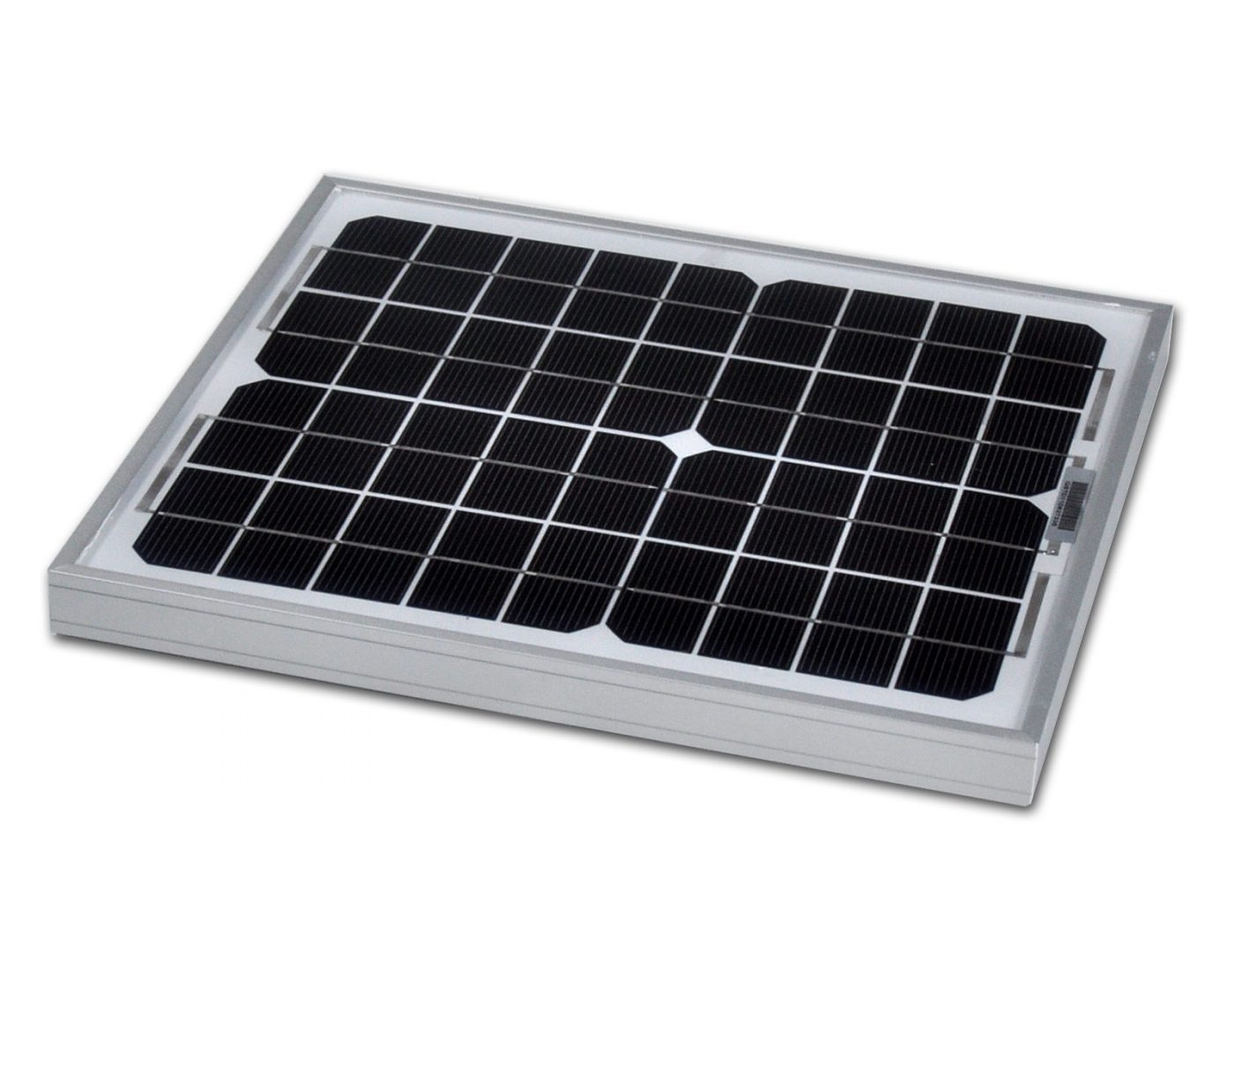
Solar Panel:
The 10W solar panel is a little and effective sunlight-powered module that makes about 10 watts of power from the sun.
It's made to be flexible and user-friendly, often used for small solar jobs

Slide 27
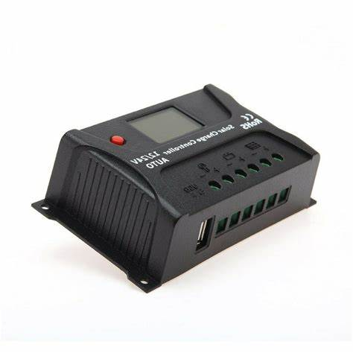
Solar Charge Controller:
This device is designed to manage and monitor the charging of solar batteries by adjusting the voltage and current from solar panels.

Slide 28
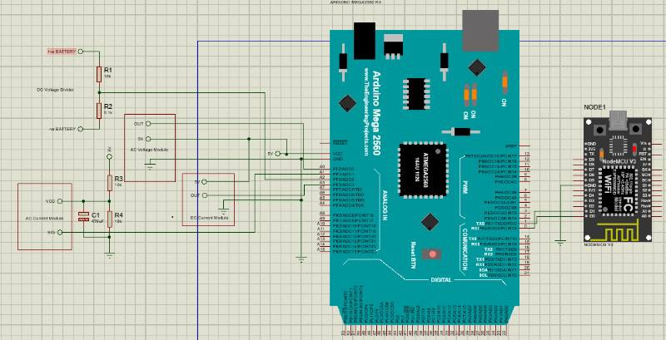
Control circuit schematic design

Slide 29
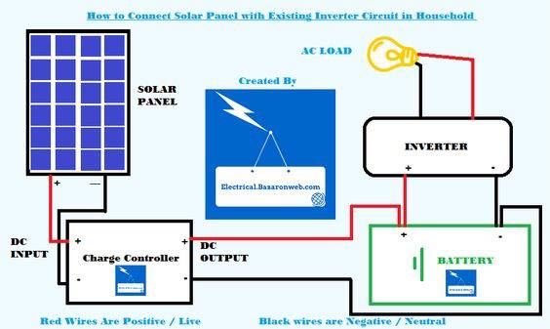
Power circuit design

Slide 30
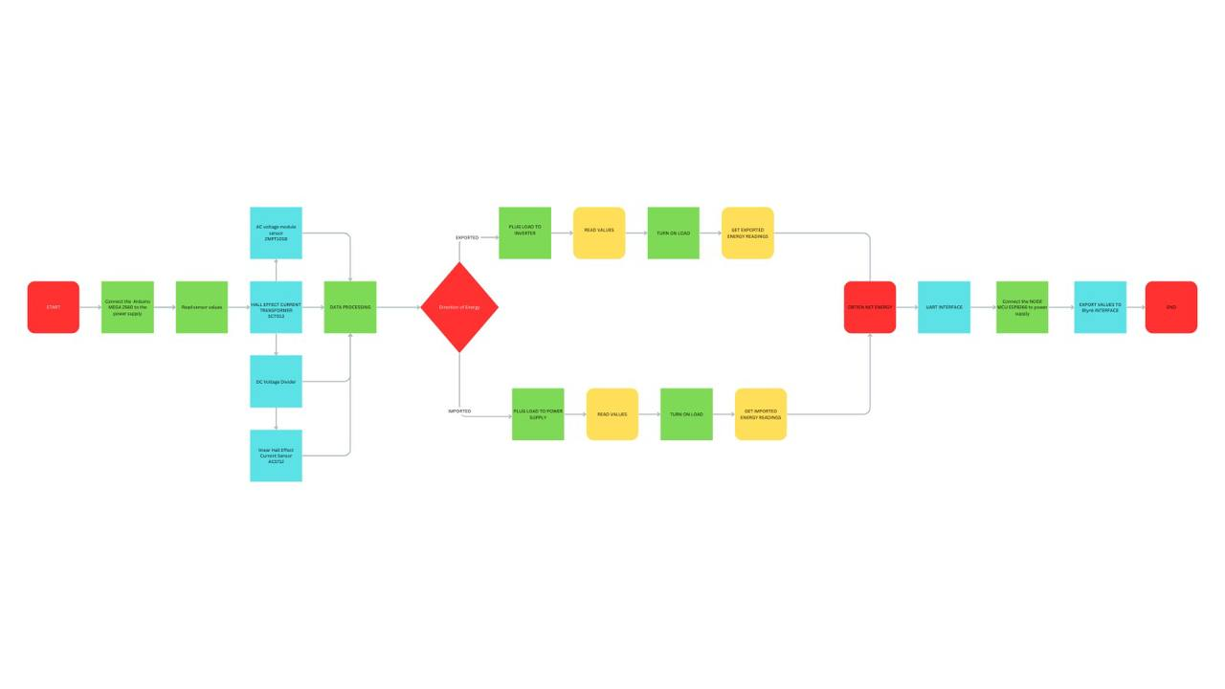
Flowchart

Slide 31
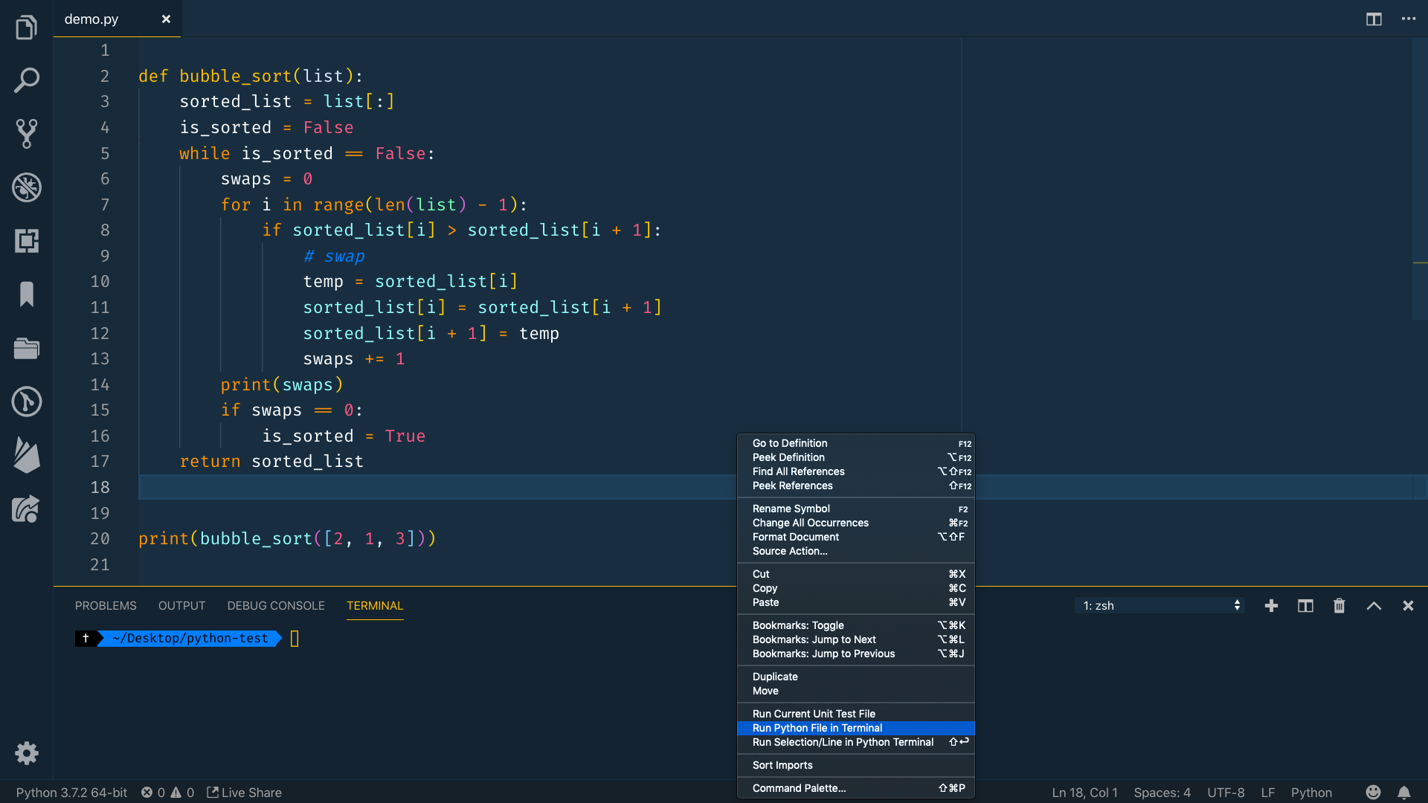
Code :
ARDUINO MEGA 2560
FIREBEETLE ESP8266
Blynk APP
THESE CODES ARE FURTHER EXPLAINED IN ARDUINO IDE
This Photo by Unknown author is licensed under CC BY-SA-NC.

Slide 32
Blynk

Slide 33
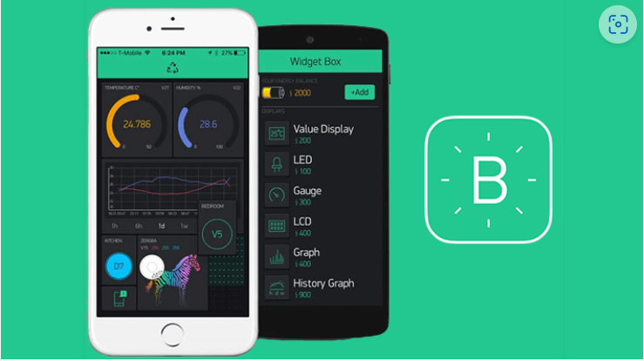
Blynk interface
Blynk is designed for IoT projects, providing a user-friendly platform.
Enables easy control of devices through a mobile app.
Users can create personalized interfaces with buttons and graphs for their IoT devices.

Slide 34
Real-time sensors readings :

Slide 35
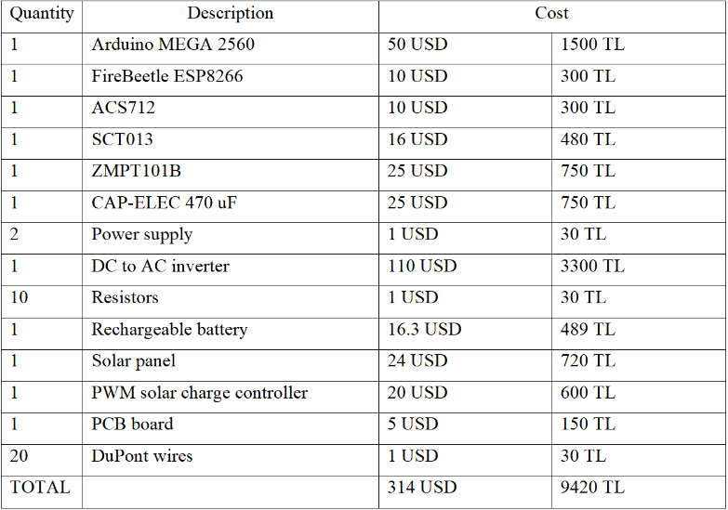
Cost analysis

Slide 36
ENGINEERING STANDARDS
IEC 60364: Electrical installations for buildings.
IEC 60479: Effects of current on human beings and livestock.
IEC 61010: Safety requirements for electrical equipment for measurement, control, and laboratory use.
IEC 61131: Industrial automation systems and integration – Programmable controllers
IEC 61784: Industrial communication networks – Field-bus specifications
IEC 62304: Medical device software – Software life cycle processes
ISO/IEC 12207: Systems and software engineering – Software life cycle processes
ISO/IEC 15504: Information technology – Process assessment
ISO/IEC 25020: Systems and Software Engineering – Systems and Software Quality

Slide 37
conclusion
The BIPOWER tracker, with its accuracy, reliability, and user-friendly interface, holds promise as an efficient solution for monitoring and controlling electrical systems.
The project demonstrated accuracy and reliability in measuring electrical parameters, ensuring trustworthy data.
Users can conveniently access and control the BIPOWER tracker from anywhere, improving overall system accessibility.
The system's ability to measure both AC and DC parameters adds versatility, making it suitable for diverse electrical setups.

Slide 38
Q&A'S

