Slide 1

SMART INDIA HACKATHON 2026
HexaViz: on-device visual perception with privacy-before-transmission
Problem Statement ID
SIH26171
Problem Statement Title
On-device Visual Perception for Light-weight Browser Agents
Theme
Miscellaneous
PS Category
Software
Team ID
K26002
Team Name
HexaTech

Slide 2
HexaTech
The Problem and Our Solution
Manual browser tasks
Agents cannot truly see
Raw screen = sensitive data
Users still navigate pages, find UI elements and run multi-step workflows by hand.
DOM/text misses canvas widgets, images, PDFs and custom controls. Agents need to perceive the rendered screen.
Screens hold faces, passwords, Aadhaar/PAN, cards and emails. Sending raw pixels to a cloud model is a privacy risk.
OUR SOLUTION: PRIVACY BEFORE TRANSMISSION
ON-DEVICE | USER'S BROWSER
CLOUD
1 SCREEN
2 LOCAL PERCEPTION
3 PII DETECTION
4 REDACTION
5 VERIFY
6 SAFE CONTEXT
7 AGENT REASONING
Rendered page, one frame per agent step
On-device models find UI elements, faces, text
Aadhaar, PAN, card, email, OTP, faces
Blur, mask or pixelate on-device
Re-scan output. PII left = block (fail-closed)
Redacted frame + numbered elements
Qwen via Groq (cloud, current). Returns e.g. click #7
By design, raw pixels stay in the browser. Only the verified, redacted frame and numbered elements cross the trust boundary.
WHAT IS NEW IN HEXAVIZ
INTEGRATING
INTEGRATING
INTEGRATING
INTEGRATING
Vision-first perception
Redact before reason
Fail-closed privacy gate
Change-aware and marked
In-browser vision models (WebGPU / ONNX Runtime) parse the screenshot into numbered UI elements. DOM is a cross-check.
Faces, passwords, Aadhaar, PAN, cards, emails and OTPs are blurred or masked on-device before anything is sent.
A second scan checks the redacted frame. If PII remains or any stage fails, nothing is sent. A local log lists sent frames.
Frame-diff re-runs models only on changed regions. The server answers with marks ("click #7"), not raw pixels.
SIH2026 | SIH26171 | Team HexaTech (K26002)
2

Slide 3
HexaTech
System Architecture: Vision Runs On-Device
ON-DEVICE | USER'S BROWSER (Chrome / Edge, Manifest V3)
TRUST
BOUNDARY
REASONING SIDE
1
Screen Capture
2
Local Vision
3
Privacy Filter
4
Verification Gate
CROSSES: redacted frame, safe metadata, numbered elements
5
Agent Server
captureVisibleTab gives an ImageBitmap. One frame per agent step, sized to 640 px for the models.
ONNX Runtime Web on WebGPU (WASM fallback). UI detector, face detector, text OCR.
Detect and classify PII (faces, Aadhaar, PAN, cards, emails). Blur, mask or pixelate.
Re-scan the redacted frame. PII found or any stage fails = block. Fail-closed.
WORKING: CLOUD
Node + TypeScript. Qwen via Groq. Reads redacted frame + numbered elements, returns structured action JSON.
RAW SCREEN DATA
never crosses
INTEGRATING
INTEGRATING
INTEGRATING
PLANNED
next frame
7
Frame Diff, Verify and Re-plan
6
Action Executor
Offline / open-weight path
Next-frame diff confirms the effect. Retry or re-plan on mismatch. Frame-diff also limits model re-runs to changed regions.
Maps mark #id to a target. Click, type, scroll via Chrome APIs.
Locally hosted open-weight model or small on-device VLM replaces the cloud call.
action JSON only
(e.g. click #7)
WORKING (LOOP)
WORKING
Trust boundary: raw screen data stays in the browser. Only the verified redacted frame, safe metadata and numbered elements cross.
Current prototype: cloud reasoning (Qwen via Groq). Offline / open-weight reasoning: a planned deployment path, not yet implemented.
SIH2026 | SIH26171 | Team HexaTech (K26002)
3

Slide 4
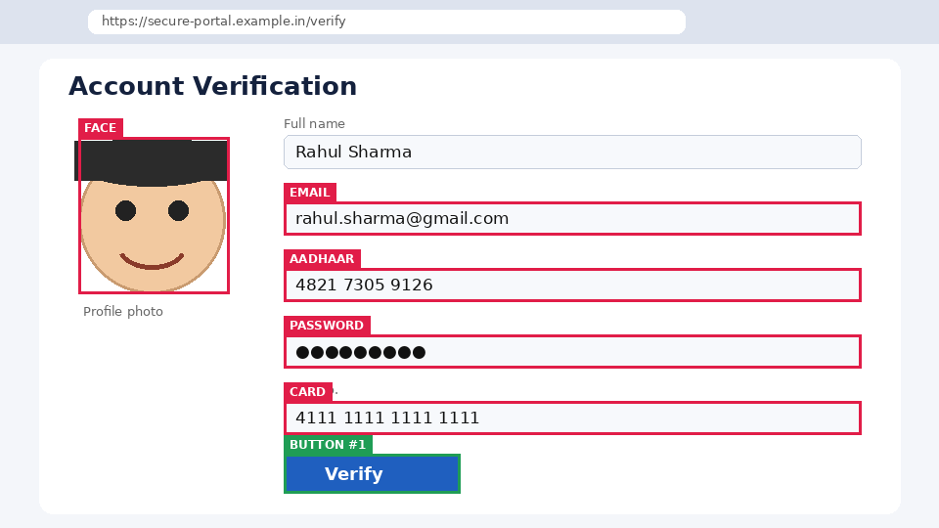
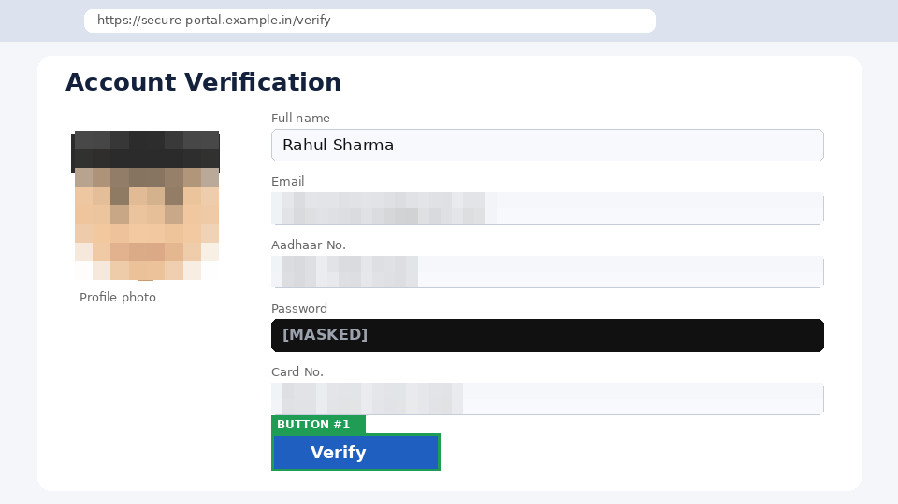
HexaTech
How It Works: Local Vision and Privacy Filter
SYNTHETIC EXAMPLE
SYNTHETIC EXAMPLE
VERIFY GATE (FAIL-CLOSED)
LOCAL
PROCESSING
PII clear
send the redacted frame
PII remains or a stage fails
BLOCK: nothing is sent
BEFORE: detected locally, never leaves device
AFTER: what the server receives
1 DETECT
2 CLASSIFY
3 REDACT
4 VERIFY
5 BLOCK IF PII REMAINS
Faces, text and password fields located by local models.
Aadhaar (Verhoeff), card (Luhn), PAN, email, phone, OTP.
Pixelate faces, solid-mask secrets, blur emails, strip metadata.
Re-scan the redacted output.
Any PII found blocks the send. Nothing leaves the browser.
ON-DEVICE MODELS (ONNX INT8)
INTEGRATING
UI detector: YOLO / ViT-Tiny | Faces: YuNet (under 1 MB) | Text + OCR: PP-OCR mobile | WebGPU first, WASM fallback | Frame-diff: changed tiles only
Illustrative synthetic example, dummy data. Not a benchmark: redaction precision and recall are not yet measured (see slide 5).
SIH2026 | SIH26171 | Team HexaTech (K26002)
4

Slide 5
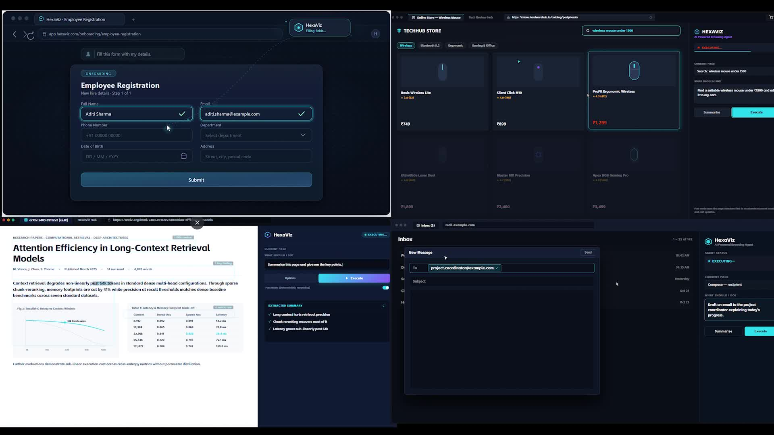
HexaTech
Prototype and Results Metrics
TARGETS
Design budgets, not results. Measured column stays pending until benchmarks finish.
Metric | Target | Measured by | Measured
UI detection mAP@0.5 | 0.80 or higher | Held-out UI screenshots | Pending
PII redaction recall | 0.95+; passwords 1.00 | 200 pages, synthetic PII | Pending
PII redaction precision | 0.90 or higher | Same set, over-redaction | Pending
Latency per frame | 300 ms GPU; 1.2 s WASM | performance.now() | Pending
Model footprint (INT8) | 40 MB; 400 MB peak GPU | DevTools profiler | Pending
Raw frames sent out | 0; redacted JPEG 150 KB max | Network tab audit | Pending
Task success rate | 75% or higher | Form, store, inbox, research | Pending
Demo video: HexaViz agent running tasks in the browser
Build status
IMPLEMENTED
INTEGRATING
MEASURED RESULTS
Chrome MV3 extension
Node/TS agent server, Qwen via Groq (cloud)
Plan-act-observe-verify loop
On-device vision (ONNX Runtime Web, WebGPU) replacing DOM-first perception
Privacy filter with verify gate before any frame is sent
Current status: benchmark collection in progress
Planned: latency vs accuracy trade-off (GPU vs WASM)
Firefox: not yet tested (Chrome / Edge only)
SIH2026 | SIH26171 | Team HexaTech (K26002)
5

Slide 6
HexaTech
Feasibility, Scalability, Impact and References
Feasibility
Scalability
Impact
Working prototype is a Chrome MV3 extension + Node/TS server. Open-source stack (ONNX Runtime Web, Transformers.js). INT8 models sized for integrated GPUs; footprint to be measured.
Perception runs at the edge, so server load drops. Stateless agent server scales horizontally. Cost is mostly LLM tokens.
Individual users and elders, SMEs, banking and financial workflows, government portals, visually impaired users. Designed with the DPDP Act 2023 in mind.
Sustainability
User Experience
Future Work
Lightweight local processing avoids cloud GPUs and cuts unneeded data transmission. Open browser technologies. Swappable models, no vendor lock-in.
Say a goal in plain words. Live overlay shows what was redacted. Privacy log and consent toggle. Graceful fallbacks.
All steps after the prototype are planned, not built. Each one swaps a single component behind the same trust boundary.
FUTURE PROGRESSION
BUILT
PLANNED
PLANNED
PLANNED
PLANNED
Current prototype
Offline reasoning
Firefox
Indic OCR
Mobile / enterprise
Chrome / Edge MV3, cloud reasoning (Qwen via Groq)
Local open-weight model or small on-device VLM
Port and test; not yet tested
Indic-script text detection and redaction
Mobile browsers, enterprise PII policy packs
KEY REFERENCES
[1] SIH 2026, SIH26171 problem statement
[2] Chrome Extensions MV3: developer.chrome.com/docs/extensions
[3] WebGPU: developer.mozilla.org/docs/Web/API/WebGPU_API
[4] ONNX Runtime Web: onnxruntime.ai/docs/tutorials/web
[5] Transformers.js: huggingface.co/docs/transformers.js
[6] OmniParser: github.com/microsoft/OmniParser
[7] YuNet face detector: github.com/opencv/opencv_zoo
[8] PaddleOCR: github.com/PaddlePaddle/PaddleOCR
[9] Ultralytics YOLO: docs.ultralytics.com
[10] Groq API: console.groq.com/docs | Qwen: github.com/QwenLM
SIH2026 | SIH26171 | Team HexaTech (K26002)
6

