Slide 1

SMART INDIA HACKATHON 2026
HexaViz: on-device visual perception with privacy-before-transmission
Problem Statement ID
SIH26171
Problem Statement Title
On-device Visual Perception for Light-weight Browser Agents
Theme
Miscellaneous
PS Category
Software
Team ID
K26002
Team Name
HexaTech

Slide 2




















HexaTech
The Problem and Our Solution
MANUAL BROWSER TASKS
AGENTS CANNOT FULLY SEE
RAW SCREEN = SENSITIVE DATA
Canvas
SCREEN contains:
DOM / TEXT
Images
Face
Password
USER
SEARCH
FIND
FILL
REPEAT
PDFs
Aadhaar / PAN
Card
Agents need to perceive the rendered screen
Every multi-step workflow is done by hand
Custom controls
Email
OTP
HEXAVIZ PRIVACY BEFORE TRANSMISSION
ON-DEVICE | USER'S BROWSER
CLOUD
ON-DEVICE
1 SCREEN
2 LOCAL PERCEPTION
3 PII DETECTION
4 REDACTION
5 VERIFY
6 SAFE CONTEXT
7 AGENT REASONING
8 ACTION
1 frame per agent step
UI · faces · text
Aadhaar · PAN · card · email · OTP
Blur · mask · pixelate
Re-scan. PII left = BLOCK
Redacted frame + numbered elements
Qwen via Groq (cloud, current) → click #7
Click · type · scroll
TRUST BOUNDARY
BY DESIGN, RAW PIXELS STAY IN THE BROWSER. Only the verified, redacted frame and numbered elements cross the trust boundary.
INTEGRATING
INTEGRATING
INTEGRATING
INTEGRATING
Vision-first perception
Redact before reason
Fail-closed privacy gate
Change-aware and marked
Numbered UI elements; DOM as cross-check
Blur / mask on-device before anything is sent
2nd scan; any failure = nothing is sent
Frame-diff: re-run only changed regions
SIH2026 | SIH26171 | Team HexaTech (K26002)
2

Slide 3



HexaTech
System Architecture: Vision Runs On-Device
TRUST BOUNDARY
ON-DEVICE | USER'S BROWSER (Chrome / Edge, Manifest V3)
REASONING SIDE
CROSSES
redacted frame
safe metadata
numbered elements
1 SCREEN CAPTURE
2 LOCAL VISION
3 PII DETECTION
4 PRIVACY FILTER
5 VERIFY GATE
6 AGENT SERVER
Webpage → 1 frame per step, 640 px
UI · face · text (ONNX, WebGPU)
Aadhaar · PAN · card · email · face
Blur · mask · pixelate
Re-scan; PII left = BLOCK (fail-closed)
RAW SCREEN DATA
NEVER CROSSES
Node + TypeScript · Qwen via Groq (current cloud implementation)
INTEGRATING
INTEGRATING
INTEGRATING
INTEGRATING
IMPLEMENTED
next frame
8 VERIFY / RE-PLAN
WEBPAGE
7 ACTION EXECUTOR
action JSON only
STRUCTURED ACTION
"CLICK #7"
Next-frame diff; retry on mismatch
Page changes after the action
Click · type · scroll (Chrome APIs)
IMPLEMENTED
IMPLEMENTED
CURRENT
Cloud reasoning
Qwen via Groq
PLANNED
Offline / open-weight
Legend
IMPLEMENTED
INTEGRATING
PLANNED
Trust boundary: raw screen data stays in the browser. Only the verified redacted frame, safe metadata and numbered elements cross.
Current prototype: cloud reasoning (Qwen via Groq). Offline / open-weight reasoning: PLANNED, not yet implemented.
SIH2026 | SIH26171 | Team HexaTech (K26002)
3

Slide 4
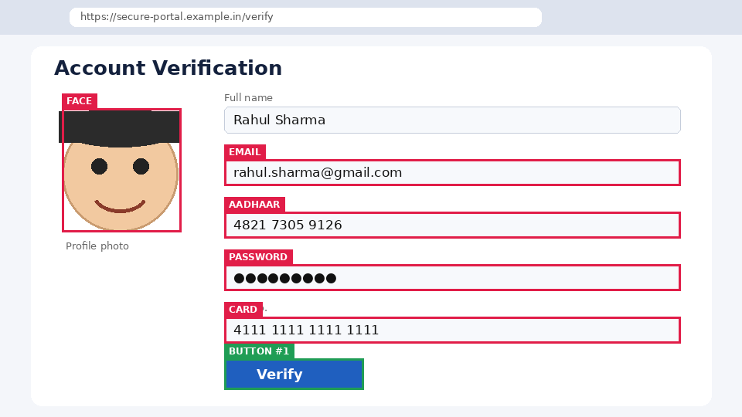

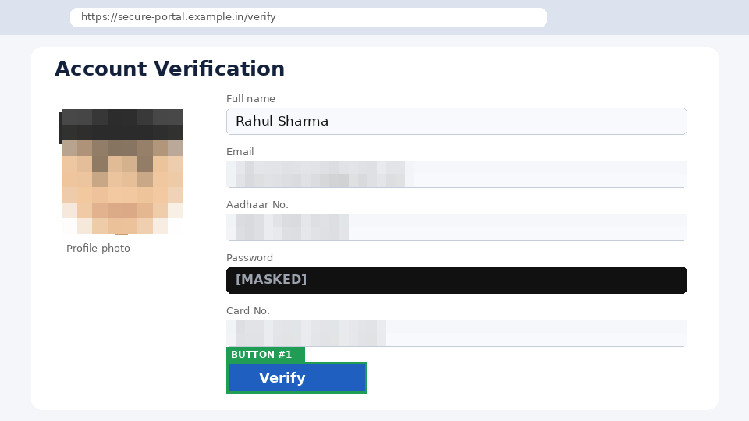





HexaTech
How It Works: Local Vision and Privacy Filter
BEFORE
LOCAL PROCESSING · ON-DEVICE
AFTER
SYNTHETIC / ILLUSTRATIVE
1 DETECT faces · text · password fields
SYNTHETIC / ILLUSTRATIVE
2 CLASSIFY Aadhaar · card · PAN · email · OTP
3 REDACT pixelate · mask · blur · strip metadata
4 RE-SCAN re-check the redacted output
5 VERIFY fail-closed gate
Sensitive information visible locally
Only verified redacted context can leave the browser
FAIL-CLOSED
PII remains or any stage fails → nothing is sent
VERIFY
PII CLEAR → SEND redacted frame
PII FOUND → BLOCK: nothing is sent
ON-DEVICE MODELS (ONNX INT8)
UI detector
YOLO / ViT-Tiny
Faces
YuNet (under 1 MB)
Text + OCR
PP-OCR mobile
Runtime
WebGPU first, WASM fallback
Frame-diff
changed tiles only
INTEGRATING
RAW PIXELS NEVER LEAVE THE DEVICE
SYNTHETIC / ILLUSTRATIVE EXAMPLE, dummy data. Not a benchmark: redaction precision and recall are not yet measured (see slide 5).
SIH2026 | SIH26171 | Team HexaTech (K26002)
4

Slide 5
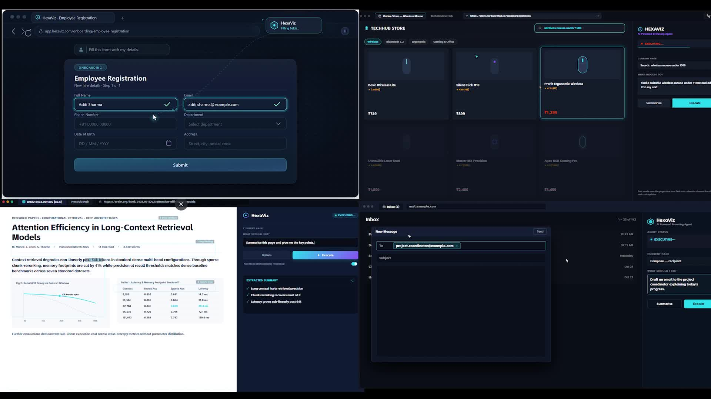




HexaTech
Prototype and Results Metrics
BROWSER
PERCEPTION
PRIVACY
AGENT
ACTION
VERIFY
Chrome MV3 extension
On-device vision (ONNX RT Web, WebGPU)
Privacy filter + verify gate
Node/TS server · Qwen via Groq (cloud)
Click · type · scroll
Plan-act-observe-verify loop
IMPLEMENTED
INTEGRATING
INTEGRATING
IMPLEMENTED
IMPLEMENTED
IMPLEMENTED
TARGET
Design budgets, not results. Measured stays pending until benchmarks finish.
UI DETECTION mAP@0.5
MEASURED: PENDING
MODEL FOOTPRINT (INT8)
MEASURED: PENDING
0.80 or higher
40 MB; 400 MB peak GPU
Measured by: Held-out UI screenshots
Measured by: DevTools profiler
PII REDACTION RECALL
MEASURED: PENDING
RAW FRAMES SENT OUT
MEASURED: PENDING
0.95+; passwords 1.00
0; redacted JPEG 150 KB max
Measured by: 200 pages, synthetic PII
Measured by: Network tab audit
PII REDACTION PRECISION
MEASURED: PENDING
TASK SUCCESS RATE
MEASURED: PENDING
0.90 or higher
75% or higher
Measured by: Same set, over-redaction
Measured by: Form, store, inbox, research
LATENCY PER FRAME
MEASURED: PENDING
ALL MEASURED VALUES: PENDING
Benchmark collection in progress
Demo video: HexaViz agent running tasks in the browser
300 ms GPU; 1.2 s WASM
Measured by: performance.now()
IMPLEMENTED
INTEGRATING
TARGET
PLANNED
Status colors show implementation state only, not performance quality.
Benchmark collection in progress
Latency vs accuracy trade-off (GPU vs WASM)
Firefox: not yet tested (Chrome / Edge only)
MEASURED: PENDING
PLANNED
PLANNED
SIH2026 | SIH26171 | Team HexaTech (K26002)
5

Slide 6









HexaTech
Feasibility, Scalability, Impact and References
IMPACT
FEASIBILITY
HEXAVIZ
Browser Extension
Lightweight Perception
Chrome MV3 + Node/TS server (working prototype)
Open-source stack; INT8 for integrated GPUs; footprint to be measured
Individuals & elders
Enterprises / SMEs
Banking / financial
Government portals
Visually impaired users
Local Privacy
Agent Reasoning
Filter + verify gate run on-device before any send
Cloud today (Qwen via Groq); open-weight path planned
BROWSER AGENT → LOCAL PRIVACY · DPDP Act 2023 in mind
SCALABILITY
SUSTAINABILITY
USER EXPERIENCE
Perception at the edge cuts server load. Stateless server scales horizontally. Cost is mostly LLM tokens.
Local processing avoids cloud GPUs and cuts data sent. Open browser tech. Swappable models, no vendor lock-in.
Say a goal in plain words. Live overlay shows what was redacted. Privacy log, consent toggle, graceful fallbacks.
FUTURE PROGRESSION
All steps after the prototype are PLANNED, not built. Each swaps one component behind the same trust boundary.
BUILT
PLANNED
PLANNED
PLANNED
PLANNED
NOW: Current prototype
NEXT: Offline reasoning
Firefox
Indic OCR
Mobile / enterprise
Chrome / Edge MV3, cloud reasoning (Qwen via Groq)
Local open-weight model or small on-device VLM
Port and test; not yet tested
Indic-script text detection and redaction
Mobile browsers, enterprise PII policy packs
KEY REFERENCES
[1] SIH 2026, SIH26171 problem statement
[2] Chrome Extensions MV3: developer.chrome.com/docs/extensions
[3] WebGPU: developer.mozilla.org/docs/Web/API/WebGPU_API
[4] ONNX Runtime Web: onnxruntime.ai/docs/tutorials/web
[5] Transformers.js: huggingface.co/docs/transformers.js
[6] OmniParser: github.com/microsoft/OmniParser
[7] YuNet face detector: github.com/opencv/opencv_zoo
[8] PaddleOCR: github.com/PaddlePaddle/PaddleOCR
[9] Ultralytics YOLO: docs.ultralytics.com
[10] Groq API: console.groq.com/docs | Qwen: github.com/QwenLM
SIH2026 | SIH26171 | Team HexaTech (K26002)
6

