Slide 1

SMART INDIA HACKATHON 2026
HexaViz: on-device visual perception with privacy-before-transmission
Problem Statement ID
SIH26171
Problem Statement Title
On-device Visual Perception for Light-weight Browser Agents
Theme
Miscellaneous
PS Category
Software
Team ID
K26002
Team Name
HexaTech

Slide 2




















HexaTech
The Problem and Our Solution
MANUAL BROWSER TASKS
AGENTS CANNOT FULLY SEE
RAW SCREEN = SENSITIVE DATA
Canvas
SCREEN contains:
DOM / TEXT
Images
Face
Password
USER
SEARCH
FIND
FILL
REPEAT
PDFs
Aadhaar / PAN
Card
Agents need to perceive the rendered screen
Every multi-step workflow is done by hand
Custom controls
Email
OTP
HEXAVIZ PRIVACY BEFORE TRANSMISSION
ON-DEVICE | USER'S BROWSER
CLOUD
ON-DEVICE
1 SCREEN
2 LOCAL PERCEPTION
3 PII DETECTION
4 REDACTION
5 VERIFY
6 SAFE CONTEXT
7 AGENT REASONING
8 ACTION
1 frame per agent step
UI · faces · text
Aadhaar · PAN · card · email · OTP
Blur · mask · pixelate
Re-scan. PII left = BLOCK
Redacted frame + numbered elements
Qwen via Groq (cloud, current) → click #7
Click · type · scroll
TRUST BOUNDARY
CONVENTIONAL BROWSER AGENT
HEXAVIZ: PRIVACY IS ENFORCED BEFORE TRANSMISSION
INTEGRATING
SCREEN
→
RAW PIXELS
over network
→
CLOUD AGENT
SCREEN
→
LOCAL
VISION
→
PII
DETECT
→
REDACT
→
VERIFY
(fail-closed)
→
SAFE
CONTEXT
→
AGENT
SIH2026 | SIH26171 | Team HexaTech (K26002)
2

Slide 3



HexaTech
System Architecture: Vision Runs On-Device
TRUST BOUNDARY
ON-DEVICE | USER'S BROWSER (Chrome / Edge, Manifest V3)
SERVER | REASONING
CROSSES
redacted frame
safe metadata
numbered elements
1 SCREEN CAPTURE
2 LOCAL VISION
3 PII DETECTION
4 PRIVACY FILTER
5 VERIFY GATE
6 AGENT SERVER
Webpage → 1 frame per step, 640 px
YOLO/ViT-Tiny · YuNet · PP-OCR
Aadhaar · PAN · card · email · face
Blur · mask · pixelate
Re-scan; PII left = BLOCK (fail-closed)
RAW SCREEN DATA
NEVER CROSSES
Node + TypeScript · Qwen via Groq (current cloud implementation)
INTEGRATING
INTEGRATING
INTEGRATING
INTEGRATING
IMPLEMENTED
next frame
8 VERIFY / RE-PLAN
WEBPAGE
7 ACTION EXECUTOR
action JSON only
STRUCTURED ACTION
"CLICK #7"
Next-frame diff; retry on mismatch
Page changes after the action
Click · type · scroll (Chrome APIs)
IMPLEMENTED
IMPLEMENTED
CURRENT
Cloud reasoning
Qwen via Groq
PLANNED
Offline / open-weight
Legend
IMPLEMENTED
INTEGRATING
PLANNED
FEASIBILITY: lightweight models + browser extension + local inference + structured actions + fail-closed gate = staged deployment path
CURRENT: Chrome/Edge MV3 + cloud reasoning (Qwen via Groq). INTEGRATING: on-device vision and privacy modules. PLANNED: offline reasoning, Firefox.
SIH2026 | SIH26171 | Team HexaTech (K26002)
3

Slide 4
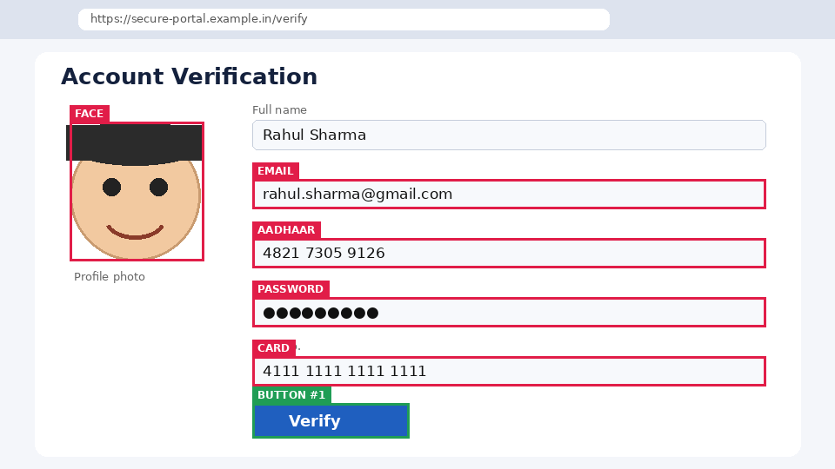

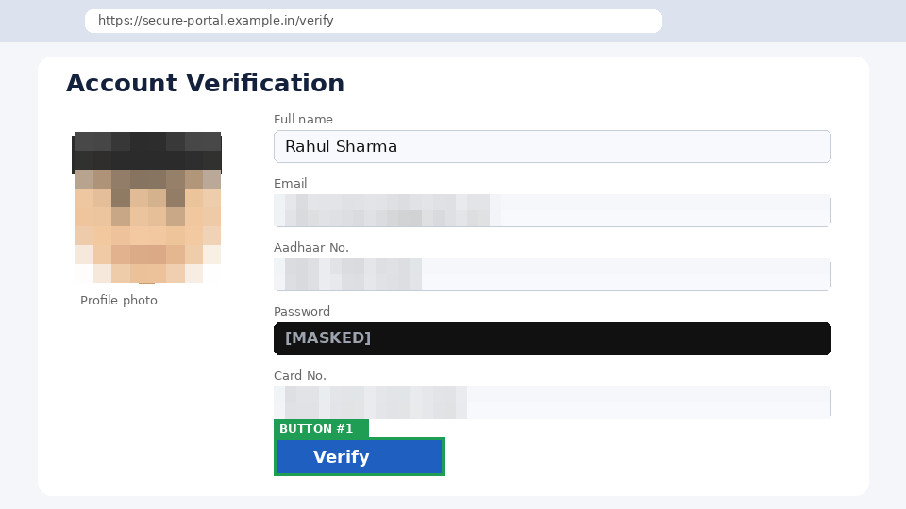





HexaTech
How It Works: Local Vision and Privacy Filter
BEFORE
LOCAL PROCESSING · ON-DEVICE
AFTER
SYNTHETIC / ILLUSTRATIVE
1 DETECT faces · text · password fields
SYNTHETIC / ILLUSTRATIVE
2 CLASSIFY Aadhaar · card · PAN · email · OTP
3 REDACT pixelate · mask · blur · strip metadata
4 RE-SCAN re-check the redacted output
5 VERIFY fail-closed gate
Sensitive information visible locally
Only verified redacted context can leave the browser
FAIL-CLOSED
PII remains or any stage fails → nothing is sent
VERIFY
PII CLEAR → SEND redacted frame
PII FOUND → BLOCK: nothing is sent
ON-DEVICE MODELS (ONNX INT8)
UI detector
YOLO / ViT-Tiny
Faces
YuNet (under 1 MB)
Text + OCR
PP-OCR mobile
Runtime
WebGPU first, WASM fallback
Frame-diff
changed tiles only
INTEGRATING
RAW PIXELS NEVER LEAVE THE DEVICE
SYNTHETIC / ILLUSTRATIVE EXAMPLE, dummy data. Not a benchmark. Real-page redaction test and precision/recall: PENDING (slide 5).
SIH2026 | SIH26171 | Team HexaTech (K26002)
4

Slide 5
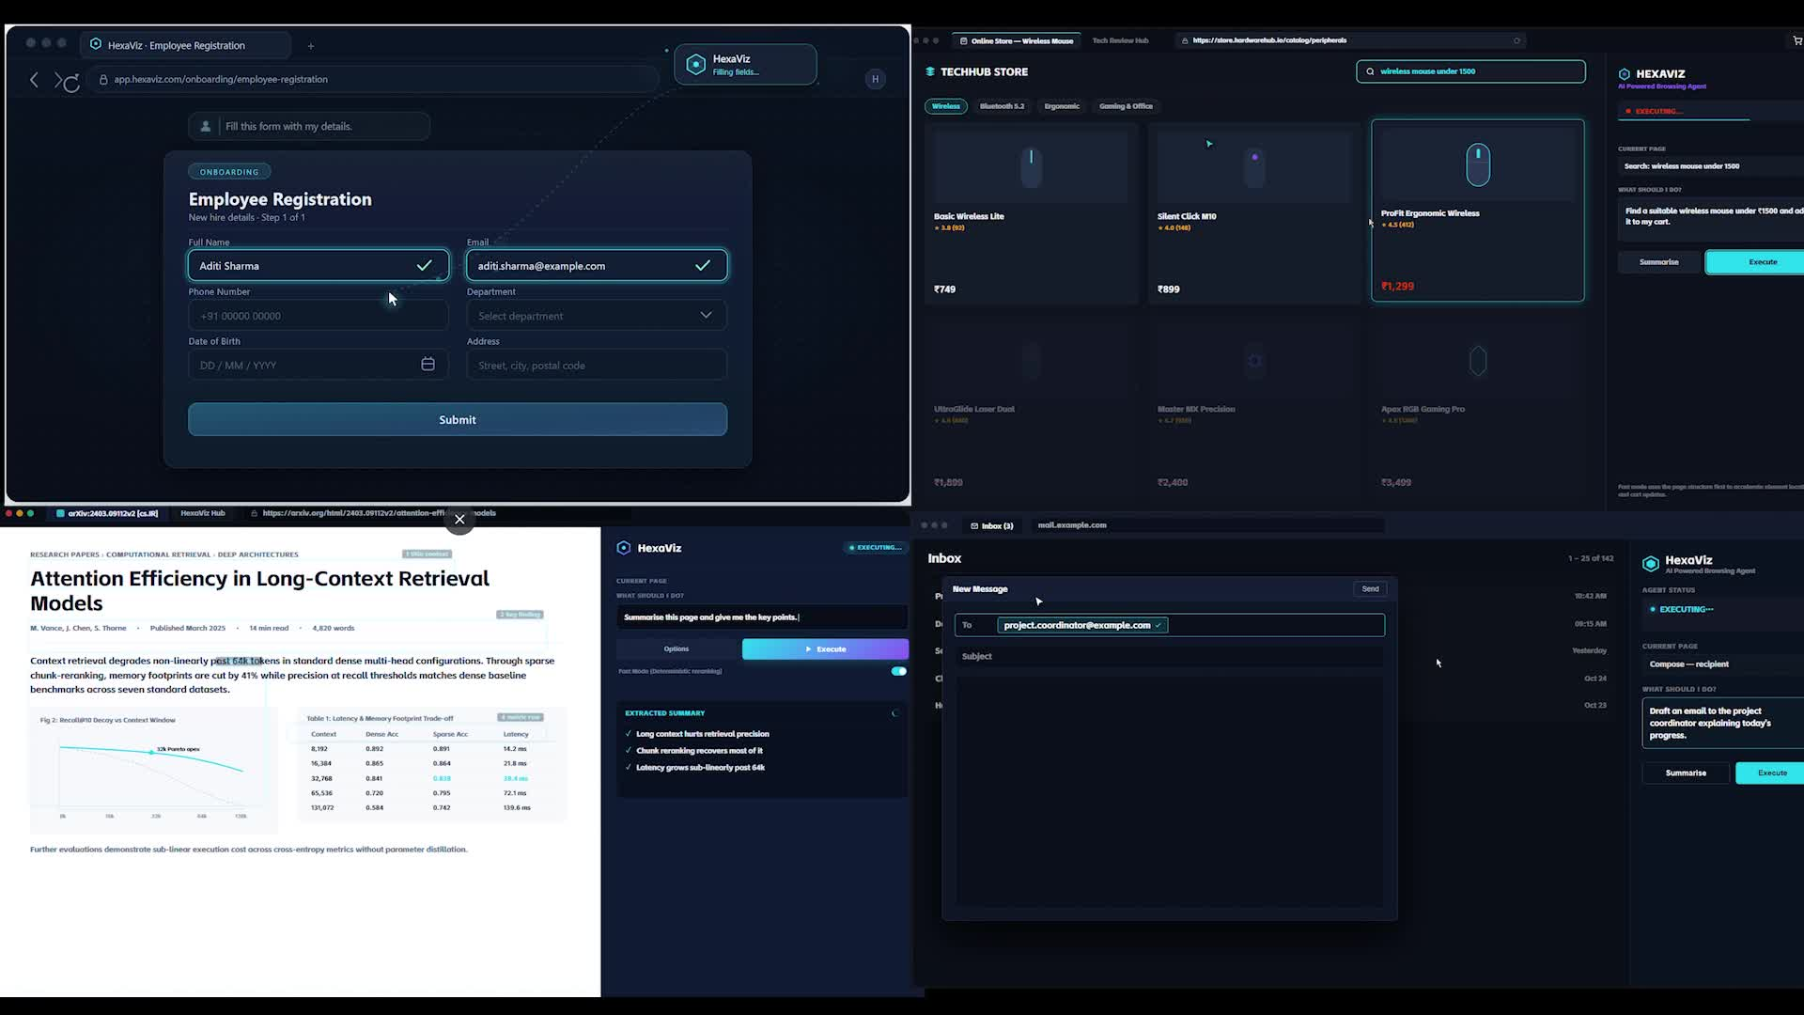




HexaTech
Prototype and Results Metrics
A END-TO-END WORKFLOW / VALIDATION PATH: request → page → perceive → protect → agent → action → verify → re-plan
BROWSER
PERCEPTION
PRIVACY
AGENT
ACTION
VERIFY
Chrome MV3 extension
On-device vision (ONNX RT Web, WebGPU)
Privacy filter + verify gate
Node/TS server · Qwen via Groq (cloud)
Click · type · scroll
Plan-act-observe-verify loop
IMPLEMENTED
INTEGRATING
INTEGRATING
IMPLEMENTED
IMPLEMENTED
IMPLEMENTED
TARGET
C MEASUREMENTS: targets are design budgets. No measured value exists yet.
UI DETECTION mAP@0.5
MEASURED: PENDING
MODEL FOOTPRINT (INT8)
MEASURED: PENDING
0.80 or higher
40 MB; 400 MB peak GPU
Measured by: Held-out UI screenshots
Measured by: DevTools profiler
PII REDACTION RECALL
MEASURED: PENDING
RAW FRAMES SENT OUT
MEASURED: PENDING
0.95+; passwords 1.00
0; redacted JPEG 150 KB max
Measured by: 200 pages, synthetic PII
Measured by: Network tab audit
PII REDACTION PRECISION
MEASURED: PENDING
TASK SUCCESS RATE
MEASURED: PENDING
0.90 or higher
75% or higher
Measured by: Same set, over-redaction
Measured by: Form, store, inbox, research
LATENCY PER FRAME
MEASURED: PENDING
CPU / GPU / RAM UTILIZATION
MEASURED: PENDING. Profiled in DevTools; no target set
Agent UI running in Chrome (demo video). PII-redaction run: PENDING
300 ms GPU; 1.2 s WASM
Measured by: performance.now()
IMPLEMENTED
INTEGRATING
TARGET
PLANNED
PLANNED: offline reasoning, Firefox (not tested), Indic OCR. NOT MEASURED: GPU vs WASM trade-off (benchmark to run).
WITHOUT HEXAVIZ: user finds → clicks → types → checks → repeats by hand
WITH HEXAVIZ: user gives intent → filter auto-redacts → agent acts → verified
SIH2026 | SIH26171 | Team HexaTech (K26002)
5

Slide 6









HexaTech
Feasibility, Scalability, Impact and References
IMPACT
FEASIBILITY
HEXAVIZ
Browser Extension
Lightweight Perception
Chrome MV3 + Node/TS server (working prototype)
Open-source stack; INT8 for integrated GPUs; footprint to be measured
Individuals & elders
Enterprises / SMEs
Banking / financial
Government portals
Visually impaired users
Local Privacy
Agent Reasoning
Filter + verify gate run on-device before any send (INTEGRATING)
Cloud today (Qwen via Groq); open-weight path planned
AUTOMATION + VISUAL DATA + SENSITIVE INFORMATION → LOCAL PRIVACY
SCALABILITY
SUSTAINABILITY
USER EXPERIENCE
Design intent: edge perception cuts server load. Stateless server scales horizontally. Cost is mostly LLM tokens.
DESIGN BENEFITS, not measured: raw PII not transmitted; frame-diff re-runs only changed regions; swappable models.
User gives intent; filter runs automatically. Live overlay, privacy log, consent toggle: DESIGN GOALS.
FUTURE PROGRESSION
All steps after the prototype are PLANNED, not built. Each swaps one component behind the same trust boundary.
BUILT
PLANNED
PLANNED
PLANNED
PLANNED
NOW: Current prototype
NEXT: Offline reasoning
Firefox
Indic OCR
Mobile / enterprise
Chrome / Edge MV3, cloud reasoning (Qwen via Groq)
Local open-weight model or small on-device VLM
Port and test; not yet tested
Indic-script text detection and redaction
Mobile browsers, enterprise PII policy packs
KEY REFERENCES
[1] SIH 2026, SIH26171 problem statement
[2] Chrome Extensions MV3: developer.chrome.com/docs/extensions
[3] WebGPU: developer.mozilla.org/docs/Web/API/WebGPU_API
[4] ONNX Runtime Web: onnxruntime.ai/docs/tutorials/web
[5] Transformers.js: huggingface.co/docs/transformers.js
[6] OmniParser: github.com/microsoft/OmniParser
[7] YuNet face detector: github.com/opencv/opencv_zoo
[8] PaddleOCR: github.com/PaddlePaddle/PaddleOCR
[9] Ultralytics YOLO: docs.ultralytics.com
[10] Groq API: console.groq.com/docs | Qwen: github.com/QwenLM
SIH2026 | SIH26171 | Team HexaTech (K26002)
6

