Slide 1

SMART INDIA HACKATHON 2026
HexaViz: on-device visual perception with privacy-before-transmission
Problem Statement ID
SIH26171
Problem Statement Title
On-device Visual Perception for Light-weight Browser Agents
Theme
Miscellaneous
PS Category
Software
Team ID
K26002
Team Name
HexaTech

Slide 2
HexaTech
From Raw Screen Exposure to Privacy-Safe Browser Agents
THE PROBLEM
MANUAL BROWSER TASKS
Users navigate pages and run multi-step workflows by hand
VISUAL WEB LIMITATIONS
DOM / text misses canvas, images, PDFs, custom controls
SENSITIVE DATA EXPOSURE
Faces, passwords, Aadhaar / PAN, cards on raw screens
CONVENTIONAL VS HEXAVIZ
CONVENTIONAL
BROWSER AGENT
RAW SCREEN
VISION / AGENT
CLOUD REASONING
ACTION
EXPOSURE POINT
Raw pixels flow straight into reasoning
ON-DEVICE — RAW PIXELS STAY HERE
SAFE CONTEXT ONLY BEYOND THIS LINE
HEXAVIZ
RAW SCREEN
01
LOCAL PERCEPTION
02
PII DETECTION
03
REDACTION
04
VERIFY
05
SAFE CONTEXT
06
AGENT
07
ACTION
08
TRUST BOUNDARY
Raw screen data is filtered before it reaches reasoning.
WHAT MAKES HEXAVIZ DIFFERENT
01
02
03
04
05
PRIVACY-BEFORE-REASONING
FAIL-CLOSED PRIVACY GATE
VISION-FIRST PERCEPTION
SAFE MARKED ACTIONS
CHANGE-AWARE PERCEPTION
Local PII filtering before agent reasoning
Residual PII → BLOCK transmission
Rendered screen first; DOM as cross-check
Agent acts on numbered elements: “click #7”
Reprocess changed regions only
SIH2026 | SIH26171 | Team HexaTech (K26002)
2

Slide 3
HexaTech
Technical Architecture: Local Privacy Pipeline, Remote Reasoning
ON-DEVICE | USER'S BROWSER (Chrome / Edge, Manifest V3)
REASONING | SERVER
SCREEN CAPTURE
captureVisibleTab
INTEGRATING
INTEGRATING
INTEGRATING
PLANNED
LOCAL VISION
ONNX Runtime Web
WebGPU · WASM fallback
UI ELEMENT DETECTION
YOLO / ViT-Tiny
FACE / PII DETECTION
YuNet · PP-OCR
OFFLINE / OPEN-WEIGHT PATH
on-device reasoning alternative
INTEGRATING
INTEGRATING
WORKING
REDACTION
blur · mask · pixelate
VERIFY
re-scan · fail-closed
SAFE CONTEXT
redacted frame + elements
WHAT CROSSES
redacted frame
numbered elements
structured metadata
QWEN REASONING
via Groq · reads safe context only
NEXT FRAME ↑
VERIFY / RE-PLAN
retry on mismatch
OBSERVE
next-frame diff
ACTION EXECUTOR
click / type / scroll via Chrome APIs
STRUCTURED ACTION
action JSON · e.g. click #7
RAW PIXELS NEVER CROSS THIS BOUNDARY
WHY IT IS FEASIBLE: MODULAR AND INCREMENTALLY DEPLOYABLE
LIGHTWEIGHT MODELS
+
BROWSER EXTENSION
+
WEBGPU / WASM
+
MODULAR PIPELINE
+
STRUCTURED ACTIONS
=
INCREMENTAL DEPLOYMENT PATH
SIH2026 | SIH26171 | Team HexaTech (K26002)
3

Slide 4
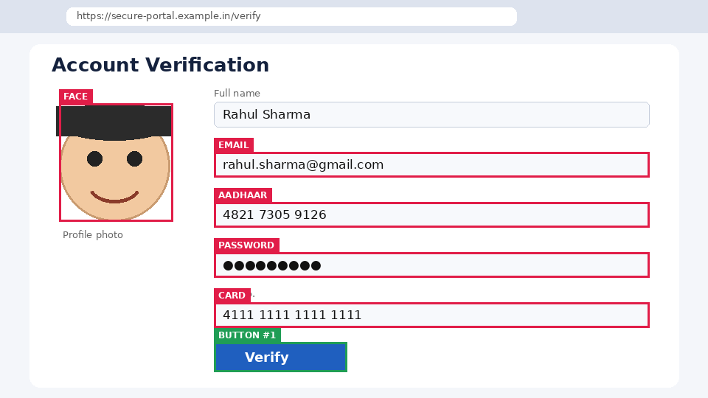
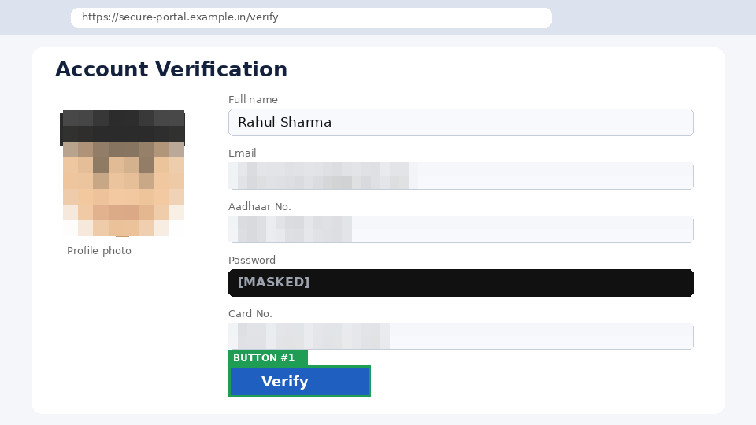
HexaTech
Privacy Gate: Detect → Redact → Verify → Block or Send
SCREEN
DETECT
faces · text · password fields
CLASSIFY
Verhoeff · Luhn · PAN · email · OTP
REDACT
blur · mask · pixelate
RE-SCAN
scan the output again
VERIFY
any PII left?
BEFORE: PII DETECTED LOCALLY
AFTER: REDACTED REGIONS
VERIFY
GATE
re-scan the redacted frame
PASS
SAFE CONTEXT → AGENT
FAIL
BLOCK → NO TRANSMISSION
SYNTHETIC / ILLUSTRATIVE EXAMPLE · DUMMY DATA
Face · email · phone · password · card
FAIL-CLOSED
Residual PII or any stage failure → nothing is sent. A local log shows every frame that left.
ON-DEVICE MODELS (ONNX INT8)
UI detector: YOLO / ViT-Tiny
Faces: YuNet (under 1 MB)
Text + OCR: PP-OCR mobile
WebGPU first · WASM fallback
PRIVACY FILTER: INTEGRATING
SIH2026 | SIH26171 | Team HexaTech (K26002)
4

Slide 5
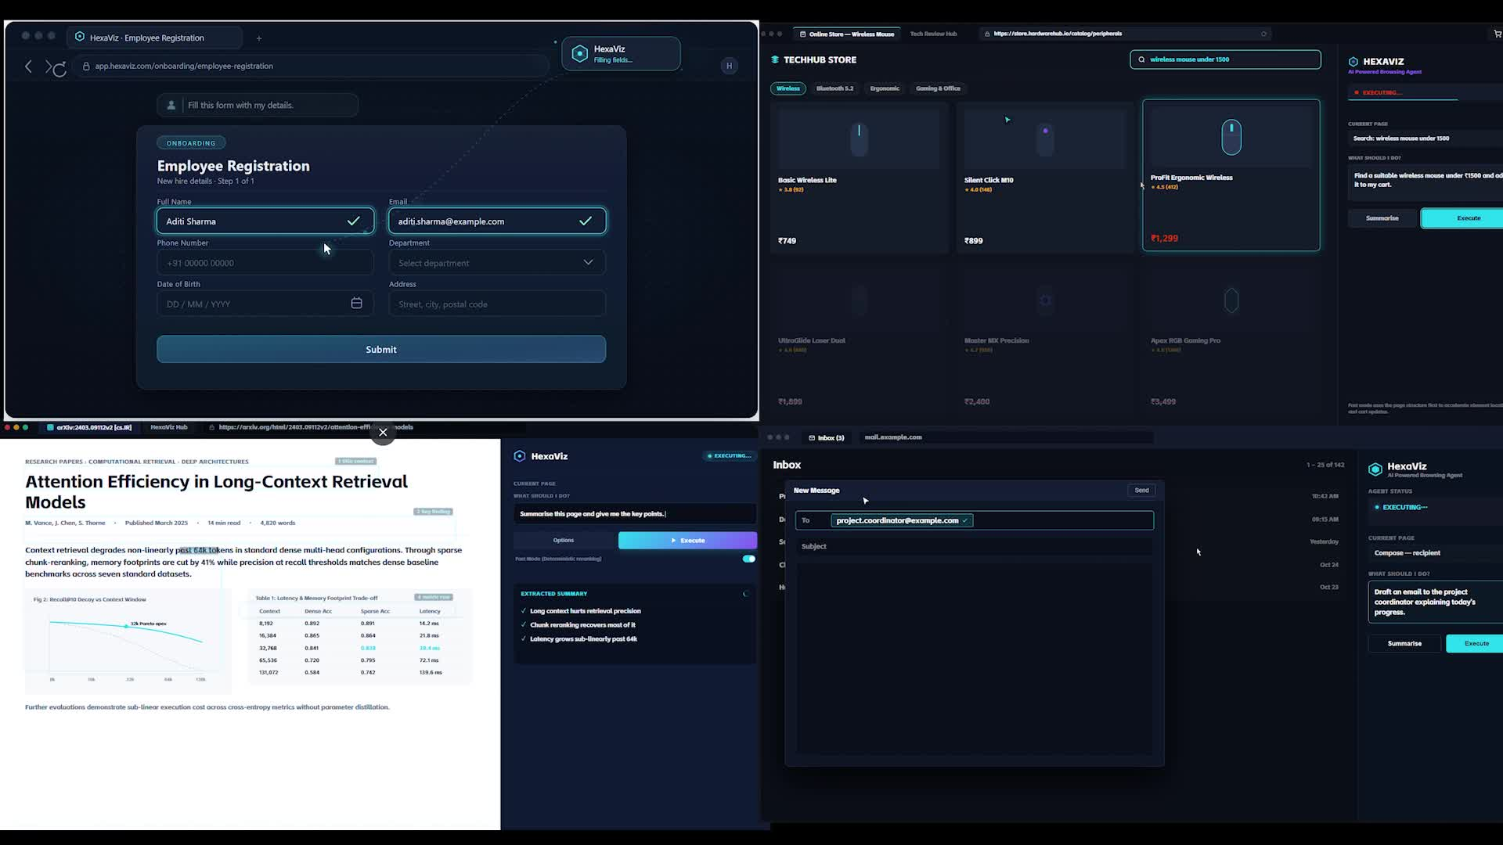
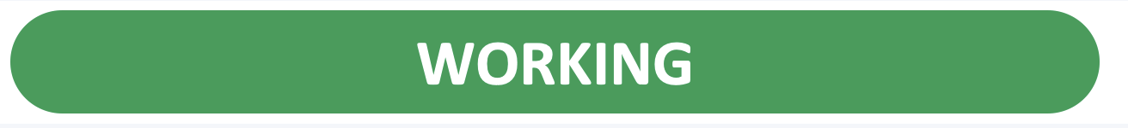
HexaTech
From User Intent to Verified Browser Action
ON-DEVICE: RAW PIXELS STAY HERE
01
USER REQUEST
02
BROWSER SCREEN
03
LOCAL PERCEPTION
04
PII FILTER
05
SAFE CONTEXT
“Fill the form”
rendered page
numbered UI elements
detect · redact · re-scan
redacted frame + elements
10
VERIFY / RE-PLAN
09
OBSERVE RESULT
08
LOCAL EXECUTOR
07
STRUCTURED ACTION
06
AGENT REASONING
retry on mismatch
next-frame diff
mark → browser target
CLICK #7 · TYPE #4
Qwen via Groq
SAFE MARKED-ELEMENT PROTOCOL
PROTOTYPE DEMO
VALIDATION STATUS
LOCAL PERCEPTION
#1 Search
#2 Email field
#3 Submit
#4 Password field
AGENT
{
"action": "click",
"target": 3
}
EXECUTOR
#3 → actual browser target
PII DETECTION
INTEGRATING
REDACTION
INTEGRATING
FAIL-CLOSED GATE
INTEGRATING
AGENT ACTION
WORKING
ACTION VERIFY
WORKING
PERCEIVE · PROTECT · REASON · ACT · VERIFY
User stays in control: privacy log + consent toggle
Chrome MV3 agent running browser tasks (source deck video)
LATENCY
RESOURCE USAGE
TASK SUCCESS
SIH2026 | SIH26171 | Team HexaTech (K26002)
5

Slide 6
HexaTech
Feasibility, Impact, Sustainability and Roadmap
1 FEASIBILITY
2 SUSTAINABILITY / EFFICIENCY
DESIGN BENEFITS · NOT MEASURED
OPEN / MODULAR STACK
LIGHTWEIGHT MODELS
WEBGPU + WASM
BROWSER DEPLOYMENT
FRAME
FRAME DIFF
CHANGED REGION
SELECTIVE REPROCESSING
ONNX Runtime Web · Transformers.js
INT8 · YOLO / ViT-Tiny · YuNet · PP-OCR
WASM fallback
Chrome MV3 extension
LOCAL PRIVACY FILTER
SAFE CONTEXT
LESS RAW DATA SENT
TECHNICAL
DEPLOYMENT
COMPUTATIONAL
OPERATIONAL
3 SCALE / IMPACT
TARGET APPLICATIONS
4 ROADMAP
INDIVIDUALS
FINANCIAL WORKFLOWS
CURRENT PROTOTYPE
OFFLINE / OPEN-WEIGHT REASONING
FIREFOX
INDIC OCR
MOBILE / ENTERPRISE
PRIVACY-PRESERVING BROWSER AUTOMATION
ENTERPRISE / SME
GOVERNMENT PORTALS
ACCESSIBILITY
WORKING
PLANNED
PLANNED
PLANNED
PLANNED
Prototype: extension + agent loop working; on-device vision + privacy gate integrating
KEY REFERENCES
[1] SIH 2026, SIH26171 problem statement
[2] Chrome Extensions MV3: developer.chrome.com/docs/extensions
[3] WebGPU: developer.mozilla.org/docs/Web/API/WebGPU_API
[4] ONNX Runtime Web: onnxruntime.ai/docs/tutorials/web
[5] Transformers.js: huggingface.co/docs/transformers.js
[6] OmniParser: github.com/microsoft/OmniParser
[7] YuNet: github.com/opencv/opencv_zoo
[8] PaddleOCR: github.com/PaddlePaddle/PaddleOCR
[9] Ultralytics YOLO: docs.ultralytics.com
[10] Groq: console.groq.com/docs | Qwen: github.com/QwenLM
SIH2026 | SIH26171 | Team HexaTech (K26002)
6

