Slide 1

SMART INDIA HACKATHON 2026
TITLE PAGE
Problem Statement ID – SIH26034
Problem Statement Title- Software System to check compliance of Packaged Commodities under Legal Metrology (Packaged Commodities) Rules, 2011 by scanning products, images and labels.
Theme- Agriculture, Food Tech & Rural Development
PS Category- Software
Team ID- Runtime Larpers
Team Name – Runtime Larpers

Slide 2



IDEA TITLE
Runtime Lapers
IDEA
Implementation of Scanning Police, a multimodal computer vision engine specialized for real-time verification of Legal Metrology (Packaged Commodities) Rules, 2011 across physical retail and e-commerce platforms.
Multimodal OCR pipeline for multi-angle scanning of flexible packaging, cylindrical bottles, and paper labels.
Spatial layout parser to isolate key text fields regardless of font style, graphic design, or text orientation.
Legal Metrology rule-mapping backend to validate mandatory declarations (MRP, Net Quantity, Mfg. Date, Country of Origin, Customer Care).
Automated bounding-box detection that visually flags missing, misplaced, or illegible label information.
Edge-compatible mobile client allowing field auditors to run baseline scans without an active internet connection.
Problem Resolution:
Automates field & digital audits: Replaces slow, manual visual checks with automated scanning and instant pass/fail report generation for Ministry enforcement officers.
Eliminates online listing non-compliance: Integrates into e-commerce vendor onboarding to automatically flag non-compliant packaging before products are listed online.
Unique Value Propositions (UVP):
Sub-second validation latency
Dynamic bounding-box overlay highlighting errors directly on the image
Spatial layout parser that extracts text effectively regardless of packaging curvature or wrinkles.

Slide 3
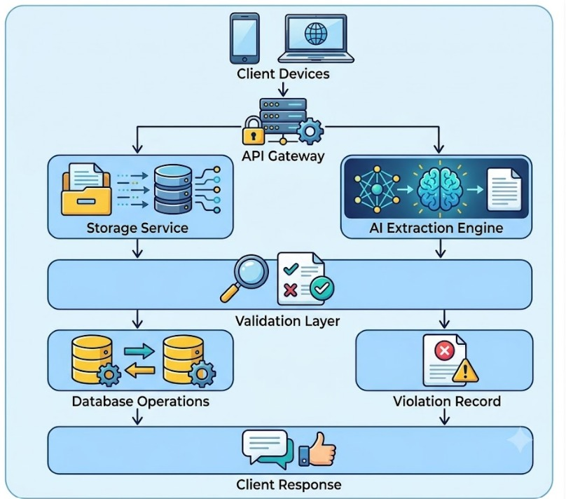
TECHNICAL APPROACH
Runtime Lapers
Technologies to be Used
Backend Framework: Python with FastAPI for high-performance, asynchronous REST API endpoints.
AI/ML Extraction: Vision-Language Models (VLM) managed via dedicated microservices for spatial text extraction and image parsing.
Core Logic: A deterministic Python-based rules engine to validate extracted text against LMPC requirements.
Database & Storage: Relational database mapping using ORM models (user.py, scan.py, combined with scalable blob storage for hosting raw product images.
Testing & CI/CD: Pytest ensuring robust test coverage for validation rules and API logic.

Slide 4


FEASIBILITY AND VIABILITY
Runtime Lapers
Potential Challenges and Risks
Optical Distortion: Heavy reflective glare on plastic wrappers and perspective warping on cylindrical packaging (bottles, cans) can cause standard OCR to fail.
Format Variability: Unpredictable graphic designs, highly stylized marketing fonts, and multi-lingual text can disrupt data extraction.
Network Reliability: Field auditors inspecting remote warehouses may encounter low or no internet connectivity, halting cloud-based API processing.
Analysis of the Feasibility of the Idea
Highly viable due to the integration of established, open-source Vision-Language Models (e.g., LayoutLM) and cloud OCR APIs, ensuring low upfront development and compute costs.
Requires zero specialized hardware; the mobile application relies on standard smartphone cameras, making it instantly deployable to Ministry field officers.
The modular backend separates the OCR extraction from the validation logic, meaning LMPC rule updates can be deployed instantly without retraining the AI models.

Slide 5
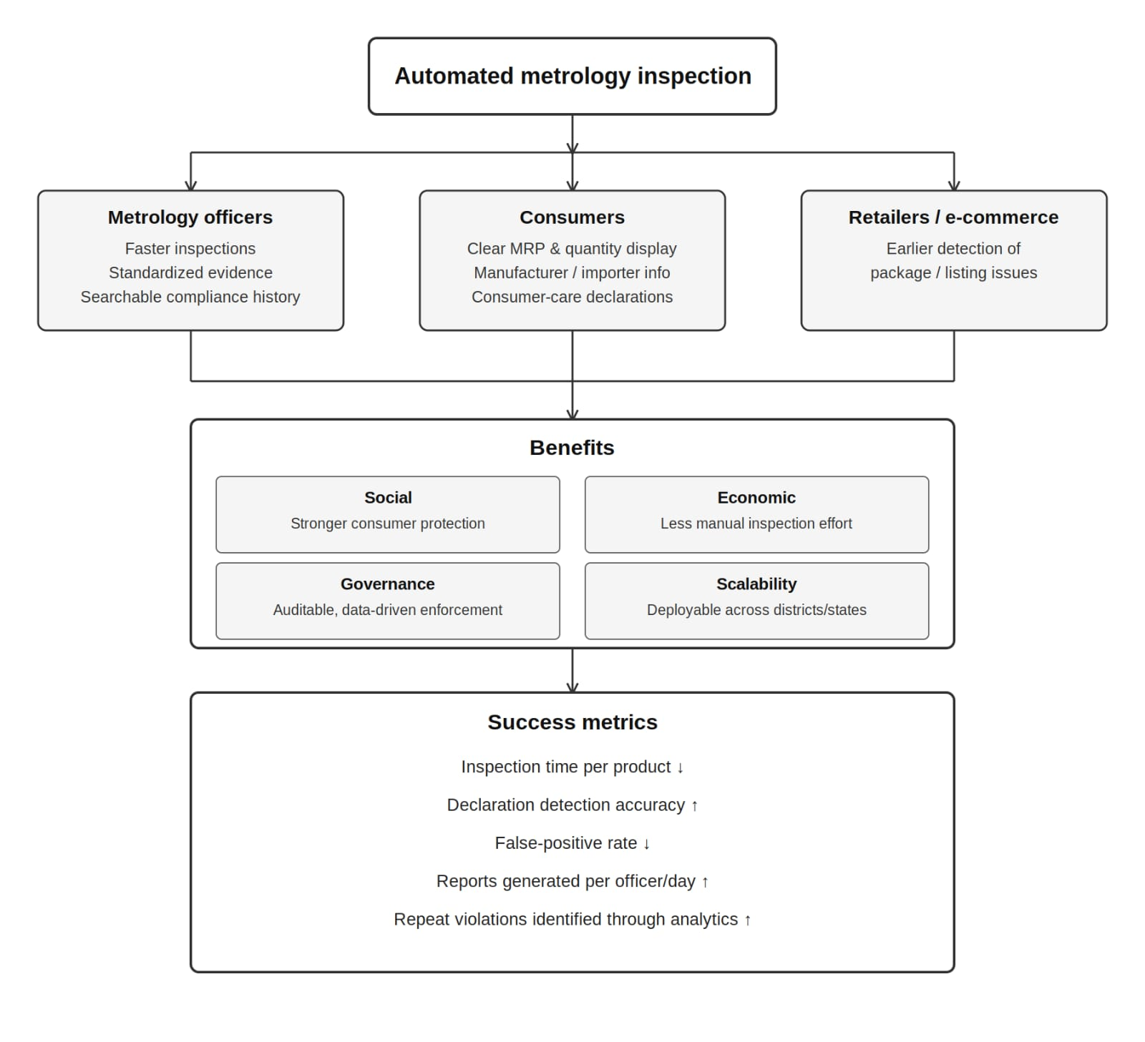
IMPACT AND BENEFITS
Runtime Lapers
Potential impact on target audience
• Legal Metrology officers: faster inspections, standardized evidence and searchable compliance history.
• Consumers: stronger visibility of MRP, quantity, manufacturer/importer and consumer-care declarations.
• Retailers/e-commerce platforms: earlier detection of package/listing issues.
Benefits
SOCIAL — stronger consumer protection and transparency.
ECONOMIC — reduces manual inspection effort and identifies repeat non-compliance.
GOVERNANCE — auditable, data-driven enforcement and centralized dashboards.
SCALABILITY — deployable across districts/states with configurable rule sets.
Success metrics
• Inspection time per product ↓ • Declaration detection accuracy ↑ • False-positive rate ↓
• Reports generated per officer/day ↑ • Repeat violations identified through analytics ↑

Slide 6
RESEARCH AND REFERENCES
Runtime Lapers
Google.gemini.com
Claude.com
Chatgpt.com

Slide 7
IMPORTANT INSTRUCTIONS
Please ensure below pointers are met while submitting the Idea PPT:
Kindly keep the maximum slides limit up to six (6). ( Including the title slide)
Try to avoid paragraphs and post your idea in points /diagrams / Infographics /pictures
Keep your explanation precise and easy to understand
Idea should be unique and novel.
You can only use provided template for making the PPT without changing the idea details pointers (mentioned in previous slides).
You need to save the file in PDF and upload the same on portal. No PPT, Word Doc or any other format will be supported.
Note - You can delete this slide (Important Pointers) when you upload the details of your idea on SIH portal.

