Slide 1
Cap Store Application

Slide 2
S.P.S.S. Swaroopa - 152990 JEE Full Stack - MIPL

Slide 3
Modules Assigned
CapStore Home Page
Product Page
WishList
Similar Products

Slide 4
Modules Owned:
Wish List Front End
Product Page Fetching Details
Notes:
Usar para separador de capitulos . Seria bom ter esta versao em vermelho e verde tb..

Slide 5
Softwares Used
• JDK 10
• Spring Boot 2.x
• My SQL 5.x
• SQL Yog 8.5
• Spring Tool Suite 3.9.x
• Spring Boot Data
• Spring Boot Rest Controller
• JSP – Front-end
• Jenkins – Build Server
• Git - Source Code Repository
• Postman

Slide 6
Tables Involved
Wish List
Inventory
Customer

Slide 7
Wish List Table
Name | Data Type | Constraints | Description
WishList_id | Int | Primary_key
Customer_id | Int | Foreign_key | Recognition of customer
Product_id | Int | Foreign_key | To Recognize Products
isActive | Varchar |  | Indicates the status

Slide 8
Inventory Table
Name | Data Type | Constraints | Description
Product_id | Int | Primary_key | To Get Details for Particular Product.
Customer Table
Name | Data Type | Constraints | Description
Customer_id | Int | Primary_key | To Get Details for Customer Logged in.

Slide 9
SCREEN SHOTS

Slide 10
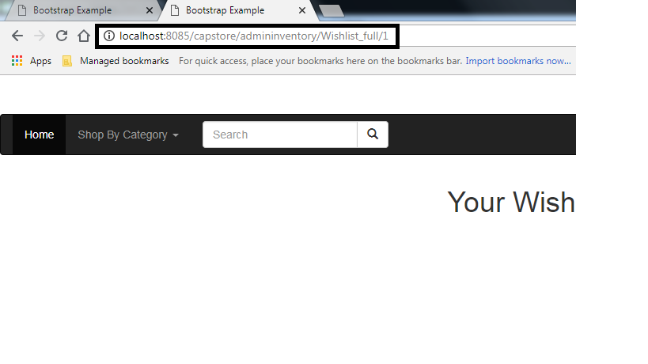
Navigates to Wish List Page when customer Id is given.
Here, the customer Id is 1.

Slide 11
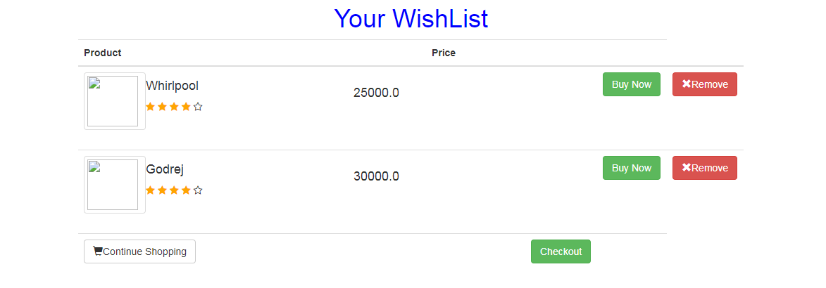
Wish List Page
Displays the wish list of the particular customer id.

Slide 12
Thank You
Notes:
EVITAR usar o spada branco – tem que ser sempre o colorido.

