Slide 1

Data Lake Value Proposition
Medical Data Processing Company
Jeegar Maru
Udacity IPS Version 1.0

Slide 2
Agenda
What is a Data Lake
Components of a Data Lake
Data Lake vs Data Warehouse
Business Value of Data Lake Solution
Proposed Data Lake Architecture for Medical Data Processing system
Udacity IPS Ver. 1 2/2020

Slide 3
What is a Data Lake
Executive summary
<Provide high-level executive summary - no more than 3-4 sentences of what is a data lake. >
A system or a set of systems where we ingest, store & process data
Supports many different kinds of data & data formats
Supports many different kinds of business use-cases

Slide 4
Components of Data Lake
< Think About: What elements are needed to make a data lake? What different layers and/or tools involved? Identify at least 3 in your high level list here. Elaborate more on each component in video.>
Data Ingestion layer : Supports ingesting data from various sources into the data lake
Data Storage layer : Supports storing data of different types like XML, CSV, real-time, etc.
Data Processing layer : Supports data processing to clean & transform data
Data Serving layer : Supports serving the data for business use-cases like reporting, SQL queries, etc.

Slide 5
Data Lake vs Data Warehouse
< Think about: Research if a Data Warehouse can still be a viable solution instead of a Data Lake? What is the difference between both? >
< You will complete this information on the next slide. Please provide at least 3 items for each. No need to add any content on this slide >
< Video tip: While presenting the differences, elaborate why a Data Lake solution makes more sense for Medical Data Processing Company over a Data Warehouse approach? How the Data Lake / Big Data characteristics different from Data warehouse>

Slide 6
Data Warehouse
Data Lake
Great for SQL-based workloads
Supports only SQL-based workloads
Does not support unstructured or semi-structured data
Usually vertically scalable
Great for all kinds of data (for eg. unstructured, semi-structured)
Great for running all kinds of workloads (ML models, adhoc analysis, interactive dashboards, SQL queries)
Usually horizontally scalable
Highly scalable to store large quantities of data
Udacity IPS Ver. 1 2/2020

Slide 7
Business Value of Data Lake
< Think about: Provide an executive level summary based on your analysis of problem statement. How would implementing a Data Lake solution help Medical Data Processing Company? Please identify at least 3 business outcomes of building a Data Lake?>
<Video tip: Explain “Why” Data Lake solution makes sense for Medical Data Processing Company. >
Offers a reliable, fault-tolerant & highly scalable data storage & processing solution
Offers business agility & innovation by supporting many kinds of workloads & use-cases
Can be built with open-source technology, thereby there would be no vendor lock-in
Supports metadata-driven design, which would avoid custom scripts, make data easy to find & prevent data silos

Slide 8
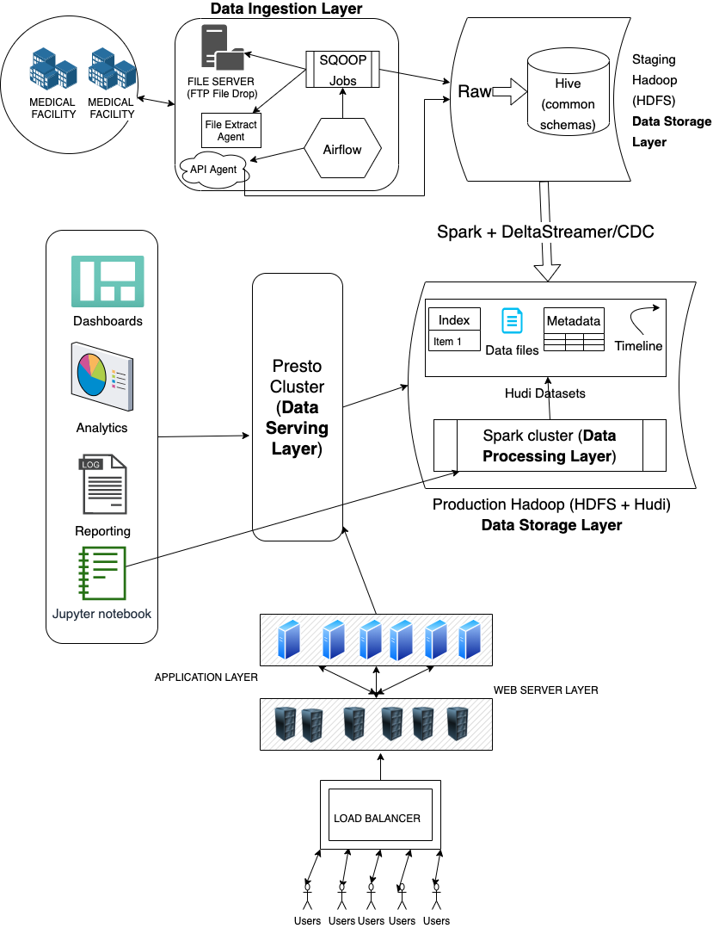
Data Lake Architecture

Slide 9
THANK YOU
Udacity IPS Version 1.0

