Slide 1

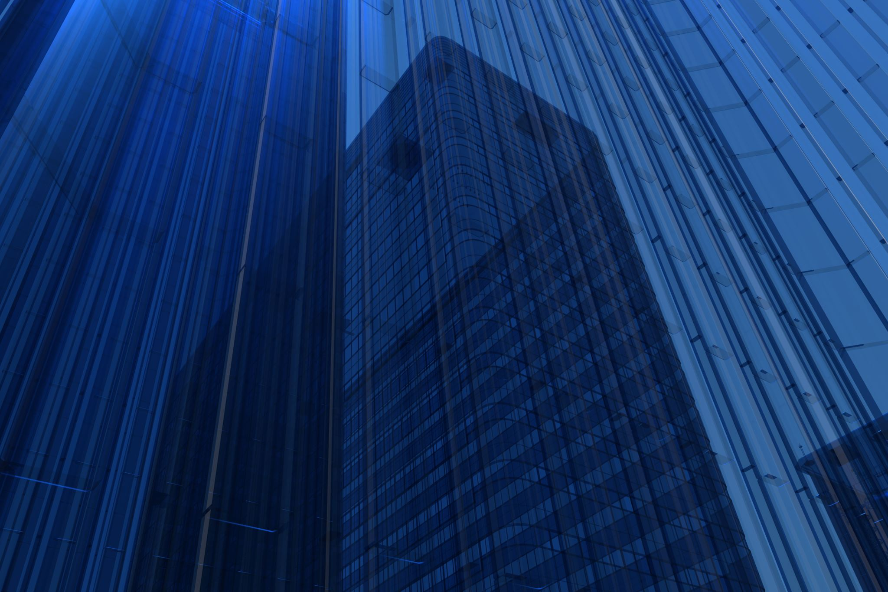
SMART KT – DOCUMENTATION MADE SIMPLE

Slide 2
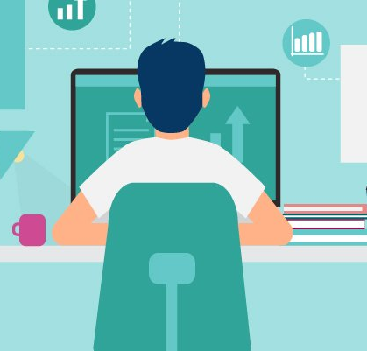
GROUP 4
Jeegniben Patel - 200494051
Anjani Sonavane – 200481194
Sanket Borkar - 200487463
Gurkirat Singh Saini - 200481510
Armaghan Rahman - 200484628
Professor
Jahanzeb Abbas

Slide 3
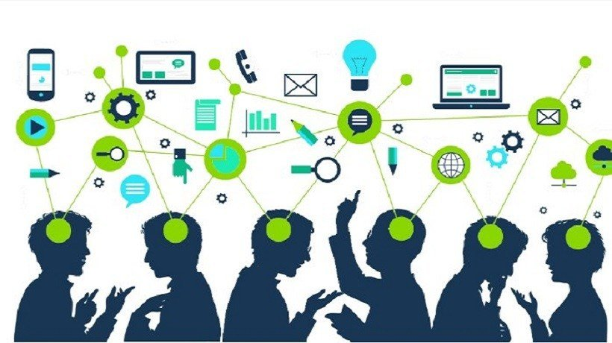
PROBLEM STATEMENT
What is Knowledge transfer?
Problems
Challenges during screen sharing

Slide 4
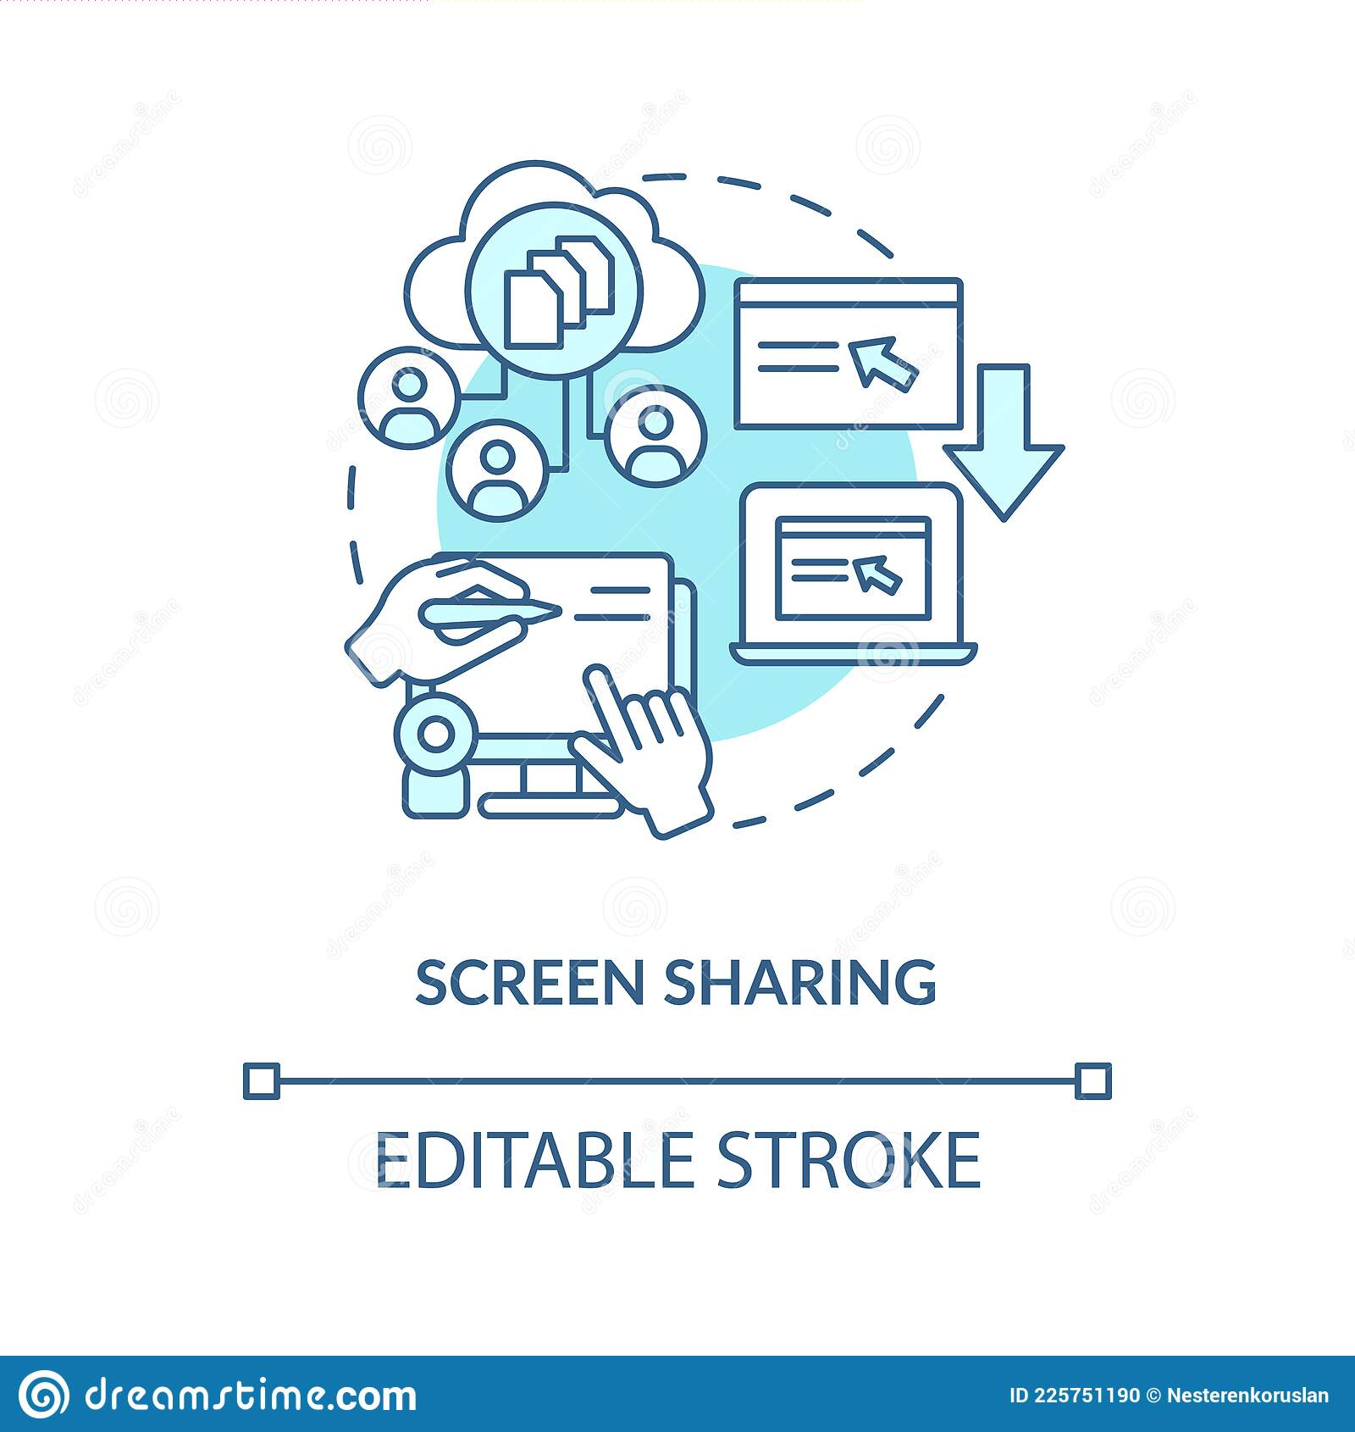
PROBLEMS
Presenters know their content while sharing screen.
Receivers have difficulty remembering data.
Cumbersome process.

Slide 5
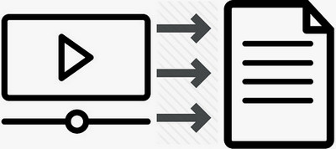
SOLUTION
Auto-detect the relevant text.
Divide video into frames and preprocess the data.
Extract key data for reports.
Helpful for both presenter and learner.

Slide 6

ML PROCESS AUTOMATION
Use MLJAR for automation
What is MLJAR?
Uses

Slide 7
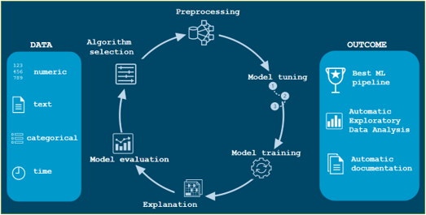
ML PIPELINE

Slide 8
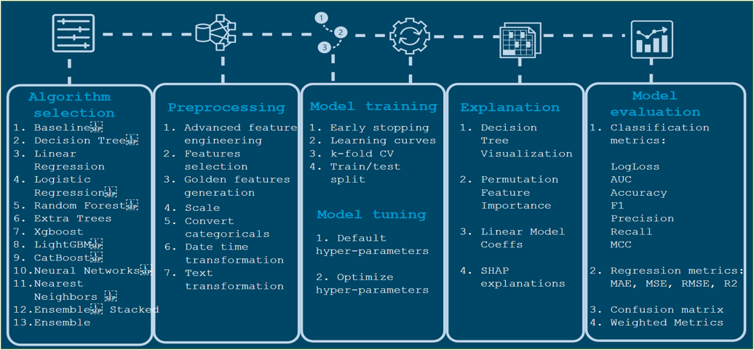
ML PIPELINE

Slide 9
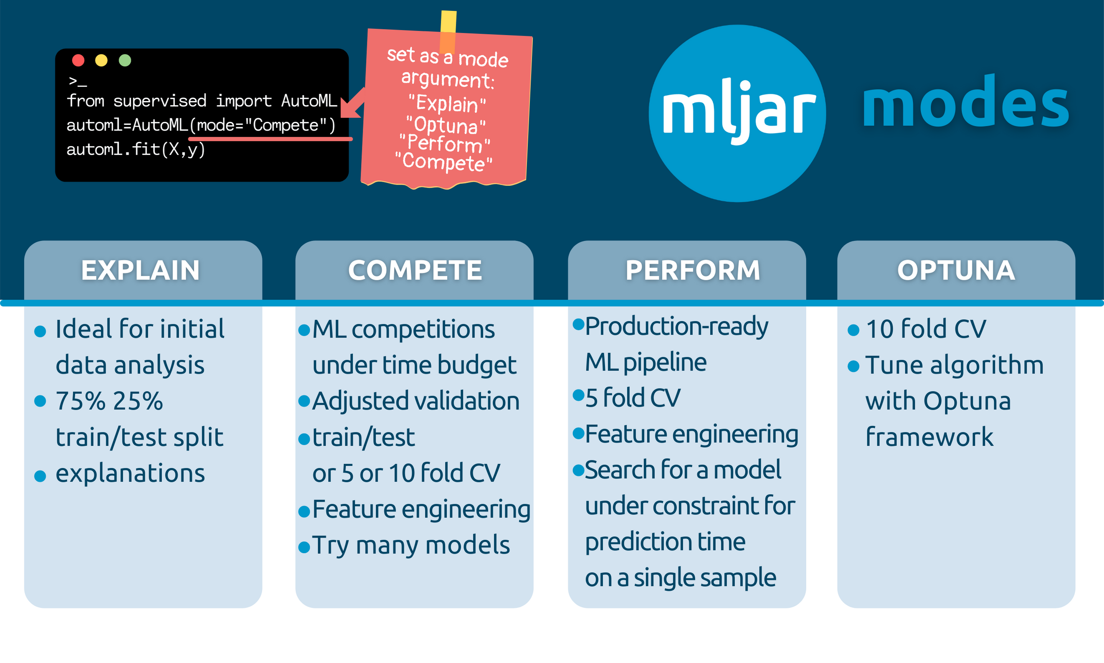
FOUR MODES OF MLJAR

Slide 10
10 steps for AutoML
simple algorithms
default algorithms
not_so_random
golden_features
insert_random_feature
features_selection
hill_climbing
ensemble
stack
ensemble_stacked

Slide 11
Pros​ | Cons​
Designed for all levels of datasets and to be used with multiple cores/machines. An open-source & closed-source solution​. | May require powerful system requirements to run. A closed-source solution allows one to run in their virtual environment for a fee.​
Easy Install & Multi-mode Performance​. | Need to know about ML models for fine-tuning and feature processing​.
Creates markdown reports​. | ​
Detailed documentation & creator support​. | ​

Slide 12
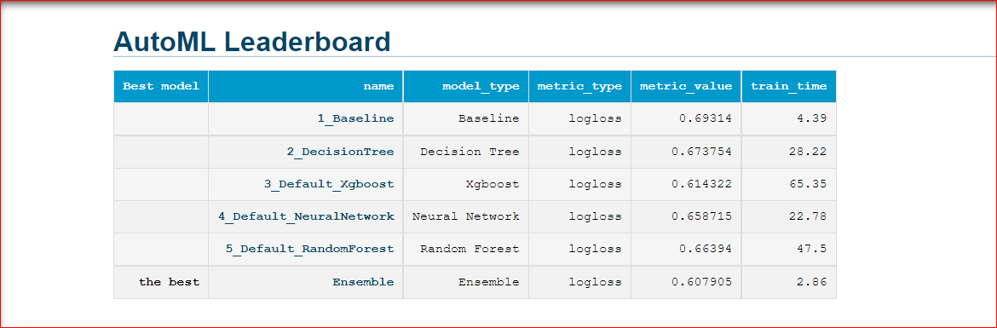
Accuracy : 66.85%

Slide 13
REFERENCES
Lee, Y. S. (2020, June). Analysis of Automatic Machine Learning Solution Trends of Startups. School of ICT Convergence, Pyeongtaek University. https://doi.org/10.17703/IJACT.2020.8.2.297
Saeed, W. (2021, May). Comparison of Automated Machine Learning Tools for SMS Spam Message Filtering. Center for Artificial Intelligence Research (CAIR), University of Agder. https://arxiv.org/abs/2106.08671
Truong, A., Walters, A., Goodsitt, J., Hines, K., Bruss, C. B., & Farivar, R. (2019, September). Towards Automated Machine Learning: Evaluation and Comparison of AutoML Approaches and Tools. Department of Computer Science University of Illinois. https://doi.org/10.1109/ICTAI.2019.00209

Slide 14

Thank you!

