Slide 1
Getting Set Up

Slide 2
Installation Checklist
Use a hosted environment (requires subscription)
OR
Install Anaconda
▫ Open up an Anaconda command prompt
▫ conda install pydotplus
▫ pip install tensorflow
PS
# 1. Allow PowerShell to run virtual environment scripts
# (Only need to do this once)
Set-ExecutionPolicy -ExecutionPolicy RemoteSigned -Scope Process
# 2. Create the virtual environment
python -m venv myenv
# 3. Activate the virtual environment
.\myenv\Scripts\Activate.ps1
# 4. Install the Python packages
pip install tensorflow pydotplus
# 5. Install Graphviz system-wide
winget install Graphviz
DOS
    python -m venv myenv
    .\myenv\Scripts\activate
    pip install tensorflow pydotplus
    winget install Graphviz
Update Environment Variables
C:\Program Files\Graphviz\bin
Relaunch VS Code.
PS : dot –V or Dos : dot -V
Notes:
pydotplus is a Python library that provides a Python interface to Graphviz's Dot language.
It is most commonly used in data science and machine learning for visualizing decision trees generated by scikit-learn
Graphviz (short for Graph Visualization Software) is an open-source tool used to represent structural information as diagrams of abstract graphs and networks.
C:\Program Files\Graphviz\bin
Update Environment Variables
Press the Windows Key, type env, and select "Edit the system environment variables".
Click the Environment Variables... button at the bottom right.
Under System variables (bottom half), scroll down, select Path, and click Edit....
Click New on the right side and paste the path you copied (e.g., C:\Program Files\Graphviz\bin).
Click OK on all three windows to save the changes.
Relaunch VS Code.
PS : dot -V
dos : dot -V

Slide 3
Python Basics

Slide 4

Let’s just jump right into some code.

Slide 5
Types of Data

Slide 6
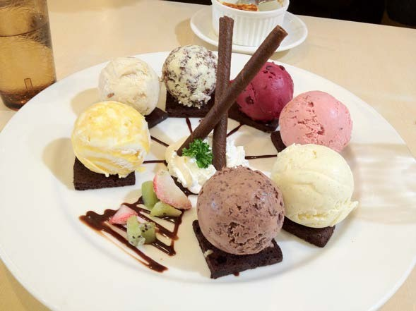
Many Flavors of Data

Slide 7
Major Types of Data
Numerical
Categorical
Ordinal

Slide 8
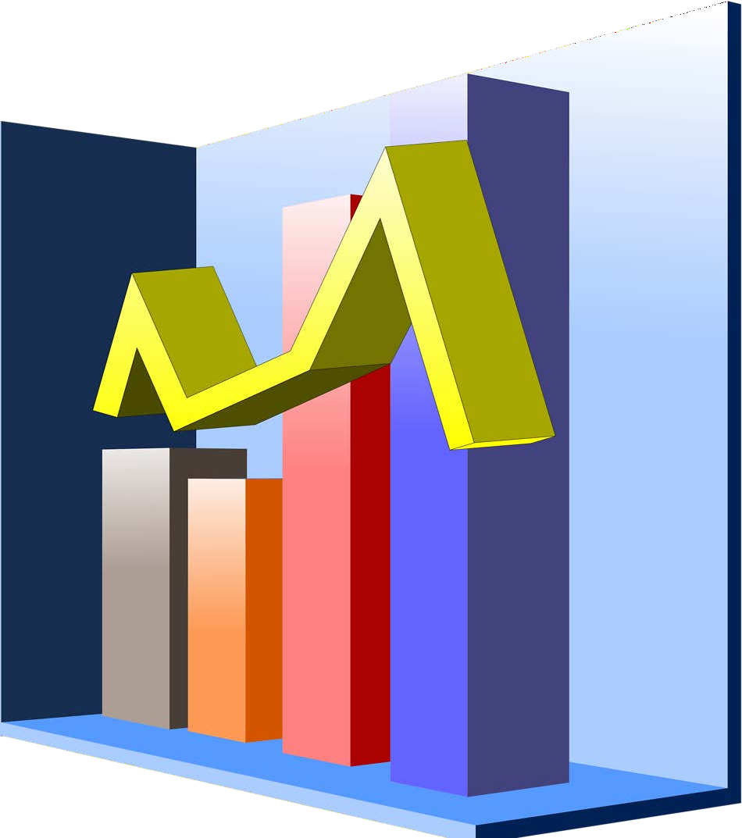
Numerical
Represents some sort of quantitative measurement
▫ Heights of people, page load times, stock prices, etc.
Discrete Data
▫ Integer based; often counts of some event.
🞄 How many purchases did a customer make in a year?
🞄 How many times did I flip “heads”?
Continuous Data
▫ Has an infinite number of possible values
🞄 How much time did it take for a user to check out?
🞄 How much rain fell on a given day?

Slide 9
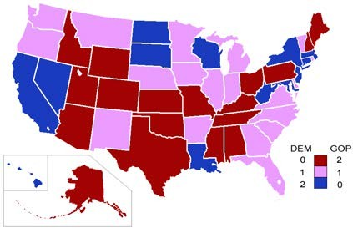
Categorical
Qualitative data that has no inherent mathematical meaning
▫ Gender, Yes/no (binary data), Race, State of Residence, Product Category, Political Party, etc.
You can assign numbers to categories in order to represent them more compactly, but the numbers don’t have mathematical meaning

Slide 10

Ordinal
A mixture of numerical and categorical
Categorical data that has mathematical meaning
Example: movie ratings on a 1-5 scale.
▫ Ratings must be 1, 2, 3, 4, or 5
▫ But these values have mathematical meaning; 1 means it’s a worse movie than a 2.

Slide 11
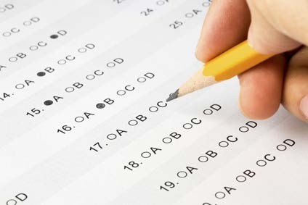
Quiz time!
Are the following types of data numerical, categorical, or ordinal?
▫ How much gas is in your gas tank
▫ A rating of your overall health where the choices are 1, 2, 3, or 4, corresponding to “poor”, “moderate”, “good”, and “excellent”
▫ The races of your classmates
▫ Ages in years
▫ Money spent in a store

Slide 12
Here is the classification for each type of data based on their characteristics:
How much gas is in your gas tank
          Classification: Numerical (Continuous)
A rating of your overall health where the choices are 1, 2, 3, or 4 (“poor”, “moderate”, “good”, “excellent”)
  Classification: Ordinal
The races of your classmates
  Classification: Categorical (Nominal)
Ages in years
  Classification: Numerical (Discrete or Continuous depending on how it's rounded, but fundamentally numerical)
Money spent in a store
  Classification: Numerical (Discrete/Ratio)

Slide 13
Mean, Median, and Mode

Slide 14
Mean
AKA Average
Sum / number of samples
Example:
▫ Number of children in each house on my street:
0, 2, 3, 2, 1, 0, 0, 2, 0
The MEAN is (0+2+3+2+1+0+0+2+0) / 9 = 1.11

Slide 15
Median
Sort the values, and take the value at the midpoint.
Example:
0, 2, 3, 2, 1, 0, 0, 2, 0
Sort it:
0, 0, 0, 0, 1, 2, 2, 2, 3

Slide 16
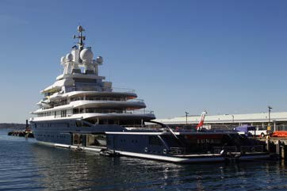
Median
If you have an even number of samples, take the average of the two in the middle.
Median is less susceptible to outliers than the mean
▫ Example: mean household income in the US is $72,641, but the median is only $51,939 – because the mean is skewed by a handful of billionaires.
▫ Median better represents the “typical” American in this example.

Slide 17
Mode
The most common value in a data set
▫ Not relevant to continuous numerical data
Back to our number of kids in each house example:
0, 2, 3, 2, 1, 0, 0, 2, 0
How many of each value are there?
0: 4, 1: 1, 2: 3, 3: 1
The MODE is 0

Slide 18
Standard Deviation and Variance

Slide 19
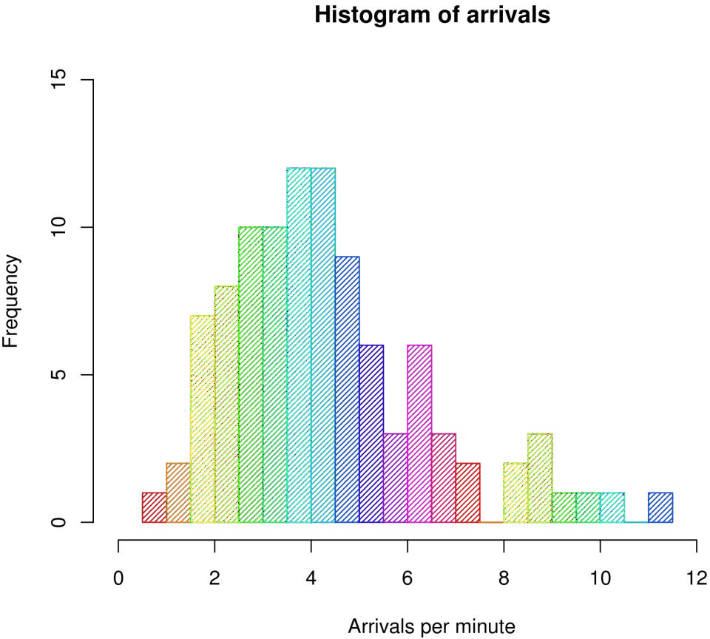
An example of a histogram

Slide 20
Variance measures how “spread-out” the data is.
Variance (𝜎²) is simply the average of the squared differences from the mean
Example: What is the variance of the data set (1, 4, 5, 4, 8)?
▫ First find the mean: (1+4+5+4+8)/5 = 4.4
▫ Now find the differences from the mean: (-3.4, -0.4, 0.6, -0.4, 3.6)
▫ Find the squared differences: (11.56, 0.16, 0.36, 0.16, 12.96)
▫ Find the average of the squared differences:
🞄 𝜎²= (11.56 + 0.16 + 0.36 + 0.16 + 12.96) / 5 = 5.04

Slide 21
Standard Deviation 𝜎 is just the square root of the
variance.
𝜎² = 5.04
2.5
2
1.5
𝜎 = 5.04 = 2.24
So the standard deviation of (1, 4, 5, 4, 8) is 2.24.
1
0.5
0
1 2 3 4 5 6 7
8
This is usually used as a way to identify outliers. Data points that lie more than one standard deviation from the mean can be considered unusual.
You can talk about how extreme a data point is by talking about “how many sigmas” away from the mean it is.
Notes:
Sigma squred is variance
Square root of variance is standard deviation

Slide 22
Population vs. Sample
If you’re working with a sample of data instead of an entire data set (the entire population)…
▫ Then you want to use the “sample variance” instead of the “population variance”
▫ For N samples, you just divide the squared variances by N-1 instead of N.
▫ So, in our example, we computed the population variance like this:
🞄 𝜎²= (11.56 + 0.16 + 0.36 + 0.16 + 12.96) / 5 = 5.04
▫ But the sample variance would be:
🞄 𝑆²= (11.56 + 0.16 + 0.36 + 0.16 + 12.96) / 4 = 6.3

Slide 23
Fancy Math
Population variance:
2
_{▫ 𝜎2 =} σ 𝑋−𝜇
𝑁
Sample variance:
2
_{▫ 𝑠2 =} σ(𝑋−𝑀)
𝑁−1

Slide 24
Let’s look at another example.

Slide 25
Probability Density Functions

Slide 26
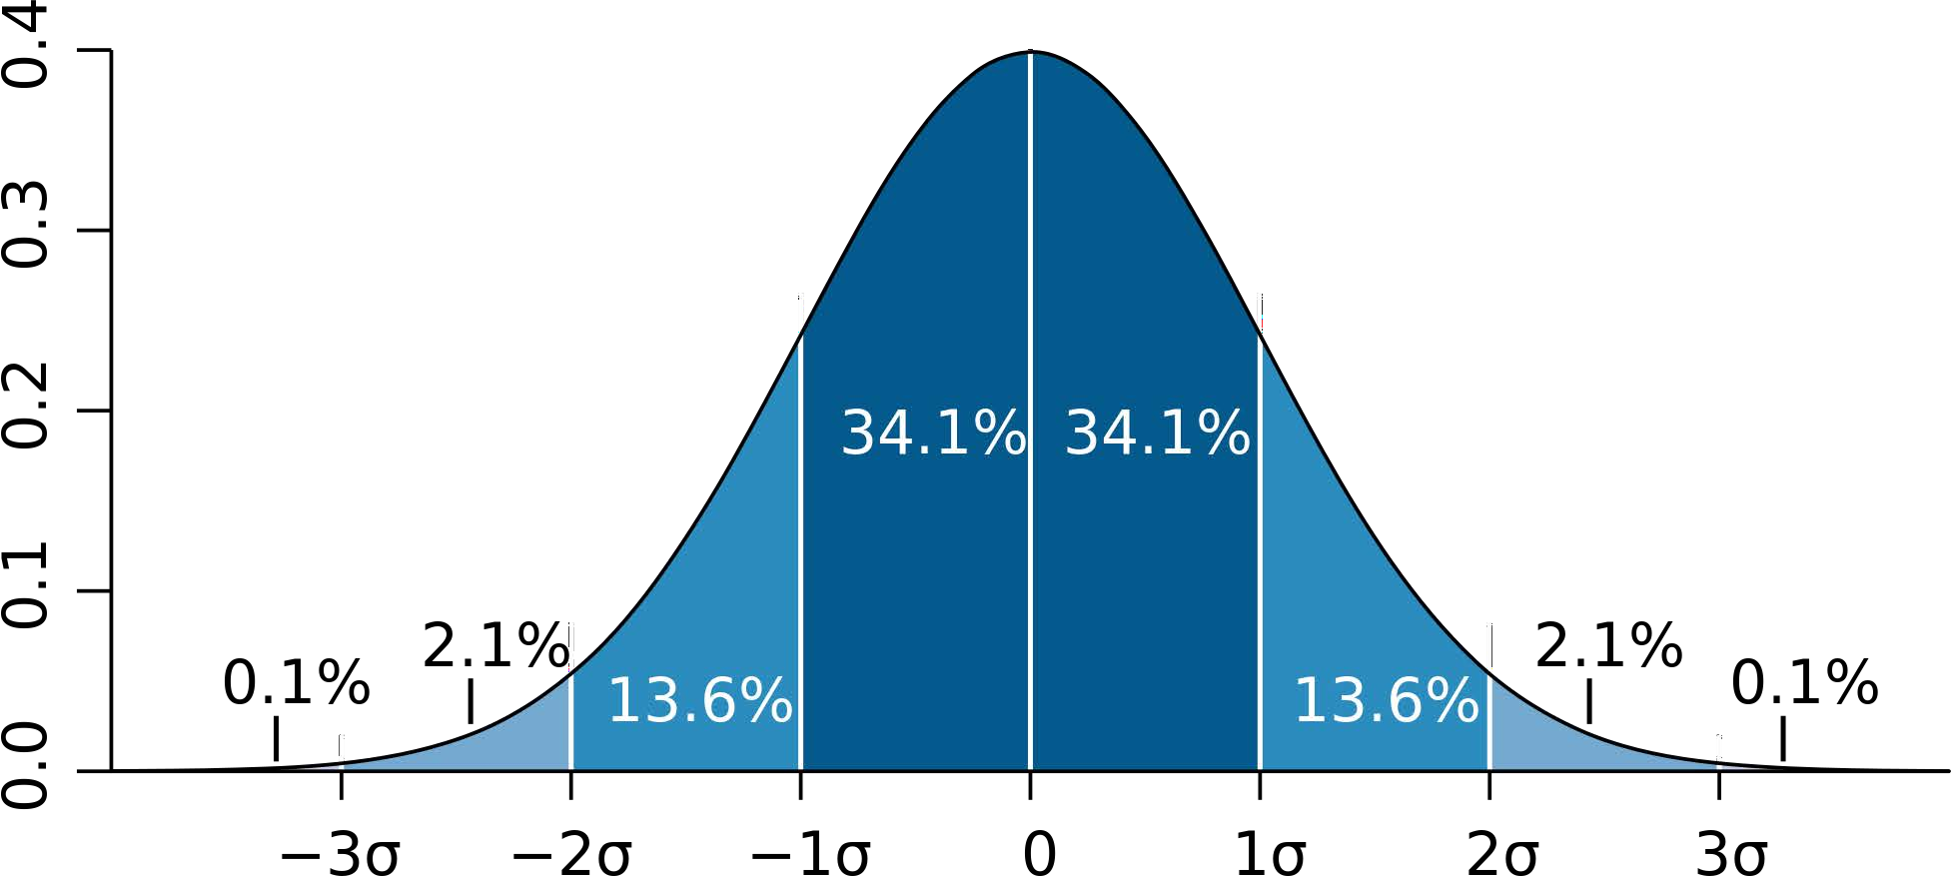
Example: a “normal distribution”

Slide 27
Gives you the probability of a data point falling within some given range of a given value.

Slide 28
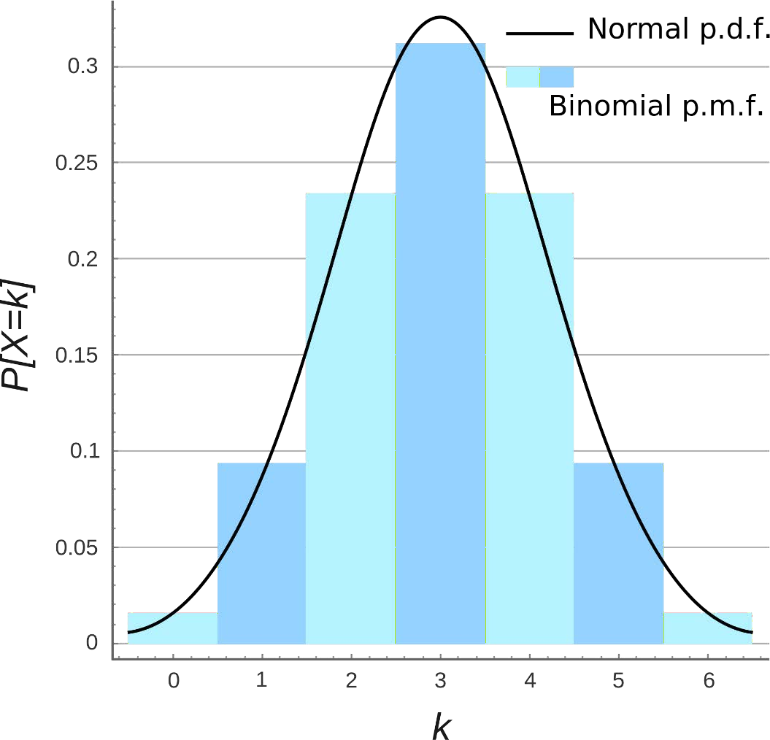
Probability Mass Function

Slide 29
Let’s play with some examples.

Slide 30
Percentiles and Moments

Slide 31
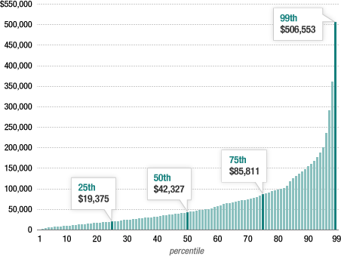
Percentiles
In a data set, what’s the point at which X% of the values are less than that value?
Example: income distribution

Slide 32
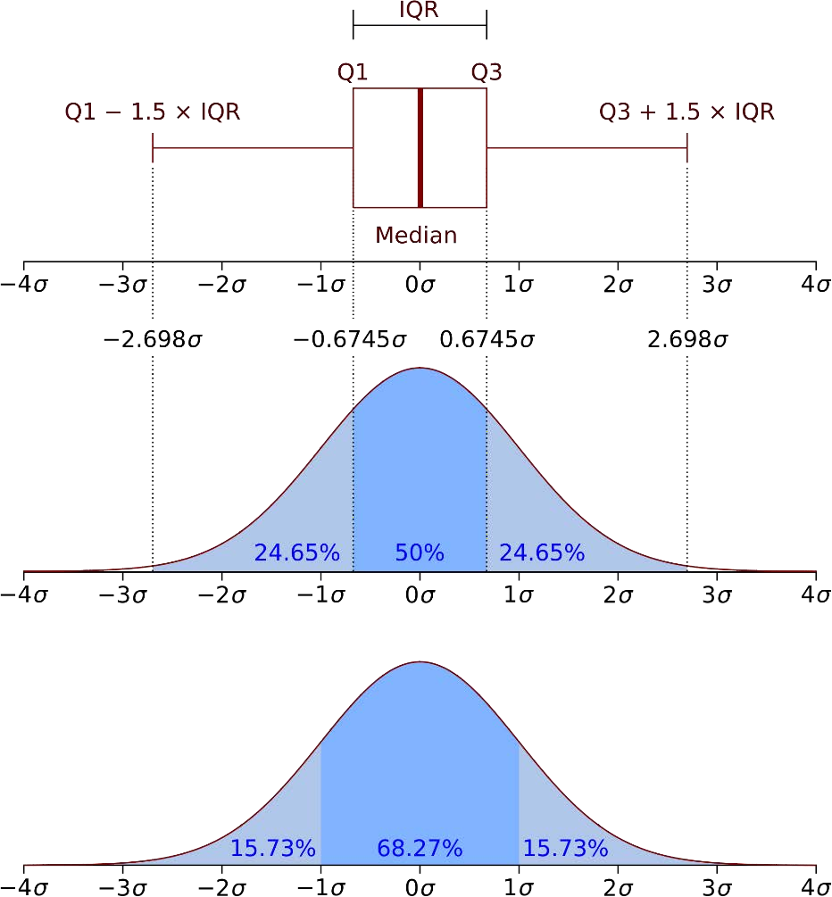
Percentiles in a normal distribution

Slide 33
Let’s look at some examples.

Slide 34
Moments
Quantitative measures of the shape of a probability density function
Mathematically they are a bit hard to wrap your head around:
But intuitively, it’s a lot simpler in statistics.

Slide 35
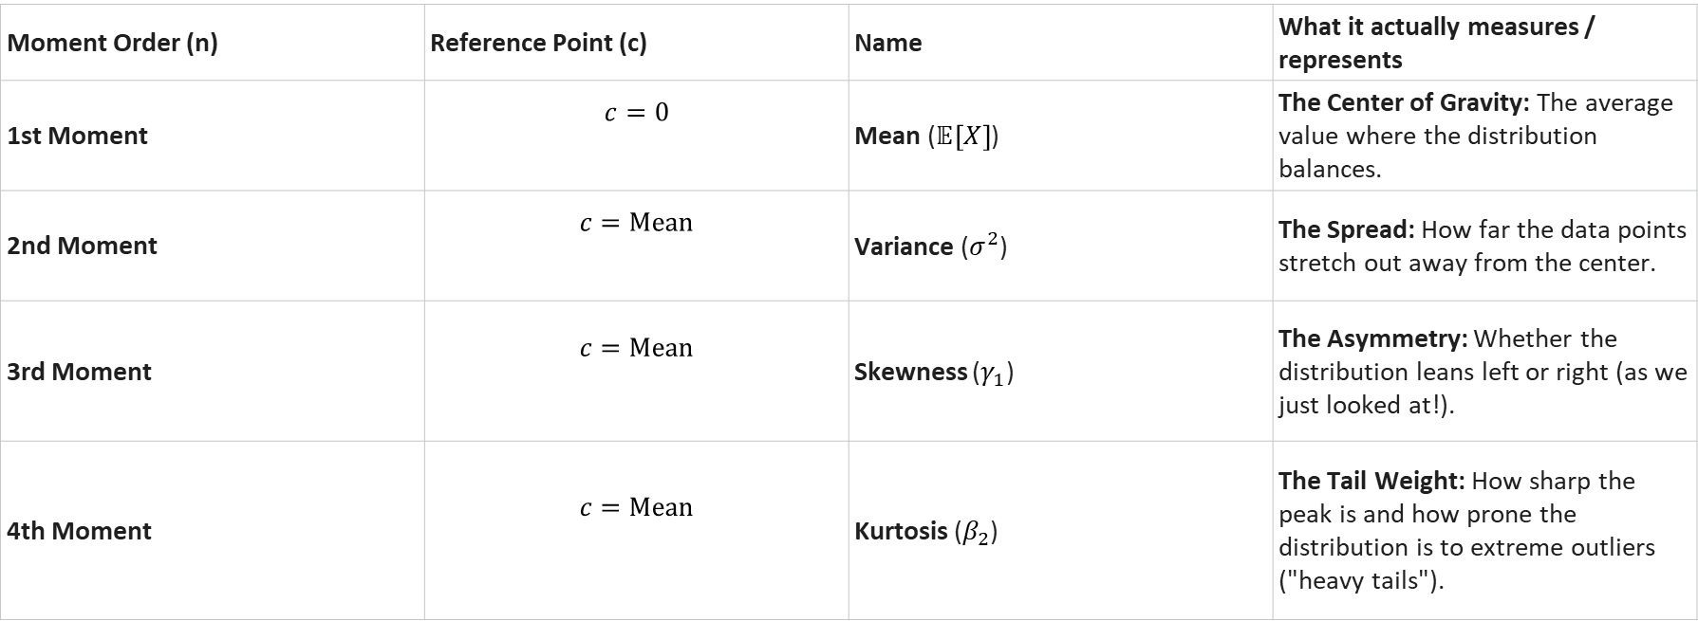
This formula calculates the $n$-th statistical moment of a continuous probability distribution about a reference point $c$.
$$μ_{n}=\int_{−∞}^{∞}{{\left(x−c\right)}^{n}}f\left(x\right) dx$$
The "Big Four" Moments of Data
Moment Order (n) | Reference Point (c) | Name | What it actually measures / represents
1st Moment | $$c=0$$ | Mean ($𝔼\left[X\right]$) | The Center of Gravity: The average value where the distribution balances.
2nd Moment | $$c=\text{Mean}$$ | Variance ($σ^{2}$) | The Spread: How far the data points stretch out away from the center.
3rd Moment | $$c=\text{Mean}$$ | Skewness ($γ_{1}$) | The Asymmetry: Whether the distribution leans left or right (as we just looked at!).
4th Moment | $$c=\text{Mean}$$ | Kurtosis ($β_{2}$) | The Tail Weight: How sharp the peak is and how prone the distribution is to extreme outliers ("heavy tails").

Slide 36
The first moment is the mean.

Slide 37
The second moment is the variance.

Slide 38
Yes, it’s just that simple.

Slide 39
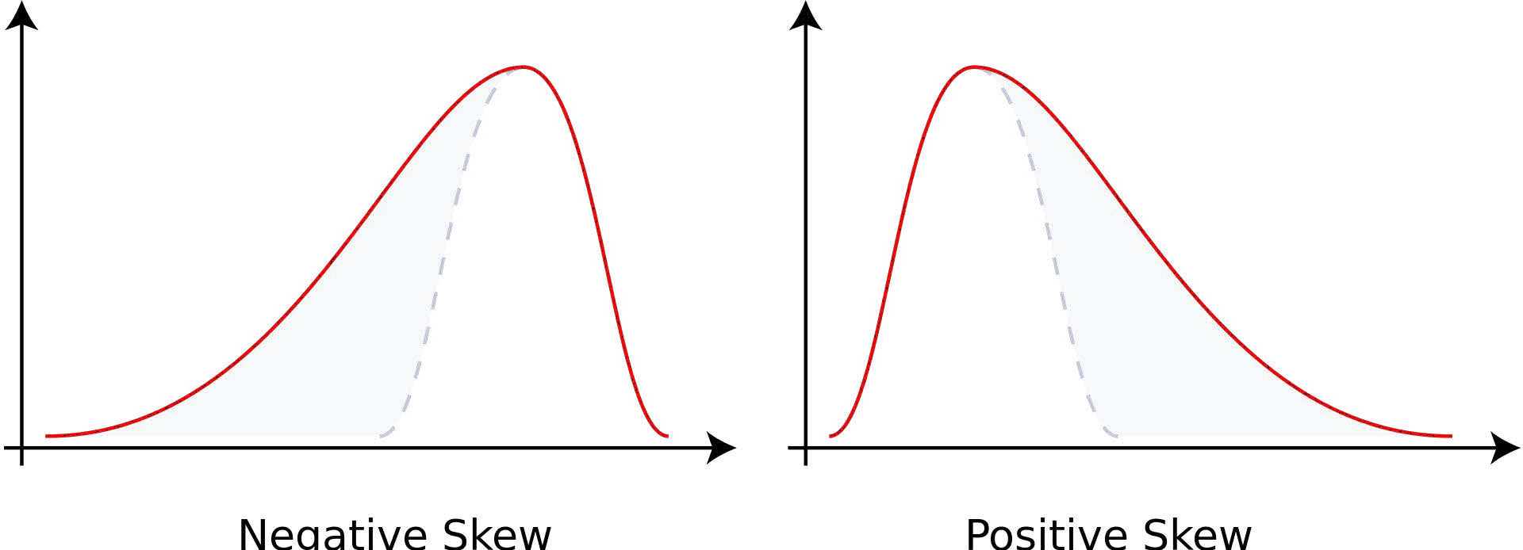
The third moment is “skew” (𝛾)
How “lopsided” is the distribution?
A distribution with a longer tail on the left will be skewed left, and have a negative skew.

Slide 40
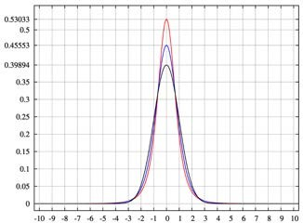
The fourth moment is “kurtosis”
How thick is the tail, and how sharp is the peak, compared to a normal distribution?
Example: higher peaks have higher kurtosis

Slide 41
Let’s compute the 4 moments in Python.

Slide 42
Covariance and Correlation

Slide 43
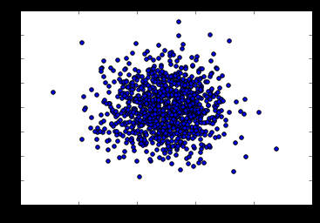
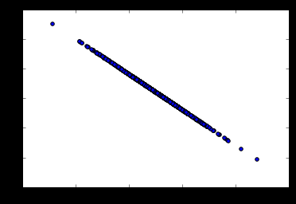
Covariance
Measures how two variables vary in tandem from their means.

Slide 44
Measuring covariance
Think of the data sets for the two variables as high-dimensional vectors
Convert these to vectors of variances from the mean
Take the dot product (cosine of the angle between them) of the two vectors
Divide by the sample size

Slide 45
Interpreting covariance is hard
We know a small covariance, close to 0, means there isn’t much
correlation between the two variables.
And large covariances – that is, far from 0 (could be negative for inverse relationships) mean there is a correlation
But how large is “large”?

Slide 46
That’s where correlation comes in!
Just divide the covariance by the standard deviations of both variables, and that normalizes things.
So a correlation of -1 means a perfect inverse correlation
Correlation of 0: no correlation
Correlation 1: perfect correlation

Slide 47
Remember: correlation does not imply causation!
Only a controlled, randomized experiment can give you insights on causation.
Use correlation to decide what experiments to conduct!

Slide 48
Let’s play with some data.

Slide 49
Conditional Probability

Slide 50
Conditional Probability
If I have two events that depend on each other, what’s the probability that both will occur?
Notation: P(A,B) is the probability of A and B both occurring
P(B|A) : Probability of B given that A has occurred
We know:
P(B|A) = ^{P(A,B)}
P(A)

Slide 51
For example
I give my students two tests. 60% of my students passed both tests, but the first test was easier – 80% passed that one. What percentage of students who passed the first test also passed the second?
A = passing the first test, B = passing the second test
So we are asking for P(B|A) – the probability of B given A
P(B|A) = ^{P(A,B)} = ^{0.6} = 0.75
P(A) 0.8
75% of students who passed the first test passed the second.

Slide 52
Let’s do another example using Python.

Slide 53
Bayes’ Theorem

Slide 54
Bayes’ Theorem
Now that you understand conditional probability, you can understand Bayes’ Theorem:
𝑃 𝐴 𝑃 𝐵 𝐴
𝑃 𝐴 𝐵 =
𝑃 𝐵
In English – the probability of A given B, is the probability of A times the probability of B given A over the probability of B.
The key insight is that the probability of something that depends on B depends very much on the base probability of B and A. People ignore this all the time.

Slide 55
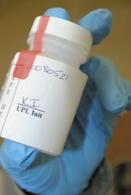
Bayes’ Theorem to the rescue
Drug testing is a common example. Even a “highly accurate” drug test can produce more false positives than true positives.
Let’s say we have a drug test that can accurately identify users of a drug 99% of the time, and accurately has a negative result for 99% of non- users. But only 0.3% of the overall population actually uses this drug.

Slide 56
Bayes’ Theorem to the rescue
Event A = Is a user of the drug, Event B = tested positively for the drug.
We can work out from that information that P(B) is 1.3% (0.99 * 0.003 +
0.01 * 0.997 – the probability of testing positive if you do use, plus the probability of testing positive if you don’t.)
𝑃 𝐴 𝑃 𝐵 𝐴 0.003 ∗0.99
= = = 22.8%
𝑃 𝐵 0.013
𝑃 𝐴 𝐵
So the odds of someone being an actual user of the drug given that they tested positive is only 22.8%!
Even though P(B|A) is high (99%), it doesn’t mean P(A|B) is high.

Slide 57
Linear Regression

Slide 58
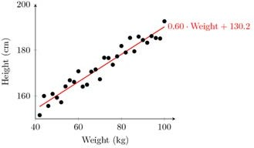
Linear Regression
Fit a line to a data set of observations
Use this line to predict unobserved values
I don’t know why they call it “regression.” It’s really misleading. You can use it to predict points in the future, the past, whatever. In fact time usually has nothing to do with it.

Slide 59
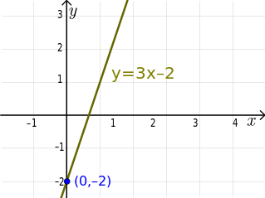
Linear Regression: How does it work?
Usually using “least squares”
Minimizes the squared-error between each point and the line
Remember the slope-intercept equation of a line? y=mx+b
The slope is the correlation between the two variables times the standard deviation in Y, all divided by the standard deviation in X.
▫ Neat how standard deviation how some real mathematical
meaning, eh?
The intercept is the mean of Y minus the slope times the mean of X
But Python will do all that for you.

Slide 60
Linear Regression: How does it work?
Least squares minimizes the sum of squared errors.
This is the same as maximizing the likelihood of the observed data if you start thinking of the problem in terms of probabilities and probability distribution functions
This is sometimes called “maximum likelihood estimation”

Slide 61
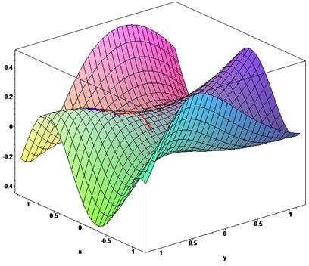
More than one way to do it
Gradient Descent is an alternate method to least squares.
Basically iterates to find the line that best follows the contours defined by the data.
Can make sense when dealing with 3D data
Easy to try in Python and just compare the results to least squares
▫ But usually least squares is a perfectly good choice.

Slide 62
Measuring error with r-squared
How do we measure how well our line fits our data?
R-squared (aka coefficient of determination) measures:
The fraction of the total variation in Y that is captured by the model

Slide 63
Computing r-squared
1.0 -
𝑠𝑢𝑚 𝑜𝑓 𝑠𝑞𝑢𝑎𝑟𝑒𝑑 𝑒𝑟𝑟𝑜𝑟𝑠
𝑠𝑢𝑚 𝑜𝑓 𝑠𝑞𝑢𝑎𝑟𝑒𝑑 𝑣𝑎𝑟𝑖𝑎𝑡𝑖𝑜𝑛 𝑓𝑟𝑜𝑚 𝑚𝑒𝑎𝑛

Slide 64
Interpreting r-squared
Ranges from 0 to 1
0 is bad (none of the variance is captured), 1 is good (all of the variance is captured).

Slide 65
Let’s play with an example.

Slide 66
Polynomial Regression

Slide 67
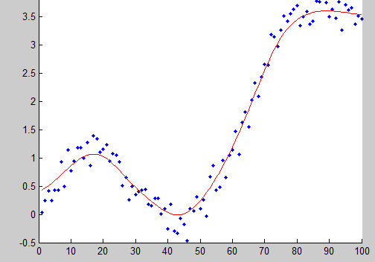
Why limit ourselves to straight lines?
Not all relationships are linear.
Linear formula: y = mx + b
▫ This is a “first order” or “first degree” polynomial, as the power of x is 1
Second order polynomial: 𝑦 = 𝑎𝑥² +
𝑏𝑥 + 𝑐
Third order: 𝑦 = 𝑎𝑥³ + 𝑏𝑥² + 𝑐𝑥 + 𝑑
Higher orders produce more complex curves.

Slide 68
Beware overfitting
Don’t use more degrees than you need
Visualize your data first to see how complex of a curve there might really be
Visualize the fit – is your curve going out of its way to accommodate outliers?
A high r-squared simply means your curve fits your training data well; but it may not be a good predictor.
Later we’ll talk about more principled ways to detect overfitting (train/test)

Slide 69
Let’s play with an example
numpy.polyfit() makes it easy.

Slide 70
Multiple Regression

Slide 71
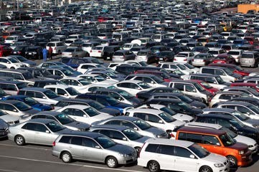
Multiple Regression
What if more than one variable influences the one you’re interested in?
Example: predicting a price for a car based on its many attributes (body style, brand, mileage, etc.)
If you also have multiple dependent variables – things you’re trying to predict – that’s “multivariate regression”

Slide 72
Still uses least squares
We just end up with coefficients for each factor.
▫ For example, 𝑝𝑟𝑖𝑐𝑒 = 𝛼 + 𝛽₁mileage + 𝛽₂age + 𝛽₃doors
▫ These coefficients imply how important each factor is (if the data is all normalized!)
▫ Get rid of ones that don’t matter!
Can still measure fit with r-squared
Need to assume the different factors are not themselves dependent on each other.

Slide 73
Let’s dive into an example.
The statsmodel package makes it easy.

Slide 74
Multi-Level Models

Slide 75
Multi-Level Models
The concept is that some effects happen at various levels.
Example: your health depends on a hierarchy of the health of your cells, organs, you as a whole, your family, your city, and the world you live in.
Your wealth depends on your own work, what your parents did, what your grandparents did, etc.
Multi-level models attempt to model and account for these interdependencies.

Slide 76
Modeling multiple levels
You must identify the factors that affect the outcome you’re trying to
predict at each level.
For example – SAT scores might be predicted based on the genetics of individual children, the home environment of individual children, the crime rate of the neighborhood they live in, the quality of the teachers in their school, the funding of their school district, and the education policies of their state.
Some of these factors affect more than one level. For example, crime rate might influence the home environment too.
Notes:
SAT stands for the Scholastic Assessment Test (originally introduced as the Scholastic Aptitude Test).
The term scholastic generally relates to schools, academics, or formal education. It is commonly used to describe academic achievements (like grades and test scores) or to distinguish core classroom subjects from non-academic, extracurricular activities.

Slide 77

Doing this is hard.
I just want you to be aware of the concept, as multi-level models showed up on some data science job requirements I’ve seen.
You’re not ready for it yet. Entire advanced statistics and modeling courses exist on this one topic alone.
Thick books exist on it too, when you’re ready.

Slide 78
Supervised and Unsupervised Machine Learning
And the concept of train/test

Slide 79
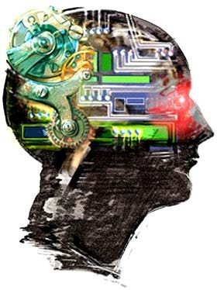
What is machine learning?
Algorithms that can learn from observational data, and can make predictions based on it.
Yeah, that’s pretty much what your own brain does too.

Slide 80
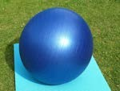
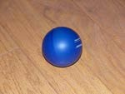
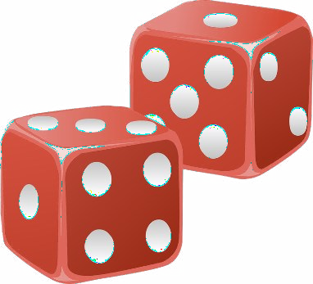

Unsupervised Learning
The model is not given any “answers” to learn from; it must make sense of the data just given the observations themselves.
Example: group (cluster) some objects together into 2 different sets. But I don’t tell you what the “right” set is for any object ahead of time.
Do I want big and small things? Round and square things? Red and blue things? Unsupervised learning could give me any of those results.

Slide 81
Unsupervised Learning
Unsupervised learning sounds awful! Why use it?
Maybe you don’t know what you’re looking for – you’re looking for latent variables.
Example: clustering users on a dating site based on their information and behavior. Perhaps you’ll find there are groups of people that
emerge that don’t conform to your known stereotypes.
Cluster movies based on their properties. Perhaps our current concepts of genre are outdated?
Analyze the text of product descriptions to find the terms that carry the most meaning for a certain category.

Slide 82
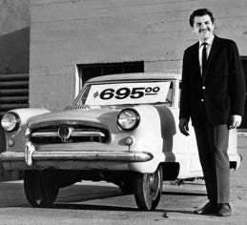
Supervised Learning
In supervised learning, the data the algorithm “learns” from comes with the “correct” answers.
The model created is then used to predict the answer for new, unknown values.
Example: You can train a model for predicting car prices based on car attributes using historical sales data. That model can then predict the optimal price for new cars that haven’t been sold before.

Slide 83

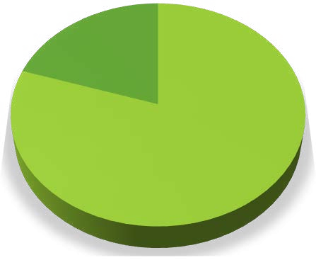




Evaluating Supervised Learning
If you have a set of training data that includes the value you’re trying to predict – you don’t have to guess if the resulting model is good or not.
If you have enough training data, you can split it into two parts: a training set and a test set.
You then train the model using only the training set
And then measure (using r-squared or some other metric) the model’s accuracy by asking it to predict values for the test set, and compare that to the known, true values.
Car Sales Data
Test set 20%
Training set 80%
Training set
Test set

Slide 84
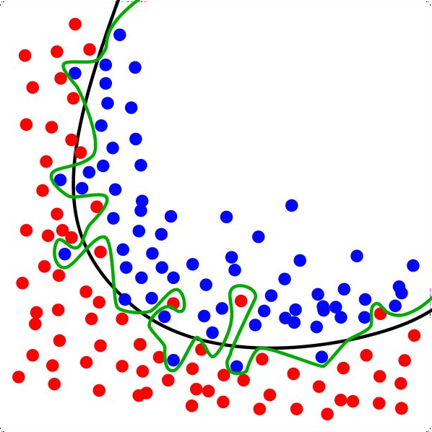
Train / Test in practice
Need to ensure both sets are large enough to contain representatives of all the variations and outliers in the data you care about
The data sets must be selected randomly
Train/test is a great way to guard against overfitting

Slide 85
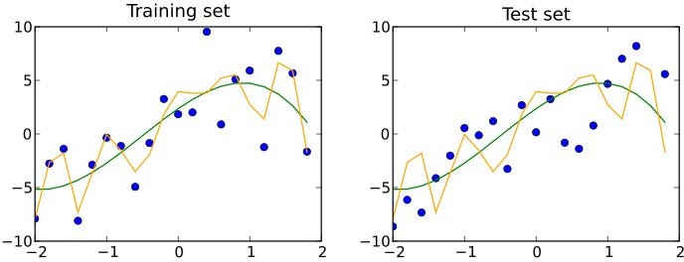
Train/Test is not Infallible
Maybe your sample sizes are too small
Or due to random chance your train and test sets look remarkably similar
Overfitting can still happen

Slide 86
K-fold Cross Validation
One way to further protect against overfitting is K-fold cross validation
Sounds complicated. But it’s a simple idea:
▫ Split your data into K randomly-assigned segments
▫ Reserve one segment as your test data
▫ Train on each of the remaining K-1 segments and measure their performance against the test set
▫ Take the average of the K-1 r-squared scores

Slide 87
Let’s go do some training and testing.

Slide 88
Bayesian Methods

Slide 89
Remember Bayes’ Theorem?
₌ 𝑃 𝐴 𝑃(𝐵|𝐴)
𝑃 𝐴 𝐵
𝑃 𝐵
Let’s use it for machine learning! I want a spam classifier.
Example: how would we express the probability of an email being spam if it contains the word “free”?
_{𝐹𝑟𝑒𝑒) =} 𝑃 𝑆𝑝𝑎𝑚 𝑃 𝐹𝑟𝑒𝑒
𝑆𝑝𝑎𝑚)
𝑃 𝑆𝑝𝑎𝑚
𝑃 𝐹𝑟𝑒𝑒
The numerator is the probability of a message being spam and containing the word “free” (this is subtly different from what we’re looking for)
The denominator is the overall probability of an email containing the word
“free”. (Equivalent to P(Free|Spam)P(Spam) + P(Free|Not Spam)P(Not Spam))
So together – this ratio is the % of emails with the word “free” that are spam.

Slide 90
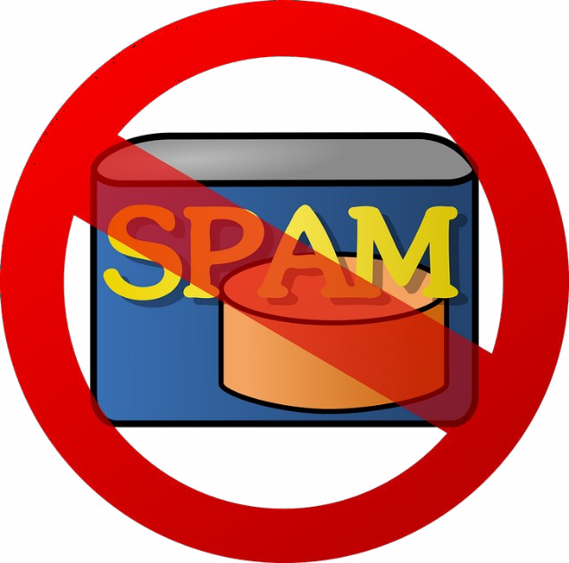
What about all the other words?
We can construct P(Spam | Word) for every (meaningful) word we encounter during training
Then multiply these together when analyzing a new email to get the probability of it being spam.
Assumes the presence of different words are independent of each other – one reason this is called “Naïve Bayes”.

Slide 91
Sounds like a lot of work.
Scikit-learn to the rescue!
The CountVectorizer lets us operate on lots of words at once, and MultinomialNB does all the heavy lifting on Naïve Bayes.
We’ll train it on known sets of spam and “ham” (non-spam) emails
▫ So this is supervised learning!
Let’s do this

Slide 92
K-Means Clustering

Slide 93
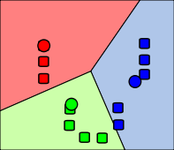
K-Means Clustering
Attempts to split data into K groups that are closest to K centroids
Unsupervised learning – uses only the positions of each data point
Can uncover interesting groupings of people
/ things / behavior
▫ Example: Where do millionaires live?
▫ What genres of music / movies / etc. naturally
fall out of data?
▫ Create your own stereotypes from demographic data

Slide 94
K-Means Clustering
Sounds fancy! Wow! Unsupervised machine learning! Clusters! K!
Actually how it works is really simple.
▫ Randomly pick K centroids (k-means)
▫ Assign each data point to the centroid it’s closest to
▫ Recompute the centroids based on the average position of each centroid’s points
▫ Iterate until points stop changing assignment to centroids
If you want to predict the cluster for new points, just find the centroid they’re closest to.

Slide 95

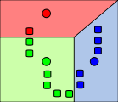

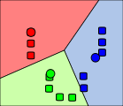
Graphical example
Images from Wikimedia Commons

Slide 96
K-Means Clustering Gotchas
Choosing K
▫ Try increasing K values until you stop getting large reductions in squared error (distances from each point to their centroids)
Avoiding local minima
▫ The random choice of initial centroids can yield different results
▫ Run it a few times just to make sure your initial results aren’t wacky
Labeling the clusters
▫ K-Means does not attempt to assign any meaning to the clusters you find
▫ It’s up to you to dig into the data and try to determine that

Slide 97
Let’s cluster stuff.
Again, scikit-learn makes this easy.

Slide 98
Entropy

Slide 99
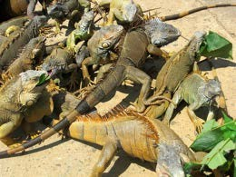
Entropy
A measure of a data set’s disorder – how same or different it is.
If we classify a data set into N different classes (example: a data set of animal attributes and their species)
▫ The entropy is 0 if all of the classes in the data are the same (everyone is an iguana)
▫ The entropy is high if they’re all different
Again, a fancy word for a simple concept.
Notes:
The Core Concept: Pure vs. Mixed
Think of a box containing 10 balls:
Entropy = 0 (Zero Disorder / Maximum Purity)
If all 10 balls are Red, there is zero uncertainty. If you pull a ball out blindfolded, you know it will be red. There is no disorder or surprise.
High Entropy (High Disorder / High Uncertainty)
If you have 5 Red balls and 5 Blue balls, the dataset is completely mixed (50/50 split). Pulling a ball out gives you maximum uncertainty—it's a complete toss-up.

Slide 100
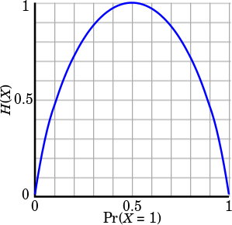

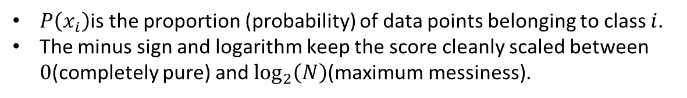
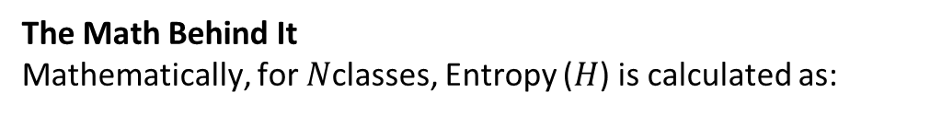
Computing entropy
𝐻 𝑆 = −𝑝₁ ln 𝑝₁ − ⋯ − 𝑝_{𝑛} ln 𝑝_{𝑛}
𝑝_{𝑖} represents the proportion of the data labeled for each class
Each term looks like this:
The Math Behind It
Mathematically, for $N$classes, Entropy ($H$) is calculated as:
$$H\left(X\right)=−\sum_{i=1}^{N}{P}\left(x_{i}\right)\log_{2}{P}\left(x_{i}\right)$$
$$H\left(X\right)=−\left(P\left(x_{1}\right)\log_{2}{P}\left(x_{1}\right)+P\left(x_{2}\right)\log_{2}{P}\left(x_{2}\right)+P\left(x_{3}\right)\log_{2}{P}\left(x_{3}\right)+P\left(x_{4}\right)\log_{2}{P}\left(x_{4}\right)\right)$$
$P\left(x_{i}\right)$is the proportion (probability) of data points belonging to class $i$.
The minus sign and logarithm keep the score cleanly scaled between $0$(completely pure) and $\log_{2}\left(N\right)$(maximum messiness).
Notes:
Concrete Numerical Example
Imagine a group of 10 animals containing:
4 Iguanas $→P\left(\text{Iguana}\right)=\frac{4}{10}=0.4$
3 Dogs $→P\left(\text{Dog}\right)=\frac{3}{10}=0.3$
2 Cats $→P\left(\text{Cat}\right)=\frac{2}{10}=0.2$
1 Bird $→P\left(\text{Bird}\right)=\frac{1}{10}=0.1$
Expanding the Series with Values:
$$H\left(X\right)=−\left(0.4\log_{2}\left(0.4\right) + 0.3\log_{2}\left(0.3\right) + 0.2\log_{2}\left(0.2\right) + 0.1\log_{2}\left(0.1\right)\right)$$
Calculating Term by Term:
Term 1 (Iguana): $0.4×\left(−1.322\right)=−0.529$
Term 2 (Dog): $0.3×\left(−1.737\right)=−0.521$
Term 3 (Cat): $0.2×\left(−2.322\right)=−0.464$
Term 4 (Bird): $0.1×\left(−3.322\right)=−0.332$
Summing Up:
$$\left(X\right)=−\left(−0.529−0.521−0.464−0.332\right)=1.846 \text{bits}$$
$$H\left(X\right)=−\left(0.4\log_{2}\left(0.4\right) + 0.3\log_{2}\left(0.3\right) + 0.2\log_{2}\left(0.2\right) + 0.1\log_{2}\left(0.1\right)\right)$$
Takeaway: The individual logarithmic terms are always negative, which is why the formula places a minus sign ($−$) at the front to give a positive final entropy score.

Slide 101
Decision Trees

Slide 102
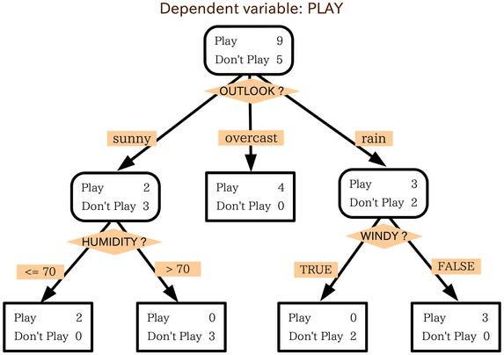
Decision Trees
You can actually construct a flowchart to help you decide a classification for something with machine learning
This is called a Decision Tree
Another form of supervised learning
▫ Give it some sample data and the resulting classifications
▫ Out comes a tree!

Slide 103
Decision Tree example
You want to build a system to filter out resumes based on historical hiring data
You have a database of some important attributes of job candidates, and you know which ones were hired and which ones weren’t
You can train a decision tree on this data, and arrive at a system for predicting whether a candidate will get hired based on it!

Slide 104
Totally Fabricated Hiring Data
Candidate ID | Years Experience | Employed? | Previous employers | Level of Education | Top-tier school | Interned | Hired
0 | 10 | 1 | 4 | 0 | 0 | 0 | 1
1 | 0 | 0 | 0 | 0 | 1 | 1 | 1
2 | 7 | 0 | 6 | 0 | 0 | 0 | 0
3 | 2 | 1 | 1 | 1 | 1 | 0 | 1
4 | 20 | 0 | 2 | 2 | 1 | 0 | 0

Slide 105
Totally Fabricated Should-I-Hire-This-Person Tree
Did an internship?
No Yes
Currently employed?
Hire!
No Yes
Less than one prior employer?
Hire!
No Yes
Attended a top-tier school?
Don’t Hire!
Don’t Hire!
No Yes
Hire!

Slide 106
How Decision Trees Work
At each step, find the attribute we can use to partition the data set to minimize the entropy of the data at the next step
Fancy term for this simple algorithm: ID3
It is a greedy algorithm – as it goes down the tree, it just picks the decision that reduce entropy the most at that stage.
▫ That might not actually result in an optimal tree.
▫ But it works.

Slide 107
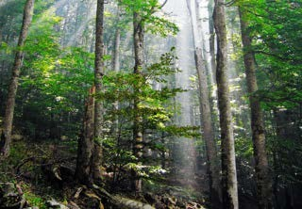
Random Forests
Decision trees are very susceptible to overfitting
To fight this, we can construct several
alternate decision trees and let them “vote” on the final classification
▫ Randomly re-sample the input data for each tree (fancy term for this: bootstrap aggregating or bagging)
▫ Randomize a subset of the attributes each step is allowed to choose from

Slide 108
Let’s go make some trees.
Yet again, scikit-learn is awesome for this.

Slide 109
Ensemble Learning

Slide 110
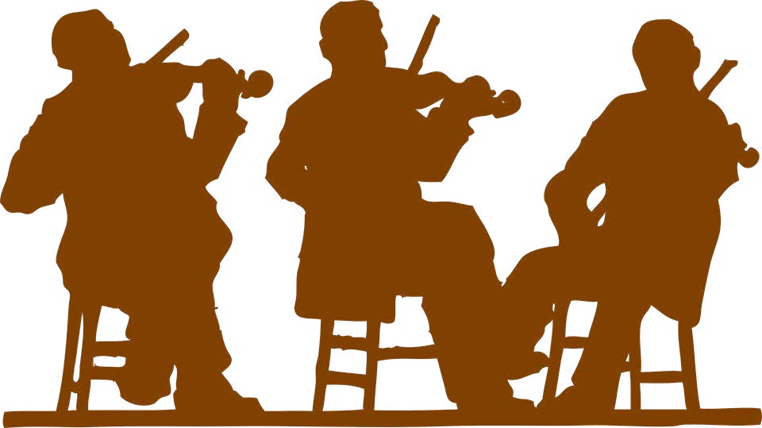
Ensemble Learning
Random Forests was an example of ensemble learning
It just means we use multiple models to try and solve the same problem, and let them vote on the results.

Slide 111
Ensemble Learning
Random Forests uses bagging (bootstrap aggregating) to implement ensemble learning
▫ Many models are built by training on randomly-drawn subsets of the data
Boosting is an alternate technique where each subsequent model in the ensemble boosts attributes that address data mis-classified by the previous model
A bucket of models trains several different models using training data, and picks the one that works best with the test data
Stacking runs multiple models at once on the data, and combines the results together
▫ This is how the Netflix prize was won!

Slide 112
Advanced Ensemble Learning: Ways to Sound Smart
Bayes Optimal Classifier
▫ Theoretically the best – but almost always impractical
Bayesian Parameter Averaging
▫ Attempts to make BOC practical – but it’s still misunderstood, susceptible to overfitting, and often outperformed by the simpler bagging approach
Bayesian Model Combination
▫ Tries to address all of those problems
▫ But in the end, it’s about the same as using cross-validation to find the best combination of models
Notes:
Bayes Optimal Classifier (BOC)

Slide 113
XGBoost

Slide 114
XGBoost
booster[0]:
0:[f2<2.3499999] yes=1,no=2,missing=1
1:leaf=0.425454557
2:leaf=-0.218918934
booster[1]:
0:[f2<2.3499999] yes=1,no=2,missing=1
1:leaf=-0.212727293
2:[f3<1.75] yes=3,no=4,missing=3
3:[f2<4.94999981] yes=5,no=6,missing=5
5:leaf=0.404698014
6:leaf=0.0310344752
4:[f2<4.94999981] yes=7,no=8,missing=7
7:leaf=-0.0360000096
8:leaf=-0.212101951
booster[2]:
0:[f3<1.6500001] yes=1,no=2,missing=1
1:[f2<4.94999981] yes=3,no=4,missing=3
3:leaf=-0.218272462
4:leaf=0.179999992
2:[f2<4.85000038] yes=5,no=6,missing=5
5:leaf=0.128571421
6:leaf=0.410059184
booster[3]:
0:[f2<2.3499999] yes=1,no=2,missing=1
1:leaf=0.293001503
2:leaf=-0.195878834
booster[4]:
0:[f2<2.3499999] yes=1,no=2,missing=1
1:leaf=-0.189249262
2:[f3<1.75] yes=3,no=4,missing=3
3:[f2<4.94999981] yes=5,no=6,missing=5
5:leaf=0.278669834
6:leaf=0.0307718068
4:[f2<4.94999981] yes=7,no=8,missing=7
7:leaf=-0.0279411841
8:leaf=-0.189206496
eXtreme Gradient Boosted trees
Remember boosting is an ensemble method
▫ Each tree boosts attributes that led to mis-
classifications of previous tree
It is AMAZING
▫ Routinely wins Kaggle competitions
▫ Easy to use
▫ Fast
▫ A good choice for an algorithm to start with

Slide 115
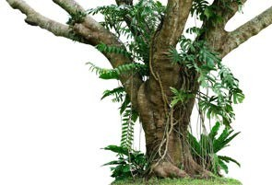
Features of XGBoost
Regularized boosting (prevents overfitting)
Can handle missing values automatically
Parallel processing
Can cross-validate at each iteration
▫ Enables early stopping, finding optimal number of iterations
Incremental training
Can plug in your own optimization objectives
Tree pruning
▫ Generally results in deeper, but optimized, trees

Slide 116
Using XGBoost
Pip install xgboost
Also CLI, C++, R, Julia, JVM interfaces
It’s not just made for scikit_learn, so it has its own interface
▫ Uses DMatrix structure to hold features & labels
🞄 Can create this easily from a numpy array though
▫ All parameters passed in via a dictionary
Call train, then predict. It’s easy.

Slide 117
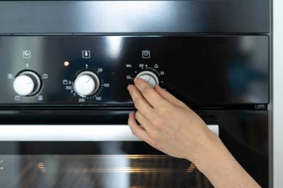
XGBoost Hyperparameters
Booster
▫ gbtree or gblinear
Objective (ie, multi:softmax, multi:softprob)
Eta (learning rate – adjusts weights on each step)
Max_depth (depth of the tree)
Min_child_weight
▫ Can control overfitting, but too high will underfit
…and many others

Slide 118

XGBoost
It’s almost all that you need to know for ML in practical terms, at least for simple classification or regression problems.
Let’s see it in action.

Slide 119
Support Vector Machines

Slide 120
Support Vector Machines
Works well for classifying higher-dimensional data (lots of features)
Finds higher-dimensional support vectors across which to divide the data (mathematically, these support vectors define hyperplanes. Needless to say I’m not going to get into the mathematical details!)
Uses something called the kernel trick to represent data in higher- dimensional spaces to find hyperplanes that might not be apparent in lower dimensions

Slide 121
Higher dimensions? Hyperplanes? Huh?
The important point is that SVM’s employ some advanced mathematical trickery to cluster data, and it can handle data sets with lots of features.
It’s also fairly expensive – the “kernel trick” is the only thing that makes it possible.

Slide 122
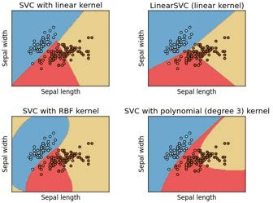
Support Vector Classification
In practice you’ll use something called SVC to classify data using SVM.
You can use different “kernels” with SVC. Some will work better than others for a given data set.

Slide 123
Let’s play with SVC’s
Don’t even try to do this without scikit-learn.

Slide 124
Recommender Systems

Slide 125

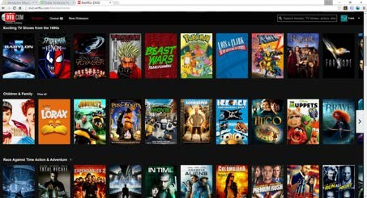
What are recommender systems?

Slide 126
User-Based Collaborative Filtering
Build a matrix of things each user bought/viewed/rated
Compute similarity scores between users
Find users similar to you
Recommend stuff they bought/viewed/rated that you haven’t yet.

Slide 127












User-Based Collaborative Filtering

Slide 128
User-Based Collaborative Filtering

Slide 129
Problems with User-Based CF
People are fickle; tastes change
There are usually many more people than things
People do bad things

Slide 130
What if we based recommendations on relationships between things instead of people?
A movie will always be the same movie – it doesn’t change
There are usually fewer things than people (less computation to do)
Harder to game the system

Slide 131
Item-Based Collaborative Filtering
Find every pair of movies that were watched by the same person
Measure the similarity of their ratings across all users who watched both
Sort by movie, then by similarity strength
(This is just one way to do it!)

Slide 132

Item-Based Collaborative Filtering

Slide 133
Item-Based Collaborative Filtering

Slide 134
Item-Based Collaborative Filtering

Slide 135
Item-Based Collaborative Filtering

Slide 136
Let’s Do This
Next, we’ll use Python to create real “movie similarities” using the real MovieLens data set.
▫ In addition to being important for item-based collaborative filtering, these results are valuable in themselves – think “people who liked X also liked Y”
It’s real world data, and we’ll encounter real world problems
Then we’ll use those results to create movie recommendations for individuals

Slide 137
K-Nearest Neighbor

Slide 138
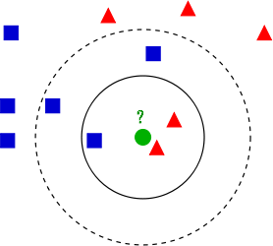
K-Nearest Neighbor (KNN)
Used to classify new data points based on “distance” to known data
Find the K nearest neighbors, based on your distance metric
Let them all vote on the classification
That’s it!

Slide 139
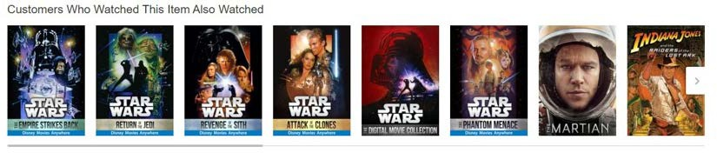
It’s Really That Simple
Although it’s one of the simplest machine learning models there is – it still qualifies as “supervised learning”.
But let’s do something more complex with it
Movie similarities just based on metadata!

Slide 140
Discrete Choice Models

Slide 141
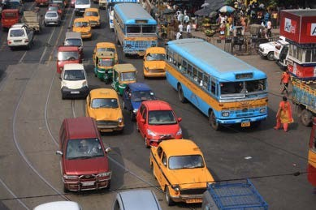
Discrete Choice Models
Predict some choice people have between discrete alternatives
▫ Do I take the train, bus, or car to work today? (Multinomial choice)
▫ Which college will I go to? (Multinomial)
▫ Will I cheat on my spouse? (Binary)
The alternatives must be finite, exhaustive, and mutually exclusive

Slide 142
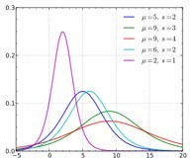
Discrete Choice Models
Use some sort of regression on the relevant attributes
▫ Attributes of the people
▫ Variables of the alternatives
Generally uses Logit or Probit models
▫ Logistic Regression, Probit Model
▫ Based on some utility function you define
▫ Similar – one uses logistic distribution, Probit uses normal distribution. Logistic looks a lot like normal, but with fatter tails (higher kurtosis)

Slide 143
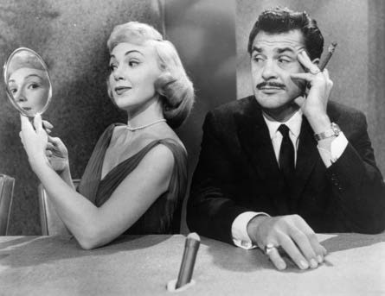
Example
Will my spouse cheat on me?

Slide 144
The Curse of Dimensionality
Principal Component Analysis

Slide 145
What is the curse of dimensionality?
Many problems can be thought of as having a huge number of “dimesions”
For example, in recommending movies, the ratings vector for each movie may represent a dimension – every movie is its own dimension!
That makes your head hurt. It’s tough to visualize.
Dimensionality reduction attempts to distill higher-dimensional data down to a smaller number of dimensions, while preserving as much of the variance in the data as possible.

Slide 146
Remember K-Means Clustering?
This is an example of a dimensionality reduction algorithm.
It reduces data down to K dimensions.

Slide 147
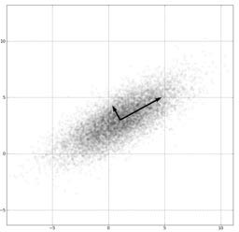
Another way: Principal Component Analysis (PCA)
Involves fancy math – but at a high level:
Finds “eigenvectors” in the higher dimensional data
▫ These define hyperplanes that split the data while preserving the most variance in it
▫ The data gets projected onto these hyperplanes, which represent the lower dimensions you want to represent
▫ A popular implementation of this is called Singular Value Decomposition (SVD)
Also really useful for things like image compression and facial recognition

Slide 148

Example: Visualizing 4-D Iris Flower Data
The “Iris dataset” comes with scikit-learn
An Iris flower has petals and sepals (the lower, supportive part of the flower.)
We know the length and width of the petals and sepals for many Iris specimens
▫ That’s four dimensions! Ow.
▫ We also know the subspecies classification of each flower
PCA lets us visualize this in 2 dimensions instead of 4, while still preserving variance.

Slide 149
Example: Visualizing 4-D Iris Flower Data
Yet again, scikit-learn makes this complex technique really easy.

Slide 150
ETL and ELT
Data Warehousing Introduction

Slide 151

What is Data Warehousing?
A large, centralized database that contains information from many sources
Often used for business analysis in large corporations or organizations
Queried via SQL or tools (i.e. Tableau)
Often entire departments are dedicated to maintaining a data warehouse
▫ Data normalization is tricky – how does all of this data
relate to each other? What views do people need?
▫ Maintaining the data feeds is a lot of work
▫ Scaling is tricky

Slide 152

ETL: Extract, Transform, Load
ETL and ELT refer to how data gets into a data warehouse.
Traditionally, the flow was Extract, Transform, Load:
▫ Raw data from operational systems is first periodically extracted
▫ Then, the data is transformed into the schema needed by the DW
▫ Finally, the data is loaded into the data warehouse, already in the structure needed
But what if we’re dealing with “big data”? That transform step can turn into a big problem.

Slide 153

ELT: Extract, Load, Transform
Today, a huge Oracle instance isn’t the only choice for a large
data warehouse
Things like Hive let you host massive databases on a Hadoop cluster
Or, you might store it in a large, distributed NoSQL data store
▫ …and query it using things like Spark or MapReduce
The scalability of Hadoop lets you flip the loading process on its head
▫ Extract raw data as before
▫ Load it in as-is
▫ Then use the power of Hadoop to transform it in-place

Slide 154

Lots more to explore
Data warehousing is a discipline in itself, too big too cover here
Check out other courses on Big Data, Spark, and MapReduce
▫ We will cover Spark in more depth later in this course.

Slide 155
Reinforcement Learning

Slide 156

Reinforcement Learning
You have some sort of agent that “explores” some space
As it goes, it learns the value of different state changes in different conditions
Those values inform subsequent behavior of the agent
Examples: Pac-Man, Cat & Mouse game
Yields fast on-line performance once the space has been explored

Slide 157
Q-Learning
A specific implementation of reinforcement learning
You have:
▫ A set of environmental states s
▫ A set of possible actions in those states a
▫ A value of each state/action Q
Start off with Q values of 0
Explore the space
As bad things happen after a given state/action, reduce its Q
As rewards happen after a given state/action, increase its Q

Slide 158
Q-Learning
Q(s, a) += alpha * (reward(s,a) + max(Q(s') - Q(s,a)) where s is the previous state, a is the previous action,s' is the current state, and alpha is the discount factor (set to .5 here).
What are some state/actions here?
▫ Pac-man has a wall to the West
▫ Pac-man dies if he moves one step South
▫ Pac-man just continues to live if going North or East
You can “look ahead” more than one step by using a discount factor when computing Q (here s is previous state, s’ is current state)
▫ Q(s,a) += discount * (reward(s,a) + max(Q(s’)) – Q(s,a))

Slide 159
The exploration problem
How do we efficiently explore all of the possible states?
▫ Simple approach: always choose the action for a given state with the highest Q. If there’s a tie, choose at random
🞄 But that’s really inefficient, and you might miss a lot of paths that way
▫ Better way: introduce an epsilon term
🞄 If a random number is less than epsilon, don’t follow the highest Q, but choose at random
🞄 That way, exploration never totally stops
🞄 Choosing epsilon can be tricky

Slide 160
Fancy Words
Markov Decision Process
▫ From Wikipedia: Markov decision processes (MDPs) provide a mathematical framework for modeling decision making in situations where outcomes are partly random and partly under the control of a decision maker.
▫ Sound familiar? MDP’s are just a way to describe what we just did using mathematical notation.
▫ States are still described as s and s’
▫ State transition functions are described as 𝑃_{𝑎} 𝑠, 𝑠′
▫ Our “Q” values are described as a reward function 𝑅_{𝑎} 𝑠, 𝑠′
Even fancier words! An MDP is a discrete time stochastic control process.

Slide 161
More Fancy Words
Dynamic Programming
▫ From Wikipedia: dynamic programming is a method for solving a complex problem by breaking it down into a collection of simpler subproblems, solving each of those subproblems just once, and storing their solutions - ideally, using a memory-based data structure. The next time the same subproblem occurs, instead of recomputing its solution, one simply looks up the previously computed solution, thereby saving computation time at the expense of a (hopefully) modest expenditure in storage space.
▫ Sound familiar?

Slide 162

So to recap
You can make an intelligent Pac-Man in a few steps:
▫ Have it semi-randomly explore different choices of movement (actions) given different conditions (states)
▫ Keep track of the reward or penalty associated with
each choice for a given state/action (Q)
▫ Use those stored Q values to inform its future choices
Pretty simple concept. But hey, now you can say you understand reinforcement learning, Q-learning, Markov Decision Processes, and Dynamic Programming!

Slide 163
Implementing Reinforcement Learning
Python Markov Decision Process Toolbox:
▫ http://pymdptoolbox.readthedocs.org/en/latest/api/mdp.html
Cat & Mouse Example:
▫ https://github.com/studywolf/blog/tree/master/RL/Cat%20vs%20Mouse% 20exploration
Pac-Man Example:
▫ https://inst.eecs.berkeley.edu/~cs188/sp12/projects/reinforcement/reinfor cement.html

Slide 164
Confusion Matrix

Slide 165

Sometimes accuracy doesn’t tell the whole story
A test for a rare disease can be 99.9% accurate by just guessing “no” all the time
We need to understand true positives and true negative, as well as false positives and false negatives.
A confusion matrix shows this.

Slide 166
Binary confusion matrix
 | Actual YES | Actual NO
Predicted YES | TRUE POSITIVES | FALSE POSITIVES
Predicted NO | FALSE NEGATIVES | TRUE NEGATIVE

Slide 167

Image has cat?
 | Actual cat | Actual not cat
Predicted cat | 50 | 5
Predicted not cat | 10 | 100

Slide 168
Another format
 | Predicted NO | Predicted YES
Actual NO | 50 | 5 | 55
Actual YES | 10 | 100 | 110
 | 60 | 105

Slide 169

Multi-class confusion matrix + heat map

Slide 170
Measuring your Models

Slide 171
Remember our friend the confusion matrix
 | Actual YES | Actual NO
Predicted YES | TRUE POSITIVES | FALSE POSITIVES
Predicted NO | FALSE NEGATIVES | TRUE NEGATIVE

Slide 172
Recall
𝑇𝑅𝑈𝐸 𝑃𝑂𝑆𝐼𝑇𝐼𝑉𝐸𝑆
•
𝑇𝑅𝑈𝐸 𝑃𝑂𝑆𝐼𝑇𝐼𝑉𝐸𝑆+𝐹𝐴𝐿𝑆𝐸 𝑁𝐸𝐺𝐴𝑇𝐼𝑉𝐸𝑆
AKA Sensitivity, True Positive rate, Completeness
Percent of positives correctly predicted
Good choice of metric when you care a lot about false negatives
▫ i.e., fraud detection

Slide 173
Recall example
 | Actual fraud | Actual not fraud
Predicted fraud | 5 | 20
Predicted not fraud | 10 | 100
Recall = TP/(TP+FN)
Recall = 5/(5+10) = 5/15 = 1/3 = 33%

Slide 174
Precision
𝑇𝑅𝑈𝐸 𝑃𝑂𝑆𝐼𝑇𝐼𝑉𝐸𝑆
•
𝑇𝑅𝑈𝐸 𝑃𝑂𝑆𝐼𝑇𝐼𝑉𝐸𝑆+𝐹𝐴𝐿𝑆𝐸 𝑃𝑂𝑆𝐼𝑇𝐼𝑉𝐸𝑆
AKA Correct Positives
Percent of relevant results
Good choice of metric when you care a lot about false positives
▫ i.e., medical screening, drug testing

Slide 175
Precision example
 | Actual fraud | Actual not fraud
Predicted fraud | 5 | 20
Predicted not fraud | 10 | 100
Precision = TP/(TP+FP)
Precision = 5/(5+20) = 5/25 = 1/5 = 20%

Slide 176
Other metrics
Specificity =
F1 Score
𝑇𝑁
= “True negative rate”
𝑇𝑁+𝐹𝑃
▫
2𝑇𝑃
2𝑇𝑃+𝐹𝑃+𝐹𝑁
_{2 ∙} 𝑃𝑟𝑒𝑐𝑖𝑠𝑖𝑜𝑛∙𝑅𝑒𝑐𝑎𝑙𝑙
▫
𝑃𝑟𝑒𝑐𝑖𝑠𝑖𝑜𝑛+𝑅𝑒𝑐𝑎𝑙𝑙
▫ Harmonic mean of precision and sensitivity
▫ When you care about precision AND recall
RMSE
▫ Root mean squared error, exactly what it sounds like
▫ Accuracy measurement
▫ Only cares about right & wrong answers

Slide 177

ROC Curve
Receiver Operating Characteristic Curve
Plot of true positive rate (recall) vs. false positive rate at various threshold settings.
Points above the diagonal represent good classification (better than random)
Ideal curve would just be a point in the upper-left corner
BOR at the English language Wikipedia [CC BY-SA 3.0 (http://creativecommons.org/licenses/by-sa/3.0/)]
The more it’s “bent” toward the upper-left, the better

Slide 178
AUC
The area under the ROC curve is… wait for it..
Area Under the Curve (AUC)
Equal to probability that a classifier will rank a randomly chosen positive instance higher than a randomly chosen negative one
ROC AUC of 0.5 is a useless classifier, 1.0 is perfect
Commonly used metric for comparing classifiers

Slide 179
The Bias / Variance Tradeoff

Slide 180

Bias and Variance
Bias is how far removed the mean of your predicted values is from the “real” answer
Variance is how scattered your predicted values are from the “real” answer
Describe the bias and variance of these four cases (assuming the center is the correct result)

Slide 181


Often you need to choose between bias and variance
It comes down to overfitting vs underfitting your data

Slide 182
But what you really care about is error
Bias and variance both contribute to error
▫ 𝐸𝑟𝑟𝑜𝑟 = 𝐵𝑖𝑎𝑠² + 𝑉𝑎𝑟𝑖𝑎𝑛𝑐𝑒
But it’s error you want to minimize, not bias or variance specifically
A complex model will have high variance and low bias
A too-simple model will have low variance and high bias
But both may have the same error – the optimal complexity is in the middle

Slide 183
Tying it to earlier lessons
Increasing K in K-Nearest-Neighbors decreases variance and increases bias (by averaging together more neighbors)
A single decision tree is prone to overfitting – high variance
▫ But a random forest decreases that variance.

Slide 184
Avoiding Overfitting
Using K-Fold Cross Validation

Slide 185
Review: K-Fold Cross Validation
One way to further protect against overfitting is K-fold cross validation
Sounds complicated. But it’s a simple idea:
▫ Split your data into K randomly-assigned segments
▫ Reserve one segment as your test data
▫ Train on the combined remaining K-1 segments and measure their performance against the test set
▫ Repeat for each segment
▫ Take the average of the K r-squared scores
Prevents you from overfitting to a single train/test split

Slide 186
Using K-Fold Cross Validation
Scikit-learn makes this really easy. Even easier than just a single train/test split.
In practice, you need to try different variations of your model and measure the mean accuracy using K-Fold Cross validation until you find a sweet spot

Slide 187
Let’s Play
Use K-Fold Cross Validation with a SVC model of Iris classification.
We’ll see that without K-Fold, we could overfit the model.

Slide 188
Cleaning Your Data

Slide 189

Cleaning your Data
The reality is, much of your time as a data
scientist will be spent preparing and “cleaning” your data
▫ Outliers
▫ Missing Data
▫ Malicious Data
▫ Erroneous Data
▫ Irrelevant Data
▫ Inconsistent Data
▫ Formatting

Slide 190

Garbage In, Garbage Out
Look at your data! Examine it!
Question your results!
▫ And always do this – not just when you don’t get a result that you like!

Slide 191

Let’s analyze some web log data.
All I want is the most-popular pages on my non-profit news website.
How hard can that be?

Slide 192
Normalizing Numerical Data

Slide 193
The importance of normalizing data
If your model is based on several numerical attributes – are they comparable?
▫ Example: ages may range from 0-100, and incomes from 0-billions
▫ Some models may not perform well when different attributes are on very different scales
▫ It can result in some attributes counting more than others
▫ Bias in the attributes can also be a problem.

Slide 194
Examples
Scikit-learn’s PCA implementation has a “whiten” option that does this for you. Use it.
Scikit-learn has a preprocessing module with handy normalize and scale functions
Your data may have “yes” and “no” that needs to be converted to “1” and “0”

Slide 195
Read the docs
Most data mining and machine learning techniques work fine with raw, un-normalized data
But double check the one you’re using before you start.
Don’t forget to re-scale your results when you’re done!

Slide 196
Dealing with Outliers

Slide 197

Dealing with Outliers
Sometimes it’s appropriate to remove outliers from your training data
Do this responsibly! Understand why you are doing this.
For example: in collaborative filtering, a single user who rates thousands of movies could have a big effect on everyone else’s ratings. That may not be desirable.
Another example: in web log data, outliers may represent bots or other agents that should be discarded.
But if someone really wants the mean income of US citizens for example, don’t toss out billionaires just because you want to.

Slide 198
Dealing with Outliers
Our old friend standard deviation provides a principled way to classify outliers.
Find data points more than some multiple of a standard deviation in your training data.
What multiple? You just have to use common sense.

Slide 199
Let’s play with some data.

Slide 200
Feature Engineering

Slide 201
What is feature engineering?
Applying your knowledge of the data – and the model you’re using - to create better features to train your model with.
▫ Which features should I use?
▫ Do I need to transform these features in some way?
▫ How do I handle missing data?
▫ Should I create new features from the existing ones?
You can’t just throw in raw data and expect good results
This is the art of machine learning; where expertise is applied
“Applied machine learning is basically feature engineering” – Andrew Ng

Slide 202

The Curse of Dimensionality
Too many features can be a problem – leads to sparse data
Every feature is a new dimension
Much of feature engineering is selecting the features most relevant to the problem at hand
▫ This often is where domain knowledge comes into play
Unsupervised dimensionality reduction techniques can also be employed to distill many features into fewer features
▫ PCA
▫ K-Means

Slide 203

Imputing Missing Data: Mean Replacement
Replace missing values with the mean value from the rest of the column (columns, not rows! A column represents a single feature; it only makes sense to take the mean from other samples of the same feature.)
Fast & easy, won’t affect mean or sample size of overall data set
Median may be a better choice than mean when outliers are present
But it’s generally pretty terrible.
▫ Only works on column level, misses correlations between features
▫ Can’t use on categorical features (imputing with most frequent value can work in this case, though)
▫ Not very accurate

Slide 204

Imputing Missing Data: Dropping
If not many rows contain missing data…
▫ …and dropping those rows doesn’t bias your data…
▫ …and you don’t have a lot of time…
▫ …maybe it’s a reasonable thing to do.
But, it’s never going to be the right answer for the “best” approach.
Almost anything is better. Can you substitute another similar field perhaps? (i.e., review summary vs. full text)

Slide 205
Imputing Missing Data: Machine Learning
KNN: Find K “nearest” (most similar) rows and average their values
▫ Assumes numerical data, not categorical
▫ There are ways to handle categorical data (Hamming distance), but categorical data is probably better served by…
Deep Learning
▫ Build a machine learning model to impute data for your machine learning model!
▫ Works well for categorical data. Really well. But it’s complicated.
Regression
▫ Find linear or non-linear relationships between the missing feature and other features
▫ Most advanced technique: MICE (Multiple Imputation by Chained Equations)

Slide 206
Imputing Missing Data: Just Get More Data
What’s better than imputing data? Getting more real data!
Sometimes you just have to try harder or collect more data

Slide 207
Handling Unbalanced Data

Slide 208

What is unbalanced data?
Large discrepancy between “positive” and “negative” cases
▫ i.e., fraud detection. Fraud is rare, and most rows will be not-fraud
▫ Don’t let the terminology confuse you; “positive” doesn’t mean “good”
🞄 It means the thing you’re testing for is what happened.
🞄 If your machine learning model is made to detect fraud, then fraud is the positive case.
Mainly a problem with neural networks

Slide 209

Oversampling
Duplicate samples from the minority class
Can be done at random

Slide 210

Undersampling
Instead of creating more positive samples, remove negative ones
Throwing data away is usually not the right answer
▫ Unless you are specifically trying to avoid “big data” scaling issues

Slide 211
SMOTE
Synthetic Minority Over-sampling TEchnique
Artificially generate new samples of the minority class using nearest neighbors
▫ Run K-nearest-neighbors of each sample of the minority class
▫ Create a new sample from the KNN result (mean of the neighbors)
Both generates new samples and undersamples majority class
Generally better than just oversampling

Slide 212

Adjusting thresholds
When making predictions about a classification (fraud / not fraud), you have some sort of threshold of probability at
which point you’ll flag something as the positive case (fraud)
If you have too many false positives, one way to fix that is to simply increase that threshold.
▫ Guaranteed to reduce false positives
▫ But, could result in more false negatives

Slide 213

Binning
Bucket observations together based on ranges of values.
Example: estimated ages of people
▫ Put all 20-somethings in one classification, 30-somethings in another, etc.
Quantile binning categorizes data by their place in the data distribution
▫ Ensures even sizes of bins
Transforms numeric data to ordinal data
Especially useful when there is uncertainty in the measurements

Slide 214

Transforming
Feature data with an exponential trend may benefit from a logarithmic transform
Applying some function to a feature to make it better suited for training
Example: YouTube recommendations
  A numeric feature 𝑥 is also represented by
𝑥²and 𝑥
This allows learning of super and sub-linear
functions
(ref: https://static.googleusercontent.com/media/research.google.com/en//pubs/archive/45530.pdf)
Image: By Autopilot - Own work, CC BY-SA 3.0, https://commons.wikimedia.org/w/index.php?curid=10733854

Slide 215

Encoding
Transforming data into some new representation required by the model
One-hot encoding
▫ Create “buckets” for every category
▫ The bucket for your category has a 1, all others have a 0
▫ Very common in deep learning, where categories are represented by
individual output “neurons”
0 | 0 | 0 | 0 | 0 | 0 | 0 | 0 | 1 | 0

Slide 216

Scaling / Normalization
Some models prefer feature data to be normally distributed around 0 (most neural nets)
Most models require feature data to at least be scaled to comparable values
▫ Otherwise features with larger magnitudes will have more weight than they should
▫ Example: modeling age and income as features – incomes will be much higher values than ages
Scikit_learn has a preprocessor module that helps (MinMaxScaler, etc)
Remember to scale your results back up
Geek3 [CC BY 3.0 (https://creativecommons.org/licenses/by/3.0)]

Slide 217

Shuffling
Many algorithms benefit from shuffling their training data
Otherwise they may learn from residual signals in the training data resulting from the order in which they were collected

Slide 218
Installing Apache Spark on Windows

Slide 219

Installing Spark on Windows
Install a JDK
Install Python (but you should already have this)
Install a pre-built version of Spark for Hadoop
Create a conf/log4j.properties file to change the warning level
Add a SPARK_HOME environment variable
Add %SPARK_HOME%\bin to your PATH
Set HADOOP_HOME to c:\winutils
Install winutils.exe to c:\winutils\bin

Slide 220
Installing Spark on other OS’s
Pretty much the same, but look up how to set environment variables on your OS
Winutils.exe not needed of course

Slide 221
Let’s Do It

Slide 222
Spark Introduction

Slide 223

What is Spark?
"A fast and general engine for large-scale data processing"

Slide 224
It’s Scalable
Executor
- Cache
-Tasks
Driver Program
-Spark Context
Cluster Manager
(Spark, YARN)
Executor
- Cache
-Tasks
Executor
- Cache
-Tasks
...

Slide 225
It’s Fast
"Run programs up to 100x faster than Hadoop MapReduce in memory, or 10x faster on disk."
DAG Engine (directed acyclic graph) optimizes workflows

Slide 226
It’s Hot
Amazon
Ebay: log analysis and aggregation
NASA JPL: Deep Space Network
Groupon
TripAdviser
Yahoo
Many others: https://cwiki.apache.org/confluence/display/SPARK/Power ed+By+Spark

Slide 227
It’s Not That Hard
Code in Python, Java, or Scala
Built around one main concept: the Resilient Distributed Dataset (RDD)

Slide 228
Components of Spark
Spark Streaming
Spark SQL
MLLib
GraphX
SPARK CORE

Slide 229
Python vs. Scala
Why Python?
▫ No need to compile, manage dependencies, etc.
▫ Less coding overhead
▫ You already know Python
▫ Lets us focus on the concepts instead of a new language
But...
▫ Scala is probably a more popular choice with Spark.
▫ Spark is built in Scala, so coding in Scala is "native" to Spark
▫ New features, libraries tend to be Scala-first.

Slide 230
Fear Not
Python and Scala look very similar in Spark.
Python code to square numbers in a data set:
nums = sc.parallelize([1, 2, 3, 4])
squared = nums.map(lambda x: x * x).collect()
Scala code to square numbers in a data set:
val nums = sc.parallelize(List(1, 2, 3, 4))
val squared = nums.map(x => x * x).collect()

Slide 231
Resilient Distributed Datasets (RDDs)

Slide 232
RDD
Resilient
Distributed
Dataset

Slide 233
The SparkContext
Created by your driver program
Is responsible for making RDD's resilient and distributed!
Creates RDD's
The Spark shell creates a "sc" object for you

Slide 234
Creating RDD’s
nums = parallelize([1, 2, 3, 4])
sc.textFile("file:///c:/users/frank/gobs-o-text.txt")
▫ or s3n:// , hdfs://
hiveCtx = HiveContext(sc) users")
Can also create from:
rows = hiveCtx.sql("SELECT name, age FROM
▫ JDBC
▫ Cassandra
▫ HBase
▫ Elastisearch
▫ JSON, CSV, sequence files, object files, various compressed formats

Slide 235
Transforming RDD’s
map
flatmap
filter
distinct
sample
union, intersection, subtract, cartesian

Slide 236
Map() example
rdd = sc.parallelize([1, 2, 3, 4])
rdd.map(lambda x: x*x)
This yields 1, 4, 9, 16

Slide 237
What’s that lambda thing?
Many RDD methods accept a function as a parameter
rdd.map(lambda x: x*x)
Is the same thing as
def squareIt(x):
return x*x
rdd.map(squareIt)
There, you now understand functional programming.

Slide 238
RDD Actions
collect
count
countByValue
take
top
reduce
… and more ...

Slide 239
Lazy Evaluation
Nothing actually happens in your driver program until an action is called!

Slide 240
Introducing MLLib

Slide 241
Some MLLib Capabilities
Feature extraction
▫ Term Frequency / Inverse Document Frequency useful for search
Basic statistics
▫ Chi-squared test, Pearson or Spearman correlation, min, max, mean, variance
Linear regression, logistic regression
Support Vector Machines
Naïve Bayes classifier
Decision trees
K-Means clustering
Principal component analysis, singular value decomposition
Recommendations using Alternating Least Squares

Slide 242
Special MLLib Data Types
Vector (dense or sparse)
LabeledPoint
Rating

Slide 243
TF-IDF

Slide 244

TF-IDF
Stands for Term Frequency and Inverse Document Frequency
Important data for search – figures out what terms are most relevant for a document
Sounds fancy!

Slide 245
TF-IDF Explained
Term Frequency just measures how often a word occurs in a document
▫ A word that occurs frequently is probably important to that document’s meaning
Document Frequency is how often a word occurs in an entire set of documents, i.e., all of Wikipedia or every web page
▫ This tells us about common words that just appear everywhere no matter what the topic, like “a”, “the”, “and”, etc.

Slide 246
TF-IDF Explained
So a measure of the relevancy of a word to a document might be:
𝑇𝑒𝑟𝑚 𝐹𝑟𝑒𝑞𝑢𝑒𝑛𝑐𝑦
𝐷𝑜𝑐𝑢𝑚𝑒𝑛𝑡 𝐹𝑟𝑒𝑞𝑢𝑒𝑛𝑐𝑦
Or: Term Frequency * Inverse Document Frequency
That is, take how often the word appears in a document, over how often it just appears everywhere. That gives you a measure of how important and unique this word is for this document

Slide 247
TF-IDF In Practice
We actually use the log of the IDF, since word frequencies are distributed exponentially. That gives us a better weighting of a words overall popularity
TF-IDF assumes a document is just a “bag of words”
▫ Parsing documents into a bag of words can be most of the work
▫ Words can be represented as a hash value (number) for efficiency
▫ What about synonyms? Various tenses? Abbreviations? Capitalizations?
Misspellings?
Doing this at scale is the hard part
▫ That’s where Spark comes in!

Slide 248
Using TF-IDF
A very simple search algorithm could be:
▫ Compute TF-IDF for every word in a corpus
▫ For a given search word, sort the documents by their TF-IDF score for that word
▫ Display the results

Slide 249

Let’s use TF-IDF on Wikipedia

Slide 250
Deploying models for real-time use

Slide 251
How do I use my model in an app?
Your external apps can’t just run a notebook!
Separate your training from your predictions
▫ Train the model periodically offline
▫ Push the model – or its results – to a web service
▫ Your app calls the web service

Slide 252
Example: Google Cloud ML
Dump your trained classifier using sklearn.externals
▫ from sklearn.externals import joblib joblib.dump(clf, 'model.joblib')
Upload model.joblib to Google cloud storage, specifying the scikit-learn framework
Cloud ML Engine exposes a REST API that you can call to make predictions in real-time
Exported classifier
Cloud Storage
Cloud ML Engine
REST
Applications

Slide 253



Example: AWS (recommender system)
Server logs
Client app

Slide 254










Other approaches
Roll your own web service with Flask or another framework
▫ Then you have servers to provision and maintain :/
Go all-in with a platform
A

Slide 255
A/B Tests

Slide 256


What is an A/B test?
A controlled experiment, usually in the context of a website
You test the performance of some change to your website (the variant) and measure conversion relative to your unchanged site (the control.)

Slide 257
What sorts of things can you test?
Design changes
UI flow
Algorithmic changes
Pricing changes
You name it

Slide 258
How do you measure conversion
Ideally choose what you are trying to influence
▫ Order amounts
▫ Profit
▫ Ad clicks
▫ Order quantity
But attributing actions downstream from your change can be hard
▫ Especially if you’re running more than one experiment

Slide 259
Variance is your Enemy
Common mistake:
▫ Run a test for some small period of time that results in a few purchases to analyze
▫ You take the mean order amount from A and B, and declare victory or defeat
▫ But, there’s so much random variation in order amounts to begin with, that your result was just based on chance.
▫ You then fool yourself into thinking some change to your website, which could actually be harmful, has made tons of money.

Slide 260
Variance is your Enemy
Sometimes you need to also look at conversion metrics with less variance
Order quantities vs. order dollar amounts, for example

Slide 261
T-Tests and P-Values

Slide 262
Determining significance
So, how do we know if a result is likely to be “real” as opposed to just random variation?
T-tests and P-values

Slide 263
The T-Statistic
A measure of the difference between the two sets expressed in units of standard error
The size of the difference relative to the variance in the data
A high t value means there's probably a real difference between the two sets
Assumes a normal distribution of behavior
▫ This is a good assumption if you’re measuring revenue as conversion
▫ See also: Fisher’s exact test (for clickthrough rates), E-test (for transactions per user) and chi-squared test (for product quantities purchased)

Slide 264
The P-Value
Think of it as the probability of A and B satisfying the “null hypothesis”
So, a low P-Value implies significance.
It is the probability of an observation lying at an extreme t-value assuming the null hypothesis

Slide 265
Using P-values
Choose some threshold for “significance” before your experiment
▫ 1%? 5%?
When your experiment is over:
▫ Measure your P-value
▫ If it’s less than your significance threshold, then you can reject the null hypothesis
🞄 If it’s a positive change, roll it out
🞄 If it’s a negative change, discard it before you lose more money.

Slide 266
Let’s work through an example.

Slide 267
How Long Do I Run an Experiment?

Slide 268
How do I know when I’m done with an A/B test?
You have achieved significance (positive or negative)
You no longer observe meaningful trends in your p-value
▫ That is, you don’t see any indication that your experiment will “converge” on a result over time
You reach some pre-established upper bound on time

Slide 269
A/B Test Gotchas

Slide 270
Correlation does not imply causation
Even your low p-value score on a well-designed experiment does not imply causation!
▫ It could still be random chance
▫ Other factors could be at play
▫ It’s your duty to ensure business owners understand this

Slide 271
Novelty Effects
Changes to a website will catch the attention of previous users who are used to the way it used to be
▫ They might click on something simply because it is new
▫ But this attention won’t last forever
Good idea to re-run experiments much later and validate their impact
▫ Often the “old” website will outperform the “new” one after awhile, simply because it is a change

Slide 272

Seasonal Effects
An experiment run over a short period of time may only be valid for that period of time
▫ Example: Consumer behavior near Christmas is very different than other times of year
▫ An experiment run near Christmas may not represent behavior during the rest of the year

Slide 273
Selection Bias
Sometimes your random selection of customers for A or B isn’t really random
▫ For example: assignment is based somehow on customer ID
▫ But customers with low ID’s are better customers than ones with high ID’s
Run an A/A test periodically to check
Audit your segment assignment algorithms

Slide 274

Data Pollution
Are robots (both self-identified and malicious) affecting your experiment?
▫ Good reason to measure conversion based on something that requires spending real money
More generally, are outliers skewing the result?

Slide 275
Attribution Errors
Often there are errors in how conversion is attributed to an experiment
Using a widely used A/B test platform can help mitigate that risk
▫ If your is home-grown, it deserves auditing
Watch for “gray areas”
▫ Are you counting purchases toward an experiment within some given time-frame of exposure to it? Is that time too large?
▫ Could other changes downstream from the change you’re measuring affect your results?
▫ Are you running multiple experiments at once?

Slide 276
deep learning pre-requisites

Slide 277






gradient descent
sundog-education.com

Slide 278
autodiff
Gradient descent requires knowledge of, well, the gradient from your cost function (MSE)
Mathematically we need the first partial derivatives of all the inputs
  This is hard and inefficient if you just throw calculus at the problem
Reverse-mode autodiff to the rescue!
  Optimized for many inputs + few outputs (like a neuron)
  Computes all partial derivatives in # of outputs + 1 graph traversals
  Still fundamentally a calculus trick – it’s complicated but it works
  This is what Tensorflow uses
sundog-education.com

Slide 279


softmax
Used for classification
  Given a score for each class
  It produces a probability of each class
  The class with the highest probability is the “answer” you get
x is a vector of input values theta is a vector of weights
sundog-education.com

Slide 280

in review
Gradient descent is an algorithm for minimizing error over multiple steps
Autodiff is a calculus trick for finding the gradients in gradient descent
Softmax is a function for choosing the most probable classification given several input values
sundog-education.com

Slide 281
introducing artificial neural networks

Slide 282

the biological inspiration
Neurons in your cerebral cortex are connected via axons
A neuron “fires” to the neurons it’s connected to, when enough of its input signals are activated.
Very simple at the individual neuron level – but layers of neurons connected in this way can yield learning behavior.
Billions of neurons, each with thousands of connections, yields a mind
sundog-education.com

Slide 283

cortical columns
Neurons in your cortex seem to be
arranged into many stacks, or “columns” that process information in parallel
“mini-columns” of around 100 neurons are organized into larger “hyper- columns”. There are 100 million mini- columns in your cortex
This is coincidentally similar to how GPU’s work…
(credit: Marcel Oberlaender et al.)
sundog-education.com

Slide 284
the first artificial neurons
1943!!
C
An artificial neuron “fires” if more than N input connections are active.
Depending on the number of connections from each input neuron, and whether a connection activates or suppresses a neuron, you can construct AND, OR, and NOT logical constructs this way.
A
B
This example would implement C = A OR B if the threshold is 2 inputs being active.
sundog-education.com

Slide 285
the linear threshold unit (ltu)
1957!
Adds weights to the inputs; output is given by a step function
Sum up the products of the inputs and their weights
Output 1 if sum is >= 0
Σ
Weight 1
Weight 2
Input 1
Input 2
sundog-education.com

Slide 286
the perceptron
A layer of LTU’s
A perceptron can learn by reinforcing weights that lead to correct behavior during training
This too has a biological basis (“cells that fire together, wire together”)
Σ
Σ
Σ
Bias Neuron (1.0)
Weight 1
Weight 2
Input 1
Input 2
sundog-education.com

Slide 287

multi-layer perceptrons
Σ
Σ
Σ
Addition of “hidden layers”
This is a Deep Neural Network
Training them is trickier – but we’ll talk about that.
Σ
Σ
Σ
Σ
Bias Neuron (1.0)
Weight 1
Weight 2
Input 1
Input 2
sundog-education.com

Slide 288

softmax
a modern deep neural network
Σ
Σ Σ
Replace step activation function with something better
Apply softmax to the output
Training using gradient descent
Bias Neuron (1.0)
Σ
Σ
Σ
Σ
Bias Neuron (1.0)
Weight 1
Weight 2
Input 1
Input 2
sundog-education.com

Slide 289
let’s play

Slide 290
deep learning

Slide 291

backpropagation
How do you train a MLP’s weights? How does it learn?
Backpropagation… or more specifically: Gradient Descent using reverse-mode autodiff!
For each training step:
  Compute the output error
  Compute how much each neuron in the previous
hidden layer contributed
  Back-propagate that error in a reverse pass
  Tweak weights to reduce the error using gradient descent
sundog-education.com

Slide 292

activation functions (aka rectifier)
Step functions don’t work with gradient descent – there is no gradient!
  Mathematically, they have no useful derivative.
Alternatives:
  Logistic function
  Hyperbolic tangent function
  Exponential linear unit (ELU)
  ReLU function (Rectified Linear Unit)
ReLU is common. Fast to compute and works well.
  Also: “Leaky ReLU”, “Noisy ReLU”
  ELU can sometimes lead to faster learning
though.
ReLU function
sundog-education.com

Slide 293

optimization functions
There are faster (as in faster learning) optimizers than gradient descent
  Momentum Optimization
    Introduces a momentum term to the descent, so it slows down as things start to flatten and speeds up as the slope is steep
  Nesterov Accelerated Gradient
    A small tweak on momentum optimization – computes momentum based on the gradient slightly ahead of you, not where you are
  RMSProp
    Adaptive learning rate to help point toward the minimum
  Adam
    Adaptive moment estimation – momentum + RMSProp combined
    Popular choice today, easy to use
sundog-education.com

Slide 294

avoiding overfitting
With thousands of weights to tune, overfitting is a problem
Early stopping (when performance starts dropping)
Regularization terms added to cost function during training
Dropout – ignore say 50% of all neurons randomly at each training step
  Works surprisingly well!
  Forces your model to spread out its learning
sundog-education.com

Slide 295

tuning your topology
Trial & error is one way
  Evaluate a smaller network with less neurons in
the hidden layers
  Evaluate a larger network with more layers
    Try reducing the size of each layer as you progress – form a funnel
More layers can yield faster learning
Or just use more layers and neurons than you need, and don’t care because you use early stopping.
Use “model zoos”
sundog-education.com

Slide 296
tensorflow

Slide 297
why tensorflow?
It’s not specifically for neural networks– it’s more generally an architecture for executing a graph of numerical operations
Tensorflow can optimize the processing of that graph, and distribute its processing across a network
  Sounds a lot like Apache Spark, eh?
It can also distribute work across GPU’s!
  Can handle massive scale – it was made by Google
Runs on about anything
Highly efficient C++ code with easy to use Python API’s
sundog-education.com

Slide 298
tensorflow basics
Install with conda install tensorflow or conda install tensorflow-gpu
A tensor is just a fancy name for an array or matrix of values
To use Tensorflow, you:
  Construct a graph to compute your tensors
  Initialize your variables
  Execute that graph – nothing actually happens until then
World’s simplest Tensorflow app:
import tensorflow as tf
a | = | tf.Variable(1, | name="a")
b | = | tf.Variable(2, | name="b")
f | = | a + b
tf.print(f)
sundog-education.com

Slide 299

softmax
creating a neural network with tensorflow
Mathematical insights:
  All those interconnected arrows multiplying weights can be thought of as a big matrix multiplication
  The bias term can just be added onto the result
of that matrix multiplication
So in Tensorflow, we can define a layer of a neural network as:
output =
tf.matmul(previous_layer, layer_weights) + layer_biases
By using Tensorflow directly we’re kinda doing this the “hard way.”
Σ
Σ Σ
Bias Neuro n (1.0)
Σ
Σ Σ Σ
Weight 1
Weight
2
Bias Neuron
(1.0)
Input 1
Input 2
sundog-education.com

Slide 300

creating a neural network with tensorflow
Load up our training and testing data
Construct a graph describing our neural network
Associate an optimizer (ie gradient descent) to the network
Run the optimizer with your training data
Evaluate your trained network with your testing data
sundog-education.com

Slide 301
make sure your features are normalized
Neural networks usually work best if your input data is normalized.
  That is, 0 mean and unit variance
  The real goal is that every input feature is comparable in terms of magnitude
scikit_learn’s StandardScaler can do this for you
Many data sets are normalized to begin with – such as the one we’re about to use.
sundog-education.com

Slide 302
keras

Slide 303

why keras?
Easy and fast prototyping
  Runs on top of TensorFlow (or CNTK,
or Theano)
  scikit_learn integration
  Less to think about – which often yields better results without even trying
  This is really important! The faster you can experiment, the better your results.
sundog-education.com

Slide 304

let’s dive in
sundog-education.com

Slide 305
Example: multi-class classification
MNIST is an example of multi-class classification.
model = Sequential()
model.add(Input(shape=(20,))) model.add(Dense(64, activation='relu’)) model.add(Dropout(0.5)) model.add(Dense(64, activation='relu')) model.add(Dropout(0.5)) model.add(Dense(10, activation='softmax'))
sgd = SGD(lr=0.01, decay=1e-6, momentum=0.9, nesterov=True)
model.compile(loss='categorical_crossentropy', optimizer=sgd, metrics=['accuracy'])

Slide 306
example: binary classification
model = Sequential() model.add(Input(shape=(20,))) model.add(Dense(64, activation='relu')) model.add(Dropout(0.5)) model.add(Dense(64, activation='relu')) model.add(Dropout(0.5)) model.add(Dense(1, activation='sigmoid')) model.compile(loss='binary_crossentropy',
optimizer='rmsprop', metrics=['accuracy'])
sundog-education.com

Slide 307
integrating keras with scikit-learn
from scikeras.wrappers import KerasClassifier
def create_model(): model = Sequential()
model.add(Input(shape=(4,)))
model.add(Dense(6, kernel_initializer='normal', activation='relu'))
model.add(Dense(4, kernel_initializer='normal', activation='relu')) model.add(Dense(1, kernel_initializer='normal', activation='sigmoid')) model.compile(loss='binary_crossentropy', optimizer=‘adam', metrics=['accuracy']) return model
estimator = KerasClassifier(model=create_model, epochs=100, verbose=0)
cv_scores = cross_val_score(estimator, features, labels, cv=10) print(cv_scores.mean())
sundog-education.com

Slide 308

let’s try it out
sundog-education.com

Slide 309
convolutional neural networks

Slide 310

cnn’s: what are they for?
When you have data that doesn’t neatly align into columns
  Images that you want to find features within
  Machine translation
  Sentence classification
  Sentiment analysis
They can find features that aren’t in a specific spot
  Like a stop sign in a picture
  Or words within a sentence
They are “feature-location invariant”
sundog-education.com

Slide 311

cnn’s: how do they work?
Inspired by the biology of the visual cortex
  Local receptive fields are groups of neurons that only respond to a part of what your eyes see (subsampling)
  They overlap each other to cover the entire visual field (convolutions)
  They feed into higher layers that identify increasingly complex images
    Some receptive fields identify horizontal lines, lines at different angles, etc. (filters)
    These would feed into a layer that identifies shapes
    Which might feed into a layer that identifies objects
  For color images, extra layers for red, green, and blue
sundog-education.com

Slide 312
how do we “know” that’s a stop sign?
Individual local receptive fields scan the image
looking for edges, and pick up the edges of the stop sign in a layer
Those edges in turn get picked up by a higher level
convolution that identifies the stop sign’s shape (and letters, too)
This shape then gets matched against your
pattern of what a stop sign looks like, also using the strong red signal coming from your red layers
That information keeps getting processed upward until your foot hits the brake!
A CNN works the same way
sundog-education.com

Slide 313
cnn’s with keras
Source data must be of appropriate dimensions
  ie width x length x color channels
Conv2D layer type does the actual convolution on a 2D image
  Conv1D and Conv3D also available – doesn’t have to be image data
MaxPooling2D layers can be used to reduce a 2D layer down by taking the maximum value in a given block
Flatten layers will convert the 2D layer to a 1D layer for passing into a flat hidden layer of neurons
Typical usage:
  Conv2D -> MaxPooling2D -> Dropout -> Flatten -> Dense -> Dropout -> Softmax
sundog-education.com

Slide 314

cnn’s are hard
Very resource-intensive (CPU, GPU, and RAM)
Lots of hyperparameters
  Kernel sizes, many layers with different
numbers of units, amount of pooling… in addition to the usual stuff like number of layers, choice of optimizer
Getting the training data is often the hardest part! (As well as storing and accessing it)
sundog-education.com

Slide 315
specialized cnn architectures
Defines specific arrangement of layers, padding, and hyperparameters
LeNet-5
  Good for handwriting recognition
AlexNet
  Image classification, deeper than LeNet
GoogLeNet
  Even deeper, but with better performance
  Introduces inception modules (groups of convolution layers)
ResNet (Residual Network)
  Even deeper – maintains performance via skip connections.
sundog-education.com

Slide 316

let’s try it out
sundog-education.com

Slide 317
recurrent neural networks

Slide 318

rnn’s: what are they for?
Time-series data
  When you want to predict future behavior based on past behavior
  Web logs, sensor logs, stock trades
  Where to drive your self-driving car based on past trajectories
Data that consists of sequences of arbitrary length
  Machine translation
  Image captions
  Machine-generated music
sundog-education.com

Slide 319
a recurrent neuron
Σ
sundog-education.com

Slide 320
another way to look at it
Σ
Σ
Σ
A “Memory Cell”
Time
sundog-education.com

Slide 321
a layer of recurrent neurons
Σ
Σ
Σ
Σ
sundog-education.com

Slide 322

rnn topologies
Sequence to sequence
  i.e., predict stock prices based on
series of historical data
Sequence to vector
  i.e., words in a sentence to sentiment
Vector to sequence
  i.e., create captions from an image
Encoder -> Decoder
  Sequence -> vector -> sequence
  i.e., machine translation
sundog-education.com

Slide 323
training rnn’s
Backpropagation through time
  Just like backpropagation on MLP’s, but applied to each time step.
All those time steps add up fast
  Ends up looking like a really, really deep neural network.
  Can limit backpropagation to a limited number of time steps (truncated backpropagation through time)
sundog-education.com

Slide 324

training rnn’s
State from earlier time steps get diluted over time
  This can be a problem, for example when learning sentence structures
LSTM Cell
  Long Short-Term Memory Cell
  Maintains separate short-term and long-term states
GRU Cell
  Gated Recurrent Unit
  Simplified LSTM Cell that performs about as well
sundog-education.com

Slide 325

training rnn’s
It’s really hard
  Very sensitive to topologies, choice of hyperparameters
  Very resource intensive
  A wrong choice can lead to a RNN that doesn’t converge at all.
sundog-education.com

Slide 326

let’s run an example
sundog-education.com

Slide 327
Transfer Learning

Slide 328

Re-using trained models
For many common problems, you can import pre-trained models and just use them.
▫ Image classification (ResNet, Inception, MobileNet, Oxford VGG)
▫ NLP (word2vec, GloVe)
Use them as-is, or tune them for your application
Model Zoos
▫ Caffe Model Zoo

Slide 329
Tuning Neural Networks

Slide 330





Learning Rate
Neural networks are trained by gradient descent (or similar means)
We start at some random point, and sample different solutions (weights) seeking to minimize some cost function, over many epochs
How far apart these samples are is the learning rate

Slide 331
Effect of learning rate
Too high a learning rate means you might overshoot the optimal solution!
Too small a learning rate will take too long to find the optimal solution
Learning rate is an example of a
hyperparameter

Slide 332
Batch Size
How many training samples are used within each epoch
Somewhat counter-intuitively:
▫ Smaller batch sizes can work their way out of “local minima” more easily
▫ Batch sizes that are too large can end up getting stuck in the wrong solution
▫ Random shuffling at each epoch can make this look like very inconsistent results from run to run

Slide 333
To Recap
Small batch sizes tend to not get stuck in local minima
Large batch sizes can converge on the wrong solution at random
Large learning rates can overshoot the correct solution
Small learning rates increase training time

Slide 334
Neural Network Regularization Techniques

Slide 335

What is regularization?
Preventing overfitting
▫ Models that are good at making predictions on the data they were trained on, but not on new data it hasn’t seen before
▫ Overfitted models have learned patterns in
the training data that don’t generalize to the real world
▫ Often seen as high accuracy on training data set, but lower accuracy on test or evaluation data set.
🞄 When training and evaluating a model, we use
training, evaluation, and testing data sets.
Regularization techniques are intended to prevent overfitting.
Chabacano [CC BY-SA 4.0 (https://creativecommons.org/licenses/by-sa/4.0)]

Slide 336

Too many layers? Too many neurons?
softmax
Σ
Σ Σ
Bias Neuron (1.0)
Σ
Σ Σ Σ
Weight 1
Weight 2
Bias Neuron (1.0)
Input 1
Input 2

Slide 337

Dropout
softmax
Σ
Σ Σ
X
X
Bias Neuron (1.0)
Σ
Σ
Σ
Σ
Weight 1
Weight 2
Bias Neuron (1.0)
Input 1
Input 2

Slide 338

Early Stopping

Slide 339
Generative Modeling

Slide 340
Variational Auto-Encoders

Slide 341

Auto-Encoders
An encoder learns how to reduce input down to its latent features (using convolution, like a CNN)
A decoder learns how to reconstruct data from those latent features (using transpose convolution!)
The system as a whole is trained such that the original input fed into the encoder is as close as possible to the reconstructed data generated by the decoder
Once trained, we can discard the encoder and
just use the decoder to create synthetic data!
Applications: dimensionality reduction, compression, search, denoising, colorization

Slide 342

Transpose convolution
The decoder uses Conv2DTranspose layers to reconstruct images from their latent features
It learns weights used to create new image pixels from lower-dimensional representations
▫ Well, it can be used on more than just images
Stride of 2 is often used
Can use max-unpooling (inverse of max-pooling)
Think of the decoder as a CNN that works
backwards.

Slide 343

Variational Auto-Encoders
In a VAE, the latent vectors are probability distributions (like this)
Represented by mean and variance of Gaussian normal distributions
X -> p(z/X) -> z -> p(X/z)
This is the inspiration of generative adversarial networks (GAN’s) – we’re getting there

Slide 344

The “reparameterization trick”
A problem with the VAE idea is the probability distribution (z) can’t be differentiated
And we need derivatives for backpropagation to work…
The “trick” is to convert the random sampling
from z to a deterministic form:
Z = mu + sigma * epsilon
Here, epsilon is the random variable (from a
standard normal distribution)
That pushes the random step out of the network as an input, giving us a connected graph.

Slide 345

Kullback-Leibler Divergence
How do we measure the distance between two probability distributions of the original and reconstructed data?
KL Divergence is used
▫ Sometimes called “earth-mover distance”
KL Divergence = ∑ p(x) * log(p(x)/q(x))
Equivalent to Cross Entropy (p, q) - Entropy (p)
▫ Sometimes called “relative entropy”
We use it as a loss function
▫ kl_loss = -0.5 * (1 + z_log_var - tf.square(z_mean) - tf.exp(z_log_var))

Slide 346
Generative Adversarial Networks (GAN’s)

Slide 347

Generative Adversarial Networks
Yes, it’s the tech behind “deepfakes” and all those viral face-swapping and aging apps
But researchers had nobler intentions…
▫ Generating synthetic datasets to remove private info
▫ Anomaly detection
▫ Self-driving
▫ Art, music
This person doesn’t exist.
Datasciencearabic1, CC BY-SA 4.0 <https://creativecommons.org/licenses/by-sa/4.0>, via Wikimedia Commons

Slide 348

GAN’s
Learns the actual distribution of latent vectors
▫ Doesn’t assume Gaussian normal distributions like VAE’s
The generator maps random noise(!) to a probability distribution
The discriminator learns to identify real images from generated (fake) images
The generator is trying to fool the discriminator into thinking its images are real
The discriminator is trying to catch the generator
The generator and discriminator are adversarial,
hence the name…
Once the discriminator can’t tell the difference anymore, we’re done (in theory)

Slide 349
Fancy math
That’s the adversarial loss function.
We call it a “min-max game”
▫ The generator is minimizing its loss in creating realistic images
▫ The discriminator, at the same time, is maximizing its ability to detect fakes
It is complicated and delicate.
▫ Training is very unstable; lots of trial & error / hyperparameter tuning
▫ Mode collapse
▫ Vanishing gradients

Slide 350
The Transformer Architecture (GPT, ChatGPT)
And how self-attention works its magic

Slide 351

The Evolution of Transformers
RNN’s, LSTMs
Introduced a feedback loop for propagating information forward
Useful for modeling sequential things
▫ Time series
▫ Language! A sequence of words (or tokens)

Slide 352

The Evolution of Transformers
Machine translation
Encoder / Decoder architecture
Encoders and Decoders are RNN’s
But, the one vector tying them together creates an information bottleneck
▫ Information from the start of the sequence may be lost

Slide 353

“Attention is all you need”
A hidden state for each step (token)
Deals better with differences in word order
Starts to have a concept of relationships between words
But RNN’s are still sequential in nature, can’t parallelize it

Slide 354

Transformers
Ditch RNN’s for feed-forward neural networks (FFNN’s)
Use “self-attention”
This makes it parallelizable (so can train on much more
data)

Slide 355


Self-Attention (in more depth)
Each encoder or decoder has a list of embeddings (vectors) for each token
Self-attention produces a weighted average of all token embeddings. The magic is in computing the attention weights.
This results in tokens being tied to other tokens that are important for its context, and a new embedding that captures its “meaning” in context.

Slide 356
Self-Attention (in more depth)
Three matrices of weights are learned through back- propagation
▫ Query (Wq)
▫ Key (Wk)
▫ Value (Wv)
Every token gets a query (q), key (k), and value (v) vector by multiplying its embedding against these matrices
Wq
q
q
q
Wk
k
k
k
=
x
v
v
v
Wv
a
good
novel

Slide 357
Self-Attention (in more depth)
Compute a score for each token by multiplying (dot
softmax
scores
50%
product) its query with each key
“Scaled dot-product attention”
Dot product is just one similarity function we can use.
In practice, softmax is then applied to the scores to normalize them.
20% 30%
q q
q
x
x
x
k
k
k
a
good
novel

Slide 358
Masked Self-Attention
softmax
A mask can be applied to prevent tokens from
“peeking” into future tokens (words)
GPT does this, but BERT does something else (masked language modeling)
In this example, “good” wouldn’t be affected by
“novel”, but “novel” could by affected by “good”.
This is just the concept… actual implementation details will vary.
masks
scores
20%
50%
30%
q
q
q
x
x
x
k
k
k
a
good
novel

Slide 359
Self-Attention (in more depth)
Now we sum.
Multiply values by scores, and sum them up.
sums
z
+
z
+
+
z
products
z
Scores (after masking, softmax)
20%
x
50%
x
30%
x
v
v
v
a
good
novel

Slide 360
Self-Attention (in more depth)
Repeat entire process for each token (in parallel)
Now we have our
Updated
FFNN
FFNN
FFNN
updated embeddings for each token!
These weight each token embedding as it’s passed into the feed-forward
z
z
z
embeddings
Self-attention
a
good
novel
neural network.

Slide 361
Multi-Headed Self-Attention
q
The q, k, and v vectors are reshaped into matrices
Then each row of the matrix can be processed in parallel
The number of rows are the number of “heads”
q
k
k
v
v

Slide 362

Applications of Transformers
Chat!
Question answering
Text classification
▫ i.e., sentiment analysis
Named entity recognition
Summarization
Translation
Code generation
Text generation
▫ i.e., automated customer service

Slide 363
From Transformers to GPT
Generative Pre-Trained Transformers

Slide 364


GPT
Generative Pre-Trained Transformer (GPT-2 in this example)
Decoder-only – stacks of decoder blocks
▫ Each consisting of a masked self-attention layer, and a feed-forward neural network
▫ As an aside, BERT consists only of encoders. T5 is an example of a
model that uses both encoders and decoders.
No concept of input, all it does is generate the next token over and over
▫ Using attention to maintain relationships to previous words / tokens
▫ You “prompt” it with the tokens of your question or whatever
▫ It then keeps on generating given the previous tokens
Getting rid of the idea of inputs and outputs is what allows us to train it on unlabeled piles of text
▫ It’s “learning a language” rather than optimizing for some specific task
Hundreds of billions of parameters

Slide 365


GPT: Input processing
Tokenization, token encoding
Token embedding
▫ Captures semantic relationships between
tokens, token similarities
Positional encoding
▫ Captures the position of the token in the input relative to other nearby tokens
▫ Uses an interleaved sinusoidal function so
it works on any length

Slide 366

GPT: Output processing
The stack of decoders outputs a vector at the end
Multiply this with the token embeddings
This gives you probabilities (logits) of each token being the right next token (word) in the sequence
You can randomize things a bit here (“temperature”) instead of always picking the highest probability

Slide 367

Transfer Learning with Transformers
Add additional training data through the whole thing
Freeze specific layers, re-train others
▫ Train a new tokenizer to learn a new
language
Add a layer on top of the pre-trained model
▫ Just a few may be all that’s needed!
▫ Provide examples of prompts and desired
completions
🞄 “How’s the weather?” -> “What’s it to you, bucko?”
▫ Adapt it to classification or other tasks
🞄 “Wow, I love this course!” -> “Positive”

Slide 368
From GPT to ChatGPT and GPT-4
How video games, robotics, and humans came together to create an AI

Slide 369

From GPT to ChatGPT: Deep Reinforcement Learning
Reinforcement learning with a neural network
Developed by training on old Atari video
games! Only inputs are the pixels of the game.
▫ Well, difference frames technically, so we can capture motion.
A Policy Network learns how to control the game
▫ For example, should I move up or down in Pong given a state?
▫ The “reward” is if the ball eventually gets past the opponent or not
▫ Given the number of pixels and the number of frames before a round is won, this is crazy-hard.

Slide 370

Policy Gradients
Can’t train this like a typical neural network, since we don’t have a label to back-propagate right away
▫ A given motion may not result in a win until some time in the future
Instead, each action has a gradient associated with it (just like supervised learning)
After we win or lose, we go back and update those gradients as positive (+1) for an eventual win and negative (-1) for an eventual loss.

Slide 371

Pong AI with Policy Gradients
Andrej Karpathy https://www.youtube.com/watch?v=YOW8m2YGtRg

Slide 372

Proximal Policy Optimization (PPO)
Policy Gradients have issues
▫ Very sensitive to step size
▫ Poor efficiency
Enter PPO
▫ Introduces Kullback-Leibler divergence into the algorithm
🞄 This is just a distance between two
probability distributions
▫ New variants simplify out the KL penalty
▫ Compatible with SGD
▫ Easier to tune
OpenAI

Slide 373

What do video games and robots have to do with ChatGPT?
ChatGPT builds on top of GPT- n with Reinforcement Learning from Human Feedback (RLHF)
GPT is fine-tuned using Proximal Policy Optimization (PPO) and Deep RL

Slide 374

From GPT to ChatGPT: Step 1
Initial model is trained by humans providing conversations where they play both sides
▫ The model did suggest responses to them
▫ Earlier training data from InstructGPT also used
This is supervised fine-tuning
The result is a trained, supervised policy
▫ …which will later be optimized with PPO
ChatGPT’s secret is that it’s built by supervised training from a large army of humans

Slide 375


From GPT to ChatGPT: Step 2
Create a reward model for reinforcement learning.
▫ It’s not as simple as “did I win this game of pong”… how do we know which responses are best?
A prompt, and several model outputs, are selected
A human labeler ranks the outputs from best to worst.
This data trains a reward model.
In GPT-4, the reward model is also used to punish “harmful outputs.”

Slide 376

From GPT to ChatGPT: Step 3
The supervised policy from step 1 is optimized using our reward model from step 2
Proximal Policy Optimization (PPO) is used.
Several iterations are performed

Slide 377

ChatGPT Moderation
Another layer that prevents content that is
▫ Sexual
▫ Hateful
▫ Violent
▫ Promotes self-harm
▫ Harassment
Although it’s complicated, it fundamentally relies on human labelers
▫ …and that’s not a good job.
▫ https://arxiv.org/abs/2208.03274

Slide 378

…and that’s how you build an AI.
…the moderation layer kicked in here, how disappointing.

Slide 379
The OpenAI API

Slide 380
Chat Completions
Just an API into ChatGPT
A chat is a series of messages
▫ Each message has a role (system, user, or assistant) and content.
Other parameters:
▫ Model (gpt-3.5-turbo, gpt-4, etc.)
▫ Temperature or top_p (how random the responses are)
▫ N (number of choices to generate)
▫ Stream (whether to stream out the output one word at a time)
▫ Stop (Stop sequences)
▫ Max_tokens
▫ Presence_penalty (penalize or encourage tokens that already appeared)
▫ Logit_bias (map to directly affect the probability of certain tokens)
from openai import OpenAI
client = OpenAI()
client.chat.completions.create( model="gpt-3.5-turbo", messages=[
{"role": "system", "content": "You are a helpful assistant."},
{"role": "user", "content": "Who won the
world series in 2020?"},
{"role": "assistant", "content": "The Los Angeles Dodgers won the World Series in 2020."},
{"role": "user", "content": "Where was it played?"}
]
)

Slide 381

Tools and Functions
Chat completions also have a tools parameter that contains functions
You provide a description of what this function does, and what its parameters are.
ChatGPT can then embed function calls as part
of its response!
This allows you to integrate your own services into the response.
One way to implement “retrieval augmented
generation” (RAG)
Example: if the user asks for the weather, call your weather API to get the current weather conditions.

Slide 382

Image generation
Create image
Create image edit
▫ Provide a mask of a transparent area in an image, and it will fill it in
Create image variation
▫ Provide an image, and it makes a slightly different one.

Slide 383
Embeddings
The starship Enterprise
Converts text or code into vectors (of very high dimension)
▫ Text or code that is similar to each other will be close to each other in this vector space
Text similarity
▫ Useful for clustering, data viz, classification
Spaceballs
The Orville
▫ Dot product of two vectors gives you a “similarity score” (cosine similarity)
▫ text-similarity-davinci-
Text search
▫ Embed documents and query
▫ Use cosine similarity to find best match
▫ text-search-davinci-{doc, query}-
potato
Code search
▫ Same deal, but optimized for code
rhubarb
▫ code-search-babbage-{doc, query}-

Slide 384

Completions (now deprecated)
Legacy API no longer being updated
You give it a prompt, and it completes it
Just one prompt, as opposed to a list of messages in the Chat Completions API.
Can do the same thing in Chat Completions by just passing in a single message.
Temporary caveat in 2023: completions supports older models than chat
completions, and only those older models can be fine-tuned at this time.

Slide 385

Responses (the newer hotness)
Text or image inputs -> text or JSON output
Conversation state features
Streaming responses supported
Tools
▫ Your own functions (like in chat completions)
▫ Built-in tools
🞄 Web search
🞄 File search
🞄 Image generation
🞄 Remote MCP (Model Context Protocol) servers
🞄 Code Interpreter
🞄 Computer use

Slide 386

Reasoning Models with Responses API
Can specify reasoning.effort (low/medium/high) in the response
Uses reinforcement learning under the hood
▫ Breaks down complex tasks into a “chain of thought”
▫ Useful for coding complex systems as well
🞄 Refactoring, planning
▫ Good at STEM research (biotech etc)
▫ Give it a high level goal; it figures out the details
Tokens can pile up fast, increasing costs
▫ Reasoning tokens exist under the hood, may be tens of thousands of them!
▫ You can control this with max_output_tokens
🞄 But hitting the limit will result in an incomplete response
▫ You cannot see the actual reasoning tokens, but you can ask
for a summary of them
🞄 Requires organization verification
“mini” reasoning models (o3-mini, 04-mini) are cheaper than full blown o3 or o1 for example

Slide 387

Fine-tunes
Adapt an existing large language model to your specific use case!
Additional training using your own data – potentially lots of it
▫ Eliminates need to build up a big conversation to get the results you want (“prompt engineering” / “prompt design”
▫ Saves on tokens in the long run
Your fine-tuned model can be used like any other
You can fine-tune a fine-tuned model, making it “smarter” over time
Applications:
▫ Chatbot with a certain personality or style, or with a
certain objective (i.e., customer support, writing ads)
▫ Training with data more recent than what the LLM had
▫ Training with proprietary data (i.e., your past emails or messages, customer support transcripts)
▫ Specific applications (classification, evaluating truth)

Slide 388
Fine-tunes (legacy)
1. Prepare your dataset
▫ jsonl format, each line is a prompt and an ideal completion.
▫ Prompts should end with some sort of separator (like \n\n###\n\n)
▫ Completions should begin with whitespace and end with a fixed stop sequence (###, END, whatever – as long as it doesn’t appear in the completion.)
▫ CLI data preparation tool can validate data (and import from csv, excel, json)
▫ You will be charged by the token in this training data.
2. Create the fine-tuned model
▫ CLI interface where you just pass in the training data and the model to tune
▫ This can take hours!
3. Use the model!
▫ CLI, API, playground

Slide 389
Fine-tuning (newer API)
Same idea, but input data is in chat completions API format.
Newer models (GPT-3.5-turbo, GPT 4 coming soon)
The fine tuned model can be used in chat completions, instead of completions.
Can provide both training and validation files (use File API to
upload them, and refer to their ID’s)
Let’s look at an example for specifics…
{"messages": [
{"role": "system", "content": "Data is an android
in the TV series Star Trek: The Next Generation."},
{"role": "user", "content": "PICARD: You will agree, Data, that Starfleet's instructions are difficult?"},
{"role": "assistant", "content": "DATA: Difficult ... how so? Simply solve the mystery of Farpoint Station."}]
}

Slide 390

Moderation
You give it text
It tells you if it violates OpenAI’s usage policies, and how.
Detects hate speech, violence, self-harm, and
sexual content.
Returns specific categories it violates (if any) along with the scores for each.

Slide 391

Audio (speech to text)
You pass in an audio file
▫ mp3, mp4, mpeg, mpga, m4a, wav, or webm
It gives you a transcript.
It’s that simple.
You can include a prompt to guide the style
Temperature may be specified to adjust determinism
▫ Default of 0 uses log probability to try to set
it automatically
Output (response_format) may be json, text, srt, verbose_json, or vtt
Can also translate foreign speech into English

Slide 392
Retrieval Augmented Generation (RAG)
Or, “cheat to win”

Slide 393

Retrieval Augmented Generation (RAG)
Like an open-book exam for LLM’s
You query some external database for the answers instead of relying on the LLM
Then, work those answers into the prompt for the LLM to work with
▫ Or, use tools and functions to incorporate the search into the LLM in a slightly more principled way
What did the President say in his speech yesterday?
(vector?)
Database
What did the President say in his speech yesterday? Consider the text of the following news article in your response: Last night, President…

Slide 394
RAG: Pros and Cons
Faster & cheaper way to incorporate new or proprietary information into “GenAI” vs fine- tuning
Updating info is just a matter of
updating a database
Can prevent “hallucinations” when you ask the model about something it wasn’t trained on
If your boss wants “AI search”,
this is an easy way to deliver it.
Technically you aren’t “training”
a model with this data
You have made the world’s most overcomplicated search engine
Very sensitive to the prompt templates you use to incorporate your data
Non-deterministic
It can still hallucinate
Very sensitive to the relevancy of the information you retrieve

Slide 395
RAG: Example Approach (winning at Jeopardy!)
Database of Jeopardy! questions
“In 1986, Mexico scored as the first country to host this international sports competition twice.
Query Encoder
Document
Generator
Document
The World Cup
Document
Document
Retriever
Basically, we are handing the generator potential answers from an external database.

Slide 396
Choosing a Database for RAG
Q: 'Which pink items are suitable for children?’
{
"color": "pink", "age_group": "children"
}
You could just use whatever database is appropriate for the type of data you are retrieving
▫ Graph database (i.e., Neo4j) for retrieving product recommendations or relationships between items
▫ Elasticsearch or something for traditional text search (TF/IDF)
▫ The functions / tools API can be used to try and get GPT to provide structured queries and extract info from the original query
🞄 “RAG with a Graph database” in the OpenAI Cookbook is one example
🞄 https://cookbook.openai.com/examples/rag_with_graph_
Q: 'Help me find gardening gear that is waterproof’
{
"category": "gardening gear", "characteristic": "waterproof“
}
Q: 'I'm looking for a bench with dimensions 100x50 for my living room’
{
"measurement": "100x50", "category": "home decoration"
}
db
But for some reason, most examples you find of RAG use a Vector database

Slide 397
Review: embeddings
The starship Enterprise
An embedding is just a big vector associated with your data
Think of it as a point in multi-
dimensional space (typically 100’s or thousands of dimensions)
Embeddings are computed such that items that are similar to each other are close to each other in that space
We can use OpenAI’s embeddings API (for example) to compute them en masse
Spaceballs
The
Orville
potato
rhubarb

Slide 398
Embeddings are vectors, so store them in…
…a vector database!
It just stores your data alongside their computed embedding vectors
Leverages the embeddings you might already have for ML
Retrieval looks like this:
▫ Compute an embedding vector for the thing you want to search
for
The starship Enterprise
Spaceballs
The
Orville
▫ Query the vector database for the top items close to that vector
▫ You get back the top-N most similar things (K-Nearest Neighbor)
▫ “Vector search”
Examples of vector databases
▫ Coercing existing databases to do vector search
🞄 Elasticsearch, SQL, Neptune, Redis, MongoDB, Cassandra
▫ Purpose-built vector DB’s
🞄 Pinecone, Weaviate (commercial)
🞄 Chroma, Marqo, Vespa, Qdrant, LanceDB, Milvus, vectordb (open source)
potato
rhubarb

Slide 399
RAG Example with a Vector Database: Making Data from Star Trek, by Cheating.
You are Commander Data from Star Trek. How might Data respond to the
question “Data, tell me about your daughter Lal”, taking into account the following related lines from Data: …
Compute embedding vector
Data, tell me about your daughter Lal.
Vectordb of Data’s script lines
Similar lines
Prompt + query + relevant data

Slide 401
Evaluating RAG
The “RAG Triad”
Context relevancy
▫ Extract relevant sentences from context
Query
▫ Divide by total sentences in context
Context recall
Answer Relevance
Context Relevance
▫ Use a “ground truth” answer to a given question
▫ Divide # of sentences in context by ground truth
Context precision
Response
Context
▫ Are contexts containing true facts ranked at the top?
Faithfulness
Groundedness
▫ Is the answer lying?
Answer relevancy
▫ How similar is the answer and the query?
Toolkit: RAGAs

Slide 402

Context Relevance
Extract key sentences from the context
▫ “Please extract relevant sentences from the provided context that can potentially help answer the
following question….”
Source: ragas documentation
𝑒𝑥𝑡𝑟𝑎𝑐𝑡𝑒𝑑 𝑟𝑒𝑙𝑒𝑣𝑎𝑛𝑡 𝑠𝑒𝑛𝑡𝑒𝑛𝑐𝑒𝑠
𝑡𝑜𝑡𝑎𝑙 𝑠𝑒𝑛𝑡𝑒𝑛𝑐𝑒𝑠 𝑖𝑛 𝑐𝑜𝑛𝑡𝑒𝑥𝑡

Slide 403

Context Recall
Split ground truth answer into individual statements
Compare ground truth answer to retrieved context
Source: ragas documentation
𝐺𝑟𝑜𝑢𝑛𝑑 𝑡𝑟𝑢𝑡ℎ 𝑠𝑒𝑛𝑡𝑒𝑛𝑐𝑒𝑠 𝑎𝑡𝑡𝑟𝑖𝑏𝑢𝑡𝑒𝑑 𝑡𝑜 𝑐𝑜𝑛𝑡𝑒𝑥𝑡
𝑆𝑡𝑎𝑡𝑒𝑚𝑒𝑛𝑡𝑠 𝑖𝑛 𝑔𝑟𝑜𝑢𝑛𝑑 𝑡𝑟𝑢𝑡ℎ

Slide 404
Context Precision
Are relevant contexts containing true facts ranked at the top?
Can be high just because you don’t have a lot of relevant recalls to start with
Precision =
𝑡𝑟𝑢𝑒 𝑝𝑜𝑠𝑖𝑡𝑖𝑣𝑒𝑠
𝑡𝑟𝑢𝑒 𝑝𝑜𝑠𝑖𝑡𝑖𝑣𝑒𝑠+𝑓𝑎𝑙𝑠𝑒 𝑝𝑜𝑠𝑖𝑡𝑖𝑣𝑒𝑠
Context precision =
σ 𝑝𝑟𝑒𝑐𝑖𝑠𝑖𝑜𝑛
𝑡𝑜𝑡𝑎𝑙 𝑟𝑒𝑙𝑒𝑣𝑎𝑛𝑡 𝑖𝑡𝑒𝑚𝑠 𝑖𝑛 𝑡𝑜𝑝 𝐾 𝑟𝑒𝑠𝑢𝑙𝑡𝑠

Slide 405

Faithfulness
Extract statements the answer
▫ “Create one or more statements from each sentence in the given answer…”
Determine if each statement can be
inferred from the context
▫ “Consider the given context and following statements, then determine whether they are supported by the information present in the context…”
F = |V| / |S|
▫ |V| = number of statements that can
be inferred from the context
▫ |S| = total number of statements
Source: ragas documentation

Slide 406

Answer Relevance
“Generate a question for the given answer…”
Compute embeddings for each generated question
Source: ragas documentation
Calculate cosine similarity for each generated question qi and the original question q
𝑛
1
෍ 𝑠𝑖𝑚(𝑞, 𝑞_{𝑖})
𝑛
𝑖=1

Slide 407


Slide 408
Advanced RAG
Fine-tuning Retrieval-Augmented Generation with more complex approaches

Slide 409
Breaking up the R in RAG
Pre-Retrieval
▫ Indexing
🞄 Granularity / chunking
🞄 Data extraction
▫ Query Rewriting
Retrieval
Post-Retrieval
Query
Pre-retrieval
Retrieval
Post-
Retrieval
Augment,
Generate
Data
indexing
Response

Slide 410
Pre-Retrieval
DATA:
I cannot become nervous. However, I do sense a certain...
anticipation regarding my role in the wedding. (beat)
All systems normal, sir.
Sickbay reported that Lieutenant Juarez went into labor at zero four hundred hours. We remain on station awaiting the arrival of the starship Zhukov and guest quarters have been prepared for Ambassador T'Pel.
What should you be storing in your database?
Data granularity matters
Example: Every set of lines Data had, or individual sentences? Or blocks of text of a fixed length? Why just Data’s lines?
▫ Or maybe summaries of those lines?
▫ You can use an LLM for this too…
The process of splitting up your data prior to storage is referred to as CHUNKING.
I cannot become nervous.
However,
I do sense a certain...
anticipation regarding my role in the wedding.
All systems normal, sir.
Sickbay reported that Lieutenant Juarez went into labor at zero four hundred hours.
We remain on station awaiting the arrival
of the starship Zhukov and guest quarters have been prepared for Ambassador T'Pel.

Slide 411
More on Chunking
Make sure we don’t end up feeding more info into the LLM than it can handle
Stay within the limit of how many tokens can be used within a context
▫ This limit is becoming larger and larger though.
Semantic Chunking
▫ Ensure each chunk contains semantically independent information
▫ Embedding-based (LlamaIndex / Langchain)
▫ Model-based (BERT)
▫ LLM-based (Basically tell it to do semantic
chunking)
🞄 This is costly
Decompose the "Content" into clear and simple
propositions, ensuring they are interpretable out of
context.
1. Split compound sentence into simple sentences.
Maintain the original phrasing from the input
whenever possible.
2. For any named entity that is accompanied by
additional descriptive information, separate this
information into its own distinct proposition.
3. Decontextualize the proposition by adding necessary
modifier to nouns or entire sentences
and replacing pronouns (e.g., "it", "he", "she", "they",
"this", "that") with the full name of the
entities they refer to.
4. Present the results as a list of strings, formatted in
JSON.
Sample LLM prompt for chunking from the paper “Dense Retrieval: What Retrieval Granularity Should We Use?” Chen/Wang/Chen/Yu/Ma/Zhao/Zhang/Yu and also using within LlamaIndex

Slide 412
Pre-Retrieval: Extracting Data
Can more info be extracted?
▫ PDF’s that include images and tables, or are just a scan of text
▫ Use PyPDF, or abstractions in LangChain /
LlamaIndex for structured data
▫ For unstructured (image) data, solutions also exist
🞄 Unstructured.partition.pdf.partition_pdf
🞄 ChatDOC
🞄 Ask GPT to extract data from it!

Slide 413
Query Rewriting (Pre-Retrieval)
A query that mixes different semantic meanings won’t yield a good semantic search result in a vector DB.
Data, tell me about your daughter Lal. Also, isn’t Star Wars cool?
Query Rewriter
Compute embedding vector
Lal information
Vectordb of Data’s script lines
Similar lines

Slide 414
Query Rewriting
How do we rewrite a query for an LLM? That’s right, by using an LLM.
There are many ways to do this
One is “step-back questions” where you ask the LLM to create a more abstract version of the prompt that is more likely to yield relevant search results. Tell the LLM to
paraphrase the question to a more generic “step-back” question, giving it some examples.
Then use that “step-back” question together with the original query.
Hypothetical Document Embeddings (HyDE) uses an LLM to generate a “hypothetical document” for context added to the query (available in LangChain & LlamaIndex)
▫ “Please write a passage to answer the question…”
Other techniques: Query2Doc, ITER-RETGEN, Rewrite-Retrieve-Read
Query rewriting may also be used to just simplify and edit down the original query, removing filler words etc.
Did Retrieval-Augmented Generation exist when Frank Kane started teaching?
When did Frank Kane start teaching?
When was Retrieval-Augmented Generation created?

Slide 415

Prompt Compression (Post-retrieval)
Deal with context length limits
Control costs (but, compression can be costly…)
Ensure relevancy to the original question in prompt
Try not to lose important information in the
process
Many ways to do it…
▫ Use an LLM
🞄 llmlingua package
▫ Use a small language model to delete low-perplexity tokens
▫ Just use embeddings to filter out contexts that are
not similar to the query
This is also an opportunity to do re-ranking
▫ Then select the top results most relevant to the original query
Prompt from “LLMLingua-2: Data Distillation for Efficient and Faithful Task-Agnostic Prompt Compression”,
Pan/Wu/Jiang/Xia/Luo/Zhang/Lin/Ruhle/Yang/Lin/Zhao/Qiu/Zhang

Slide 416

More Tuning Challenges
Is our database missing information?
What is “K” for KNN in choosing vector DB results?
How much consolidation is needed in post-retrieval?
Is “prompt engineering” needed for augmenting the prompt?
The more complexity you add to RAG, the more things that can go wrong
Source: Seven Failure Points When Engineering a Retrieval Augmented Generation System, Barnett/Kurniawan/Thudumu/Brannelly/Abdelrazek

Slide 418
LLM Agents

Slide 419
LLM Agents
Memory
Giving tools to your LLM!
▫ We covered this at a low level when discussing
the OpenAI API’s functions and tools
The LLM is given discretion on which tools to use for what purpose
The agent has a memory, an ability to plan how to answer a request, and tools it can use in the process.
In practice, the “memory” is just the chat history and external data stores, and the “planning module” is guidance given to the LLM on how to break down a question into sub-questions that the tools might be able to help with.
Prompts associated with each tool are used to guide it on how to use its tools.
User Request
Agent Core
Planning Module
Tools Core
Conceptual diagram of an LLM agent, as described by Nvidia (https://developer.nvidia.com/blog/introduction-to-llm-agents)

Slide 420
LLM Agents: A More Practical Approach
The Outside World (or larger environment, at least.)
“Tools” are just functions provided to the tools API.
Prompts guide the LLM on how to use them.
Tools may access outside information, retrievers, other Python modules, services, etc.
User
Request
Agent

Slide 421
Swarms of Agents
Multiple specialized agents may be combined to accomplish larger tasks
Develop agents to replace specific human roles in a larger organization
Example: software development agents may include:
▫ Design
Game Design Agent
Art Agent
Chief Technical Officer
🞄 Conceptual
🞄 Art
🞄 Architectural
🞄 API’s
Coding Agent
Testing Agent
Chief Executive Officer
▫ Documentation
▫ Testing / QA
▫ Coding
Higher-level agents (CTO, etc.) can break down tasks for other agents to handle
Remember Devin? Similar idea. ChatDev did it first (in China).
These agents need human supervision though.
Document ation Agent
Chief Product Officer

Slide 422

And give him access to math tools and current events.

Slide 423
Managing multi-agent workflows

Slide 424
What we’ve done so far: single-agent systems
Guardrails, Hooks
Input
Agent
Output
Instructions
Tools
Terminology note:
OpenAI would call this an “agent”
Anthropic would call this an “augmented LLM” (with “agents” referring more broadly to systems that behave iteratively and direct their own tool usage)

Slide 425
Why use multiple agents (or augmented LLMs)?
Too many tools
If one agent has trouble choosing the appropriate tool, multiple specialized agents with specific tools might work better
Complex logic
Prompts get too complicated with conditional statements, better to define the flow with specialized agents

Slide 426
Manager (Orchestrator – workers)
Similar to just giving tools to a single agent
▫ But many tools may be used at once
Worker
▫ For example, coding agents may need to operate on multiple files in different ways to achieve a larger task
▫ Workflows that require complex decision making can benefit from these agents (otherwise, keep it simple with deterministic workflows.)
The Orchestrator breaks down tasks and delegates them to worker LLM’s
A Synthesizer can then combine their results
Orchestrator
Worker
Synthesizer
Worker
For example, this could be a translation tool being asked to translate to multiple languages at once.
Each LLM here may have its own tools and memory.

Slide 427
Routing
A “router” LLM chooses just one of many specialized agents to call in turn
Use for complex tasks where a single classification is needed
▫ i.e., how large of a model is needed for the task
▫ What kind of customer service query is being received
LLM
Router
LLM
Output
LLM

Slide 428
Parallelization
A lot like the orchestrator
▫ But without complex orchestration
Sectioning: independent subtasks run in parallel
▫ Running multiple guardrails at once
▫ Running multiple evaluations at once
Voting
▫ Do the same thing with different models or prompts
▫ Let them vote on the right result
Worker
Input
Worker
Aggregator
Worker

Slide 429
Prompt Chaining
Use when a task has a discrete sequence of known steps
Each LLM processes the output of the previous one
Can add “gates” to keep things on track as you go, or exit early
Examples
▫ Write a document, then translate it to different languages
▫ Write an outline, then make slides
Input
LLM 1
LLM 2
GATE
LLM 3
FAIL

Slide 430
Evaluator - Optimizer
One LLM generates a response
Another evaluates that response
If it’s not good enough, provide feedback and try again
Examples
▫ Code reviewing code and incorporating those recommendations
▫ Complex search that requires multiple rounds
Generator
Evaluator
Feedback

Slide 432
OpenAI Agents SDK
from agents import Agent
history_tutor_agent = Agent(
name="History Tutor",
handoff_description="Specialist agent for historical questions",
instructions="You provide assistance with historical queries. Explain important events and context clearly.",
math_tutor_agent = Agent( name="Math Tutor",
handoff_description="Specialist agent for math questions",
instructions="You provide help with math problems. Explain your reasoning at each step and include examples",
result = Runner.run_sync(math_tutor_agent, “What is 1+1?”) print(result.final_output)
Agents made easy
▫ Pip install openai-agents
Primitives:
▫ Agents (augmented LLM’s with instructions and tools)
▫ Handoffs (Mechanism to delegate tasks to other specialized agents)
▫ Guardrails (Validate agent input and output)
▫ Sessions (Memory – maintain conversation history across runs)
)
)

Slide 433
Giving Agents Tools
Function tools
Other agents as tools
▫ Use Agent.as_tool() with tool_name and tool_description
Hosted tools
▫ WebSearchTool
▫ FileSearchTool
🞄 Uses OpenAI Vector Stores
▫ ComputerTool
▫ CodeInterpreterTool
▫ HostedMCPTool
▫ ImageGenerationTool
▫ LocalShellTool
# Hosted tools
web_search = WebSearchTool()
file_search = FileSearchTool(vector_store_ids=[vs.id], max_num_results=3)
data_agent = Agent( name="Lt. Cmdr. Data", instructions=(
f"{RECOMMENDED_PROMPT_PREFIX}\n"
"You are Lt. Commander Data from Star Trek: TNG.
Be precise and concise (≤3 sentences).\n"
"Use file_search for questions about Commander Data, and web_search for current facts on the public web.\n"
"If the user asks for arithmetic or numeric computation, HAND OFF to the Calculator agent."
),
tools=[web_search, file_search], input_guardrails=[tasha_guardrail], handoffs=[calculator_agent], model_settings=ModelSettings(temperature=0),
)

Slide 434
Sessions
Maintains conversation history and context across runs
This means it has to be stored somewhere…
▫ OpenAIConversationsSess ion
▫ SQLLiteSession (in-memory or persistent)
▫ SQLAlchemySession (allows use of PostGreSQL, MySQL, etc.)
▫ Or roll your own by implementing the Session protocol in your own class
from agents import SQLiteSession
# In-memory
session = SQLiteSession("user_id")
# Persistent
session = SQLiteSession("user_id", "conversations.db")
# Use the session
result = await Runner.run( agent,
“Hi, remember me?", session=session
)

Slide 435
Handoffs
Kind of like agents as tools
But you specify an agent can “hand off” to another agent entirely under given circumstances
Specify handoffs within the agent, like you
would with tools
Give the agent guidance on when to hand off within the prompt
You can pass info along as input with an “on_handoff” function
New agent will take over the conversation
▫ If you want to filter it so it doesn’t see everything, you can provide an input_filter
data_agent = Agent( name="Lt. Cmdr. Data", instructions=(
f"{RECOMMENDED_PROMPT_PREFIX}\n"
"You are Lt. Commander Data from Star Trek: TNG. Be precise and concise (≤3 sentences).\n"
"Use file_search for questions about Commander Data, and web_search for current facts on the public web.\n"
"If the user asks for arithmetic or numeric
computation, HAND OFF to the Calculator agent."
),
tools=[web_search, file_search], input_guardrails=[tasha_guardrail], handoffs=[calculator_agent], model_settings=ModelSettings(temperature=0),
)

Slide 436
class YarGuardOutput(BaseModel): is_blocked: bool
reasoning: str
Guardrails
Run in parallel to your agents
Input guardrails on user input
Output guardrails on agent output
An InputGuardrailTripwireTriggered or
OutputGuardrailTripwireTriggered
exception will be raised
Your guardrail functions can do whatever you want
▫ Even wrap an Agent that serves as your guardrail!
guardrail_agent = Agent( name="Tasha Yar Guardrail", instructions=(
"You are a guardrail. Determine if the user's input attempts to
discuss Tasha Yar from Star Trek: TNG.\n"
"Return is_blocked=true if the text references Tasha Yar in any way (e.g., 'Tasha Yar', 'Lt. Yar', 'Lieutenant Yar').\n"
"Provide a one-sentence reasoning. Only provide fields requested by the output schema."
),
output_type=YarGuardOutput,
model_settings=ModelSettings(temperature=0)
)
@input_guardrail
async def tasha_guardrail(ctx: RunContextWrapper[None], agent: Agent, input Union[str, List[TResponseInputItem]]) -> GuardrailFunctionOutput:
# Pass through the user's raw input to the guardrail agent for classification
result = await Runner.run(guardrail_agent, input, context=ctx.context) return GuardrailFunctionOutput(
output_info=result.final_output.model_dump(),
tripwire_triggered=bool(result.final_output.is_blocked),
)

Slide 437
Other Agentic AI Frameworks
Strands Agents
LangGraph
Google Agent Development Kit (ADK)
Microsoft AutoGen
CrewAI

Slide 438

Let’s Build Something
Input Guardrail
Agent
Calculator
Agent
Lt. Cdr. Data
Agent
Handoff
Input
Output
FileSearchTool (Data’s script lines in a vector store)
WebSearchTool

Slide 439
The Ethics of Deep Learning

Slide 440

Types of errors
Accuracy doesn’t tell the whole story
Type 1: False positive
▫ Unnecessary surgery
▫ Slam on the brakes for no reason
Type 2: False negative
▫ Untreated conditions
▫ You crash into the car in front of you
Think about the ramifications of different types of errors from your model, tune it accordingly

Slide 441

Hidden biases
Just because your model isn’t human doesn’t mean it’s inherently fair
Example: train a model on what sort of job applicants get hired, use it to screen resumes
▫ Past biases toward gender / age / race will be reflected in your model, because it was reflected in the data you trained the model with.

Slide 442

Is it really better than a human?
Don’t oversell the capabilities of an algorithm in your excitement
Example: medical diagnostics that are almost, but not quite, as good as a human doctor
Another example: self-driving cars that can kill people

Slide 443

Unintended applications of your research
Gather ‘round the fire while Uncle Frank tells you a story.

Slide 444
Learning More about Deep Learning

Slide 445
Learning more

Slide 446
Final Project

Slide 447

Your Assignment
Predict if a mass detected in a mammogram is benign or malignant, using the best supervised machine learning model you can find.

