Slide 1
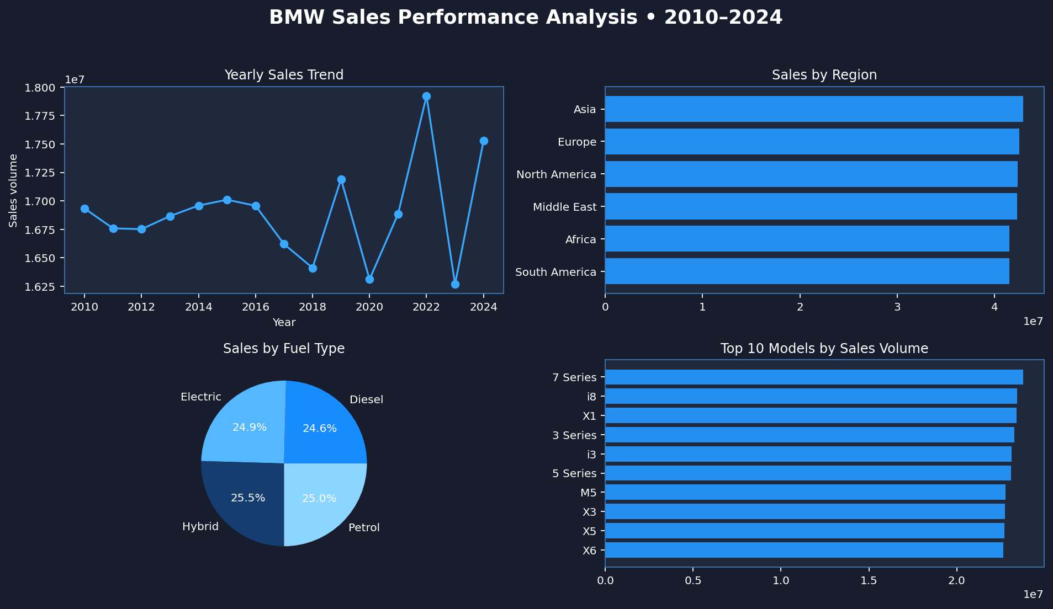
BMW SALES PERFORMANCE
Analytics Dashboard & Business Insights
Dataset period: 2010–2024 | 50,000 records
Prepared using Python • Pandas • Plotly • Streamlit

Slide 2
01 | Dataset Overview
What is included in the supplied dataset?
50,000
2010–2024
$75,035
100,307 km
records
year range
average listed price
average mileage
Fields available
Model • Year • Region • Color • Fuel Type • Transmission • Engine Size • Mileage • Price • Sales Volume • Sales Classification
Purpose: explore trends, compare regions and models, and understand price and fuel-type patterns.

Slide 3
02 | Yearly Sales Trend
Total sales volume grouped by year
Use the interactive dashboard to filter years and compare the trend.

Slide 4
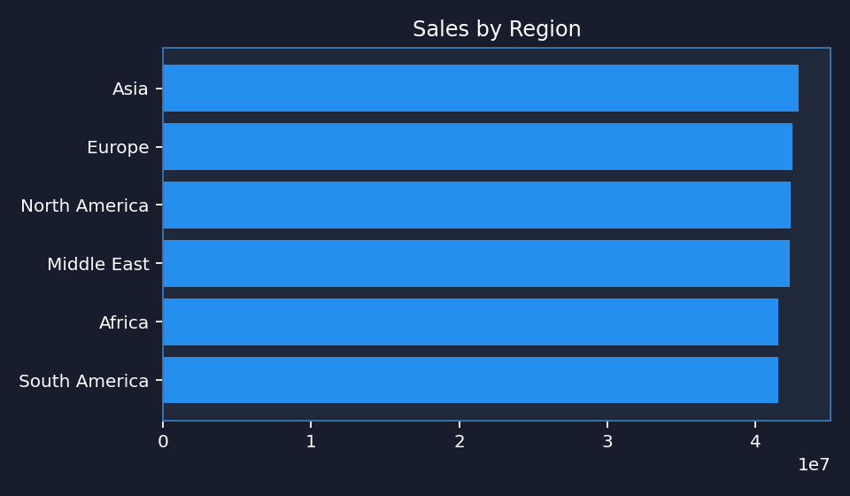
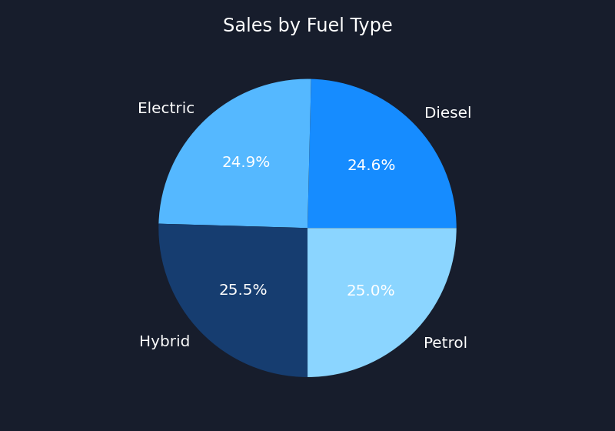
03 | Region & Fuel Type
Compare where recorded sales volume appears and its fuel mix
Highest recorded region: Asia | Most represented fuel type by volume: Hybrid

Slide 5
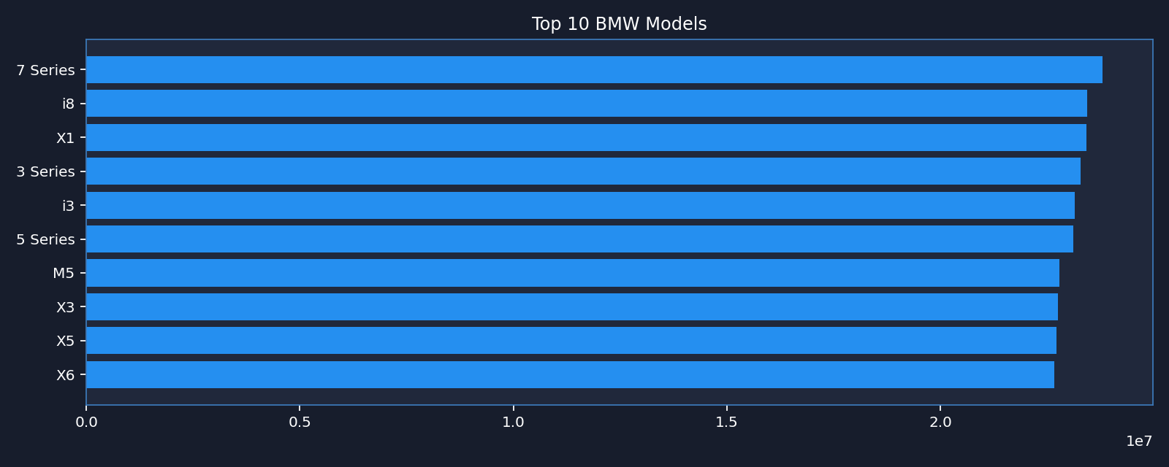
04 | Model Performance
Top models by summed sales volume
Top model by summed sales volume in this file: 7 Series.

Slide 6
05 | Key Takeaways & Next Steps
How to use this analysis responsibly
• Use year and region filters to inspect differences in recorded sales volume.
• Compare model-level volume with average price before making product decisions.
• Review fuel type and transmission mix to identify areas for deeper investigation.
• Use the scatter plot to explore whether price and sales volume appear related.
• Next step: validate the dataset source and definitions before using results as official business facts.
Note: Findings describe only the supplied CSV; they are not verified official BMW sales figures.

