Slide 1
DATA VISUALIZATION PROJECT
658
matches
MEN’S T20 INTERNATIONAL
TEAM & MATCH PERFORMANCE
106
teams
An interactive cricket analytics dashboard built with HTML, CSS and JavaScript
181,347
runs
Prepared by: Dev Kardani
Ahmedabad Institute of Technology
Source: user-provided dashboard HTML
MEN’S T20I • TEAM & MATCH PERFORMANCE
1

Slide 2
Overview & Objectives
A descriptive view of men’s T20 International cricket performance
PROJECT OVERVIEW
OBJECTIVES
• Summarizes processed ball-by-ball cricket records.
• Combines headline KPIs with team, year, dismissal and venue views.
• Supports interactive team selection and sortable comparisons.
• Focuses on descriptive analysis, not match prediction.
• Compare team win rates and scoring averages.
• Track average first-innings score and run rate by year.
• Compare batting and bowling rates by innings phase.
• Explore dismissal types and venue scoring averages.
MEN’S T20I • TEAM & MATCH PERFORMANCE
2

Slide 3
Dataset & Headline Statistics
Values shown in the supplied dashboard
658
matches
106
teams
181,347
runs
8,561
wickets
6,460
sixes
14,062
fours
148.1
avg 1st-innings score
51.2%
batting-first wins
Dashboard notes: year range displayed as 2005–2026. Matches without two completed innings are excluded.
Winners are calculated from innings totals; rain-affected outcomes may differ from official records.
MEN’S T20I • TEAM & MATCH PERFORMANCE
3

Slide 4
Dashboard Design & Methodology
How the web dashboard turns records into visual summaries
• HTML structures the page and dashboard sections.
• CSS defines layout, responsive cards, colors and typography.
• JavaScript renders the KPI strip and SVG-based charts.
• Team selection updates the team profile and phase/year views.
• Table headers sort the team comparison table.
DATA
Processed ball-by-ball CSV
SUMMARIZE
KPIs and team/year/venue measures
VISUALIZE
Bars, line chart and comparison table
EXPLORE
Select team and sort table
MEN’S T20I • TEAM & MATCH PERFORMANCE
4

Slide 5
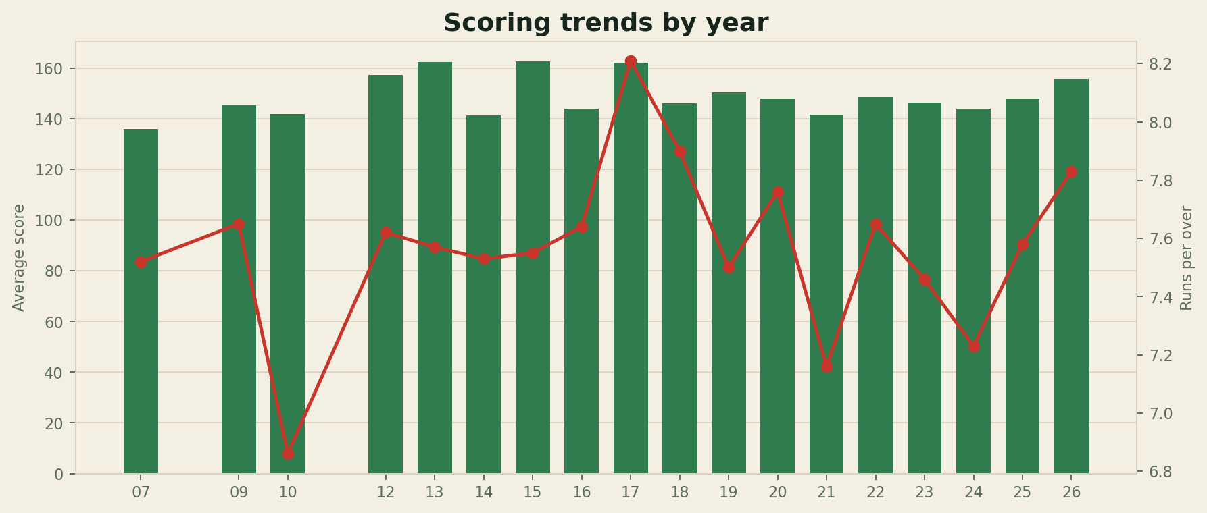
Scoring Trends by Year
Bars: average first-innings score • Line: runs per over
OBSERVATIONS
• Highest listed average: 162.6 in 2015.
• Lowest listed average: 136.0 in 2007.
• Only years present in the annual series are plotted.
MEN’S T20I • TEAM & MATCH PERFORMANCE
5

Slide 6
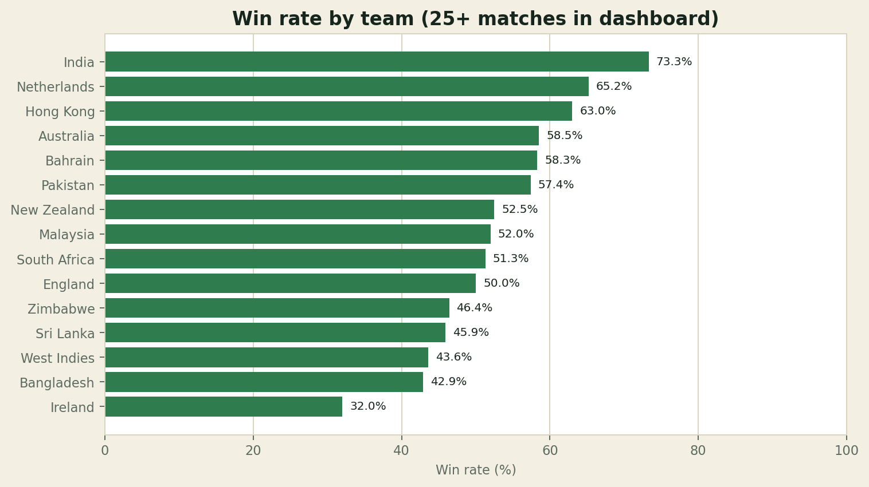
Team Performance Comparison
Teams included in the dashboard table have 25+ matches
SELECTED FIGURES
• India: 73.3% (44 wins from 62 matches).
• Netherlands: 65.2% (15 wins from 25 matches).
• Hong Kong: 63.0% (17 wins from 27 matches).
MEN’S T20I • TEAM & MATCH PERFORMANCE
6

Slide 7
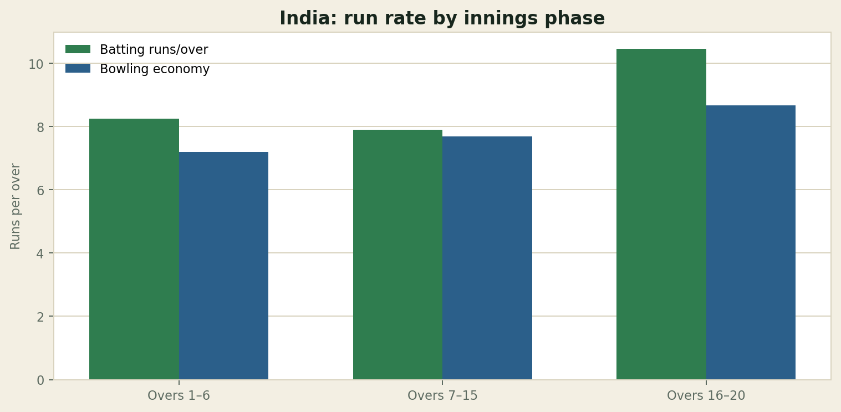
Innings-Phase Analysis: India
Run rates and bowling economy by phase, as displayed in the dashboard
INDIA PROFILE
• Batting: 8.24 (overs 1–6).
• Batting: 7.90 (overs 7–15).
• Batting: 10.45 (overs 16–20).
• Bowling economy: 7.19, 7.69 and 8.67 across the same phases.
MEN’S T20I • TEAM & MATCH PERFORMANCE
7

Slide 8
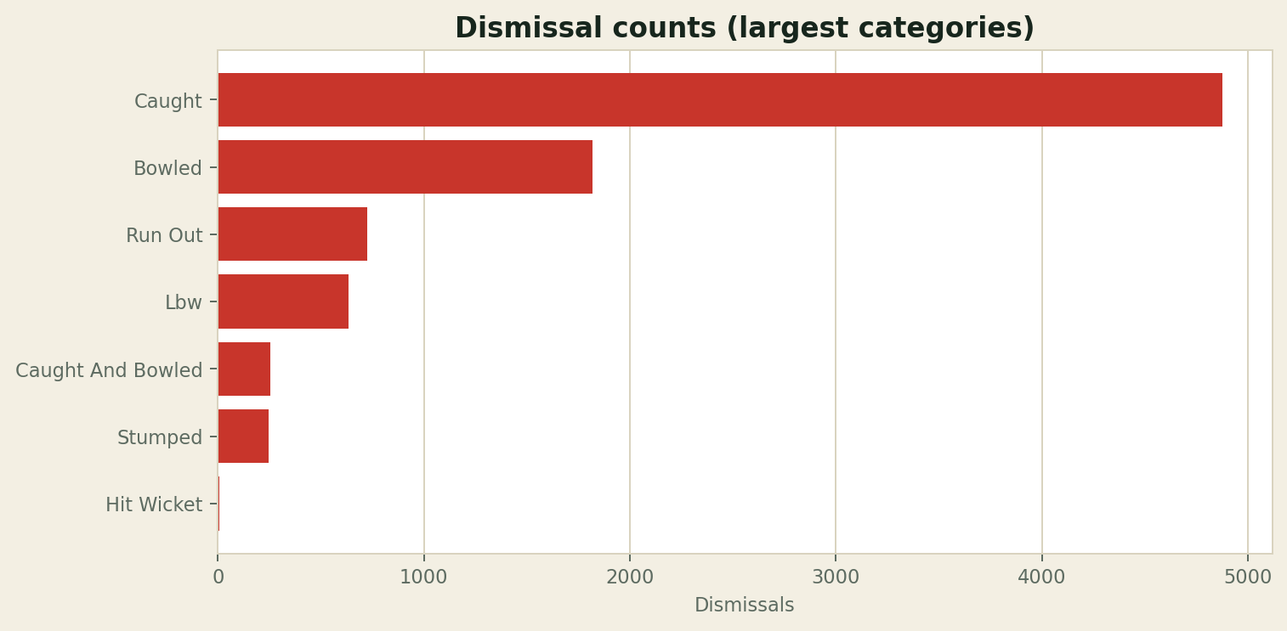
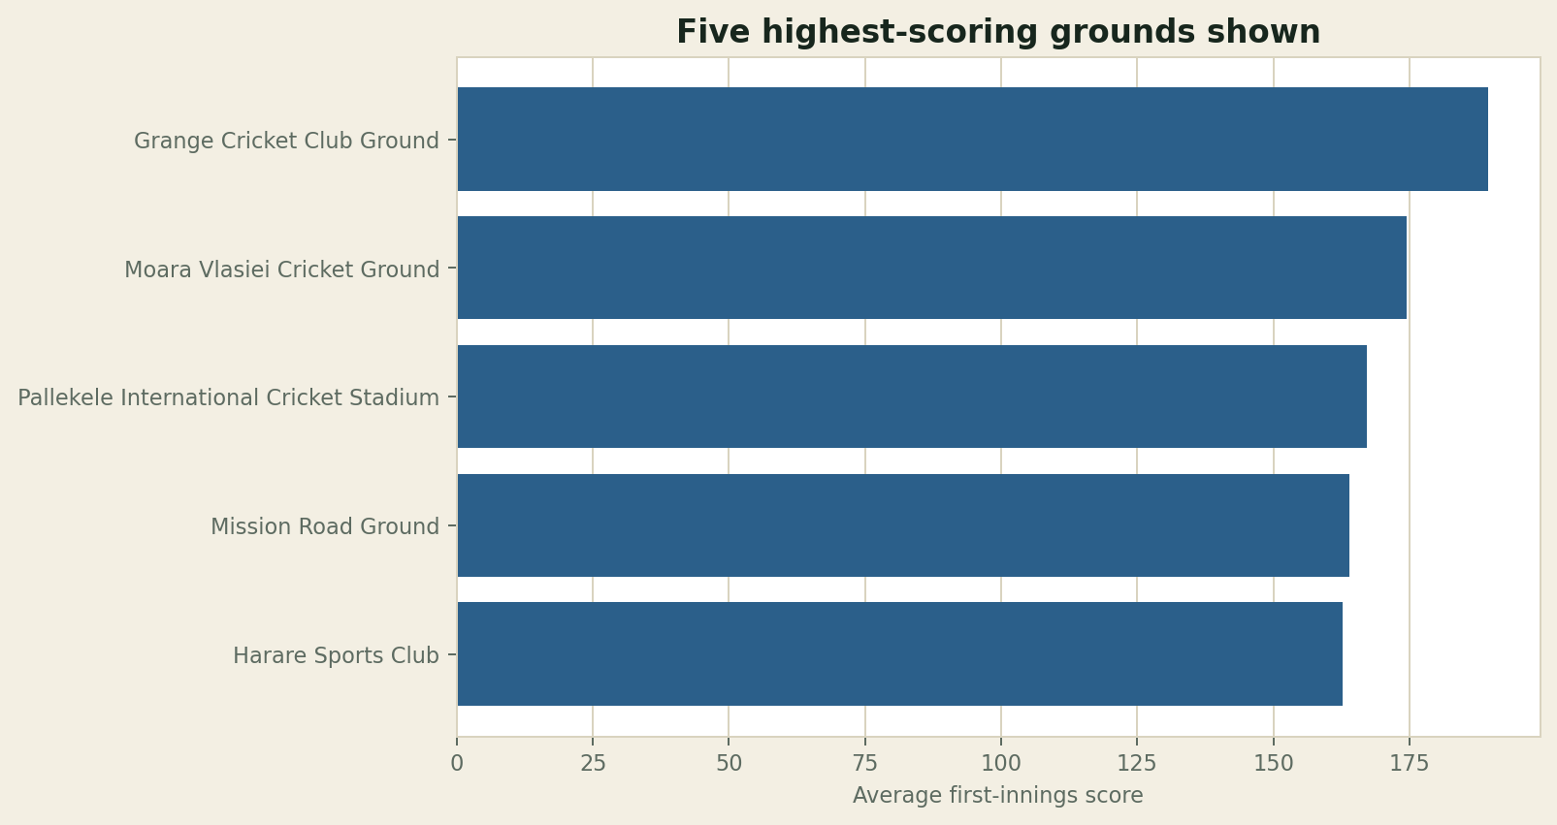
Dismissals & Venue Scoring
Two additional views from the dashboard
DISMISSAL COUNTS
AVERAGE FIRST-INNINGS SCORE BY GROUND
Caught: 4,874 dismissals. Highest listed venue average: 189.5 (Grange Cricket Club Ground, 6 matches).
MEN’S T20I • TEAM & MATCH PERFORMANCE
8

Slide 9
Key Findings
Descriptive findings grounded in the supplied dashboard
• The dashboard summarizes 658 matches and 106 teams.
• Overall batting-first win figure displayed: 51.2%.
• India has the highest win rate in the 25+ match team table at 73.3%.
• Caught dismissals (4,874) are the largest dismissal category shown.
• Annual average first-innings scores vary from 136.0 (2007) to 162.6 (2015) among listed years.
• Listed venue averages range from 94.1 to 189.5 among the displayed grounds.
MEN’S T20I • TEAM & MATCH PERFORMANCE
9

Slide 10
Skills, Limitations & Conclusion
Summary of project value and responsible interpretation
SKILLS DEMONSTRATED
LIMITATIONS
CONCLUSION
• HTML page structure
• CSS styling and responsive layout
• JavaScript-driven charts and interactions
• Data interpretation and visual communication
• Original dataset URL not supplied.
• Raw CSV and cleaning script not included.
• Rain-affected results may differ from official records.
The dashboard brings together match KPIs, scoring trends, team comparisons, dismissal patterns and venue averages in one interactive web interface. It demonstrates how front-end development can make cricket data easier to explore and communicate.
Prepared by Dev Kardani • Ahmedabad Institute of Technology
MEN’S T20I • TEAM & MATCH PERFORMANCE
10

