Slide 1



Navyug Vidyabhavan Trust
C. K. Pithawala College of Engg. & Tech.
Healthcare Analytics
PDS CIPAT PRESENTATION
      Presented By
        Om Koradia — 240090107070(DIV-C)
        Meetrajsinh Vala — 240090107087(DIV-C)
        Jeel Moradiya — 240090107097(DIV-C)
        Daksh Rana — 240090107175(DIV-C
Faculty Guide
Prof. Rakesh Katariya
Notes:
1.7.2013
1.7.2013
1.7.2013
1.7.2013
‹#›
‹#›
‹#›
‹#›

Slide 2
Outline
          Introduction to Healthcare Analytics
          Problem Statement
          Objectives
          Healthcare Dataset
          Tools & Technologies Used
          Data Cleaning & Preprocessing
          Patient & Department Analysis
          Treatment, Visit & Cost Analysis
          Data Visualization
          Statistical Analysis
          Machine Learning for Prediction
          Results & Findings
          Limitations & Future Scope
          Conclusion
Notes:
1.7.2013
1.7.2013
1.7.2013
1.7.2013
‹#›
‹#›
‹#›
‹#›

Slide 3
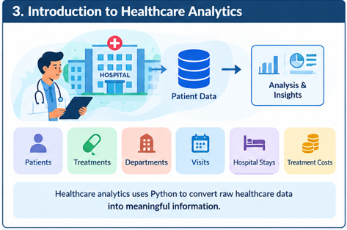
Introduction to Healthcare Analytics
    What is Healthcare Analytics?
    Healthcare generates a large amount of patient data.
    This data contains information about:
      Patients
      Treatments
      Hospital departments
      Visits
      Hospital stays
      Treatment costs
    Python can be used to convert this raw data into meaningful information.
    Our project analyzes 5,000 patient records with 10 columns.
Notes:
1.7.2013
1.7.2013
1.7.2013
1.7.2013
‹#›
‹#›
‹#›
‹#›

Slide 4
Problem Statement
Problem Statement
Manually analyzing large amounts of healthcare data is difficult.
    Our system aims to:
    Analyze patient information
    Find common treatments
    Compare hospital departments
    Analyze emergency vs routine visits
    Study treatment costs
    Analyze hospital stay duration
    Represent results using graphs
    Use Machine Learning for prediction
Notes:
1.7.2013
1.7.2013
1.7.2013
1.7.2013
‹#›
‹#›
‹#›
‹#›

Slide 5
Objectives
Project Objectives
    Understand the healthcare dataset
    Clean and prepare the data
    Analyze patient information
    Identify the most common department
    Analyze treatment types
    Compare emergency and routine visits
    Calculate statistical values
    Create graphs and visualizations
    Apply a Machine Learning model
    Understand the use of Data Science in healthcare.
Notes:
1.7.2013
1.7.2013
1.7.2013
1.7.2013
‹#›
‹#›
‹#›
‹#›

Slide 6
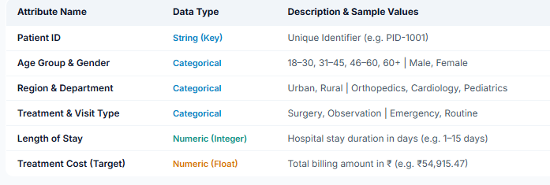
Healthcare Dataset
    patient_id – Unique identifier for each patient
    visit_date – Date and time of the hospital visit
    age_group – Categorical age brackets (18–30, 31–45, 46–60, 60+)
    gender – Gender of the patient (Male / Female)
    region – Geographical region of the patient (North, South, East, West)
    department – Hospital department (General Medicine, Orthopedics, Pediatrics, Neurology, Cardiology)
7.treatment_type – Medical intervention type (Medication, Surgery, Therapy, Observation)
8.visit_type – Category of visit (Emergency vs. Routine)
l9.ength_of_stay_days – Number of days admitted in the hospital
10.treatment_cost – Total monetary cost of treatment
Notes:
1.7.2013
1.7.2013
1.7.2013
1.7.2013
‹#›
‹#›
‹#›
‹#›

Slide 7
Tools & Technologies Used
Technology Used
    Programming Language
      Python
      Development Environment
      Jupyter Notebook
    Google Colab
    Libraries
      Pandas → Data handling
      NumPy → Numerical calculations
      Matplotlib → Graphs
      Seaborn → Data visualization
      SciPy → Statistical analysis
      Scikit-learn → Machine Learning
Notes:
1.7.2013
1.7.2013
1.7.2013
1.7.2013
‹#›
‹#›
‹#›
‹#›

Slide 8

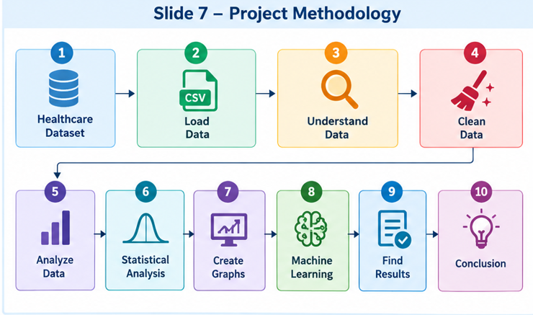
Data Cleaning & Preprocessing
      Methodology
        Healthcare Dataset → Load Data → Understand Data → Clean Data → Analyze Data → Statistical Analysis → Visualization → Machine Learning → Results → Conclusion
      Brief Explanation
        Load the healthcare CSV file
        Understand its structure
        Check and clean the data
        Perform analysis
        Calculate statistics
        Create visualizations
        Apply Machine Learning
        Interpret results
Notes:
1.7.2013
1.7.2013
1.7.2013
1.7.2013
‹#›
‹#›
‹#›
‹#›

Slide 9
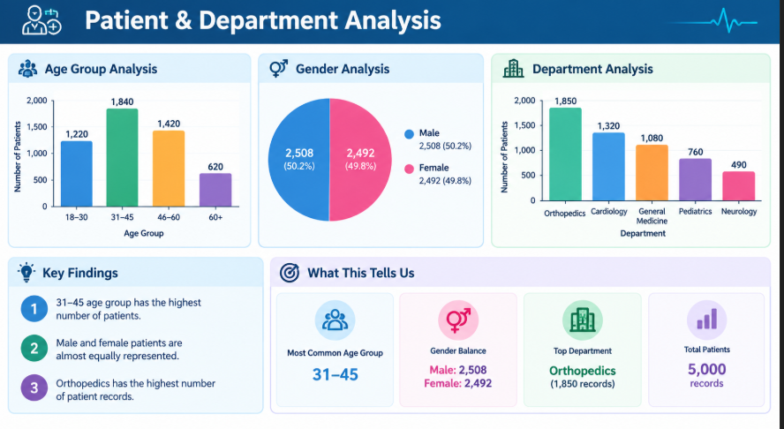
Patient & Department Analysis
Patient & Hospital Analysis
    We analyzed:
    Age Group
      18–30
      31–45
      46–60
      60+
    Gender
      Male: 2,508
      Female: 2,492
    Department
      Orthopedics
      Cardiology
      General Medicine
      Pediatrics
      Neurology
    Key Findings
      31–45 has the highest number of patients.
      Male and female patients are almost equally represented.
      Orthopedics has the highest number of patient records.
Notes:
1.7.2013
1.7.2013
1.7.2013
1.7.2013
‹#›
‹#›
‹#›
‹#›

Slide 10
Treatment, Visit & Cost Analysis
Healthcare Statistics
    Treatment Types
      Observation
      Surgery
      Medication
      Therapy
    Finding: Observation is the most common treatment.
    Visit Types
      Routine: 3,432
      Emergency: 1,568
    Finding: Routine visits are more common.
    Treatment Cost
      Average: ₹54,915.47
      Median: ₹55,123.50
      Minimum: ₹746
      Maximum: ₹119,307
    Average Hospital Stay: approximately 4 days.
Notes:
1.7.2013
1.7.2013
1.7.2013
1.7.2013
‹#›
‹#›
‹#›
‹#›

Slide 11
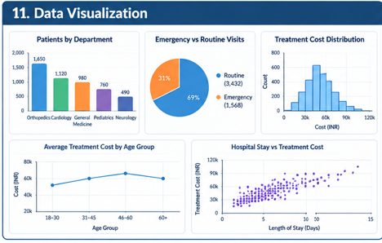
Data Visualization
Visualization Techniques
We used different graphs to understand the data:
    1. Bar Chart
      Compares patients across departments.
      Orthopedics has the highest records.
    2. Pie Chart
      Shows Emergency vs Routine visits.
      Routine visits are more common.
    3. Histogram
      Shows treatment-cost distribution.
    4. Line Graph
      Compares average treatment cost across age groups.
    5. Scatter Plot
      Shows the relationship between hospital stay and treatment cost.
Notes:
1.7.2013
1.7.2013
1.7.2013
1.7.2013
‹#›
‹#›
‹#›
‹#›

Slide 12
Statistical Analysis
Statistical Analysis Using Python
We used statistical methods to understand numerical healthcare data.
    Measures used:
      Mean → Average value
      Median → Middle value
      Standard Deviation → Measures variation
      Minimum → Lowest value
      Maximum → Highest value
      Sum → Total treatment cost
    Example
    df["treatment_cost"].mean()
    df["treatment_cost"].median()
    df["treatment_cost"].std()
Notes:
1.7.2013
1.7.2013
1.7.2013
1.7.2013
‹#›
‹#›
‹#›
‹#›

Slide 13
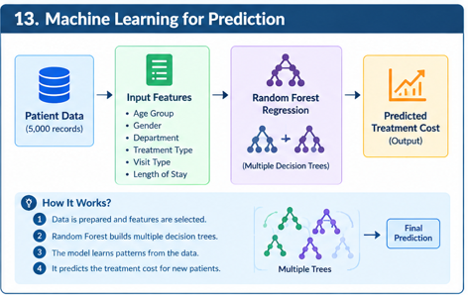
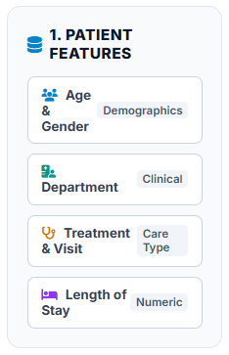
Machine Learning for Prediction
Treatment Cost Prediction
    We used Random Forest Regression to predict healthcare-related values.
    Input Features
    Output
      Predicted Treatment Cost
      Random Forest combines multiple decision trees to make predictions.

Slide 14
Results & Findings
    System Implementation
    The project follows these steps:
      Load healthcare dataset
      Check the data
      Clean missing/duplicate data
      Analyze patient information
      Perform statistical calculations
      Create graphs
      Analyze relationships between variables
      Apply Machine Learning
      Analyze results

Slide 15
Limitations & Future Scope
    Limitations
      Dataset contains limited patient information.
      No detailed disease or symptom information.
      ML predictions depend on available data quality.
      Results are based only on the given dataset.
    Future Scope
      Add more patient records
      Add disease information
      Add medical test results
      Add doctor information
      Include hospital capacity
      Use real-time healthcare data
      Use advanced ML models
      Develop a web-based healthcare analytics dashboard

Slide 16
Conclusion
Conclusion
    Healthcare Analytics demonstrates how Python can be used to solve a real-world healthcare problem.
    Our project used:
    Pandas + NumPy + Matplotlib + Seaborn + SciPy + Scikit-learn
    We analyzed:
    Patients → Departments → Treatments → Visits → Hospital Stay → Treatment Costs
📚 References:
  Dataset: [`healthcare_patient_analytics.csv`]( healthcare_patient_analytics.csv )
  GitHub Repository: [Healthcare Analytics Repository](https://github.com/jeelmoradiya078-lgtm/CIPAT-Healthcare-Analytics.git)

