Slide 1
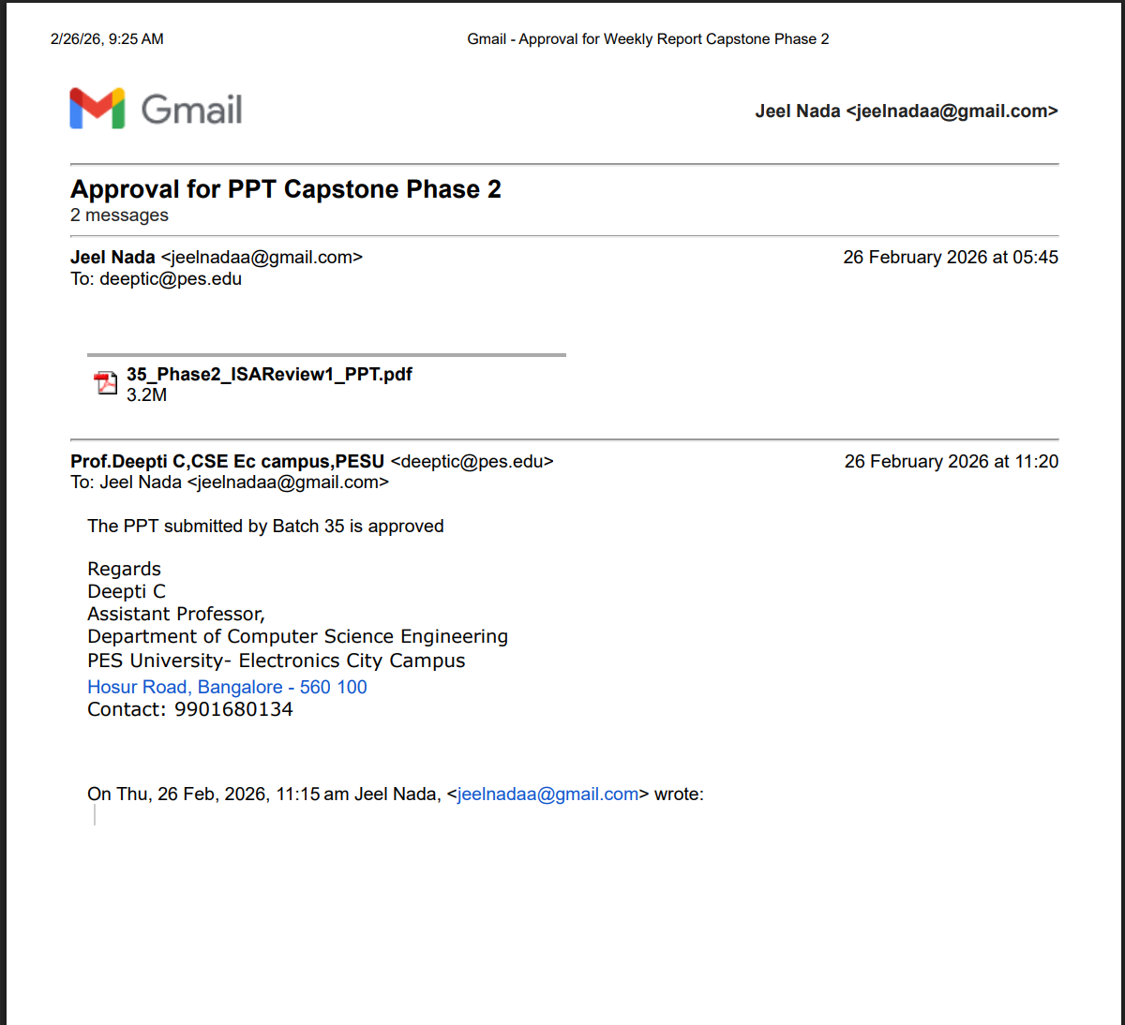

Slide 2
Capstone Project – Phase 2 Review
UE23CS320B – Project Phase 2
Project Title
Project ID
PlantIQ: AI-Driven Coffee Cultivation and Market Platform
35
Project Guide
Project Team
Prof. Deepti C
Jeel Nada – PES2UG23CS357
Nidhi N – PES2UG23CS384
Mohammed Ayaan – PES2UG23AM058

Slide 3
Today's Discussion (Agenda)
Foundation
Requirements
Problem statement, abstract, and Phase 1 feedback
Technical specifications and dataset details
Design
Progress
System architecture and module approach
Current milestones and next steps

Slide 4

The Problem Farmers Face
Scattered Cultivation Knowledge
Limited Market Visibility
Reliable information about sowing methods, irrigation schedules, pest control, and harvesting techniques is spread across multiple sources. Content is often outdated or not localized for Karnataka's unique crops and climate conditions. Farmers rely on guesswork or depend on costly intermediaries for advice.
Even after producing quality crops, farmers struggle to make their produce visible to buyers. They typically depend on middlemen, which significantly reduces their profits and bargaining power. Direct buyer connections remain difficult to establish.
The Gap: Farmers lack a unified, localized, and accessible platform that supports both cultivation decisions and direct crop visibility to buyers. PlantIQ is our solution an AI-driven platform designed to address both challenges in a farmer-first way.

Slide 5
PlantIQ: Our Solution Approach
AI Cultivation Agent
Field Level Tools
RAG-based assistant providing localized, multilingual, voice-enabled guidance on best cultivation practices tailored to Karnataka's agricultural context.
Integration of computer vision for plant disease detection and real-time weather-based advisories to support decision-making at the farm level.
Farmer-First Design
Market Visibility Module
Built with accessibility at its core, featuring support for regional languages, voice inputs, and intuitive interfaces designed for low-literacy users.
Allows farmers to list crop details such as type, quantity, price and location. Buyers can explore offerings on an interactive map and initiate direct contact, eliminating middlemen.

Slide 6
Project Milestones Achieved
Dataset Secured ✓
Technology Stack Finalized ✓
Coffee leaves dataset for disease detection
Real-time weather data via API integration
Regional soil characteristics database
Computer Vision: ResNet50 (CNN-based)
Frontend: Streamlit for rapid prototyping
Backend: FastAPI for scalable services
Architecture Designed ✓
Disease Detection Module
Advisory Generation Module
Chatbot Interface Module
Market Discovery Module

Slide 7
Addressing Phase 1 Feedback
Dataset Sourcing Resolved
Technology Adoption Validated
User Readiness Confirmed
Successfully obtained comprehensive image datasets of coffee leaves for CNN model training. Data cleaning process is underway to ensure quality and consistency across all disease categories.
As of February 2020, over 25,353 coffee growers actively used the "Coffee Krishi Taranga" mobile-based service. This demonstrates that coffee planters in Karnataka are technologically equipped with smartphones and reliable internet access.
Market research confirms our target audience has the necessary infrastructure and digital literacy to adopt PlantIQ, reducing implementation barriers significantly.

Slide 8
Requirements Overview
Module 1: Disease Detection
Module 2: Advisory Generation
Allow farmers to upload coffee leaf images
Detect disease type using CNN model
Provide confidence scores and visual feedback
Fetch environmental data based on location
Retrieve disease solutions from knowledge graph / RAG
Generate explainable advisories using LLM

Slide 9
Requirements Overview(Continued)
Module 3: Chatbot Interface
Module 4: Market Discovery
Support text and voice interactions
Multilingual support (English + Kannada)
Maintain conversation history
Connect to backend advisory engine
Enable farmer produce listings
Store crop details and pricing
Map-based buyer discovery interface
Facilitate direct buyer-farmer contact

Slide 10
Dataset / APIs
1
2
3
Disease Detection Dataset
Environmental Dataset
Elevation Data
Source: JMuBEN Coffee Leaf Disease Dataset
Source: NASA POWER API
Source: Open Elevation API
Parameters: Temperature, humidity, rainfall patterns
Data: Region-specific altitude values
Classes: Leaf Rust, Phoma, Miner, Cercospora, Healthy Leaves
Purpose: Provide contextual advisory based on real-time environmental conditions affecting coffee cultivation
Purpose: Refine disease advisory based on altitude influence on coffee plant susceptibility
Preprocessing: Image resizing, normalization, image cleaning, data augmentation
Link: https://github.com/Jorl17/open-elevation/blob/master/docs/api.md
Purpose: Train ResNet50 for accurate disease classification
Link: https://power.larc.nasa.gov/docs/services/api/temporal/daily/
Link: https://www.kaggle.com/datasets/noamaanabdulazeem/jmuben-coffee-dataset

Slide 11
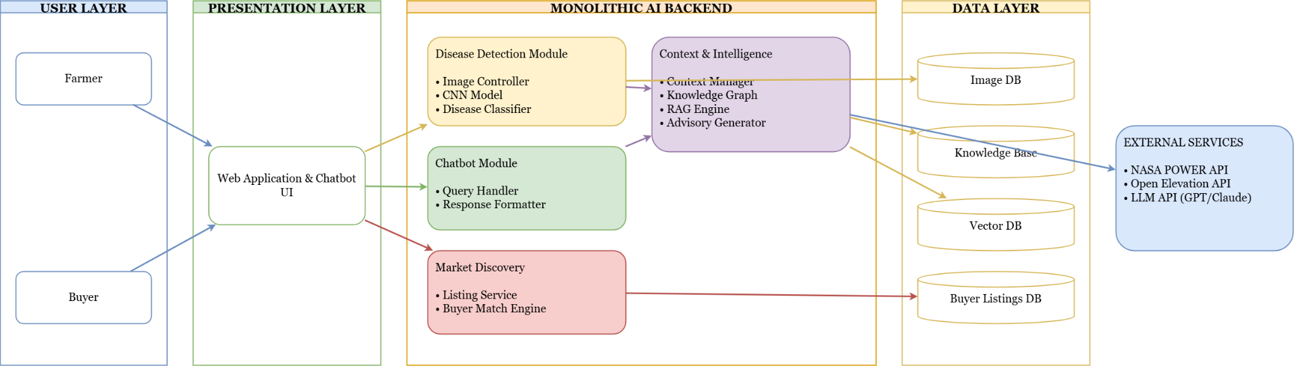
Architecture Diagram

Slide 12
Module Design & Technology Choices
Module 1: Disease Detection
Module 2: AI Advisory System
Tech: ResNet50, FastAPI, Streamlit
Tech: GPT, FAISS, KG
Why: ResNet50 ensures high-accuracy classification through deep feature extraction. FastAPI enables fast model deployment, while Streamlit provides an intuitive interface for real-time predictions.
GPT: Generates context-aware advisories.
FAISS(RAG): Semantic Search for RAG functionality.
KG(Neo4j): Shows relation between disease, symptoms and environmental data.

Slide 13
Module Design & Technology Choices(Continued)
Module 3: Chatbot Interface
Module 4: Market Discovery
Tech: React, Web Speech API, REST APIs
Tech: PostgreSQL, Google Maps API, Node.js
Why: React provides reusable UI components with mobile-friendly design. Voice support improves farmer accessibility. REST APIs enable modular communication between services.
Why: PostgreSQL supports structured and geo-location data. Map APIs enable visual buyer discovery. Node.js provides scalable backend infrastructure for marketplace operations.

Slide 14
Design Approach Followed
For PlantIQ, we adopted a Modular Layered Monolithic Architecture with Multi-Modal AI Integration. A strategic approach that balances development speed, system clarity and real-world agricultural needs.
Layered System Architecture
Modular Monolithic Backend
Multi-Modal AI Pipeline
Integrates image (CNN), text (LLM), structured data, and market information to address agricultural challenges holistically.
Structured separation across User, Presentation, AI Backend, Data, and External Services layers ensures clean data flow and maintainability.
Independent logical modules (Disease Detection, Advisory, Chatbot, Market Discovery) within a unified backend for simplified integration.

Slide 15
Why This Architectural Approach?
Layered Architecture Benefits
Monolithic Over Microservices
Clear separation of concerns across system components
Independent evolution of UI and backend systems
Simplified debugging and maintenance workflows
Alignment with industry-standard practices
We deliberately chose a monolithic architecture for this capstone implementation:
Faster development cycle --> reduced architectural overhead
Easier module integration --> shared context and data access
Simpler deployment --> single application instance
Lower DevOps complexity --> appropriate for academic scope
Research-focused --> emphasis on AI innovation over infrastructure
This foundation improves long-term maintainability and positions PlantIQ for future scalability as the platform evolves.
Microservices would introduce unnecessary complexity without proportional benefit for a prototype-stage system.

Slide 16
Architectural Trade-offs
Benefits of This Approach
Clear Separation of Concerns
Accelerated Development
Each module has a well-defined responsibility: CNN handles disease detection, Advisory manages contextual reasoning, Chatbot facilitates user interaction, and Market enables commerce integration. This clarity improves code maintainability and team collaboration.
Unified backend enables easy API calls between modules, shared database access, simplified debugging workflows and faster testing cycles which are critical advantages for meeting capstone deadlines.
Acknowledged Drawbacks
Scalability Limitations
Tight Coupling Risk
Individual modules cannot scale independently. Resource-intensive CNN and LLM operations may create computational bottlenecks under high concurrent load.
Internal dependencies mean changes in one module can ripple through the system, potentially affecting stability during iterative development.

Slide 17
Design Constraints and Assumptions
Limited Infrastructure & Compute
Integration Complexity
No dedicated GPU cluster, restricted cloud credits, and resource intensive AI requirements shaped our technical decisions:
The project combines Computer Vision, LLM, Vector Database, External APIs, Market Database, and Chat Interface
Transfer learning with ResNet50 instead of training from scratch
Retrieval-based LLM approach over full model fine-tuning
Avoided distributed microservices to minimize overhead
Layered architecture for system clarity
Unified backend for simplified communication
Careful API orchestration across components
Key Design Assumptions
Internet Availability
Image Input Quality
System depends on NASA POWER API, Open Elevation API. We assume reliable internet connectivity for real-time data retrieval.
CNN expects clear leaf images with proper lighting conditions. Preprocessing pipelines are optimized for field-captured smartphone photos.

Slide 18
Dependencies
External API Dependencies
Inter-Module Dependencies
NASA POWER API: Provides weather data (humidity, rainfall, temperature). API failure reduces environmental context accuracy and network latency may increase response time.
Sequential workflow: CNN → RAG/KG Module → LLMs → Suggestions. Failure in one module affects the complete user experience due to tight integration in the monolithic structure.
Open Elevation API: Supplies elevation data for location based advisory. Service unavailability impacts terrain specific recommendations.

Slide 19
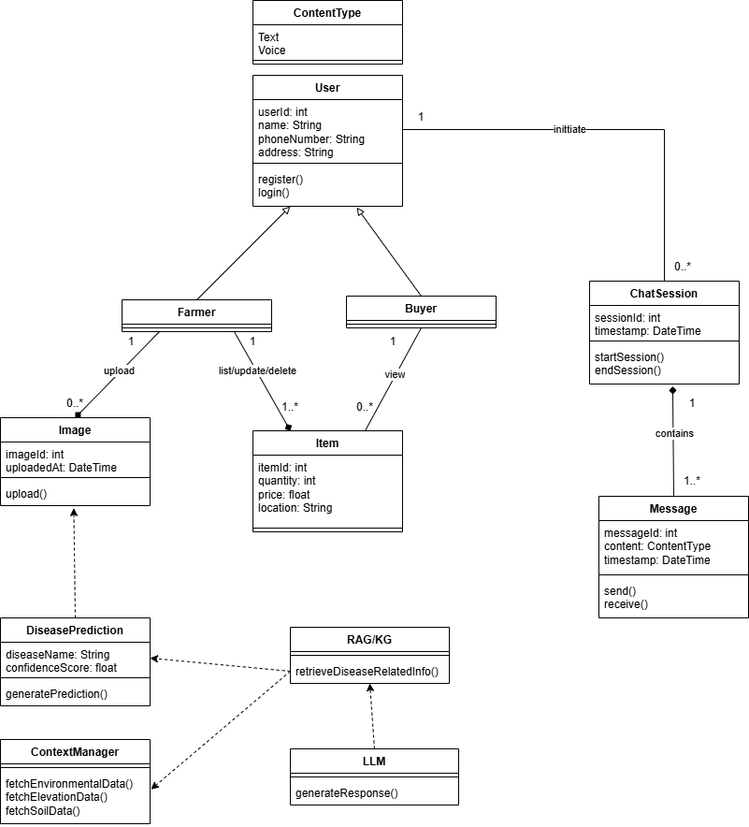
Master Class Diagram

Slide 20
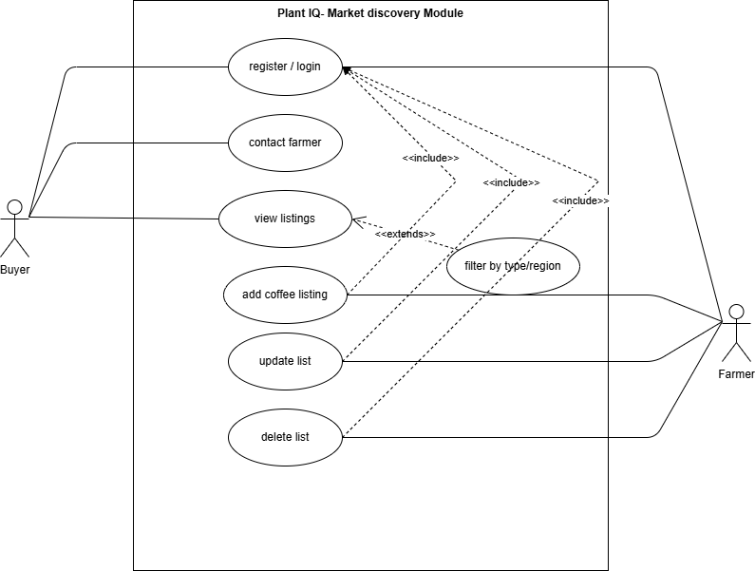
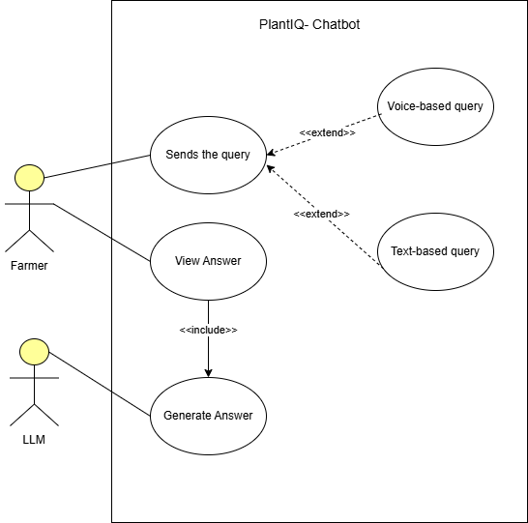
Use-Case Diagrams

Slide 21
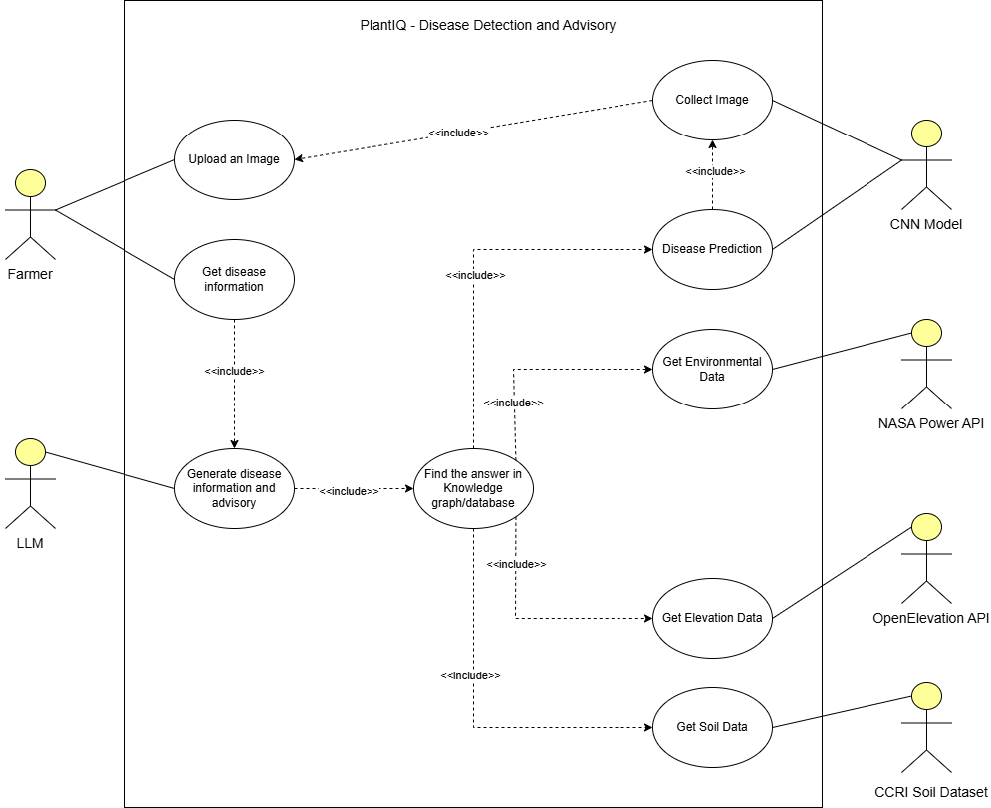

Slide 22
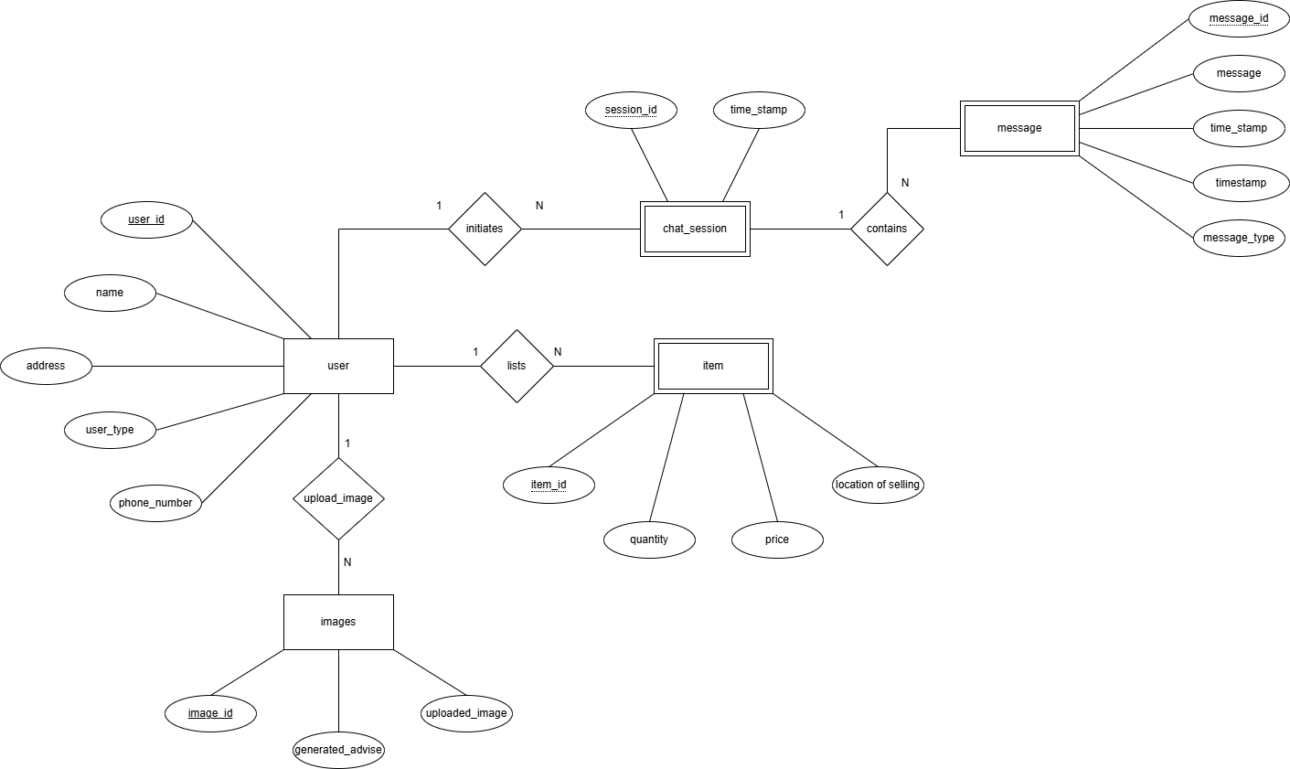
Entity-Relationship Diagrams

Slide 23
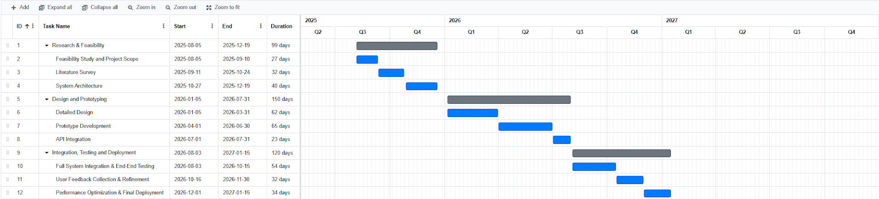
Capstone Project Timeline
Phase I
Phase II
Phase III
Literature review, requirements gathering, initial architecture design, and proof-of-concept development
Core module implementation, CNN training, LLM integration, database design, and initial testing
System integration, user interface development, comprehensive testing, performance optimization, and final evaluation

Slide 24
References
[1] Dr. Selva Kumar S., Imadh Ajaz Banday, Vibha Venkatesh Shanbhag, Afifah Khan Mohammed Ajmal Khan and Manikantha Gada, “Overcoming LLM Challenges Using RAG-Driven Precision in Coffee Leaf Disease Remediation,” IEEE International Conference on Emerging Technologies in Computer Science, 2024.
[2] X. Zhao et al., “Implementation of Large Language Models and Agricultural Knowledge Graphs for Efficient Plant Disease Detection,” Agriculture, vol. 14, no. 8, 2024.
[3] A. K. S. et al., “Coffee Leaf Disease Detection Using Convolution Neural Network,” Grenze International Journal of Engineering and Technology, 2024.
[4] R. Sapkota et al., “Multi-Modal LLMs in Agriculture: A Comprehensive Review,” IEEE Transactions on Automation Science and Engineering, 2024.
[5] N. Singh et al., “Farmer.Chat: Scaling AI-Powered Agricultural Services for Smallholder Farmers,” ACM Proceedings, 2024.
[6] C. S. Santhosha and K. K. Umesh, “An Ensemble Approach for Coffee Crop Yield Prediction Based on Agronomic Factors,” ASEAN Engineering Journal, vol. 13, no. 3, 2023.
[7] S. Patil et al., “Influence of Elevation and Rainfall on Leaf Growth, Bean Characteristics and Yield Components of Coffee Under Changing Climatic Conditions in Karnataka, India,” Journal of Plantation Crops, vol. 50, no. 2, pp. 78–84, 2022.

Slide 25
Thank You
PlantIQ represents a farmer-first approach to agricultural AI combining cutting-edge technology with practical design decisions tailored for real world constraints and academic excellence.

