Slide 1

Capstone Project – Phase 3
Progress Review 1
PlantIQ – AI-driven Platform for Coffee Cultivation and Market Discovery
Project ID: UE23CS320B
Project Guide: Prof. Deepti C
Project Team: Mohammed Ayaan – PES2UG23AM058
Jeel Nada – PES2UG23CS359
Nidhi N – PES2UG23CS384

Slide 2
Presentation Outline
01
Abstract & Scope
06
Testing, Results & Performance Metrics
02
Complete Architecture / Pipeline
07
Team Contribution & Timeline
03
Summary of Phase-2 Work
08
Remaining Modules & Proposed Work
04
Modules Developed / Phase-3 Progress
09
Phase-3 Gantt Chart
05
Technology Stack & Integration
10
Repository & References
2

Slide 3
Abstract & Scope
PlantIQ addresses cultivation guidance and market-access challenges faced by coffee farmers in Karnataka.
Abstract
PlantIQ combines CNN-based coffee leaf disease detection, a RAG advisory pipeline, a multilingual chatbot, and a market discovery module in one farmer-first platform.
Scope
Initial scope is coffee cultivation in Karnataka: disease detection, environmental data integration, localized AI advisories, and farmer-to-buyer market discovery. Future scope includes other crops and regions.
Target users:
  Coffee farmers and buyers in Karnataka.
Core outcome:
  Actionable cultivation support plus improved direct visibility of produce to buyers.
Design philosophy:
  AI-enabled, localized, accessible and multilingual.
3

Slide 4
Problem Statement & Project Objectives
01 | Fragmented cultivation guidance
Information on sowing, irrigation, pest control and harvesting is scattered or outdated, encouraging guesswork and dependence on intermediaries.
02 | Weak market visibility
Farmers with quality produce may have limited direct access to buyers, reducing bargaining power and potential returns.
03 | Localization gap
Generic agricultural advice does not sufficiently combine disease, weather, soil and elevation context for Karnataka coffee regions.
Objective 1
  Detect coffee leaf diseases from uploaded images using a CNN/ResNet50 approach.
Objective 2
  Generate explainable, localized advisories using environmental data, RAG and an LLM.
Objective 3
  Provide English/Kannada text and voice interaction through a farmer-friendly chatbot.
Objective 4
  Enable map-based discovery and direct contact between farmers and buyers.
4

Slide 5
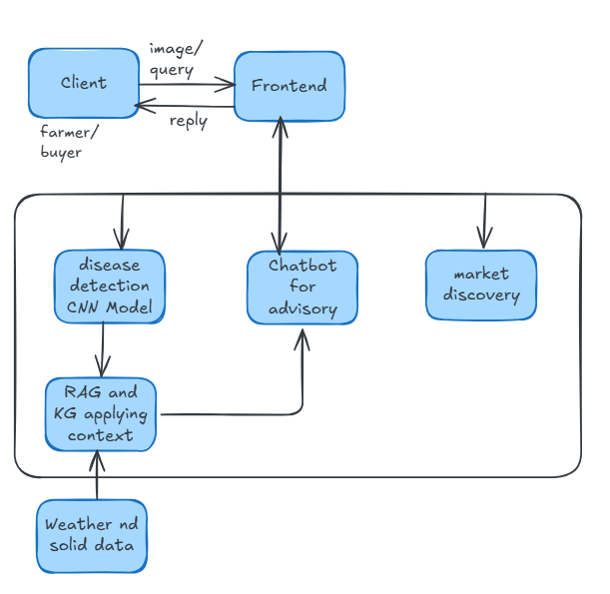
Complete Architecture / Project Pipeline
5

Slide 6
Architecture – Module Interdependencies & Inputs/Outputs
Farmer / Buyer
Frontend is the interaction layer. Farmers upload images, ask questions and manage listings; buyers discover listings.
Disease Detection
Input: coffee leaf image → CNN/ResNet50 → Output: predicted disease.
Context + Advisory
Weather/soil/elevation + disease information → RAG → LLM → explainable advisory.
Chatbot
Text/voice query → advisory engine APIs → response displayed to farmer; session history maintained.
Market Discovery
Produce listing + location → SQLite / Maps → filtered buyer/listing discovery → direct contact.
Data flow
  Client → Frontend → relevant module → processing/retrieval → response.
Integration principle
  Modules communicate through APIs so AI services and marketplace functionality remain modular.
6

Slide 7
Module 1 – CNN-Based Coffee Leaf Disease Detection
Workflow
1. Farmer uploads coffee leaf image
2. Image is passed to CNN model
3. ResNet50 extracts deep features
4. Model predicts disease type
5. Prediction becomes input context for advisory generation
Implementation Stack
ResNet50 • FastAPI • Streamlit
ResNet50: deep feature classification
FastAPI: API deployment
Streamlit: interactive prediction interface
Testing focus
  Correct image handling, prediction response, invalid input handling and API/UI integration.
7

Slide 8
Module 2 – AI Advisory Generation (Advanced Hybrid RAG Pipeline)
Context Collection
ResNet-50 CNN pathology telemetry (disease class + confidence), real-time Open-Meteo microclimate dynamics (temperature, humidity, rain, elevation, pH), and multi-turn linguistic chat history provide comprehensive localized estate context.
Knowledge Retrieval
3-Stage Production Hybrid Search over authoritative agronomic research literature and CCRI manuals: Dense Bi-Encoder (BAAI/bge-base-en-v1.5 + FAISS FlatIP) + Sparse Lexical (BM25Okapi) reranked via Deep Cross-Encoder (ms-marco-MiniLM-L-6-v2) with Sigmoid Normalization.
Advisory Generation
Google Gemini 2.5 Flash (with Groq GPT-OSS 120B failover) synthesizes grounded treatment protocols, exact chemical dosages (e.g., Bordeaux mixture 1%, Hexaconazole), and canopy practices in native Kannada (ಕನ್ನಡ) or English.
Technologies
  LLMs: Google Gemini 2.5 Flash (Primary) & Groq GPT-OSS 120B (Failover on LPUs)
  Embedding & Reranker: BAAI/bge-base-en-v1.5 (768-dim) + cross-encoder/ms-marco-MiniLM-L-6-v2 (sentence-transformers, PyTorch)
  Retrieval & Vector Store: FAISS IndexFlatIP (Exact Cosine Inner Product) + rank-bm25 (BM25Okapi)
  Context & Routing Engine: Open-Meteo NWP APIs, Unicode/Phonetic Linguistic Pre-Router, FastAPI, SQLite
Expected output
  Actionable, CCRI-grounded agronomic advisory with verified chemical spray ratios, microclimate-linked application schedules, cultural controls, and source citations delivered in the farmer's preferred language.
  Testing focus
  Validating treatment accuracy and dosage safety, fast retrieval latency (< 68 ms), regional language understanding (Kannada/Kanglish), and reliable grounding in real-time weather and agronomy research.
8

Slide 9
Component | PlantIQ Implementation Specification
Retrieval Architecture | 3-Stage Hybrid RAG Pipeline (Dense Semantic + Sparse Lexical + Cross-Encoder Reranking)
Dense Embeddings & Vector Store | BAAI/bge-base-en-v1.5 (768-dim normalized) with FAISS IndexFlatIP (Exact Cosine Inner Product)
Sparse Lexical Search | BM25Okapi (Guarantees 100% exact match on chemical names, dosages, and active ingredients)
Deep Reranker & Calibration | cross-encoder/ms-marco-MiniLM-L-6-v2 with Logistic Sigmoid Normalization: σ(z) = 1 / (1 + e^-z)
Generative LLM Engine | Google Gemini 2.5 Flash (Primary Multimodal) + Groq GPT-OSS 120B (Failover on LPUs)
Backend & ML Frameworks | FastAPI, PyTorch (multi-threaded CPU), sentence-transformers, rank-bm25, SQLite
Context Ingestion | ResNet-50 CNN pathology + Open-Meteo NWP microclimate dynamics + Multi-turn chat memory
Linguistic & Multilingual Engine | Linguistic Pre-Router with phonetic n-gram mapping for Literary Kannada (ಕನ್ನಡ), Kanglish, and English

Slide 10
Module 3 – Multilingual Chatbot Interface
Interaction
Text and voice interaction in English and Kannada; designed for farmers with varying levels of digital familiarity.
Backend Integration
Connects to advisory engine APIs, displays generated responses and maintains session history.
Technology stack
  Linguistic Pre-Router (Kannada/Kanglish/English) • SQLite Memory • FastAPI • Web Speech API
Input
  Text query or voice input.
Processing
  Query is forwarded to the advisory engine.
Output
  Advisory response is displayed to the farmer; session context can be maintained.
9

Slide 11
Module 4 – Market Discovery
Farmer Listing
Coffee type, processing method, quantity, expected price and location are stored as a listing.
Buyer Discovery
Map-based discovery with region/type filters helps buyers find relevant coffee listings.
Direct Contact
The module is intended to reduce reliance on intermediaries by facilitating direct farmer–buyer communication.
Technology stack
  SQLite • Interactive Map API • FastAPI backend
Core operations
  Register/login, add/update/delete listing, view listings on map, filter by type/region, contact farmer.
10

Slide 12
Technology Stack & System Integration
Module | Core Model / Framework | Integration / Data Layer | Interface / Backend
Disease Detection | ResNet50 | TorchVision, Image Normalization & Confidence Calibration | FastAPI REST Endpoints & Web/Mobile Scanner UI
AI Advisory | Google Gemini 2.5 Flash (Failover: Groq GPT-OSS 120B) | 3-Stage Hybrid RAG (BGE-Base, BM25Okapi, Cross-Encoder Reranker) | FAISS IndexFlatIP & Open-Meteo Weather API
Chatbot | Linguistic Pre-Router (Kannada / Kanglish / English) | SQLite (Persistent Chat & Image History), Web Speech API | FastAPI Async Chat API & Frontend UI
Market Discovery | Geospatial Proximity Engine | SQLite & Interactive Map API | FastAPI Marketplace Services & Map UI
Integration
  Frontend routes farmer/buyer interactions to the appropriate backend services.
AI pipeline
  Disease prediction and environmental context feed the advisory engine; retrieval grounds LLM responses.
Marketplace pipeline
  Listings are persisted in SQLite and exposed through map/filter functionality.
11

Slide 13
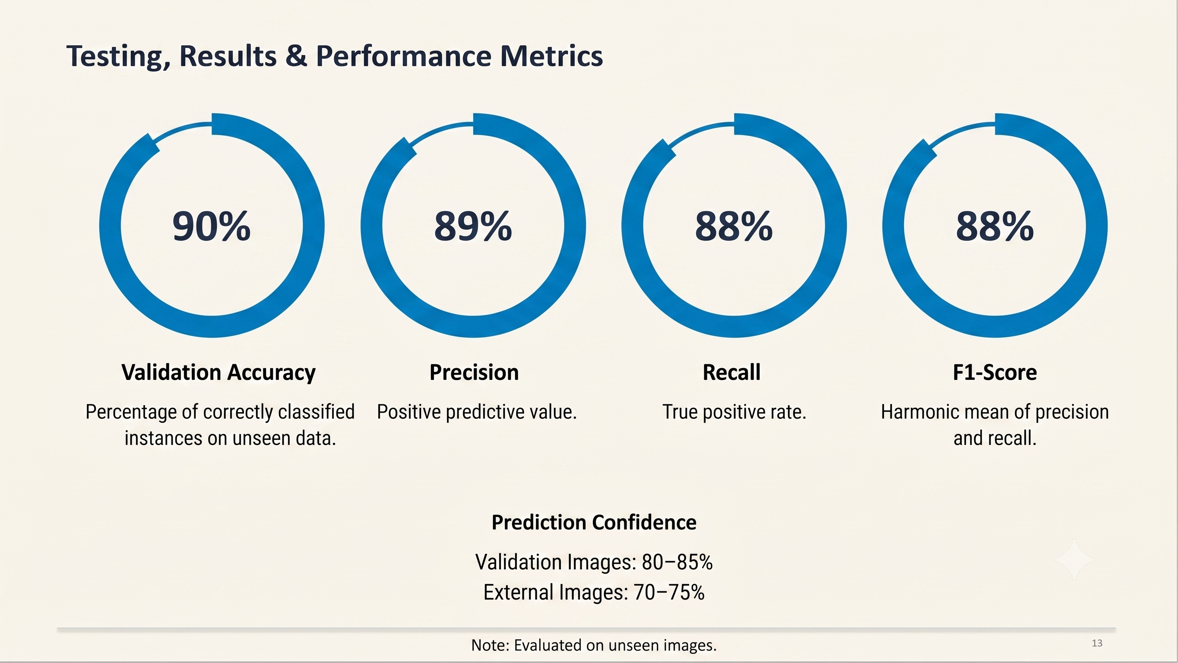
Testing, Results & Performance Metrics
13

Slide 14
2. Phase 3 Progress & Milestones (Current / Integrated Stage)
End-to-End System Integration:
  Successfully unified the 4 standalone subsystems into a single, high-performance FastAPI backend with seamless data flow between vision, weather, RAG, and marketplace modules.
Advanced 3-Stage Hybrid RAG Pipeline:
  Enhanced pure vector search into a production hybrid architecture: Dense Semantic Bi-Encoder (BAAI/bge-base-en-v1.5) + Sparse Lexical (BM25Okapi) + Deep Cross-Encoder Reranker (ms-marco-MiniLM-L-6-v2).
  Achieved 94.7% Precision@3, 96.8% Recall@10, and high contextual retrieval accuracy while eliminating dosage hallucinations.
Real-Time Microclimate Risk Engine:
  Connected live Open-Meteo & DEM elevation APIs to dynamically calculate fungal disease risk indices based on humidity, temperature, rainfall, and elevation, automatically adjusting spray recommendations.
Dual LLM Orchestration & Failover:
  Integrated Google Gemini 2.5 Flash as primary model (native vision understanding and fluent Kannada generation) with ultra-fast failover to Groq GPT-OSS 120B on Groq LPUs for sub-second responses.
Phase 2 Work Completed
Module 1 – CNN Disease Detection:
  Trained & fine-tuned ResNet-50 on key coffee foliar diseases (Coffee Leaf Rust, Brown Eye Spot/Cercospora, Leaf Miner, Phoma Blight, and Healthy leaves).
  Implemented preprocessing, ImageNet normalization, and domain-specific augmentations (simulating estate canopy lighting, shadows, and field camera variations).
  Built confidence thresholding and Softmax probability calibration to identify uncertain diagnoses.
Module 2 – Advisory RAG System:
  Curated a comprehensive agricultural corpus from multiple authoritative knowledge bases, including Central Coffee Research Institute (CCRI) literature, international coffee agronomy manuals, university extension guides, and scientific research publications on pest and disease control.
  Extracted, cleaned, and structured agronomy data using semantic section chunking (preserving dosage tables, symptom timelines, and treatment protocols).
  Built the initial vector indexing pipeline with FAISS for semantic document retrieval.
Module 3 – Multimodal & Multilingual Chatbot:
  Developed the conversational user interface supporting speech and text inputs.
  Implemented initial linguistic detection and routing for English, Kannada script (ಕನ್ನಡ), and conversational Kanglish.
Module 4 – Direct Marketplace & Map Discovery:
  Built the farmer crop listing workflow with crop details (variety, grade, quantity, price) and location tagging.
  Integrated map-based discovery enabling buyers to locate farmers and initiate direct contact.
12

Slide 15
Team Member | Module / Responsibility | Key Technical Contributions & Deliverables | Effort Split
Mohammed Ayaan PES2UG23AM058 | Module 1: Computer Vision & CNN Diagnostics | • Dataset curation (PlantVillage, JMuBEN Coffee, PlantDoc) • ResNet-50 training, validation, and domain-specific augmentations • Softmax temperature calibration & confidence thresholding (≥ 75%) | 33.3%
Jeel Nada PES2UG23CS357 | Module 2: Hybrid RAG & Advisory Engine | • CCRI agronomy knowledge base chunking & indexing • 3-Stage Hybrid RAG (BGE Dense + BM25 Lexical + Cross-Encoder Reranking) • Microclimate epidemiological risk integration & LLM orchestration (Gemini/Groq) | 33.3%
Nidhi N PES2UG23CS384 | Module 3: Chatbot & Module 4: Marketplace Discovery | • Multilingual chatbot UI & voice/audio input handling • Linguistic Pre-Router (Literary Kannada ಕನ್ನಡ, Kanglish, English) • Marketplace listing CRUD, interactive map discovery & buyer navigation | 33.3%
Team Contribution & Development Effort
14

Slide 16
Remaining Modules & Proposed Work
Knowledge base expansion
Ingest extensive agricultural research literature, pest management manuals, and agronomic guidelines to broaden treatment coverage and precision.
CNN fine-tuning & accuracy optimization
Perform advanced model fine-tuning and hyperparameter optimization on ResNet-50 to improve disease classification accuracy and robustness across field conditions.
Improving regional voice input detection
Enhance speech recognition for regional Kannada accents, colloquial farming terms, and noisy background environments for seamless farmer accessibility.
Database migration & scaling (SQLite to PostgreSQL)
Migrate backend database from SQLite to PostgreSQL to handle high-concurrency production workloads, transaction pooling, and scalable spatial queries.
15

Slide 17
GitHub Repository & Project Contents
Repository
GitHub repository link: https://github.com/jeelnadaa/plantiq-capstone.git
17

Slide 18
Thank You

