Slide 1
SUPPORT VECTOR MACHINE

Slide 2
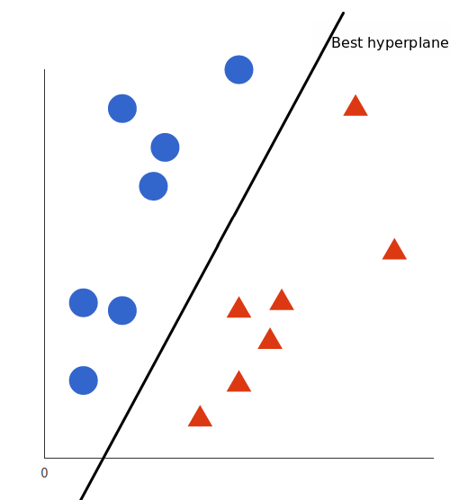
Introduction to Support Vector Machines (SVM)
Support Vector Machines (SVM) is a powerful and versatile supervised learning algorithm used for both classification and regression tasks.
It works by finding the optimal hyperplane that best separates the data into different classes.

Slide 3
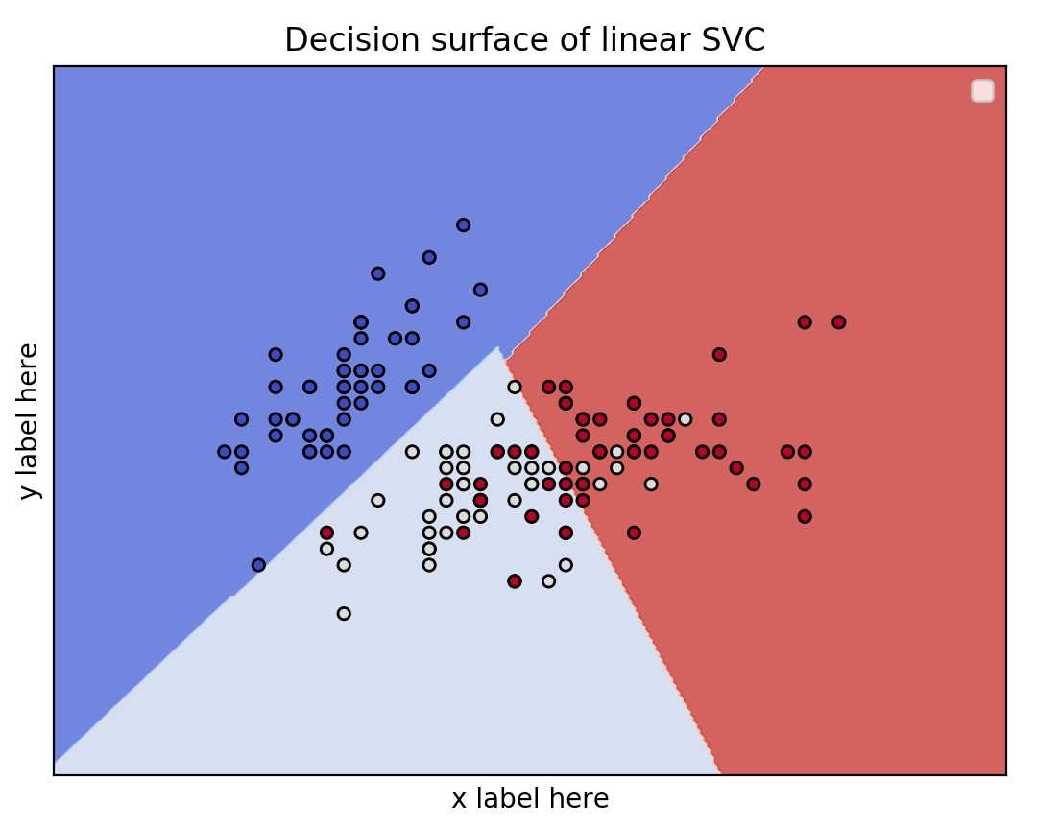
Understanding SVM with a simple example
Linear Separation
In a simple example, imagine two classes of data points that can be separated by a straight line. SVM aims to find the best line that maximizes the margin between the classes.

Slide 4
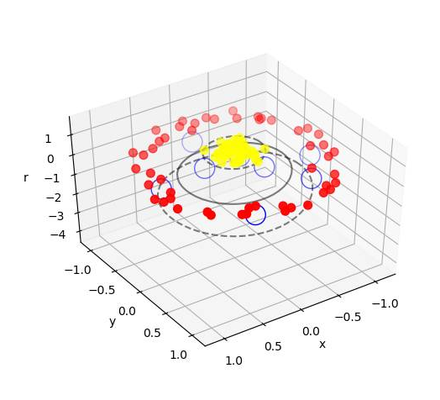
The role of Matplotlib
in SVM
Visual Representation
Matplotlib is a powerful visualization library that enables the creation of
informative plots to visualize the results and decisions made by SVM.
Decision Boundary Visualization
Matplotlib is particularly useful for visualizing the decision boundaries created by the SVM algorithm. In a two-dimension Matplotlib is particularly useful for visualizing the decision boundaries created by the SVM.
Supports Vector Visualization
SVM relies on support vectors for its decision boundary. Matplotlib can be used to highlight these support vectors in the plot, making it easier to understand their influence on the decision boundary.

Slide 5
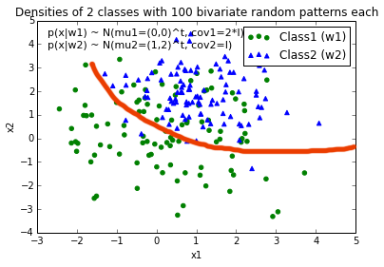
Plotting the decision boundary with matplotlib
1
Create Input Data
Generate sample data to represent the classes and their features.
2
Train the SVM
Use the input data to train the SVM model and define the decision boundary.
3
Plot Decision Boundary
Use matplotlib to plot the decision boundary and visualize the separation of classes.

Slide 6
Visualizing the support vectors with matplotlib
Identify Support Vectors
Plot Support Vectors
After training the SVM, identify the support vectors that are crucial for defining the decision boundary.
Use matplotlib to plot the support vectors as part of the graphical representation of the SVM model.

Slide 7
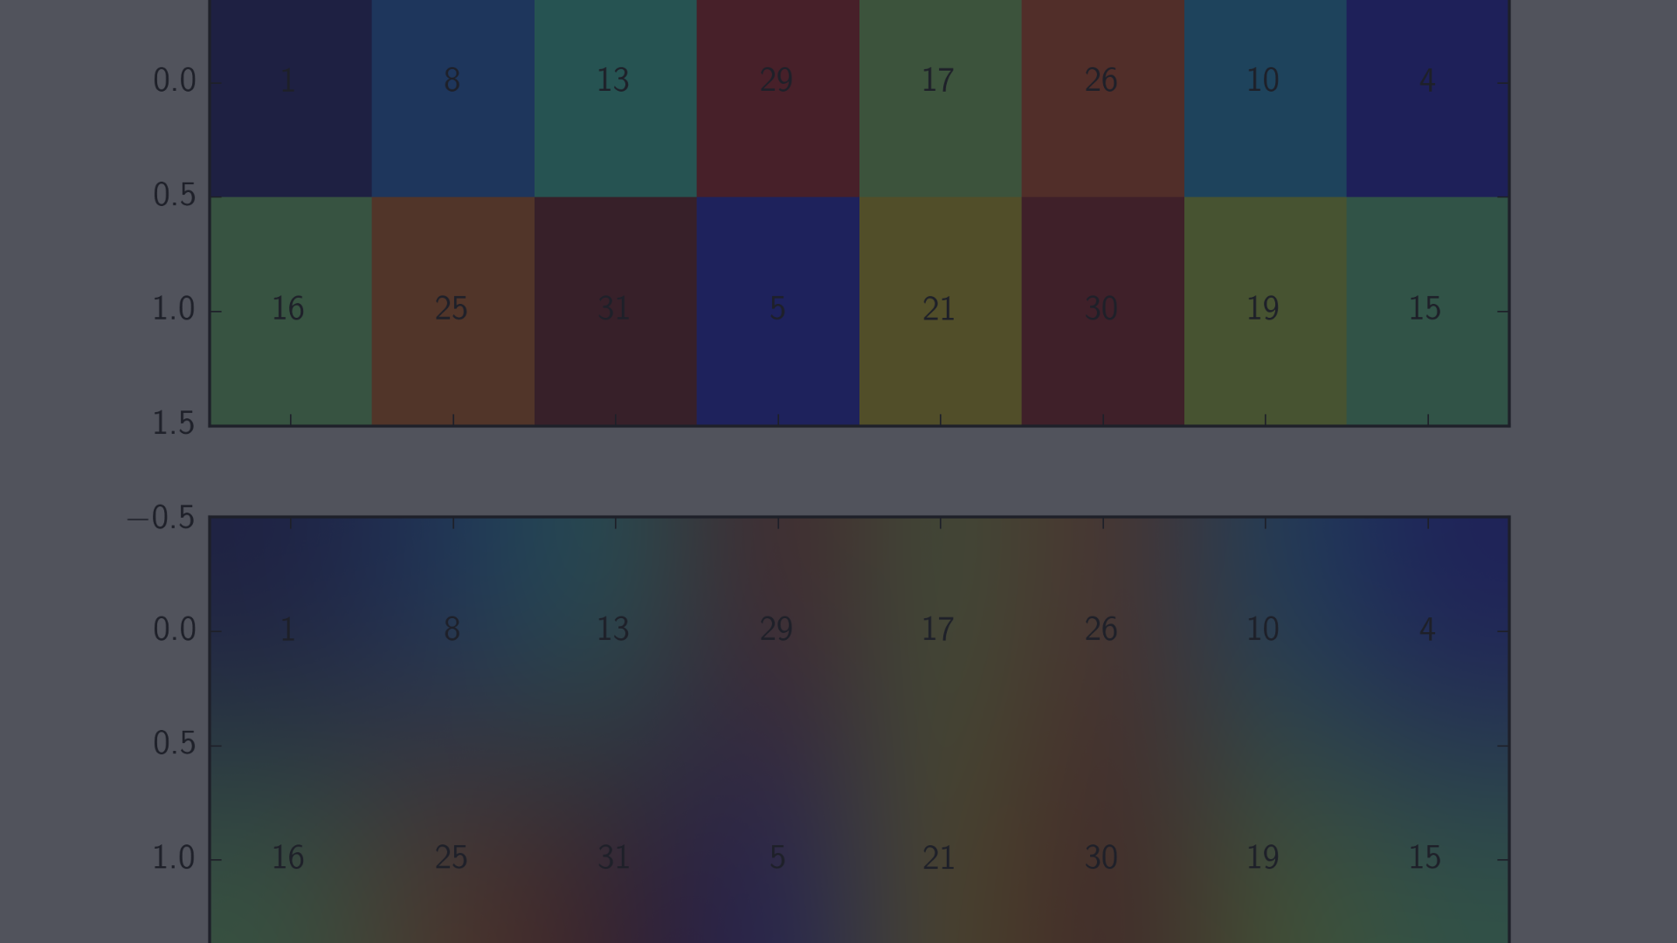


Fine-tuning SVM with mathplotlib
Adjusting Parameters
Visualize Tuning Results
Experiment with different kernel functions, regularization parameters, and margins to fine-tune the SVM model.
Use matplotlib to visualize the impact of parameter adjustments on the decision boundary and support vectors.

Slide 8
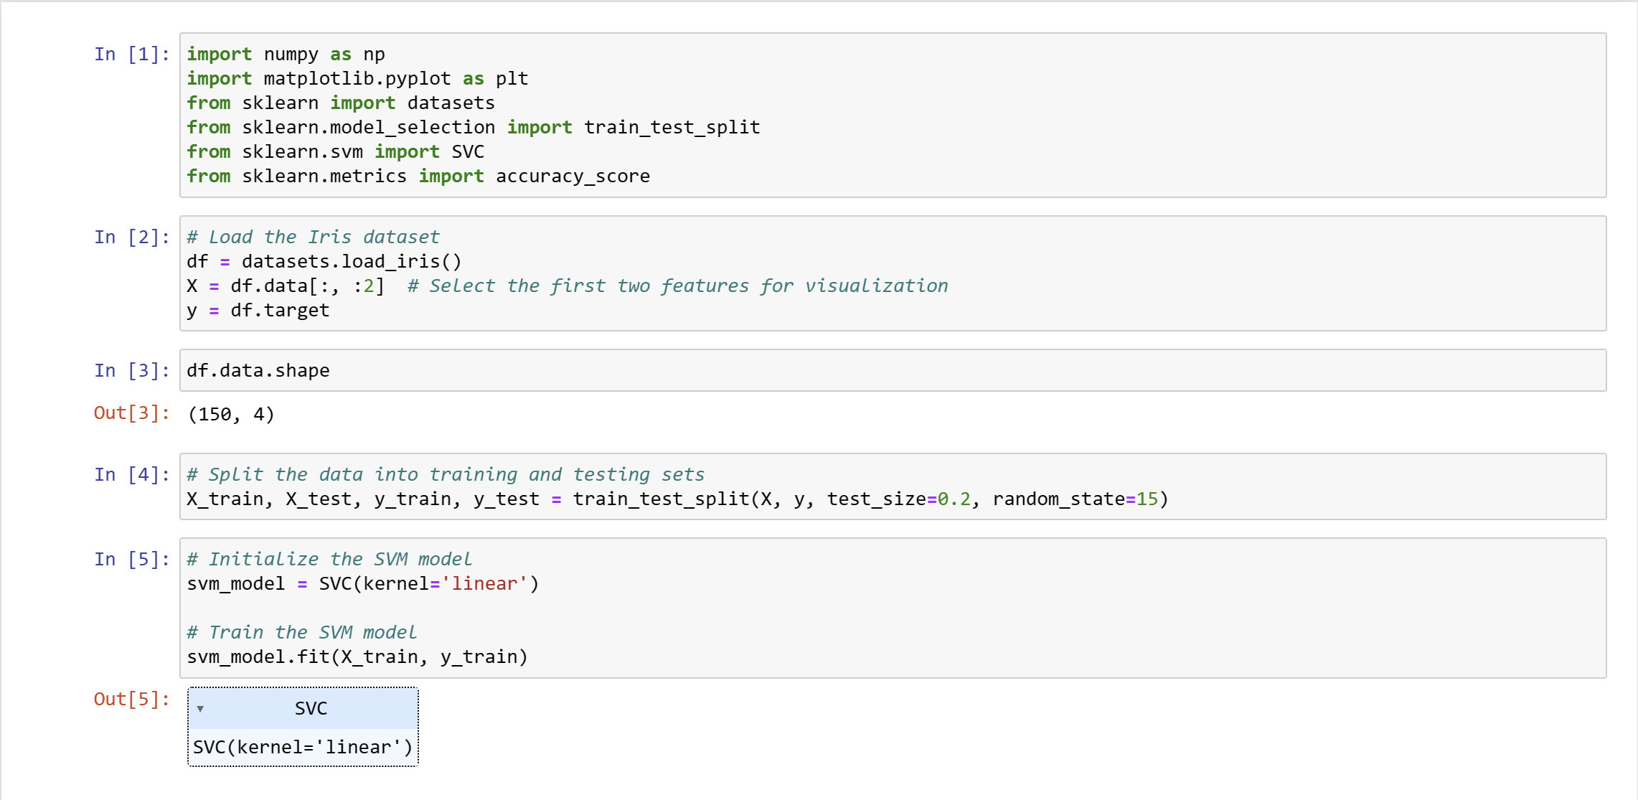

Slide 9
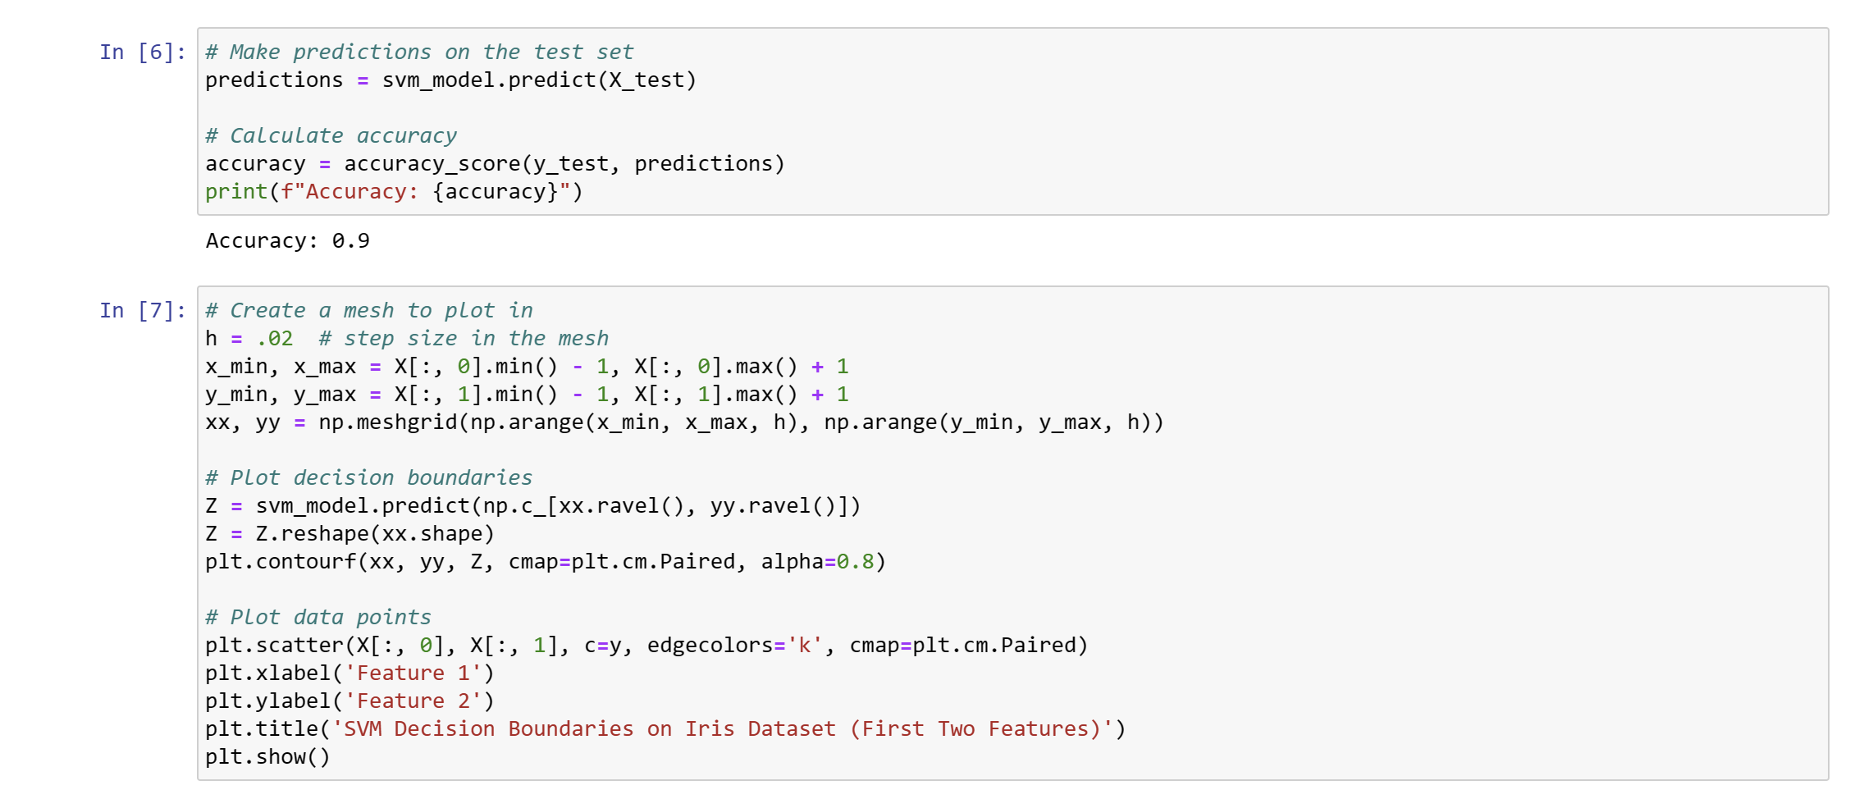

Slide 10
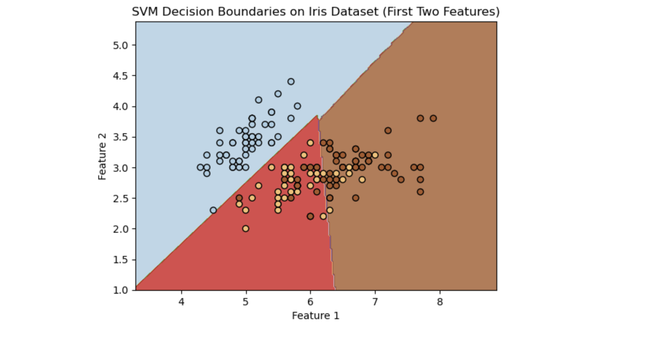

Slide 11
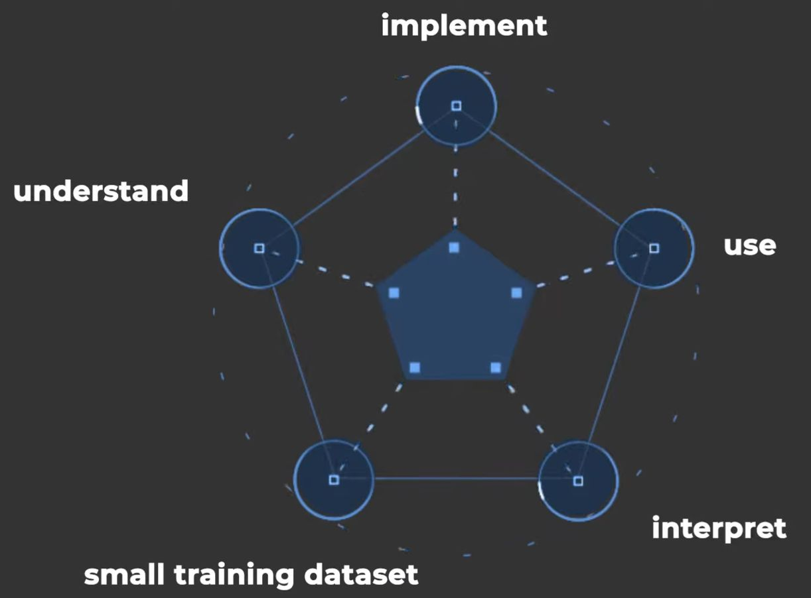
Implementation of SVM
Effective In High Dimensional Space – SVMs are particularly effective in high-dimensional spaces, making them suitable for tasks with a large number of features, such as image recognition and text classification.
2. Kernel Trick for Non-Linear Relationships - The kernel trick allows SVMs to handle non-linear relationships by implicitly mapping the input features into a higher-dimensional space. Common kernel functions include linear, polynomial, and radial basis function (RBF).
3. Scalability - While SVMs can be effective, they may not scale well to very large datasets. Training an SVM on a large dataset can be computationally expensive. In such cases, approximation techniques or alternative algorithms might be considered.
4. Choice of Kernel - The choice of kernel is crucial and depends on the nature of the data. Experimenting with different kernels and tuning their parameters is often necessary to achieve optimal performance.

Slide 12
Conclusion and further resources
Applications
Further Learning
SVM has wide applications in image recognition, medical diagnosis, and text classification, among others.
Explore advanced topics in SVM, such as kernel methods and multi-class classification, for deeper understanding.

