Slide 1

AI BASICS
INTRODUCTION TO MATPLOTLIB
Presented by :
PRADIP KACHHADIYA
DHANAJNJAY MISTRY
MEET DOSHI
MOIN MANSURI
JEEL SONI

Slide 2

INTRODUCTION TO MATPLOTLIB

Slide 3
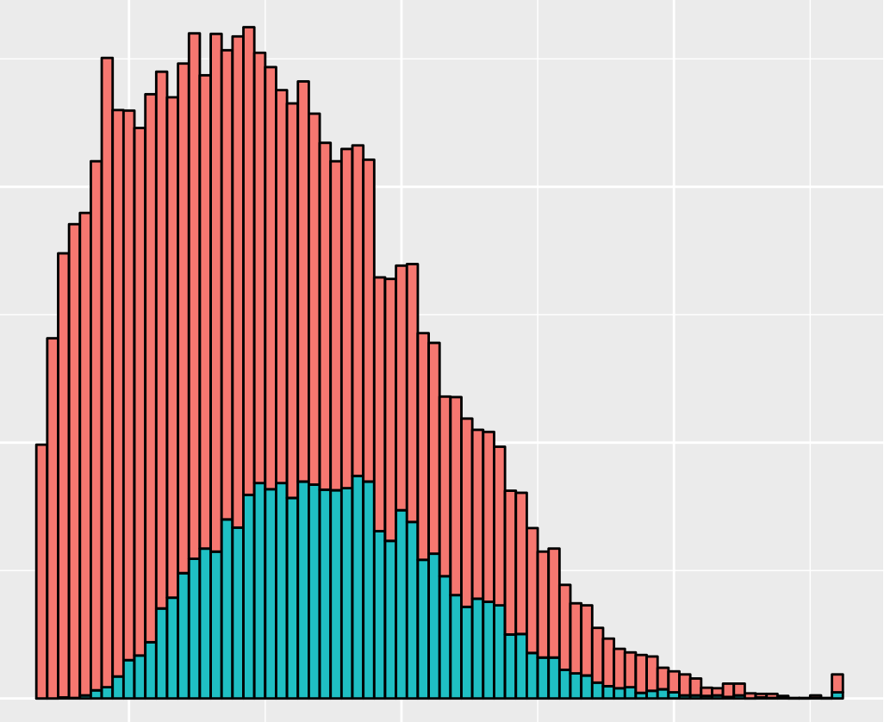
Introduction to Matplotlib
Matplotlib is a powerful data visualization library in Python, widely used for creating charts, graphs, and plots. In this presentation, we will explore the key features and capabilities of Matplotlib.

Slide 4
Importance of Data Visualization
1
Understanding Complex Data
2
Effective Communication
Data visualization helps us grasp complex patterns and relationships hidden within the data more easily.
Visual displays of data can effectively convey insights and findings to a diverse audience, facilitating better decision-making.
3
Identifying Trends and Patterns
4
Inspiring Infographics
Visualizing data enables us to identify trends, outliers, and patterns that may not be apparent in raw data
Data visualizations can transform dull data into appealing and memorable infographics, attracting viewers' attention.

Slide 5
Getting Started with Matplotlib
Importing Matplotlib
Creating a Basic Line Plot
Customizing the Plot
To work with Matplotlib, we first need to import the library in Python using the 'import matplotlib.pyplot as plt' statement.
By creating a figure and axes and plotting the data, we can generate a basic line plot with Matplotlib.
Matplotlib provides various customization options to enhance the appearance of plots, such as adding labels, titles, and legends.

Slide 6
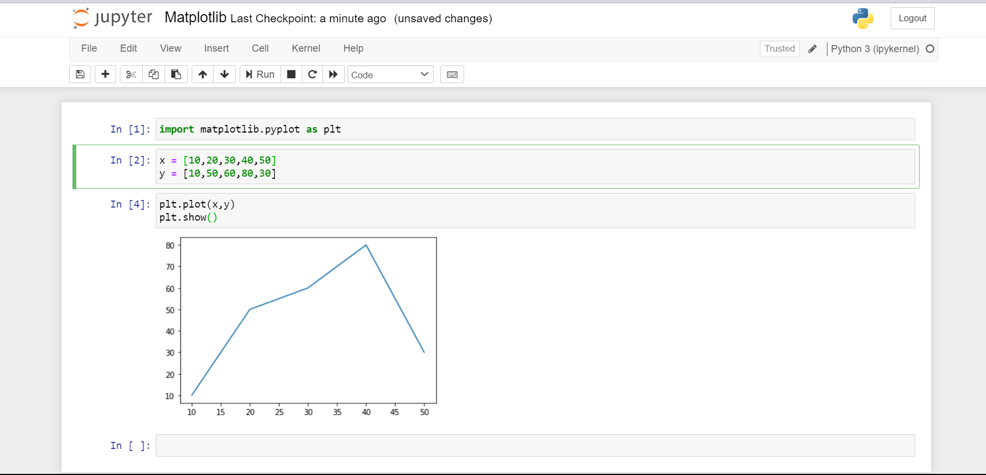

Slide 7
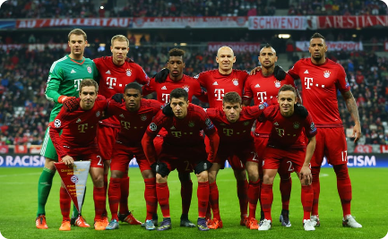

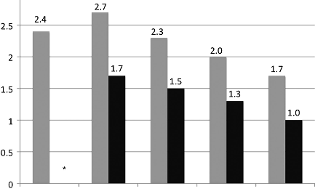
Visualizing a Football Match
Importing the Dataset
Exploring the Dataset
Creating Plots related to the Match
We begin by importing the football match dataset, including information about players, teams, and match statistics.
Through data exploration, we analyze the dataset to gain insights into player performance, team dynamics, and match outcomes.
We use Matplotlib to create various plots, such as player performance graphs, team comparison charts, and match score timelines.

Slide 8
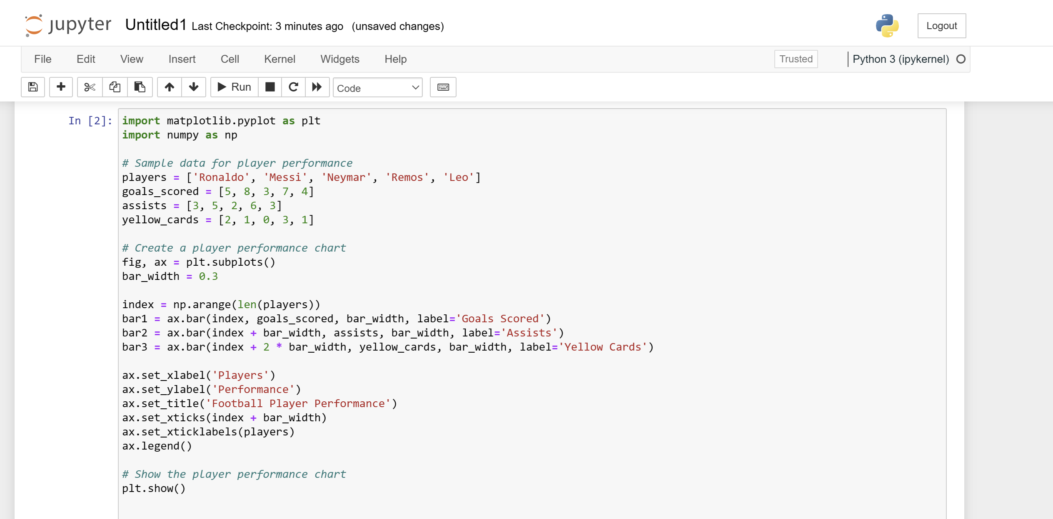

Slide 9
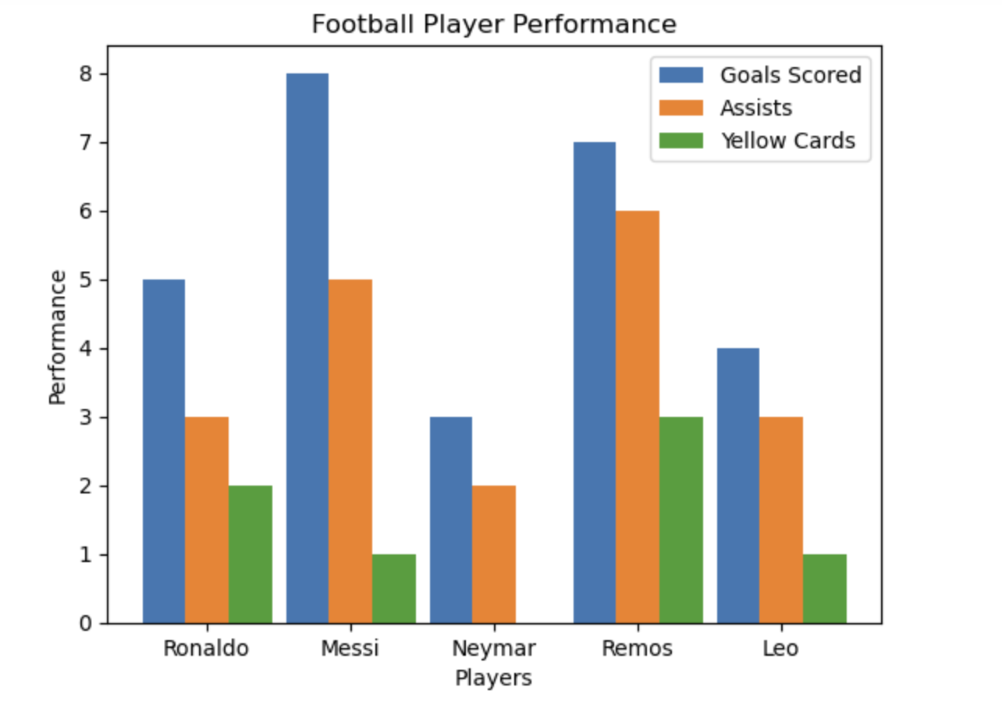

Slide 10
Advanced Plotting Techniques
1
Adding Labels, Titles, and Legends
Labels and titles enhance plot clarity, while legends help identify multiple data series on a single plot.
2
Customizing Axes Labels and Tick Marks
By customizing axes labels and tick marks, we can improve the readability and aesthetic appeal of our plots.
3
Adding Multiple Plots in a Figure
Matplotlib allows us to create subplots within a single figure, enabling us to compare and analyze multiple data sets simultaneously.

Slide 11
Conclusion
Key Takeaways
Matplotlib is a versatile data visualization library that offers numerous customization options for creating insightful and visually appealing plots.

