Slide 1

SNAPDRAGON® AI LAB BUILD & PRESENT CHALLENGE
Qualcomm Snapdragon
Smart PC Guardian
AI-powered monitoring, prediction and guidance for next-generation smart PCs
MONITOR • PREDICT • EXPLAIN • RECOMMEND
Rahul Das | B.Tech Electronics & Communication Engineering
Lovely Professional University
SHORT PITCH PRESENTATION
2026

Slide 2
01 • THE PROBLEM
Powerful PCs are still hard to understand
The issue is not a lack of sensors. It is the lack of a reasoning layer that connects them.
Signals that matter
“My laptop is slow, hot,
and the battery is dropping.
What is actually wrong?”
THE GAP
1
CPU
compute pressure
Numbers
without context
2
GPU
graphics / AI load
3
RAM / VRAM
memory pressure
Guardian turns fragmented telemetry into a single answer:
Today, students often open separate tools for CPU, GPU, RAM, battery and temperature - then interpret the numbers themselves.
4
THERMALS
heat / throttling
1.
What is happening?
5
BATTERY / POWER
endurance / energy
2.
Why does it matter?
USER PAIN
3.
What should I check next?

Slide 3
02 • THE SOLUTION
One intelligence layer for the whole PC
Guardian observes the machine like an engineer, interprets it like an AI analyst, and explains it in student-friendly language.
BEFORE
AFTER • SNAPDRAGON SMART PC GUARDIAN
CPU 82% GPU 11%
RAM 92% Battery 68%
GPU Temp 79°C
“GPU load is sustained and temperature is rising.
Watch the trend and check the workload before changing settings.”
RAW TELEMETRY
EXPLAINABLE AI
SAFE ACTION PLAN
HUMAN-IN-THE-LOOP
Multiple readings.
No clear next action.
No overclocking • No undervolting • No automatic process killing
OBSERVE
PREDICT
EXPLAIN
RECOMMEND
Live telemetry
Thermal / load risk
Human-readable diagnosis
Safe next steps

Slide 4
03 • HOW IT WORKS
Observe → Contextualize → Predict → Explain → Recommend → Log
A modular pipeline keeps the experience simple while leaving room for Snapdragon CPU/GPU/NPU integration.
01
02
03
04
05
06
Telemetry
Feature Engine
AI Inference
Explain
Recommend
Log
CPU • GPU • RAM • VRAM
Temp • Power • Fan • Battery
Utilization • trends
rolling history
Risk state • energy
forecast
Why this state?
What changed?
Safe action cards
Human-in-the-loop
History for
future training
Platform-aware mapping
SNAPDRAGON ADAPTER
CPU / GPU / NPU telemetry can be surfaced through Windows and Qualcomm-specific interfaces when supported.
Windows on Arm: native vs emulated vs driver-dependent guidance
Design principle: recommend first, change second.
The user stays in control.

Slide 5
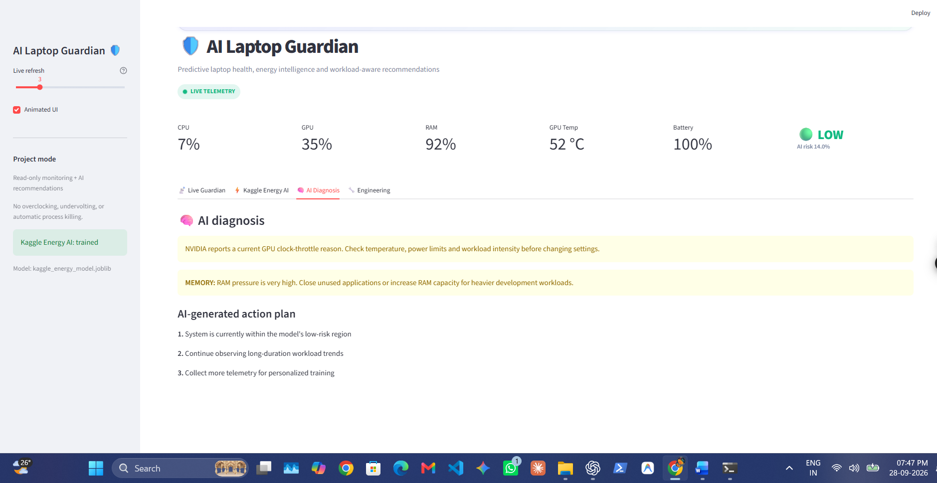
04 • PROTOTYPE DEMO
A control-room dashboard, not a spreadsheet
The working prototype combines live telemetry, a risk gauge, AI diagnosis, action planning and history.
01
LIVE KPIs
CPU • GPU • RAM • Temp • Battery
02
PREDICTIVE RISK
Low / Medium / High risk gauge
03
AI DIAGNOSIS
Plain-language explanation
04
ACTION PLAN
Safe next steps, no autonomous tuning
“
“The laptop does not just show data. It explains the data.”

Slide 6
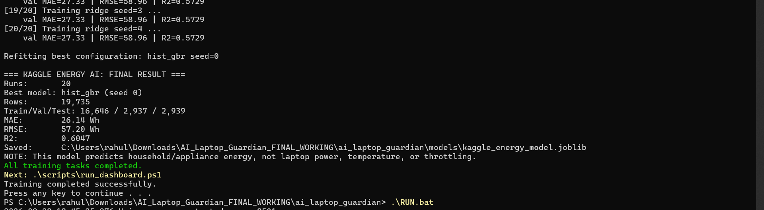
05 • AI / ML
Two AI tracks, kept technically honest
Laptop thermal intelligence and the Kaggle energy experiment are deliberately separated.
TRACK A
TRACK B • KAGGLE ENERGY EXPERIMENT
Laptop Risk Model
20-run model selection
Prototype features
20
0.6047
26.14 Wh
57.20
1
CPU / GPU utilization
CANDIDATE RUNS
TEST R²
TEST MAE
RMSE
2
RAM / VRAM pressure
Best family: HistGradientBoosting • 19,735 rows • train/val/test split
3
Temperature / power
This model predicts household/appliance energy demand - it is not a laptop wattmeter or thermal model.
4
Battery state / trends
Actual training run
RESEARCH NEXT STEP
Train on real labeled laptop telemetry.

Slide 7
06 • WHY IT MATTERS
Built around real student workflows
The same intelligence layer can support daily laptop use now and evolve toward Snapdragon AI PCs.
AI / ML
PROGRAMMING
CLASSES
Watch compute pressure during training or inference.
Spot IDE, compiler and browser resource contention.
Understand sustained camera / browser / AI load.
ENGINEERING
CONTENT + GAMING
TRAVEL
Detect long simulation and graphics stress.
Track GPU / VRAM / temperature together.
Balance performance against battery endurance.
WHY SNAPDRAGON AI PCs?
Heterogeneous compute
CPU + GPU + NPU roles
Windows on Arm
native / emulated / driver-aware context
Future: NPU-aware workload panel + Arm compatibility assistant

Slide 8
07 • IMPACT & ROADMAP
From prototype to a Snapdragon-first daily companion
The architecture is modular today and leaves a clear path toward real-device validation.
NOW
NEXT
THEN
Windows prototype
Real telemetry
Snapdragon-aware
Live telemetry
Dashboard
Risk + recommendations
Per-device baseline
Thermal labels
Energy per task
NPU utilization
Arm compatibility
Workload routing
1
6
0
COHERENT USER VIEW
CORE REASONING STAGES
AUTOMATIC RISKY ACTIONS
“
Value to students: less guesswork, clearer feedback, and a practical way to learn AI + systems together.
“Watch the laptop like an engineer. Explain it like a teacher. Recommend like an assistant.”

