Slide 1
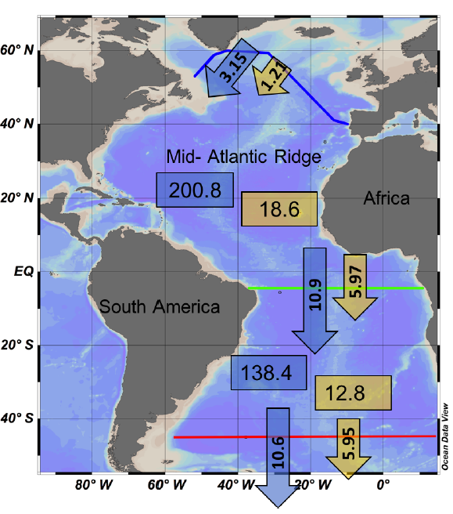
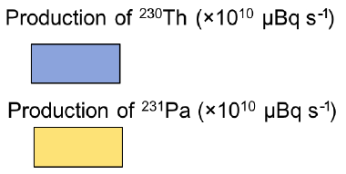
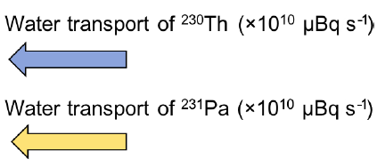
Deng et al. vs. Bern3D model
(a)
Measured: Deng et al. (2018)
(b)
Modeled: Bern3D CTRL
3.35
0.32
202.5
18.7
4%
26%
2%
22%
7.14
4.45
Net meridional adv. /production in NAtl (SAtl) of ²³⁰Th
131.4
%
12.2
Net meridional adv./production in NAtl (SAtl) of ²³¹Pa
0%
0%
3%
10%
11.0
5.68
%
Th
Pa
Th
Pa
Adapted from Deng et al. 2018, Biogeosciences
Notes:
n

Slide 2
Convert to pdf figure:
Save figure by EITHER:
Right click on grouped items => save as pdf
OR:
export file as pdf
delete all slides except 1
crop (Preview: rectangular selection tool, then crop)

