Slide 1
How to save?
Group entire object (if not done already)
Right-click: Save as picture > PDF
NB Rpoc.png curve from python was only used as a background while drawing curve on top via Insert > Shapes > Lines > Curve (3rd last)

Slide 2

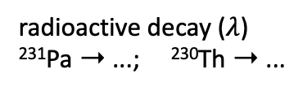

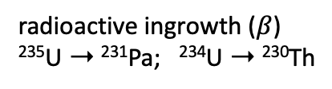


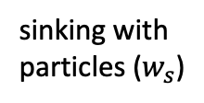

radioactive ingrowth ($β$)
²³⁵U ➝ ²³¹Pa; ²³⁴U ➝ ²³⁰Th
sinking with particles ($w_{s}$)
$$R_{POC}$$
remineralization ($R_{POC}$)
reversible scavenging:
adsorption & desorption
➝
$$k_{des}$$
transport (advection, convection, diffusion)
$$k_{ads}$$
radioactive decay ($λ$)
²³¹Pa ➝ ...; ²³⁰Th ➝ ...
$$z$$
bottom scavenging to nepheloid layers
particles: POC, CaCO₃, opal, dust; neph
Pa_{d}: Pa dissolved
Th_{d}: Th dissolved
Pa_{p}: Pa particle-bound
Th_{p}: Th particle-bound

Slide 3
²³¹Pa/²³⁰Th as proxy for AMOC strength
Under strong AMOC advection,
more Pa transported out of North Atlantic => smaller Pa_{p}/Th_{p}
Legend:
particles: opal, POC, CaCO₃, ...
Pa_{d}: Pa dissolved
Th_{d}: Th dissolved
Pa_{p}: Pa particle- bound
Th_{p}: Th particle- bound
productivity
AMOC advection
Pa_{d}
Pa
Th_{d}
Th
Atlantic Southern Ocean
North Atlantic
Summary slides – Jeemijn Scheen et al. – jeemijn.scheen@climate.unibe.ch
Notes:
Misleading! I confused myself because this water column effect is just next to the arrow – as if it is essential. It is not! Only that AMOC can dominate because at this depth we have more Pa. (?)

