Slide 1
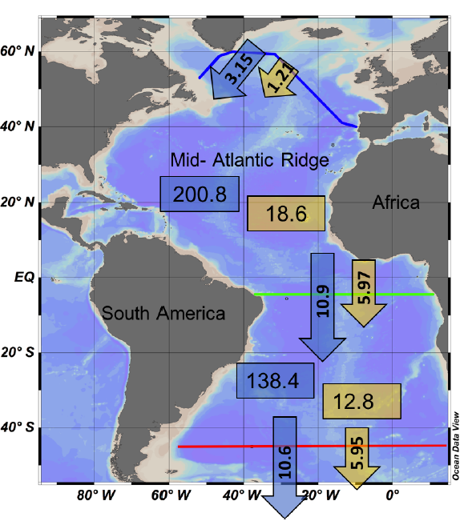
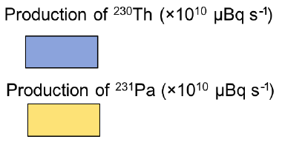
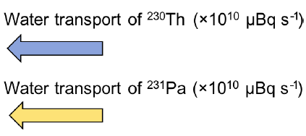
Deng et al. vs. Bern3D model
(a)
Measured: Deng et al. (2018)
(b)
Modeled: Bern3D CTRL
3.32
0.28
202.5
18.7
4%
26%
2%
22%
6.97
4.34
Net meridional adv. /production in NAtl (SAtl) of ²³⁰Th
131.4
%
12.2
Net meridional adv./production in NAtl (SAtl) of ²³¹Pa
0%
0%
3%
10%
10.9
5.55
%
Th
Pa
Th
Pa
Adapted from Deng et al. 2018, Biogeosciences

Slide 2
Deng et al. vs. Bern3D model
(a)
Measured: Deng et al. (2018)
(b)
Modeled: Bern3D CTRL
Legend
3.32
0.28
202.5
18.7
4%
26%
2%
22%
6.97
4.34
Net meridional adv. /production in NAtl (SAtl) of ²³⁰Th
%
131.4
12.2
Net meridional adv./production in NAtl (SAtl) of ²³¹Pa
0%
0%
3%
10%
%
10.9
5.55
Th
Pa
Th
Pa
Adapted from Deng et al. 2018, Biogeosciences

Slide 3
Convert to pdf figure:
Make Fig. by:
save as pdf
delete all slides except 1
use Preview: rectangular selection tool, then crop

