Slide 1





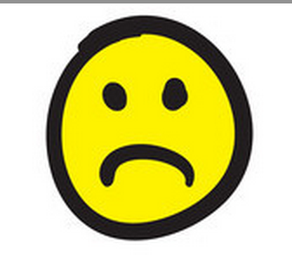

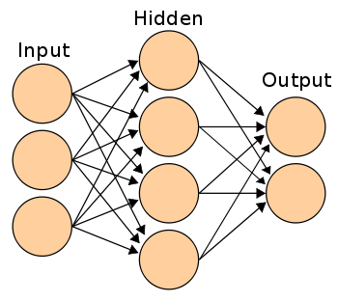
Experiments on Recursive Neural Networks for Textual Entailment and Semantic Sentence Similarity
Presented by Tianxiao Zhang
Mentor: Daniel Khashabi
Introduction/Overview
Purpose: Train neural network model for recognizing entailment Assumption: Goal: Predict the relatedness between pair sentence and detect the entialment relation between them
Background/Need
Results/Outcomes
Recommedations
Entailment: Consider two sentences (A) and (B). Suppose everything in the text(A) is true and using (A) we want to evaluate the truth of the claim in sentence (B). There are three cases for entailment detection:
  Entailment: The set of facts in the sentence(A) entail the sentence (B).
  Text: “The young boys are playing outdoors and the man is smiling nearby”
  Hypothesis: “The kids are playing outdoors near a man with a smile”
  Contradiction: The set of facts in the sentences(A) contradict the sentence(B).
  Text: ”Two children and an adult are standing next to a tree limb.”
  Hypothesis: “Two children and an adult are not standing next to a tree limb.”
  Neural: None of the above two cases.
Text: “A group of kids is playing in a yard and an old man is standing in the background”
Hypothesis: “A group of boys in a yard is playing and a man is standing in the background”
Neural Network: neural networks are computational models that are capable of machine learning and pattern recognition. They are usually presented as system of interconnected “neurons” that can compute values from inputs by feeding information through the network.
Acknowledgements
Lesson Learned
Variety of tools and algorithms in Machine Learning and Natural Language Processing
flow of recursive neural network and train it
Measure methods like precision, recall and F1-measure\
Unfolding auto encoder and dynamic pooling
Process
As a baseline system, first by making upon a state-of-the-art Paraphrase system, based on recursive neural network , which is recently developed at Stanford University.
Second is to combine any two types of them to a new value and training model based on preprocessed data.
Then, we tried keep the three labels and trained our own neural network to classify the entailment.

