Slide 1

NewYork CityBike
Data Analysis

Slide 2
Project Goal:
To better understand the behavior of Citi Bike’s customers (both one-time users and subscribers) and how they use Citi Bikes This will help us to:
Identify where more bikes should be installed
Create targeted marketing campaigns that will appeal to different customer segments

Slide 3
Key Questions:
What are the most popular pick-up locations across the city for Citi Bike rental?
How does the average trip duration vary across different age groups?
Which age group rents the most bikes?
How does bike rental vary across the two user groups (one-time users vs long-term subscribers) on different days of the week?
Does the factor of user age impact the average bike trip duration?

Slide 4
Findings and Insights

Slide 5
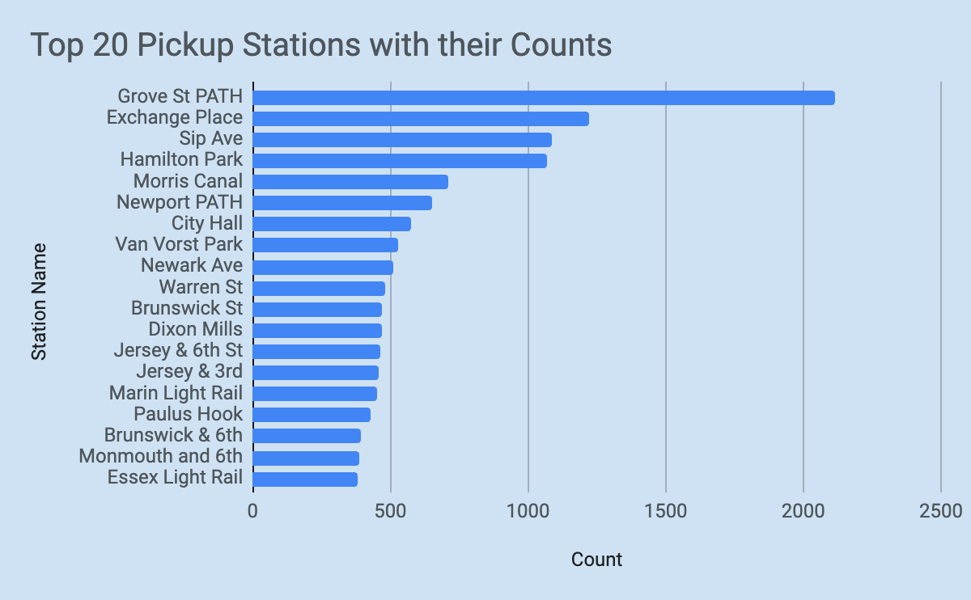
1. What are the most popular Citi Bike pick-up locations?

Slide 6
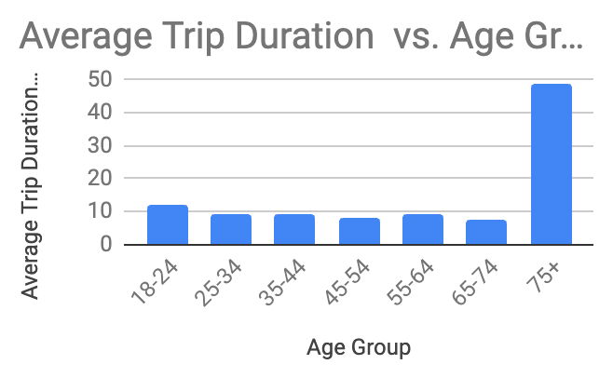
2. How does the average trip duration vary across different age groups?
Trip Duration can be seen more in elderly people who are aged above 75
People aged 75+ has taken 49 min as their average trip duration

Slide 7
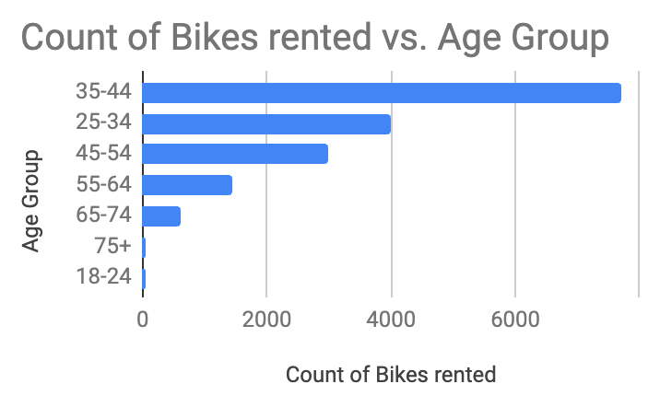
3. Which age group rents the most bikes?
Age group 35 – 44 has rented more bikes than any other age group , i.e close to 8000
All other age groups have rented less that 4000 bikes.

Slide 8
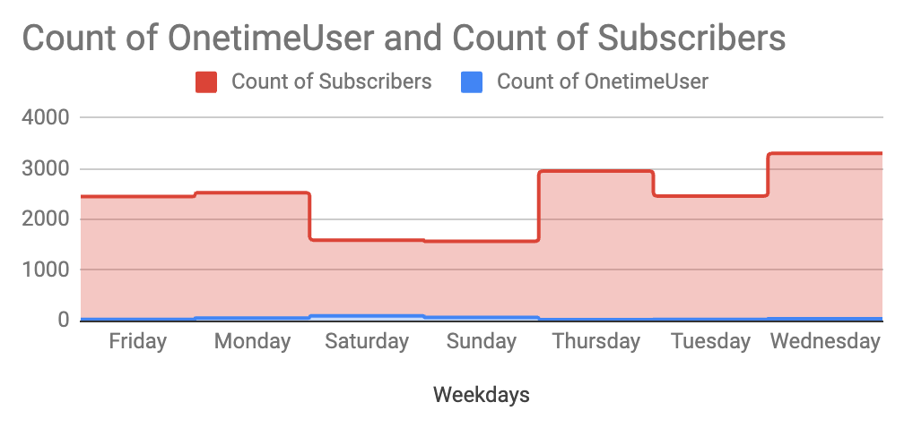
4. How does bike rental vary across the two user groups (one-time users vs long-term subscribers) on different days of the week?
We can see that Subscribers have rented way more than the one time users.
When we study One-time users, they have rented more bikes on Saturdays and Sundays than on weekdays.
While Longtime subscribers have rented their bikes more on weekdays, with Wednesday as their peak day of usage.

Slide 9
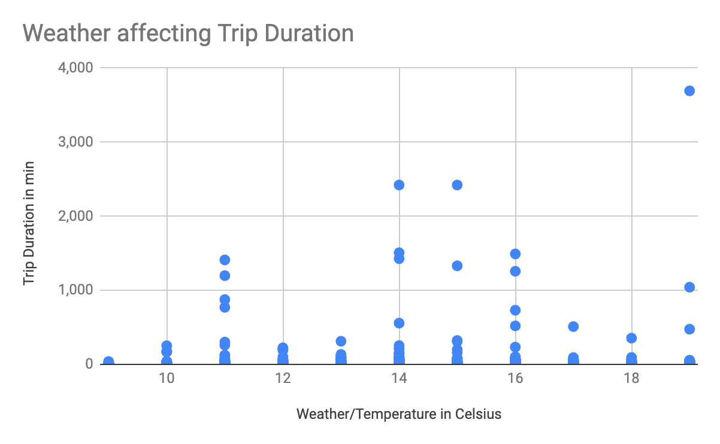
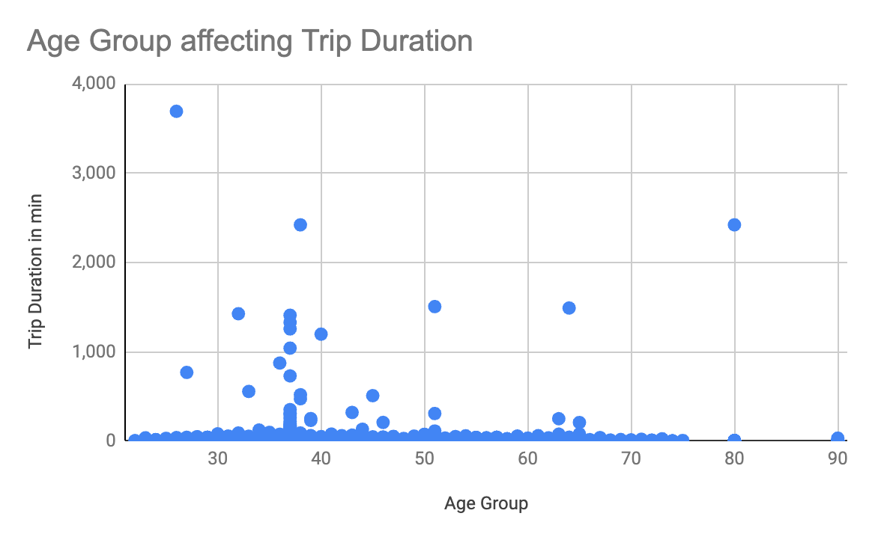
5. Do factors like weather and age impact the average bike trip duration?
We see that both weather and Age group is not affecting the trip duration in a drastic manner.
They are all distributed evenly except for few outliers in Age Group/Trip Duration where they would have gone outside the city
We see slightly more duration in their trips at temperatures more than 14 degress.

Slide 10
Summary

Slide 11
Summary of findings
Top 5 pick-up locations for bikes:
Grove St Path, Exchange Place, Sip Ave, Hamilton Park, & Morris Canal
2. Customer base: Based on our findings, the Customer base of City Bike would be Longtime subscribers in the age group of 35 -50 who rent their bikes to their work places.
3. Citi Bike customer behavior: After our descriptive statistical analysis, we can see that the minimum trip duration was made for 1 minute and maximum trip duration was made for 3693 minutes. More Bikes were rented by Long time subscribers and especially on weekdays than on weekends. We also saw that more bikes were rented on Wednesday. We can also learn from our analysis that people aged 75+ did made more average trip duration than others.

Slide 12
Actions & Recommendations

Slide 13
Recommended actions:
Product recommendations:
Install more Bikes at the top 5 Pick-Up stations as we see more number of bikes are been rented from these places compared to others.
Marketing recommendations:
The Citi Bike customer base is mostly Long time subscribers aged between 35 – 45 who are most active during weekdays. This tells us that they are probably people who live in New York and use Citi Bikes to commute to the work places and back. Marketing and advertising campaigns should therefore target this particular demographic.
We see few outliers who take their Bikes outside the city for weekends. Campaigns on any offers for weekends and for senior citizens can attract more people to hire.

Slide 14
THANK YOU !

