Slide 1
INVESTMENT ANALYSIS
By: Jeena Pandit

Slide 2
Business Problem and Goal
As an asset management company, ABC Funds wants to make investments in a few companies. We want to understand the global trends in investments so that they can take the investment decisions effectively.
We have two minor constraints for investments:
It wants to invest between 5 to 15 million USD per round of investment
It wants to invest only in English-speaking countries because of the ease of communication with the companies it would invest in.
Our Strategy is to invest where most other investors are investing.

Slide 3
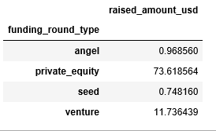
Analysis 1 - Investment type analysis.
Collecting and merging data from Companies and rounds2 files.
Finding missing values for rows and columns.
Removing columns which will not help us in further analysis like ‘funding_round_code’ and ‘founded_at’
Removing rows with missing values on ‘raised_amount_usd’ since imputing values in it will introduce heavy bias owing to its almost 14.5% missing values.
Imputing dummy values for columns which will not have any or small effect on our analysis- ‘homepage_url’, 'state_code','region','city’ (since country_code already exists and we need only country data for further analysis.
And Finding the average funding funding_round_type-wise, which we observe is as below, and hence, since, ABC Funds wants to invest 5 to 15 million USD per investment round, Venture type is most suitable.

Slide 4
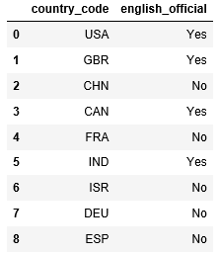
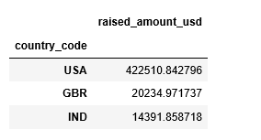
Analysis 2 - Country analysis
ABC Funds wants to invest in countries with the highest amount of funding for the chosen investment type.
We extract list of top 9 countries by highest amount of funding.
The top 9 countries are [IND, CHN, CAN, USA, GBR, FRA, ESP, DEU, ISR] (not necessarily in an order)
Among these Top 9, we are only interested in English speaking countries for ease of business, so we have the following countries, list of these have been extracted from the Wiki page “List_of_territorial_entities_where_English_is_an_official_language”.
And we find the top 3 funding(in million USD) country-wise as below-

Slide 5
Analysis 3 - Sector analysis
We extract the first sector as the primary_sector from the category_list if the category_list has more than one sub-sectors.
Now, We map the main 8 sectors to the numerous varied primary sectors with the mapping file and the data set we have.
We also correct and impute missing values for the main_sector.
Finally, we create 3 dataframes, D1, D2, D3 containing funding date country-wise for top3 countries we extracted.
We find the sector-wise investment count and understand the main_sector per country that has high number of investments.
Top Sectors in :USA: [['Others' 8318], ['Cleantech / Semiconductors' 8195], ['Social, Finance, Analytics, Advertising' 7247]
Top Sectors in :GBR [['Others' 516], ['Cleantech / Semiconductors' 455], ['Social, Finance, Analytics, Advertising' 421]
Top Sectors in :IND [['Others' 284], ['Social, Finance, Analytics, Advertising' 147], ['News, Search and Messaging' 130]

Slide 6
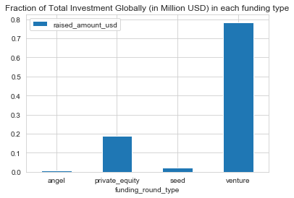
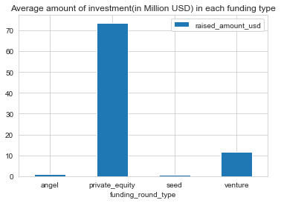
Investment Trend Globally
Plot 1
Observing the Fraction of investments made and the average amount invested in different funding types, since ABC Funds wants to invest between 5 to 15 million USD per investment round, Venture funding type is the most suitable.

Slide 7
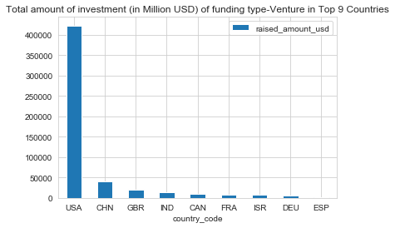
Investment trend Country-wise
Plot 2
The top 9 countries that have the highest amount of investments are given here.
Out of these top 9, USA, GBR and IND being the top 3 English Speaking Countries.

Slide 8
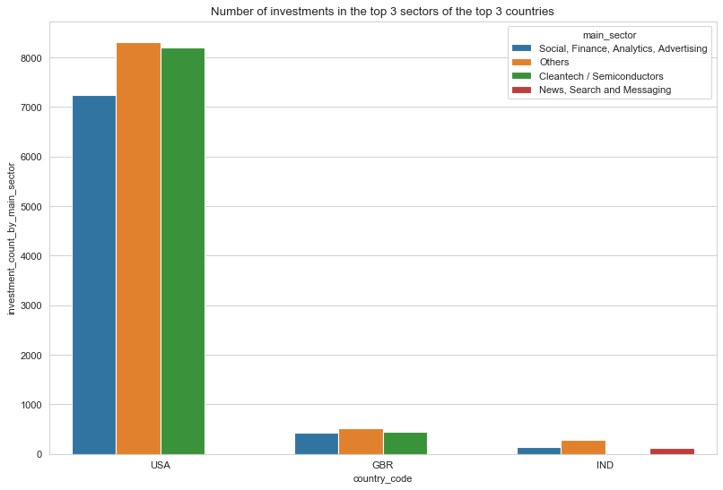
Investment trend in Top 3 countries in Top 3 sectors
Plot 3
Here are the 3 top Sectors of the Top 3 English Speaking Countries.

Slide 9
Conclusions
Venture Funding type is most suitable for ABC Funds because of its high number of investment and average funding amount which falls within the 5 to 15 million USD per round of investment criterion.
USA(United States), GBR(United Kingdom) and IND(India) are the top countries where the most investments are occurring.
The top Main Sector for investment in these top countries is ‘Others’ followed by ‘Cleantech / Semiconductors’.
'Social, Finance, Analytics, Advertising’ in USA and GBR, and ‘News, Search and Messaging’ in India are also favorable investment options.

