Slide 1
LELEC2796 : project
Jérome
(Guillaume)

Slide 2
Goal : Model a communication network and study its performance
6 supervised sessions

Slide 3
Poisson Point Processes
Monte-Carlo sampling
Stochastic geometry analytical developments
Goal : Model a communication network and study its performance
Channel modelling
(Path loss, shadowing, fading, MIMO channels)
P2P communication techniques
(SIMO, MISO, MIMO techniques)
Network management mechanisms (Power control, XDMA schemes, CoMP)
SNR, SI(N)R, Exposure
Array gain, diversity gain, multiplexing gain, etc
Mean quantities and CDF
6 supervised sessions

Slide 4
3 “guided” sessions
Problematic selection
3 “free” tutored sessions
Oral presentation
Code repository

Slide 5
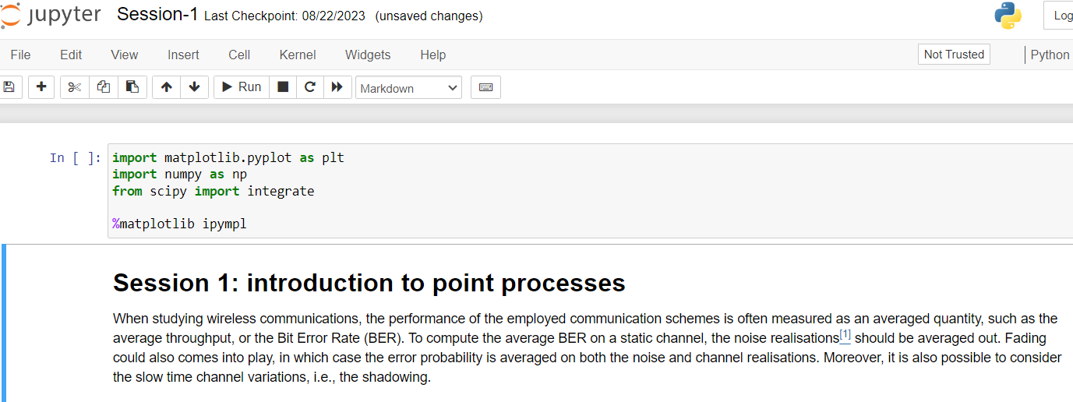
3 “guided” sessions
Session 1: introduction to point processes and Monte-Carlo sampling
Session 2: Path loss models, ray tracing and shadowing
Session 3: Fading, MISO channels and MRT beamforming + intro bibliographic tools ?

Slide 6
Metrics
Problematic selection
Network mechanisms
+ Bonus : report 4 pages, double column, template IEEE, ref, 3 pts. /!\ Evaluate the relevance of asking a report for next year.
Cell-free
Coordinated multipoint
Exposure
Energy efficiency
Power control algorithms
XDMA techniques (CDMA)
Path loss, shadowing and fading models
MISO/SIMO/MIMO beamforming techniques
MIMO fading models
MIMO multiplexing techniques
Channel modelling
Multi-antenna techniques
Example of research question : How do MIMO beamforming techniques impact closed-loop power control algorithms ?

Slide 7
Inputs from the TA
3 “free” tutored sessions
Inputs from the literature
- Should not cover the whole research question
- But at least one element should be supported by the literature

Slide 8
Midterm /3
Code /2
Presentation /15
Report bonus /3
Oral presentation:
15min/15min/10min format (Presentation/Q&A/feedback)
The presentation should focus on answering the research question.
Oral presentation
Code repository
Code repository: 2pt
Students should provide a way to reproduce their results.
Is the code clear ?
Does it have a clear structure ?
Does it enable to reproduce the results ?
Is the code fast ?
/!\ Feedback

