Slide 1




MEDCONNECT
Smart Medical Record and Resource Management System
JEESHAN RJ
HARINI V

Slide 2
ABSTRACT
Helps manage and access patient records, including past treatments, prescriptions, and diagnoses, all in one place. Monitors the availability of medicines, beds, ambulances, and other equipment to ensure proper resource use. Creates reports on medicine sales and resource usage to assist in hospital management and planning. Sends alerts to patients, especially ICU and anesthesia patients, to take their medicine on time.

Slide 3

INTRODUCTION
In the modern healthcare landscape, managing patient records, medical resources, and timely alerts. This project focuses on creating a website for medical record management, enabling hospitals to track patient histories, prescriptions, and diagnoses. It will monitor the availability of medicines and critical resources like beds and ambulances. By combining notifications,the platform will enhance healthcare efficiency and patient outcomes.

Slide 4

OBJECTIVES
To develop a centralized system for managing and accessing patient medical records efficiently.
To track real-time availability of medicines and essential resources like beds, chairs, and ambulances.
To generate detailed reports on medicine sales and resource usage for better decision-making.
To provide timely medication alerts, particularly for ICU and anesthesia patients.
To enhance communication between patients, doctors, and healthcare administrators.

Slide 5
LITERATURE SURVEY
FEATURE | MY CHART (2005) | PRACTICE FUSION (2005) | MEDISAFE (2012) | MEDCONNECT (2025)
PATIENT RECORDS | PATIENTS CAN SEE THEIR MEDICAL HISTORY | BASIC RECORDS FOR SMALL CLINICS | NO RECORDS | STORES AND UPDATE ALL PATIENT RECORDS
MEDICINE STOCK TRACKING | NO MEDICINE TRACKING | NO MEDICINE TRACKING | NO MEDICINE TRACKING | TRACKS MEDICINE IN REAL TIME TO AVOID SHORTAGES
SALES &USAGE REPORT | NO REPORTS | SIMPLE REPORTS FOR SMALL CLINIC | NO REPORTS | DETAILED REPORTS ON MEDICINE SALES AND HOSPITAL NEEDS
MEDICINE REMINDERS | REMINDS ABOUT APPOINTMENTS AND PRESCRIPTIONS | NO REMINDERS | REMINDS PATIENT TO TAKE MEDICINE | REMINDS ABOUT APPOINTMENTS AND PRESCRIPTIONS AND ALERTS FOR ICU & ANASTHESIA PATIENTS
HOSPITAL RESOURCES | DOESN’T TAKE HOSPITAL RESOURCES | DOESN’T TAKE HOSPITAL RESOURCES | DOESN’T TAKE HOSPITAL RESOURCES | TRACKS BEDS , CHAIRS , AMBULANCES ,AND OTHER NEEDS
DOCTOR-PATIENT MESSAGING | BASIC MESSAGES BETWEEN DOCTOR-PATIENT | LIMITED MESSAGING | NO COMMUNICATION FEATURE | EASY COMMUNICATION BETWEEN DOCTORS , STAFFS , AND PATIENTS
USER-FRIENDLY DESIGN | SIMPLE TO USE | BASIC DESIGN | EASY TO USE FOR MEDICINE TRACKING | CLEAN , MODERN , AND EASY TO USE
SECURITY&PRIVACY | PROTECTS PATIENT DATA AS PER RULES | PROTECTS PATIENT DATA | SECURE BUT ONLY FOR MEDICINE DATA | HIGH SECURITY WITH ENCRYPTION AND LOGIN PROTECTION

Slide 6
METHODOLOGY
The MedConnect system follows a structured methodology to ensure efficient medical record management. The frontend is built using HTML, CSS, and JavaScript, providing a responsive and user-friendly interface for patients, doctors, and admins. The backend, developed in PHP, handles authentication, role-based access, and secure data processing. A MySQL database stores patient records, medicine inventory, and reports with encrypted security.
The system includes an automated alert mechanism using Cron Jobs to send medication reminders, especially for ICU and anesthesia patients. Security measures such as HTTPS, JWT authentication, and data encryption ensure privacy and compliance. Rigorous testing using Postman and Selenium validates system performance and reliability. Finally, cloud deployment on AWS/Firebase ensures scalability, data backup, and real-time accessibility, making MedConnect a secure and efficient healthcare management solution.

Slide 7
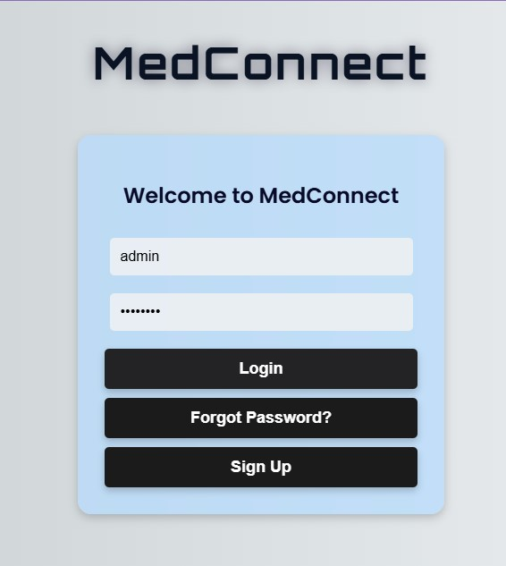
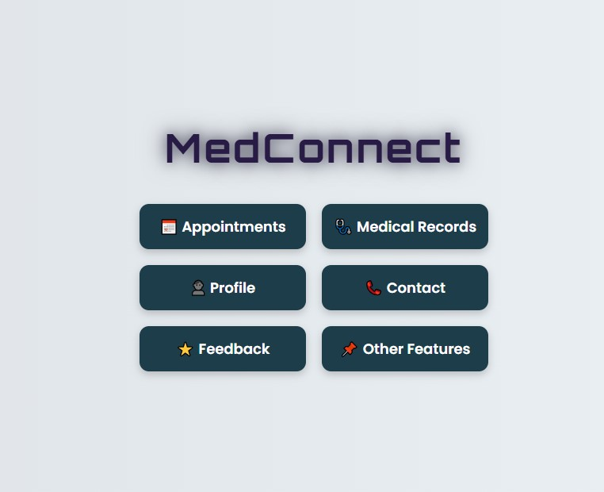
OUTPUT

Slide 8
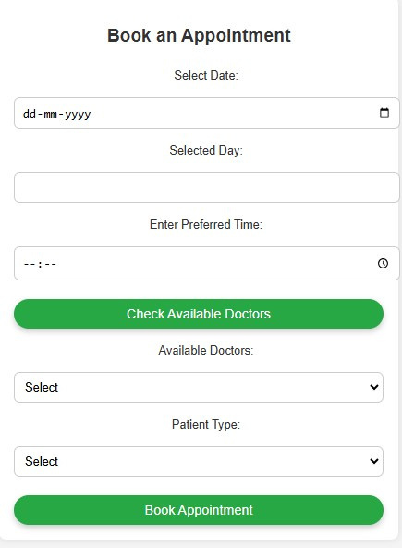
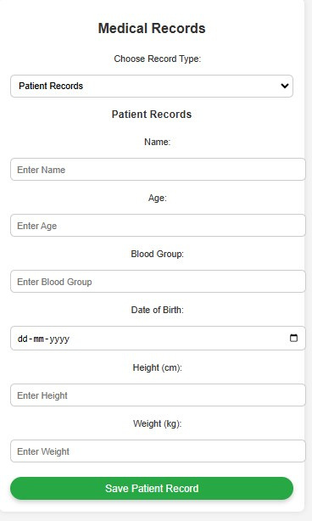
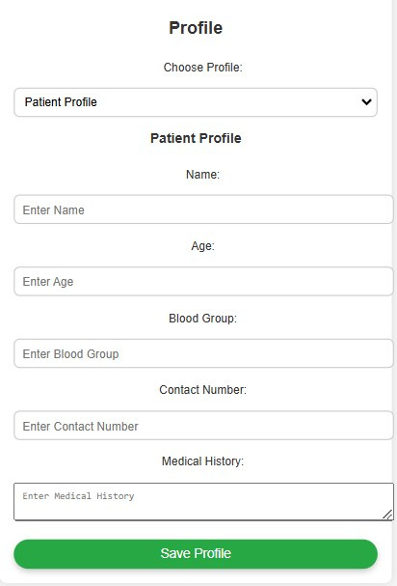
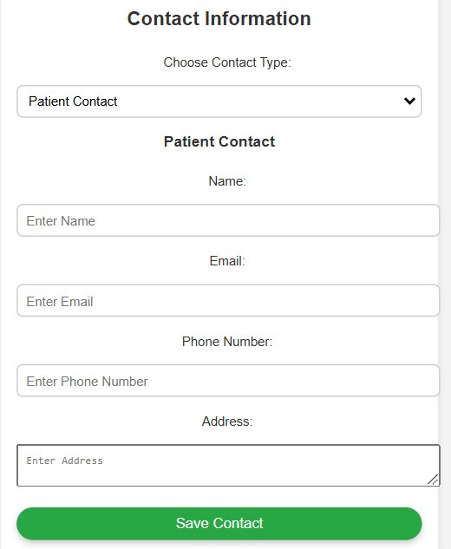
PROGRESS

Slide 9
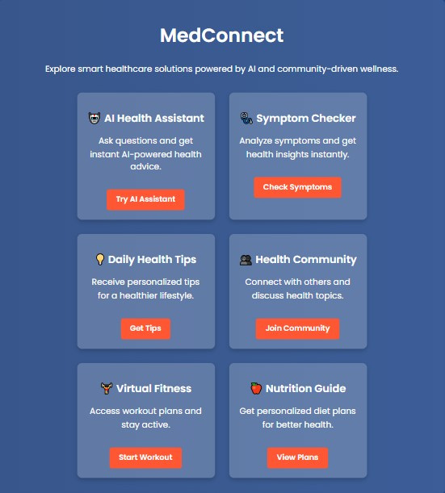
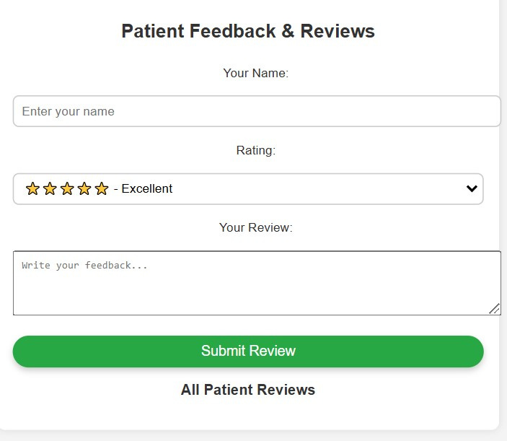
PROGRESS

Slide 10
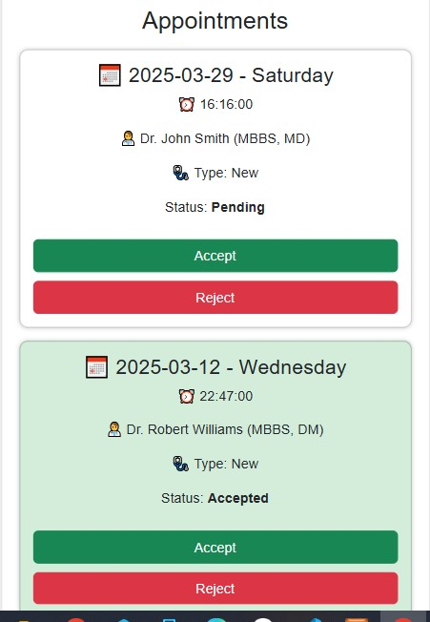
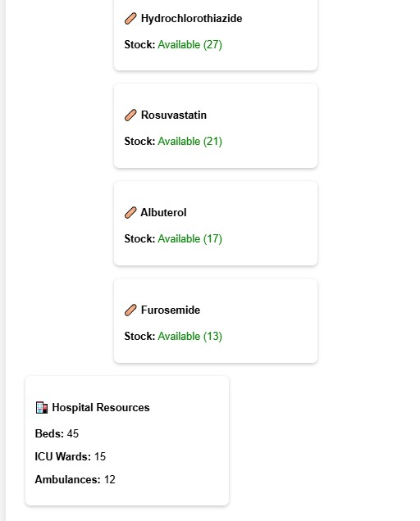
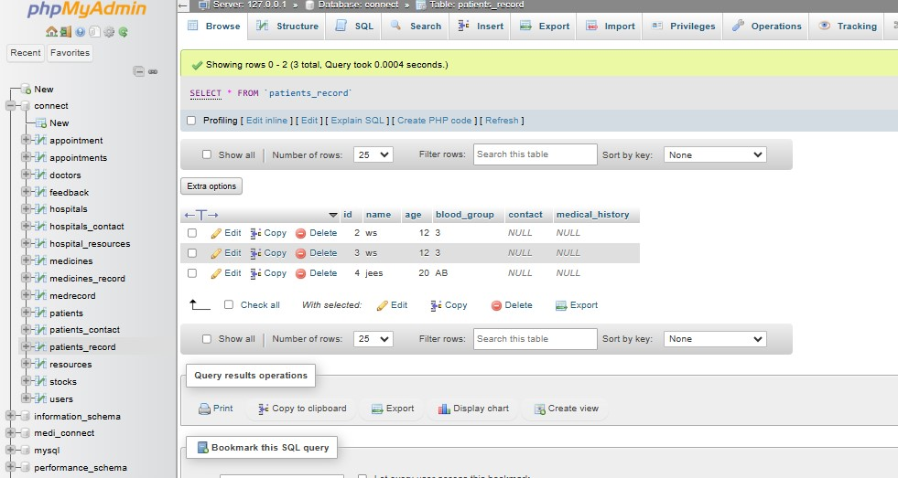
PROGRESS

Slide 11
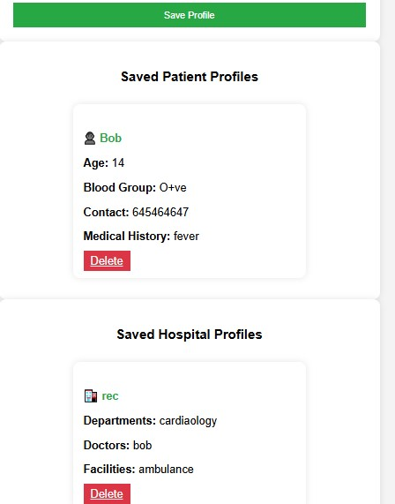
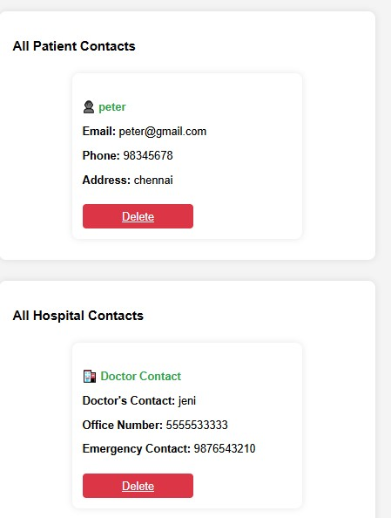
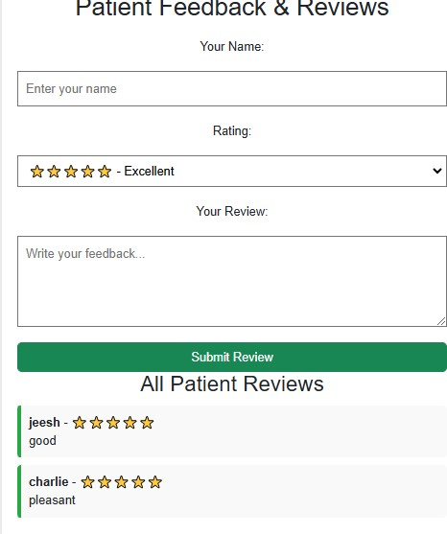
PROGRESS

Slide 12


THANK
YOU

