Slide 1
Banking System

Slide 2
Abstract
The Banking System Database is designed to manage and organize the essential operations of a bank, including customers, accounts, loans, transactions, and payments. The system ensures efficient data storage, easy retrieval, and strong relationships between different entities.

Slide 3
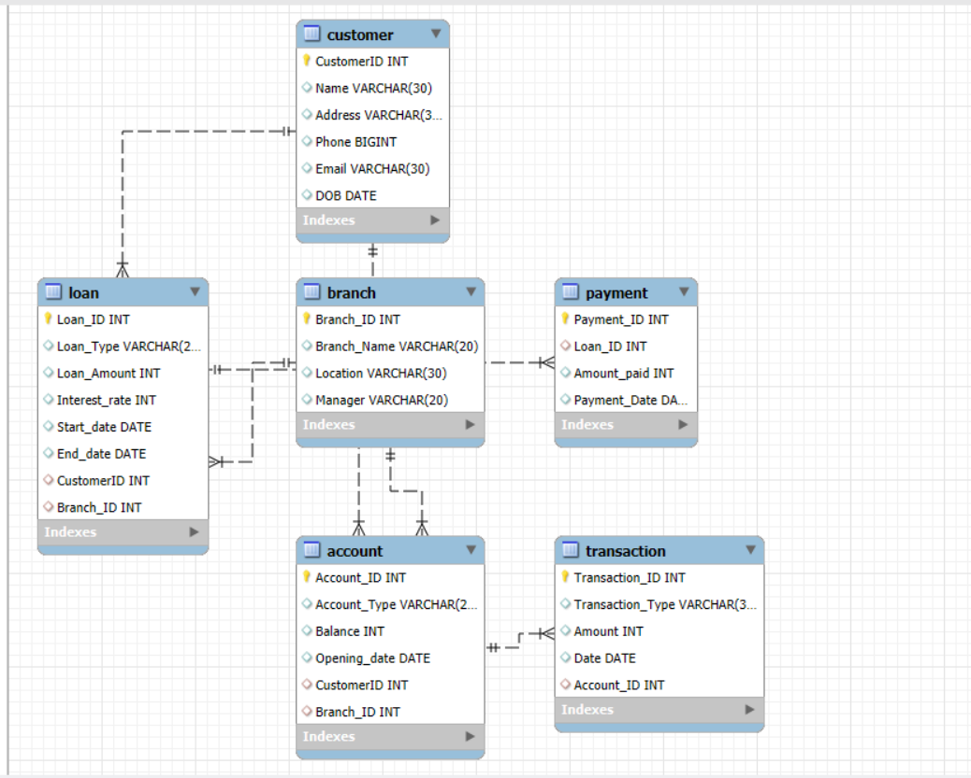
ER Diagram

Slide 4
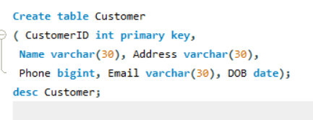
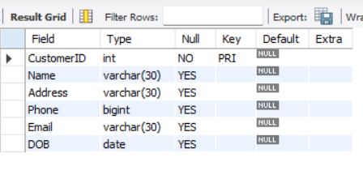
Structure of Table – Customer Table
Customer Table stores personal details of account holders.

Slide 5
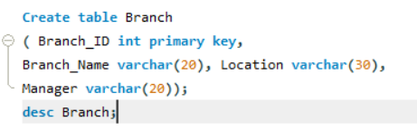
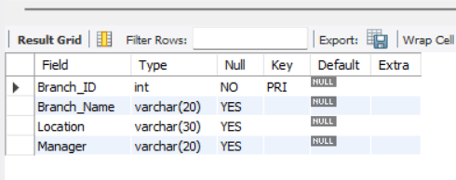
Structure of Table – Branch Table
Branch table represents different bank branches.

Slide 6
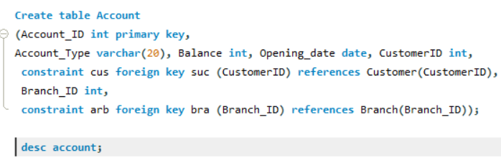
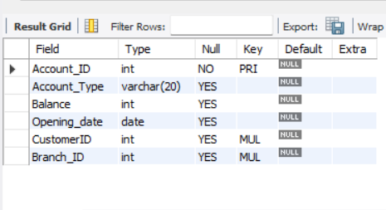
Structure of Table – Account Table
Account Table manages savings, current, and fixed deposit accounts..

Slide 7
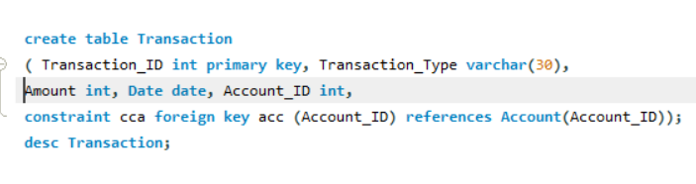
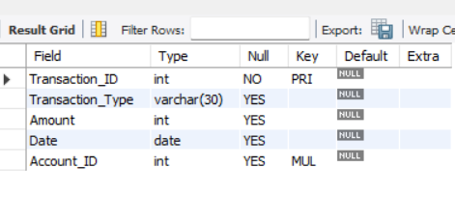
Structure of Table – Transaction Table
Transaction Table records deposits, withdrawals, and fund transfers.

Slide 8
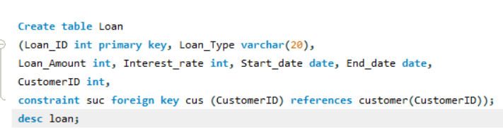
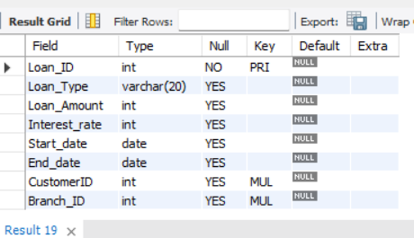
Structure of Table –
Loan Table
Loan Table tracks loan details such as type, amount, and interest rate.

Slide 9
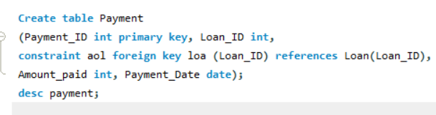
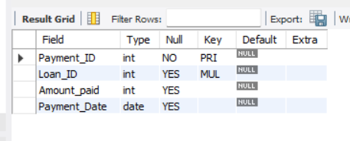
Structure of Table –
Payment Table
Payment Table maintains records of loan repayments.

Slide 10
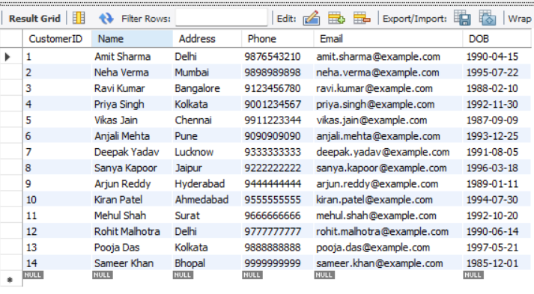
Content of Table - Customer
Syntax – Select * from Customer;

Slide 11
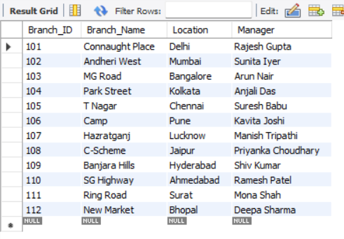
Content of Table - Branch
Syntax – Select * from Branch;

Slide 12
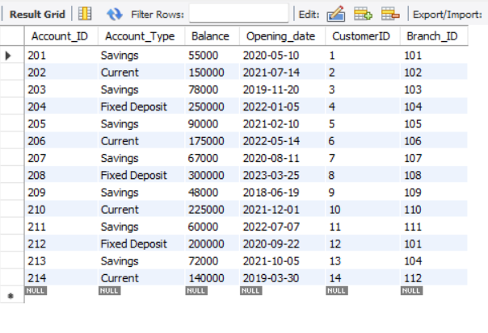
Content of Table - Account
Syntax – Select * from Account;

Slide 13
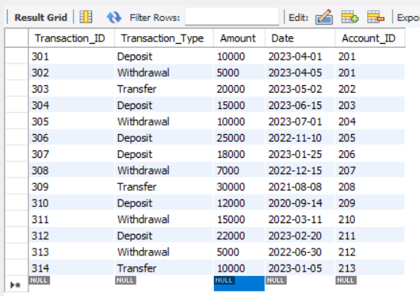
Content of Table - transaction
Syntax – Select * from transaction;

Slide 14
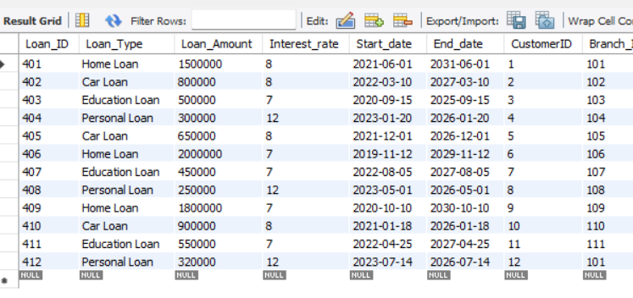
Content of Table - loan
Syntax – Select * from loan;

Slide 15
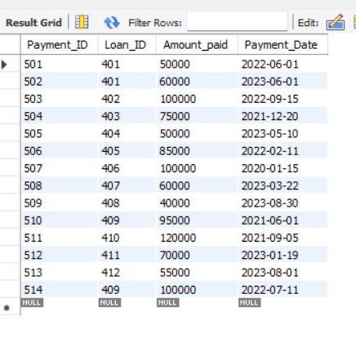
Content of Table - payment
Syntax – Select * from payment;

Slide 16
Subqueries

Slide 17
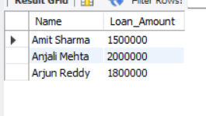
Subqueries - 1
Display customers with loans above 10,00,000.
Syntax -
SELECT c.Name, l.Loan_Amount FROM Customer c, Loan lWHERE c.CustomerID = l.CustomerID AND l.Loan_Amount > 1000000;

Slide 18
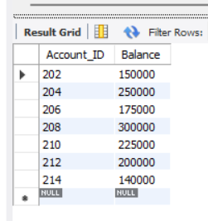
Subqueries - 2
Display accounts with balance greater than average balance.
Syntax
SELECT Account_ID, Balance FROM Account
WHERE Balance > (SELECT AVG(Balance) FROM Account);

Slide 19
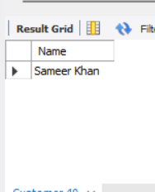
Subqueries - 3
Display customers who have not made any transactions.
Syntax
SELECT Name FROM Customer WHERE CustomerID NOT IN(SELECT DISTINCT CustomerID FROM Account a JOIN Transaction tON a.Account_ID = t.Account_ID);

Slide 20
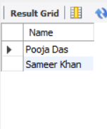
Subqueries - 4
Display customers who have not taken any loan.
Syntax
SELECT Name FROM Customer WHERE CustomerID NOT IN(SELECT DISTINCT CustomerID FROM Loan);

Slide 21
Joins

Slide 22
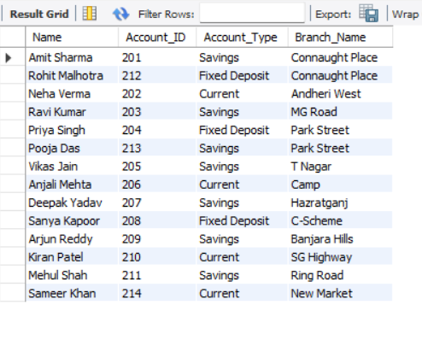
Joins - 1
Show customer names with their account details and branch name.
SELECT c.Name, a.Account_ID, a.Account_Type, b.Branch_NameFROM Customer c JOIN Account a ON c.CustomerID = a.CustomerIDJOIN Branch b ON a.Branch_ID = b.Branch_ID;

Slide 23
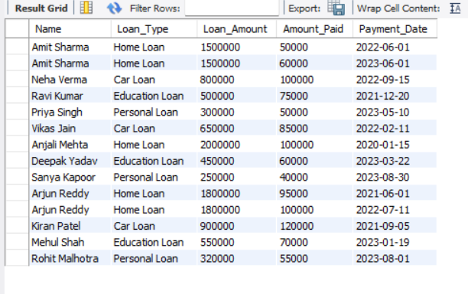
Joins - 2
Show loan details with repayment history.
SELECT c.Name, l.Loan_Type, l.Loan_Amount, p.Amount_Paid, p.Payment_DateFROM Customer c JOIN Loan l ON c.CustomerID = l.CustomerIDJOIN Payment p ON l.Loan_ID = p.Loan_ID;

Slide 24
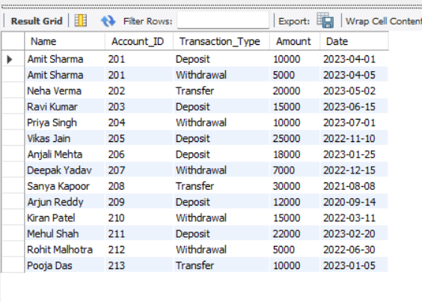
Joins - 3
Show transactions with customer and account details.
SELECT c.Name, a.Account_ID, t.Transaction_Type, t.Amount, t.DateFROM Customer c JOIN Account a ON c.CustomerID = a.CustomerIDJOIN Transaction t ON a.Account_ID = t.Account_ID;

Slide 25
Thank You

