Slide 1

AWS – Employee Onboarding Management System
AWS
SERVERLESS
A Serverless Web Application Using Amazon Web Services (AWS)
Submitted By: Venna Jeeshitha
Under the Guidance of: Mrs Bethala Sumana
Notes:
1

Slide 2
TEAM
Team Member Details
Name
Roll Number
Venna Jeeshitha
23BQ1A12E9
Tanniru Anjali Devi
23BQ1A12C8
Kambala Srivani
23BQ1A1245
Kotapati NavyaSri
23BQ1A5477
Durgam Guru Harini
23BQ5A1220
Notes:
2

Slide 3
OVERVIEW
Project Overview
This is a cloud-based Employee Onboarding Management System that automates the employee onboarding process using AWS Serverless Architecture.
Secure Management
Document & Tracking
Cloud Deployment
HR Administrator Login, Employee Registration & Management, and centralized employee records.
Employee Document Upload, Onboarding Progress Tracking, and Report Generation.
Automated Email Notifications and scalable Cloud-Based Deployment on AWS.
Technologies Used: HTML, CSS, Bootstrap, JavaScript, Python, AWS Services
Notes:
3

Slide 4




PROBLEM
Problem Statement
Traditional employee onboarding systems involve significant manual effort and operational inefficiencies that slow down HR processes.
Manual Paperwork & Registration
Poor Document Management
Time-consuming manual processes for registration and paperwork with increased chances of human error.
Lack of a centralized system for storing and retrieving employee documents securely.
Difficult Progress Tracking
Proposed Solution
No real-time visibility into onboarding status and progress across the organization.
Develop a secure cloud-based onboarding system that automates employee management using AWS Serverless services.
Notes:
4

Slide 5

OBJECTIVES
Project Objectives
The CloudHR system is designed to achieve the following core objectives for modern HR operations.
Automate Onboarding
Secure Documents
Streamline new hire setup
Protect sensitive files
Centralized Database
Track Progress
Monitor onboarding status
Maintain employee records
Each objective aligns with the AWS serverless architecture to deliver a scalable, efficient, and secure onboarding experience.
Notes:
5

Slide 6
AWS SERVICES
AWS Services Used
AWS Service
Purpose
Amazon S3
Static website hosting & document storage
Amazon CloudFront
Fast content delivery & HTTPS
Amazon API Gateway
REST API management
AWS Lambda
Backend business logic
Amazon DynamoDB
Employee & HR database
Amazon SES
Automated email notifications
AWS IAM
User roles & permissions
Amazon CloudWatch
Monitoring & application logs
Notes:
6

Slide 7
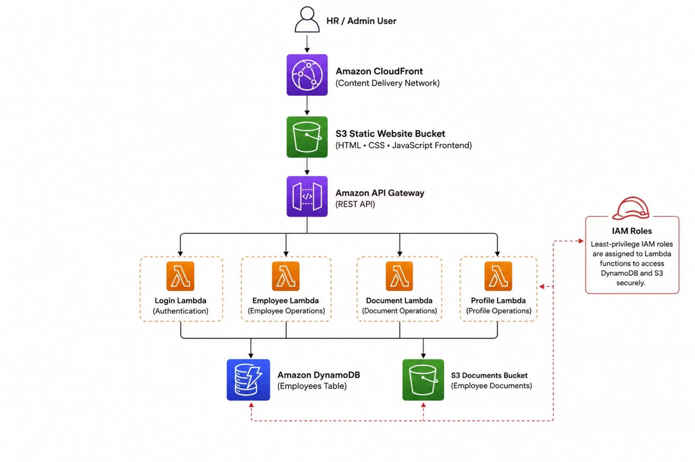
ARCHITECTURE
AWS Architecture
This system is built on a fully serverless AWS architecture, ensuring scalability, high availability, and minimal operational overhead.
Notes:
7

Slide 8

WORKFLOW
Project Workflow
The end-to-end onboarding workflow follows a structured sequence from HR login to automated email delivery, ensuring a streamlined and centralized process.
HR Login
Dashboard
Add Employee
Store Data
Outcome: A streamlined and automated onboarding process with centralized data management.
Notes:
8

Slide 9
BENEFITS
Benefits & Expected Outcomes
Benefits
Expected Outcomes
Faster onboarding process
Reduced administrative workload
Improved data security
Enhanced employee experience
Easy maintenance and future scalability
Efficiency
Reduces manual paperwork and automates the entire employee onboarding process.
Security & Centralization
Secure cloud storage for documents with centralized employee information.
Scalability
Real-time progress tracking and scalable, cost-effective serverless architecture.
Notes:
9

Slide 10

CONCLUSION
Future Enhancements & Conclusion
CloudHR successfully automates the onboarding process using AWS serverless services, improving efficiency, security, and scalability for modern HR management.
Self-Service & Mobile
Integrations
AI & Analytics
Employee Self-Service Portal and Mobile Application (Android & iOS)
Payroll System Integration and Attendance Management
AI Chatbot for HR Support and Analytics Dashboard using Amazon QuickSight
The CloudHR system demonstrates the effectiveness of cloud technologies in modern HR management — scalable, secure, and serverless. Thank you! Questions & Answers.
Notes:
10

